Slide 1
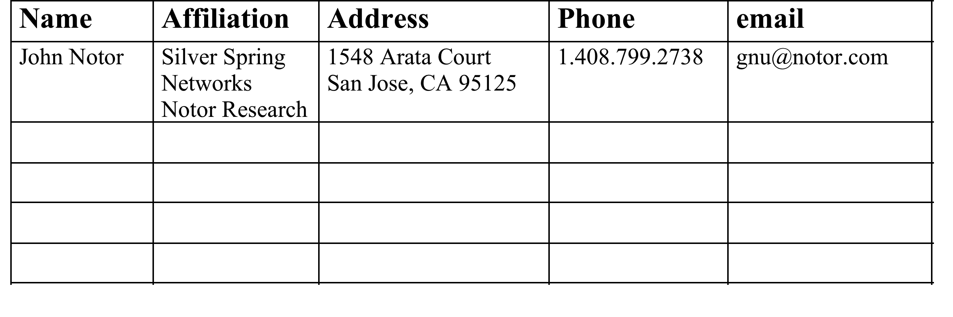
Liaison Report from 802.18
Date: September 20, 2012
Notice: This document has been prepared to assist IEEE 802.15. It is offered as a basis for discussion and is not binding on the contributing individual(s) or organization(s). The material in this document is subject to change in form and content after further study. The contributor(s) reserve(s) the right to add, amend or withdraw material contained herein.

Slide 2
Overview
This document summarizes the activities of the IEEE 802.18 Radio Regulatory Technical Advisory Group (RR-TAG) during the September 2012 IEEE 802 Interim Meeting held at the Hyatt Regency, Indian Wells, CA.

Slide 3
FCC Documents Reviewed and Approved by the RR-TAG
The IEEE 802.16 WG drafted an informational letter describing the creation and scope of P802.16.3, and inviting the Commission to participate in the project, especially in regard to defining parameters of interest in assessing mobile broadband performance.
This document was reviewed, revised, and approved by 802.18 and will be submitted to the EC for review, then forwarding to the FCC.
The document link is: FCC Submission from 802.16

Slide 4
ITU-R Documents from 802.11 Reviewed and Approved by the RR-TAG
The RR-TAG approved updates to ITU-R M.1801 and ITU-R M.1450 created by 802.11 for submission to ITU-R WP 5A. These documents will be sent to the EC for review, then to the ITU-R in time for the November 2012 meeting of WP 5A
The edited version of M.1801 is available at this link: M.1801 input to ITU-R
The edited version of M.1450 is available at this link: M.1450 input to ITU-R

Slide 5
ITU-R Documents from 802.16 Reviewed and Approved by the RR-TAG
The RR-TAG approved the following documents from 802.16 for EC review and submission to ITU-R WP 5D:
18-12/93r1, “Draft IEEE 802.16 WG Statement to FCC regarding IEEE Project P802.16.3”. Link: 18-12/93r1
18-12/94r1, “Draft Response to Liaison Statement from ITU-R WP 5D in IEEE 802.16-12-0516 - for Approval”. Link: 18-12/94r1
18-12/95r1, “Draft Response to Liaison Statement from ITU-R WP 5D in IEEE 802.16-12-0517 - for Approval”. Link: 18-12/95r1

Slide 6
Informational Presentations
Richard Kennedy, Research in Motion, presented an overview of a variety of regulatory issues of interest to IEEE 802. The document number is 18-12/89r1.

