Slide 1
Project: IEEE P802.15 Working Group for Wireless Personal Area Networks (WPANs)
Submission Title: Summary of TVWS Multichannel Cluster Tree PAN (TMCTP) for TG4m
Date Submitted: September, 2012
Source: Youngae Jeon, Sangjae Lee, and Sangsung Choi (ETRI), Soo-Young Chang (SYCA)
Contact: yajeon@etri.re.kr
Voice: +82 42 860 6497, E-Mail: yajeon@etri.re.kr
Re:
Abstract: This document provides summary of TMCTP for TG4m.
Purpose: Summary of TMCTP for TG4m
Notice: This document has been prepared to assist the IEEE P802.15. It is offered as a basis for discussion and is not binding on the contributing individual(s) or organization(s). The material in this document is subject to change in form and content after further study. The contributor(s) reserve(s) the right to add, amend or withdraw material contained herein.
Release: The contributor acknowledges and accepts that this contribution becomes the property of IEEE and may be made publicly available by P802.15.

Slide 2
Overview of TMCTP (1/3)
Extended cluster tree network
Supports clustering on multiple channels
Enables synchronous multi-hop, multi-level transfer between clusters
Super-PAN coordinator (SPC)
  Has TVWS database access (internet)
  Controls head of cluster tree
  Provides timing to child PAN coordinators on multiple/dedicated channel for each and synchronous transfer between clusters
Multi-channel support for clusters
  Reduces interference/collision between cluster PANs
  Extends effective network range
Provides for Control of latency
Notes:
모든 디바이스 또는 모든 PC가 인터넷에 연결될 수는 없기 때문에
인터넷에 연결되는 한 SPC가 TVWS 채널을 획득하고 분배하고 관리하는 중요한 역할을 수행한다.
그러다 보면 인근에 다수의 PAN이 공존할 수 있고 이로 인해 충돌이 발생할 수 있다.
그리하여 본 제안에서는 이러한 기능을 수행하는 새로운 디바이스인 SPC를 정의하고
한 SPC가 관리하는 각 PAN에게 서로 다른 채널을 부여함으로써
충돌문제나 단일 채널기반의 비콘 스케줄링에서 발생하는 긴 딜레이 문제를 해결할 수 있다.
또한 sun과 같이 멀티홉 전송이 필요한 네트워크에서
특별히 복잡한 라우팅 알고리즘이 없이 MAC의 서비스만으로도 저전력 멀티홉 통신을 가능하게 할 수 있다.

Slide 3
Overview of TMCTP (2/3)
Super PAN coordinator (SPC)
  The PAN coordinator of a TVWS Multichannel Cluster Tree PAN which was access to the TVWS geolocation database and provides synchronization services for the TVWS Multichannel Cluster Tree PAN.
The parent PAN coordinator including the SPC communicates with its own child PAN coordinators on their dedicated channels, which is marked with an asterisk (*), at their dedicated DBSs in the beacon only period (BOP).

Slide 4
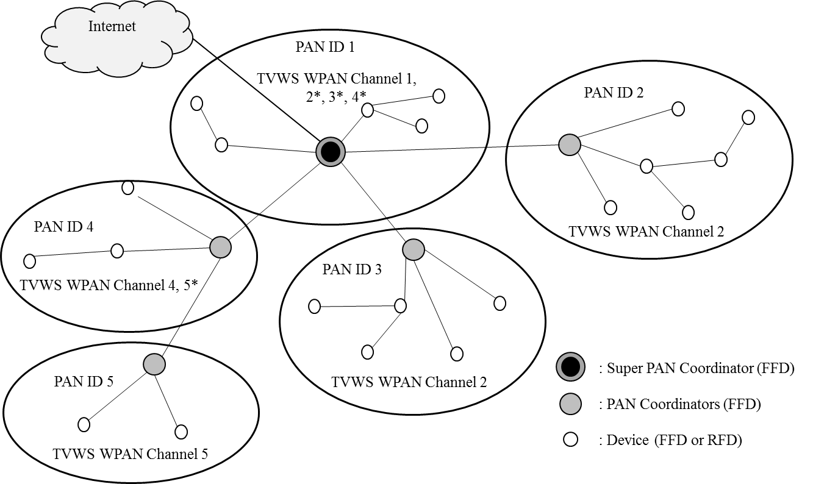
Overview of TMCTP (3/3)
< An example of TMCTP >

Slide 5
15.4 MAC Revised for TMCTP (1/2)
3.1 Definitions
3.2 Acronyms and abbreviations
4.2 Components of the IEEE 802.15.4 WPAN
4.3.2 Peer to peer network formation
4.5.1.5.1 TVWS Multichannel Cluster Tree PAN (TMCTP) Superframe Extension
5.1.1.1.3 Beacon Only Period (BOP)
5.1.1.8 Superframe use for TMCTP operation
5.1.14.1 Network formation using TMCTP
5.2.4.35 TMCTP Extended Superframe Specification IE

Slide 6
15.4 MAC Revised for TMCTP (2/2)
5.3 MAC command frames
5.3.14 DBS request command frame
5.3.15 DBS response command frame
6.2 MAC management service
    6.2.23 TMCTP DBS allocation primitives
      6.2.23.1 MLME-DBS.request
      6.2.23.2 MLME-DBS.indication
      6.2.23.3 MLME-DBS.response
      6.2.23.4 MLME-DBS.confirm
      6.4 MAC constants and PIB attributes

Slide 7
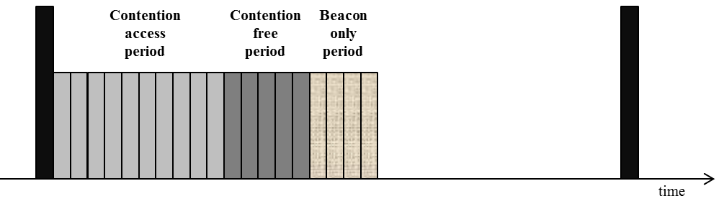
Extended Superframe Structure (1/4)
Extended Superframe Structure
  Active
    Beacon: existing in 15.4
    CAP and CFP : 16 slots: existing in 15.4
    Beacon Only Period (BOP) (newly added)
      The number of base slot: 0 ~ (2¹⁴ - 1) x 16 slots
      Base slot length: aBaseSlotDuraion (16symbols)
      Component: dedicated beacon slot (DBS)
        The number of the base slot
  Inactive: existing in 15.4
< Extended superframe structure with BOP >

Slide 8
Extended Superframe Structure (2/4)
macBeaconOrder: 2
macsuperframeOrder: 1 macTMCTPExtendedOrder: 0
< An example of the extended superframe structure >
  Beacon Only Period (BOP) in Extended Duration shall be divided into aNumSuperframeSlots x 2^{macTMCTPExtendedOrder} equally spaced slots of duration aBaseSlotDuration.
  No beacon transmissions within the BOP shall use a CSMA-CA mechanism to access the dedicated channel.
  Dedicated Beacon Slot is composed of one more base slots.
  The base slot is aBaseSlotDuration in length.

Slide 9
Extended Superframe Structure (3/4)

Slide 10
Extended Superframe Structure (4/4)
Beacon Interval (BI)
  BI = aBaseSuperframeDuration × 2^{macBeaconOrder}
  0 ≤ macBeaconOrder ≤ 14
Superframe Duration (SD)
  SD = aBaseSuperframeDuration × 2^{macSuperframeOrder}
  0 ≤ macSuperframeOrder ≤ macBeaconOrder ≤ 14
Extended Duration (ED)
  ED = aBaseSuperframeDuration × 2^{macTMCTPExtendedOrder}
  0 ≤ macTMCTPExtendedOrder ≤ (macBeaconOrder - macSuperframeOrder) ≤ macBeaconOrder ≤ 14

Slide 11
Network Formation Using TMCTP (1/5)
Basic operation between the SPC and the PAN coordinator
  Step A
    Scan, Association procedure completion
  Step B
    an enhanced beacon frame containing an Extended Superframe Specification IE (SPC)
    DBS request frame (child PAN coordinator → SPC)
  Step C
    DBS response frame (SPC → child PAN coordinator)
  Step D
    Beacon frame (on the channel of SPC)
    Beacon frame at the DBS of the child PAN coordinator (on the channel of child PAN coordinator)
  Step E
    Switching into the channel of SPC or the channel of other child PAN coordinator

Slide 12
Network Formation Using TMCTP (2/5)
Basic operation between the PAN coordinators
  Step A
    Scan, Association procedure completion
  Step B
    an enhanced beacon frame containing an Extended Superframe Specification IE (parent PAN coordinator)
    DBS request frame (child PAN coordinator → parent PAN coordinator)
    (Relay or generation directly for the DBS request)
    DBS response frame (parent PAN coordinator → child PAN coordinator)
  Step C
    Beacon frame (on the channel of parent PAN coordinator)
    Beacon frame at the DBS of the child PAN coordinator (on the channel of child PAN coordinator)
  Step D
    Switching into the channel of parent PAN Coordinator or the channel of other child PAN coordinator

Slide 13
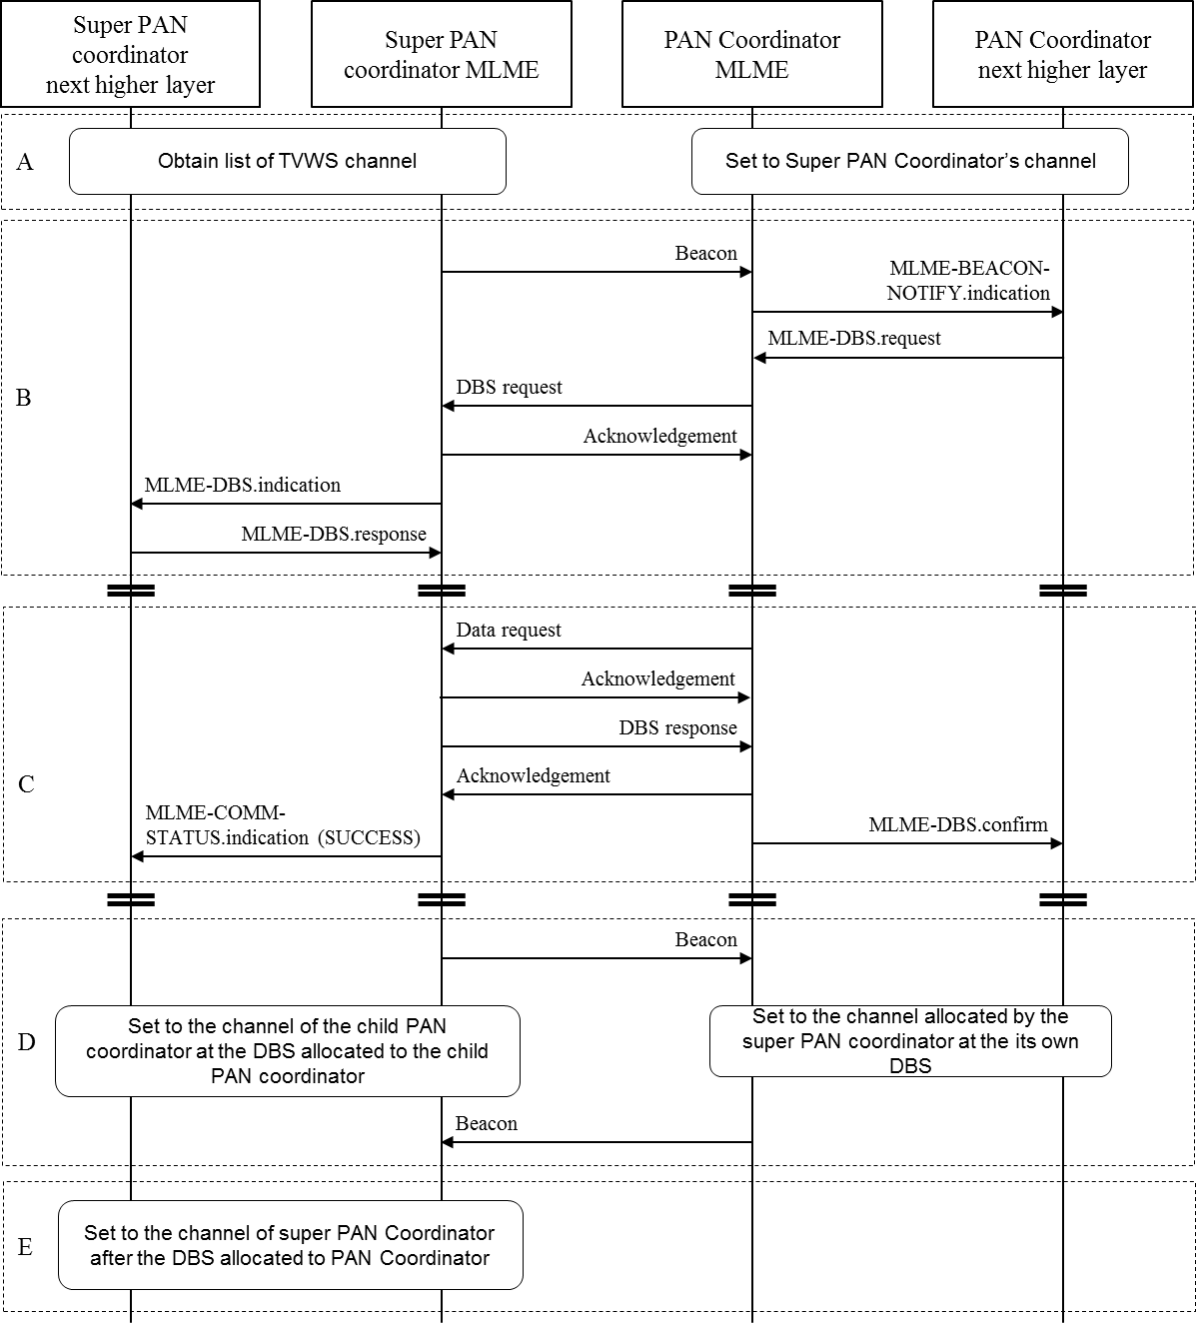
Network Formation Using TMCTP (3/5)

Slide 14
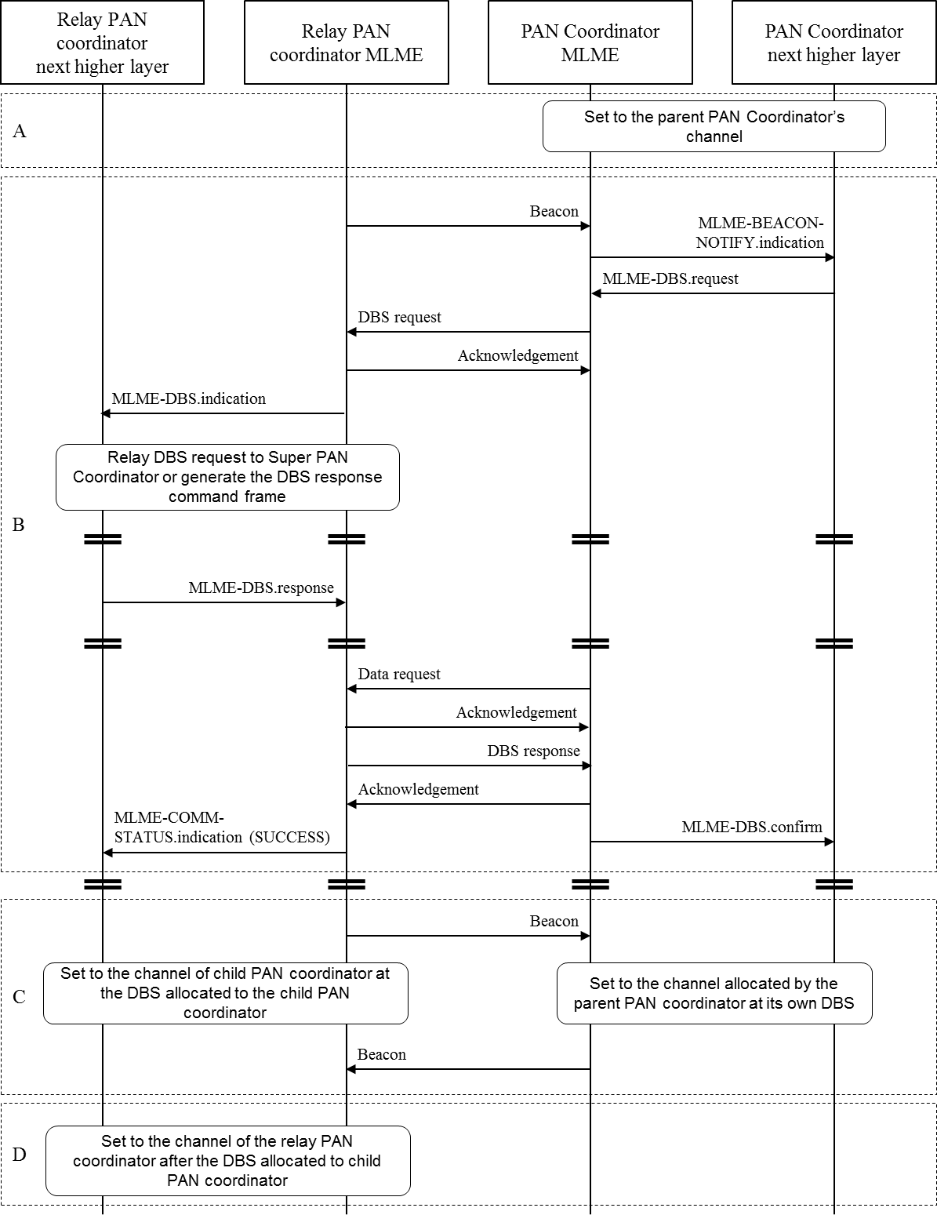
Network Formation Using TMCTP (4/5)

Slide 15
Network Formation Using TMCTP (5/5)
Superframe Structure between SPC 1 and PC 2/3/4/5 after Allocation

Slide 16
TMCTP Extended Superframe Specification IE
Extended Superframe Specification fields
  Beacon Only Period Order field (4bits)
  Dedicated Beacon Slot Allocation Capability (1bit)
  Channel Allocation Capability (1bit)
  Channel Allocation Relay Capability (1bit)
Bits: 0-3 | 4 | 5 | 6 | 7
Beacon Only Period Order | Reserved | Dedicated Beacon Slot Allocation Capability | Channel Allocation Capability | Channel Allocation Relay Capability
< Format of the Extended Superframe Specification IE field >

Slide 17
DBS Request Frame (1/2)
DBS request frame contains the following fields:
  MHR fields
  Command Frame Identifier field (1byte)
  DBS Request Information fields
    Requester Short Address field (2bytes)
      The short address of the coordinator requesting a DBS
    DBS Length field (4bits)
      The number of the aBaseSlotDuration being requested for a DBS
    Characteristics Type field (1bit)
      0x0: Deallocation of an existing DBS
      0x1: Allocation of a new DBS
    Number of the Descendent (1byte)
      the actual or expected number of descendant PAN coordinators
  FCS

Slide 18
DBS Request Frame (2/2)
Octets: 11~25 | 1 | 4 | 2/4
MHR fields | Command Frame Identifier | DBS Request Information | FCS
< DBS request command frame format >
Bits: 0-15 | 16-19 | 20-22 | 23 | 24-31
Requester Short Address | DBS Length | Reserved | Characteristics Type | Number of the Descendant
< Format of the DBS Request Information fields >

Slide 19
DBS Response Frame (1/2)
DBS response frame contains the following fields:
  MHR fields
  Command Frame Identifier field
  DBS Response Information fields
    Requester Short Address field (2bytes)
      The short address of the coordinator requesting a DBS
    Allocated DBS Starting Slot field (1byte)
      The first slot of the allocated DBS in the BOP
    Allocated DBS Length field (1byte)
      The number of the aBaseSlotDuration of the allocated DBS
    Allocated Channel Number field (1byte)
      The channel number to use for all future communications
    Allocated Channel Page field (1byte)
      The channel page to use for all future communications
    Starting Channel Number
      The assigned lowest channel number
    Ending Channel Number
    The assigned highest channel number
  FCS

Slide 20
DBS Response Frame (2/2)
Octets: 11~25 | 1 | 8 | 2/4
MHR fields | Command Frame Identifier | DBS Response Information | FCS
< DBS response command frame format >
Bytes: 2 | 1 | 1 | 1 | 1 | 1 | 1
Requester Short Address | Allocated DBS Starting Slot | Allocated DBS Length | Allocated Channel Number | Allocated Channel Page | Starting Channel Number | Ending Channel Number
< Format of the DBS Response Information fields >

Slide 21
MLME-DBS.request Primitive
  MLME-DBS.request contains the following parameters:
  Requester Short Address
    The short address of the coordinator requesting a DBS
  DBS Length
    The number of slots being requested for a DBS, where the unit of one slot shall be equal to aBaseSlotDuration.
  Characteristics Type
    Allocation or Deallocation
  Number of the Descendant
    The actual or expected number of descendant PAN coordinators
  SecurityLevel, KeyIdMode, KeySource, KeyIndex

Slide 22
MLME-DBS.indication Primitive
  MLME-DBS.indication contains the following parameters:
  CoordAddress,
    The short address of the Coordinator requesting DBS or relaying DBS request
  Requester Short Address
  DBS Length
  Characteristics Type
  Number of the Descendant
  SecurityLevel, KeyIdMode, KeySource, KeyIndex

Slide 23
MLME-DBS.response Primitive (1/2)
  MLME-DBS.response contains the following parameters:
  CoordAddress,
    The short address of the coordinator requesting DBS or relaying DBS request
  Requester Short Address
    The short address of the coordinator requesting DBS
  Allocated DBS Starting Slot
    The slot at which the GTS is to begin
  Allocated DBS Length
    The number of contiguous slots over which the DBS is active.
  Allocated channel Number
    The channel number to be allocated
  Allocated channel Page
    The channel page to be allocated

Slide 24
MLME-DBS.response Primitive (2/2)
  MLME-DBS.response contains the following parameters (cont’d):
  Starting Channel Number
    The lowest channel number, which is assigned by the parent PAN coordinator including the SPC.
  Ending Channel Number
    The highest channel number, which is assigned by the parent PAN coordinator including the SPC.
  SecurityLevel, KeyIdMode, KeySource, KeyIndex

Slide 25
MLME-DBS.confirm Primitive
  MLME-DBS.confirm contains the following parameters:
  Requester Short Address
  Allocated DBS Starting Slot
  Allocated DBS Length
  Allocated channel Number
  Allocated channel Page
  Starting Channel Number
  Ending Channel Number
  Status
    SUCCESS
    (TBD), NO_ACK, DENIED, UNAVAILABLE_KEY, UNSUPPORTED_SECURITY, INVALID_PARAMETER

