Slide 1
Project: IEEE P802.15 Working Group for Wireless Personal Area Networks (WPANs)
Submission Title: [Preliminary Technical Proposal for PTC Communications]
Date Submitted: [18 September 2012]
Source: [M-C Doong, . Li, Y Lee, H. Movahedi] Company [Lilee Systems]
Address [2905 Stender Way, Suite 78, Santa Clara CA, 95054 USA]
Voice:[+1 408-988-8672], FAX: [Add FAX number], E-Mail:[mdoong, jiaruli, yjlee, hmovahedi@lileesystems.com]
Re: []
[If this is a response to a Call for Contributions, cite the name and date of the Call for Contributions to which this document responds, as well as the relevant item number in the Call for Contributions.]
[Note: Contributions that are not responsive to this section of the template, and contributions which do
not address the topic under which they are submitted, may be refused or consigned to the “General Contributions” area.]
Abstract: []
Purpose: []
Notice: This document has been prepared to assist the IEEE P802.15. It is offered as a basis for discussion and is not binding on the contributing individual(s) or organization(s). The material in this document is subject to change in form and content after further study. The contributor(s) reserve(s) the right to add, amend or withdraw material contained herein.
Release: The contributor acknowledges and accepts that this contribution becomes the property of IEEE and may be made publicly available by P802.15.

Slide 2
Overview
Class 1 Freight Railroads in US have selected 220 MHz for their PTC needs
US transits looking at 220 MHz but also concerned about availability of spectrum, cost of spectrum, and may have existing spectrum in 160, 450, 700/800 or 900MHz spectrum
15.4p should consider accommodating 220 MHz as well as these other spectrum segments to allow future interoperability through firmware changes to software-defined radios

Slide 3
220 MHz
217 – 222 MHz
  Includes services in FCC Part 80, Part 90, Part 95, Part 97
  Different services have different uses, different interference environments
  Little or no coordination between services and users
  Constraints on use due to extant licensees and intended uses
  Special rules and exclusions within 120km of border
  US Air Force Space Surveillance System (ex-NAVSPASUR) at 217MHz
    768 kW ERP at 216.97927 MHz, Lake Kickapoo, TX
    2 other transmit sites at Maricopa, AZ, and Jordan Lake, AZ
    6 receive sites in CA, NM, AR, MS, and GA
  Out-of-band interferers
    TV Channel 13 @ 210-216MHz with ERP >+80dBm
    2nd harmonic of broadcast FM stations as high as 216MHz
    2nd harmonic of airport instrument landing systems (Localizer, VOR) at 216-224 MHz
    Amateur Radio Service 222-225 MHz (as high as +60dBm + antenna gain)
    Military ground and airborne, and Federal government communications at 225 MHz and above

Slide 4
450-470 MHz
Primarily Parts 90 and 95
Many radios digital voice
  P25, DMR, NXDN, TETRA
Land Mobile radio, both business, industrial, and municipal, state, federal government
In US, Association of American Railroads holds 38-1/2 channel pairs in the 452/457MHz area
Subject to narrowbanding mandate
Band already included as a part of published 15.4g amendment
Voice/data and data-only channels

Slide 5
160.215 - 161.565 MHz
US FCC Part 90
Land mobile radio specifically for rail operations
In US, Association of American Railroads hold 91 15kHz channels, and 181 7.5 kHz channels after narrowbanding
  http://www.fl9.com/files/Frequencies/AAR_Channel_Assignments.pdf
Band well controlled due to harmonized use
Adjacent uses are marine and US government, but similar usage, transmit power, radio performance, occupied bandwidth
Voice primary usage, but plenty of sharing with data
Potential for train control data communications

Slide 6
700/800 MHz Trunked
US FCC Part 90
Land mobile radio, used for police, fire, municipal, private
Band well controlled due to harmonized use
Voice primary usage, most radios digital, so can carry data as well
  P25, TETRA, DMR, NXDN
Potential for train control data communications
Currently not covered in 802.15.4

Slide 7
896/935 Data Communications
US FCC Part 90
Land mobile radio, used for police, fire, municipal, private
Six channel pairs under AAR control
Harmonized uses
Voice primary usage, AAR channels used exclusively for data
Currently used for legacy train control data communications
Covered by 15.4g

Slide 8
Existing 802.15.4 in general
Narrow-band channelization
  12.5, 25, 100, 200 kHz centers
Data rates
  4.8, 9.6, 10, 20, 40, 50, 100, 150, 200 kbps (and greater)
Frequency bands from 450-2483.5 MHz
  450 – 470 MHz
  470 – 510 MHz
  779 – 787 MHz
  863 – 870 MHz
  896 – 901 MHz
  901 – 902 MHz
  902 – 928 MHz
  928 – 960 MHz
  1427 – 1518 MHz
  2400 – 2483.5 MHz
Modulation Modes
  Filtered 2FSK, 4FSK; GFSK; O-QPSK

Slide 9
Suggested Additions
Data rates
  8, 16 (ITC-R), 19.2, 32 (ITC-R) Kbps
  Allowance of all other data rates in appropriate channel widths
Frequency bands (all US FCC Part 90 rules)
  156.215 – 161.59 MHz (includes Canada)
  217-218/219-220 MHz
  218 – 219 MHz
  220 – 222 MHz
Modulation Modes
  GMSK
  C4FM
  DOQPSK
  Pi/4 DQPSK
Guaranteed service separation between voice and train control traffic to allow use of same radio for both

Slide 10
Two Radio Approaches used Today
Advanced Civil Speed Enforcement System (ACSES) | Data Radio Mfgr A
Channel BW | 12.5 KHz
Access Method | TDMA (8 X 125ms timeslots/second)
Modulation | GMSK
Data Rate | 9.6 kbps
Frequency Range | 900 MHz moving to 220 MHz
Mode | Half Duplex
Electronic Train Management System (ETMS) | Data Radio Mfgr B
Channel BW | 25 KHz
Access Method | FDMA, TDMA, CSMA
Modulation | 4FM, π/4DQPSK
Data Rate | 16kbps, 32kbps
Frequency Range | 220-222MHz
Mode | Half Duplex
Compiled by Ed Thorngren, Parsons

Slide 11
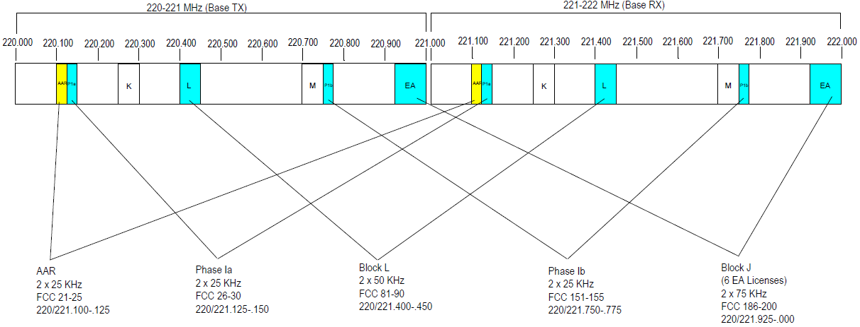
FCC: 220-222 MHz Channel Summary
Summary : 200 kHz (TX ) + 200 kHz (RX)
Total Spectrum nationwide (= 25+25+25+50+75)
Two Nationwide Commercial 5 Channel blocks, (five 5kHz channels)
  Block 1 = 25 kHz + 25 kHz Block 2 = 25 kHz + 25 kHz
AAR = 25khz + 25khz
NWA255 - U.S. and Possessions = 50 kHz + 50 kHz
ALL EAGs in Channel BLOCK J = 75 kHz + 75 kHz
11

Slide 12
PHY Considerations for a 160 MHz Default Mode
For the US 160.2075 - 161.5725 MHz spectrum
  Default channel spacing: 7.5 kHz
  Default channel bandwidth: 12.5 kHz
  Default data rate: 9.6 kbps
  Default modulation mode: GMSK
  Channel numbering for channels 7 - 97
    Fc = 160.2150 + (Ch# - 7) x 0.015
  Channel numbering for interstitial channels 107 – 197
    Fc = 160.2225 + Ch# x 0.015
All modulation methods available
All data rates available subject to available channel bandwidth
Contiguous channels may be aggregated

Slide 13
PHY Considerations for a 220 MHz Default Mode
For the US 217-222 MHz spectrum
  Default channel spacing: 12.5 kHz
  Default channel bandwidth: 12.5 kHz
  Default data rate: 9.6 kbps
  Default modulation mode: GMSK
  Channel numbering for channels 1 -176
    Fc = 217.5875 + Ch# x 0.025
  Channel numbering for interstitial channels 177 – 353
    Fc = 217.5750 + Ch# x 0.025
All modulation methods available
All data rates available subject to available channel bandwidth
Contiguous channels may be aggregated

Slide 14
TX Spectrum Mask
9.6Kbps GMSK with BT=0.3
Mask shown is FCC part 90 mask F with 5 channel aggregation
Signal power = 30W (45dBm) in this case
RBW = 100 Hz
Total TX power
-25dBm/100Hz

Slide 15
PHY Considerations for a 452-457 MHz Default Mode
For the US 450-470 MHz spectrum
  Default channel bandwidth: 12.5 kHz
  Default data rate: 9.6 kbps
  Default modulation mode: GMSK
  Channel numbering TBD
All modulation methods available
All data rates available subject to available channel bandwidth
Contiguous channels may be aggregated

Slide 16
PHY Considerations for 896-935 MHz Paired Spectrum
For the 6 pairs in the US 896/935 MHz spectrum
  Channel bandwidth: 12.5 kHz
  Default data rate: 9.6 kbps
  Default modulation mode: GMSK
  Channel numbering per 802.15.4g
All modulation methods available concomitant with channel masks

Slide 17
PHY Considerations for 928 - 952 MHz Spectrum
For operations in the 928 – 952 MHz spectrum
  Channel bandwidth: 12.5 kHz
  Default data rate: 9.6 kbps
  Default modulation mode: GMSK
  Channel numbering per 802.15.4kg
All modulation methods available concomitant with channel masks

Slide 18
Frame Format
Propose new shorter frame for low-data rate channel, to keep overhead to a minimum

Slide 19
Packet Format
Data FEC Type
(4 bits)
Data Length
(14 bits)
CRC
(8 bits)
FEC Tail
(0 or 6 bits)
PSDU
(Variable bits)
FEC Tail
(0 or 6 bits)
Pad
(variable)
GMSK Tail (3 bits)
6 bits if FEC applied
For puncturing
Preamble and SFD
(24 bits)
PHY Header
(26 or 32 bits)
Data
(Variable bits)
Blank guard bits
(Variable bits)
Pattern: 0xE540CC
Margin for turn-around time and propagation delay.

Slide 20
MAC Considerations
Use of default features brought in through 15.4e
  DSME, frameslotting, multi-superframe
  Contention-free and Contention-based (CSMA-CA) periods
  Use of Beacon to announce supported modulation modes, data rates
  Association, disassociation, reassociation
  AES-128 security built in
  Any changes to the MAC that are required to support the PHY changes (channel tables, modulation modes, coding methods)

Slide 21
Coding Addition
Add more coding rates to manage mobility
Use of same FEC methods
Add FEC rates of 2/3, 3/4 and 7/8
  Need identify availabile bits in header to signal the additional coding rates
Currently, 802.15.4 FEC encodes PHR+PSDU together
  Encoding PSDU separately removes need to know packet length

Slide 22
FEC
Convolutional codes with Puncturing
  Generator polynomials (industry standard)
    Constraint length = 7, g₀ = 133, g₁=171 (octave representation)
  Coding rates with puncturing
    1/2, 2/3, 3/4, and 7/8
    Rate 1/2 code provides strong correction and good sensitivity
    Rate 7/8 code improves sensitivity with low overhead
XOR
Output Data A
Input Data
D
D
D
D
D
D
XOR
Output Data B

Slide 23
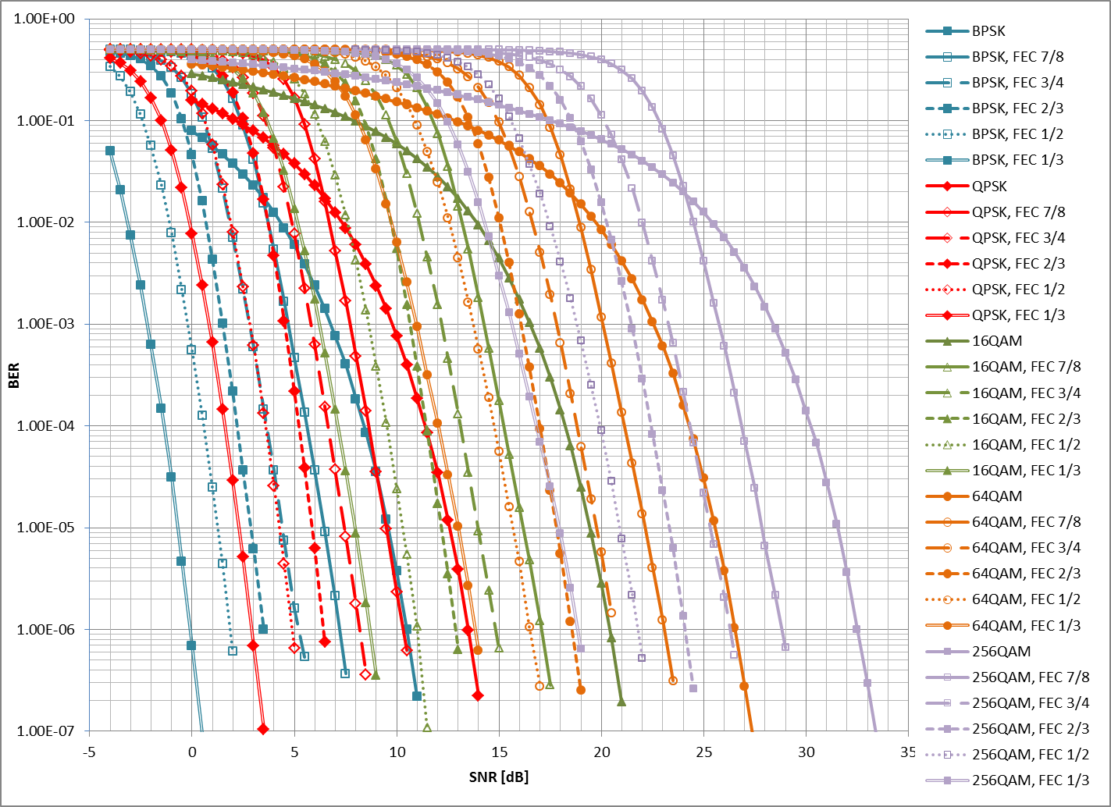
FEC Performance

Slide 24
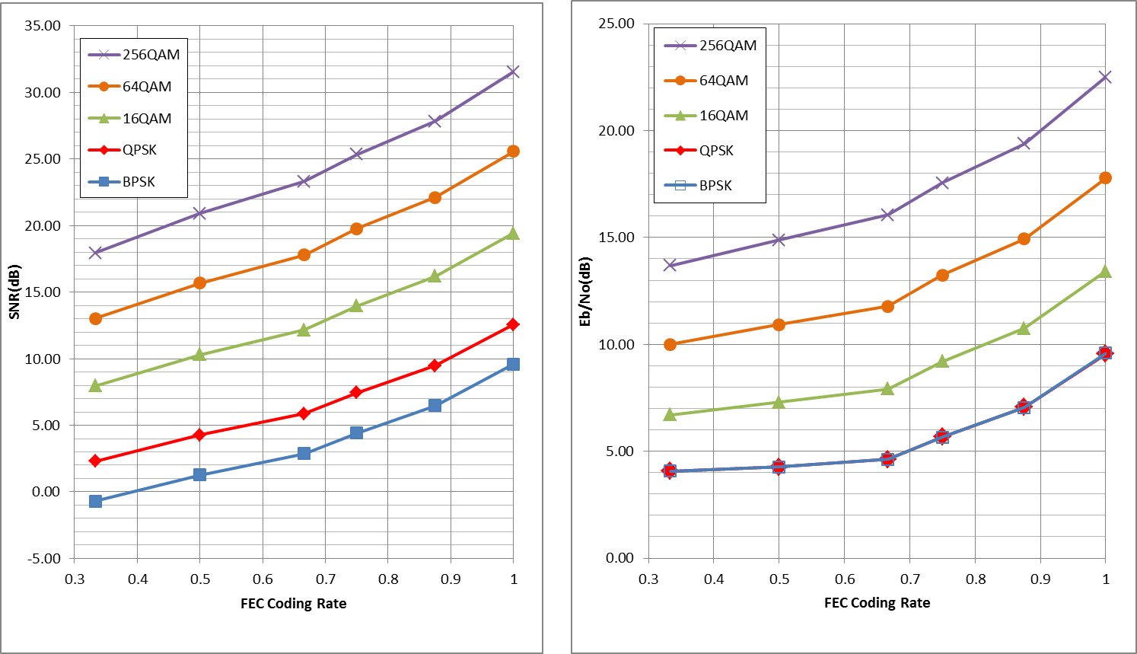
Required SNR and Eb/No for BER=10-5

Slide 25
Questions?

