Slide 1
Project: IEEE P802.15 Working Group for Wireless Personal Area Networks(WPANs)
Submission Title: Simulation Results of the Merged TVWS-OFDM PHY
Date Submitted: September 2012
Source: Cheol-ho Shin , Byoung Hak kim, Seung Sik Lee and Sangsung Choi (ETRI), Soo-Young Chang (SYCA)
Contact: chshin@etri.re.kr
Voice: +82 42 860 6831, E-Mail: chshin@etri.re.kr
Re: Call for proposals
Abstract: This presentation summarizes the performance results of the Merged TVWS-OFDM PHY
Purpose: Simulation Results demonstrating the performance of the Merged TVWS-OFDM proposal for 802.15.4m PHY
Notice: This document has been prepared to assist the IEEE P802.15. It is offered as a basis for discussion and is not binding on the contributing individual(s) or organization(s). The material in this document is subject to change in form and content after further study. The contributor(s) reserve(s) the right to add, amend or withdraw material contained herein.
Release: The contributor acknowledges and accepts that this contribution becomes the property of IEEE and may be made publicly available by P802.15.
Slide 1

Slide 2
Contents
Requirements Overview
KEY PARAMETERS AND DATA RATES
REFERENCE MODULATOR DIAGRAM
Timing-related parameter of OFDM PHY
Channel Model for Simulation
Simulation Results
Link Margin Calculations
Conclusion

Slide 3
Requirements Overview
Key requirements for TVWS WPAN
  Operations in TVWS frequency bands under regulatory constraints
  Data rate of typically 40Kbps to 2Mbps & optionally 10Mbps
  Optimal & power efficient device command & control applications
  Operating range of at least 1Km
  At least 1000 direct neighboring devices
  Opportunistic coexistence with primary users (TV broadcasting): not interfere with other primary users

Slide 4
KEY PARAMETERS AND DATA RATES
Description | Mandatory mode | Optional mode (4 times overclock mode)
Nominal bandwidth (kHz) | 1064.5 | 4258
Channel spacing (kHz) | 1250 | 4*1250
Subcarrier spacing (kHz) | 1250/128 | 4*1250/128
DFT Size | 128 | 128
Number of pilot tones | 8 | 8
Number of data tones | 100 | 100
BPSK ½ rate (kbps) | 390.625: MCS0 Mode | 1562.5: MCS3 Mode
QPSK ½ rate (kbps) | 781.250: MCS1 Mode | 3125: MCS4 Mode
16-QAM ½ rate (kbps) | 1562.5: MCS2 Mode | 6250: MCS5 Mode
Slide 4

Slide 5
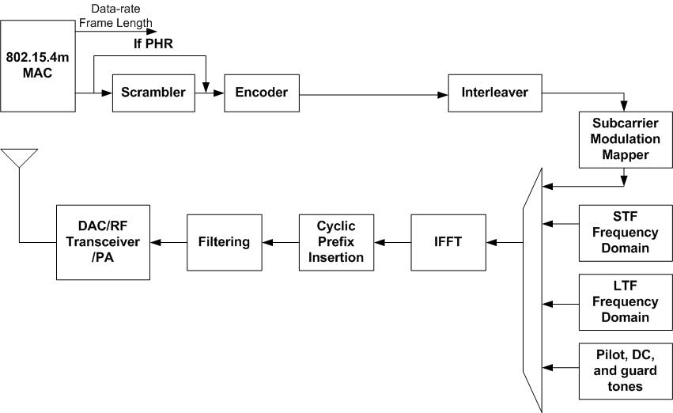
REFERENCE MODULATOR DIAGRAM

Slide 6
Timing-related parameter of OFDM PHY
Parameter | Description | Value
fs | Sampling frequency | 1250 KHz
NFFT | FFT Size | 128
∆f | Subcarrier frequency spacing | 1250/128 KHz
TFFT | IFFT and FFT period | 102.4 us
NCP | Number of samples in cyclic prefix | 32
TCP | Cyclic prefix duration in time | 25.6 us
NSYM | Total Number of samples per symbol | 160
TSYM | Symbol Duration | 128 us

Slide 7
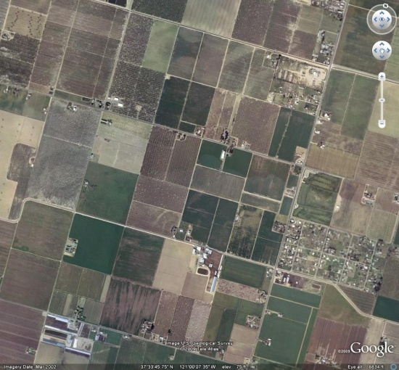

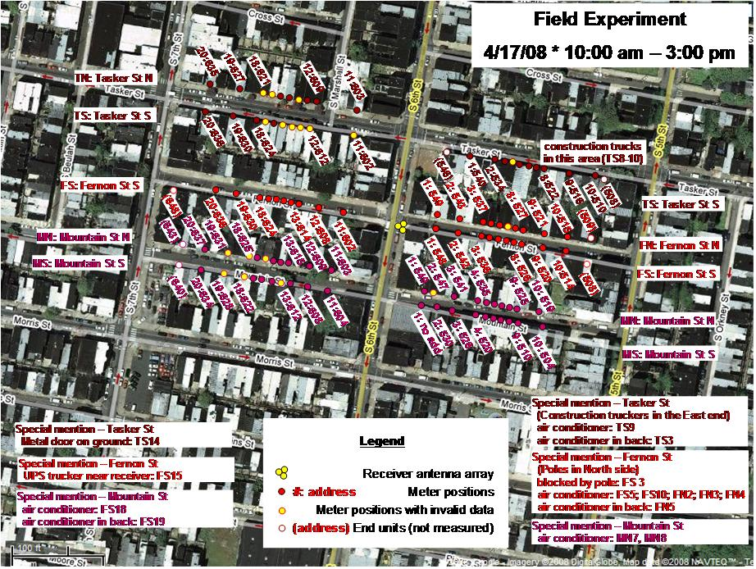
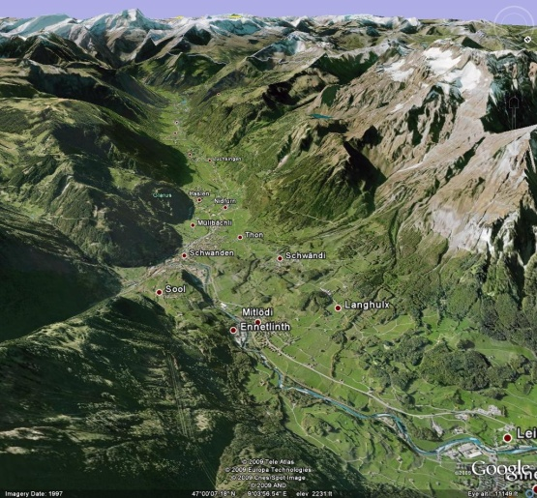
Channel Model for Simulation
Channel Models taken from ETSI EN 300 392-2 V3.2.1 (2007-09)
Propagation Model | Tap Number | Relative delay (us) | Average relative power (dB)
Rural Area (Rax) | 1 | 0 | 0
Typical Urban (Tux) | 1 | 0 | 0
 | 2 | 5 | -22.3
Bad Urban (Bux) | 1 | 0 | 0
 | 2 | 5 | -3
Hilly Terrain (HTx) | 1 | 0 | 0
 | 2 | 15 | -8.6
Ref: doc. IEEE 802.15-09-0279-01-004g
Slide 7

Slide 8
Simulation Results – MCS0
Slide 8

Slide 9
Simulation Results – MCS1
Slide 9

Slide 10
Simulation Results – MCS2
Slide 10

Slide 11
Summary of Simulation Results
Use 3,000 Packets with 100Byte LENGTH for simulations
SNRs for 10% Packet Error Rate
Channel Models used are from ETSI EN 300 392-2 v3.2.1
.
 | SNR For PER = 10%(dB)
Channel | AWGN | Typical Urban | Bad Urban | Hilly Terrain
MCS0 | 0.9 | 10.8 | 8.6 | 10.4
MCS1 | 3.9 | 13.0 | 10.9 | 12.2
MCS2 | 9.6 | 18.8 | 17.0 | 17.9
Slide 11

Slide 12
Link Margin Calculations (1)
The PSD (Power Spectral Density) limits according to types of TV bands device are defined in FCC-12-36A1.
The maximum power limits of TVWS-OFDM PHY are defined as shown below because its nominal bandwidth is 1,060kHz.
Parameter | PSD limit (100KHz) | The maximum power of TVWS OFDM PHY for nominal BW of 1060kHz
Fixed | 12.6 dBm | 22.85 dBm
Personal/portable (adj. channel) | -1.4 dBm | 8.85 dBm
Sensing only | -0.4 dBm | 9.85 dBm
All other personal /portable | 2.6 dBm | 12.85 dBm
Slide 12

Slide 13
Link Margin Calculations (2)
TX Power: About 12dBm (All other personal/portable device of the previous slide is assumed)
Noise floor: -114 dBm/MHz * 10*log(1.06MHz) = -113.7dBm
10 dB noise figure & implementation loss assumed
Link Margin(dB) = TX Power – (Noise floor + required SNR + (NF + IL))
Free space Path Loss at 1 km and TV Channel 51 (695MHz) is 89.3 dB.
 | Link Margin(dB)
Channel | AWGN | Typical Urban | Bad Urban | Hilly Terrain
MCS0 | 114.8 | 104.9 | 107.1 | 105.3
MCS1 | 111.8 | 102.7 | 104.8 | 103.5
MCS2 | 106.1 | 96.9 | 98.7 | 97.8
Slide 13

Slide 14
Conclusion
Multipath reflections considered in this work result in the frequency selective channels.
- Channel Models taken from ETSI ETSI EN 300 392-2 V3.2.1
The simulation results of TVWS-OFDM Proposal for IEEE802.15.4m show the robustness of OFDM method against the multipath
reflections.
- The differences in performance between AWGN and fading channels are about from 7.0 dB to 9.9 dB in various modes of TVWS-OFDM PHY according to outdoor channel environments.
- The link margins are enough to cover operating range of at least 1Km even though the highest TV Channel that is 51 (center frequency = 695MHz).
Slide 14

