Slide 1
Project: IEEE P802.15 Working Group for Wireless Personal Area Networks (WPANs)
Submission Title: State of TVWS
Date Submitted: Sept 17, 2012
Source: George Flammer Company Silver Spring Networks
Address 555 Broadway, Redwood City CA 94063
Voice: 650-298-4200 FAX: Deprecated E-Mail:[gflammer @ silverspringnet.com
Re: Update on the state of TVWS around the world
[
Abstract: Update on the state of TVWS around the world
Purpose: Support task group in proposal development
Notice: This document has been prepared to assist the IEEE P802.15. It is offered as a basis for discussion and is not binding on the contributing individual(s) or organization(s). The material in this document is subject to change in form and content after further study. The contributor(s) reserve(s) the right to add, amend or withdraw material contained herein.
Release: The contributor acknowledges and accepts that this contribution becomes the property of IEEE and may be made publicly available by P802.15.

Slide 2
State of TVWS

Slide 3
Summary
Adoption of TVWS has been slow:
  Regulation is slow: The US took a decade
  Competition for spectrum is fierce: Sub-GHz spectrum is very valuable
  Ecosystem is immature: few products from few vendors
Vested interests oppose unlicensed model
Worldwide interest continues
Not necessarily adopting IEEE TVWS standards: did we miss the mark?
  Business models are still being refined: is it ‘WiFi on Steroids’ or long range, low cost M2M?

Slide 4
U.S. TVWS regulations
2002 ET Docket No. 02-380 Additional Spectrum for Unlicensed Devices below 900 MHz
2003 ET Docket No. 03-108 Cognitive Radio NPRM
2004 ET Docket No. 04-186 Unlicensed Operation in the TV Broadcast Bands
2008 FCC 08-260 2nd Report and Order and Memorandum Opinion and Order
2010 FCC 10-174 2nd Memorandum Opinion and Order
2011 Sept 19 begin 45-day trial of SpectrumBridge TV bands database

Slide 5
Vested interests in Opposition
Originally Broadcasters and DTV receiver manufacturers were major opposition to TVWS legislation
  Broadcasters were losing spectrum
  DTV manufacturers were concerned that their products would not work well.
Today it is the cellular ecosystem in opposition
  they simply want the spectrum

Slide 6
US: Carriers, and cellular vendors continue to oppose unlicensed TVWS allocations
High Tech Spectrum Coalition is arguing for ‘incentive auctions’ by accentuating the near-term revenue accruing to the government. From Apple, to Cisco to Qualcomm major corporations are opposing US unlicensed TVWS.
Coalition for Free TV and Broadband is the unlikely alliance between unlicensed TVWS advocates and legacy TV broadcasters
http://hraunfoss.fcc.gov/edocs_public/attachmatch/DOC-311652A1.pdf
http://www.fiercebroadbandwireless.com/story/att-shreds-pcasts-shared-spectrum-vision/2012-08-05
http://www.publicknowledge.org/files/HTSC%20E&C%20Letter%2011-2-11.pdf
List of HTSC members: http://www.hightechspectrumcoalition.org
http://coalitionforfreetvandbroadband.org/?page_id=65

Slide 7
Worldwide Interest
Finland
European Union
United Kingdom
Singapore
Philippines
South Africa
US

Slide 8

Finland gets first EU TVWS
Geo-location licensee
Helsinki-based Fairspectrum will provide a TVWS geolocation database
For cognitive radio devices issued by the Finnish Communications Regulatory Authority (Ficora) to Turku University of Applied Sciences.
The one-year license, which is the first one in Europe to allow for the geo-location database control of frequencies, covers the 470-790 MHz frequency range in a 24 square-mile (40 square-kilometer) area surrounding Turku, Finland.

Slide 9
EU – ETSI TR 101 571
“Feasibility study for coexistence between CRS operating in TV WS band and RF Cable Networks services” (Cognitive Radio Service)
Executive summary for Report A2 from SE 43 Cognitive Radio Systems posted – Finally.
Still challenges: Feasibility study for the coexistence between Cognitive Radio Systems operating in white spaces of the 470 – 790 MHz band and services delivered by existing RF Cable Networks operating in fixed wires
Likely conclusion: Is it not reasonable for RF Cable Networks to be protected to the same level as domestic off-air transmissions
Executive summary:
http://cept.org/Documents/se-43/6270/SE43(12)60_Proposed-text-for-executive-summary-of-Report-A2-(geo-location)
ECC Report:
http://cept.org/Documents/se-43/6354/SE43(12)73_ECC-Report-159-on-further-definition-of-technical-and-operational-requirements-for-the-operation-of-WSD-in-470-790-MHz-band
Cable Industry counter:
http://cept.org/Documents/se-43/6353/SE43(12)72_Draft-Report-A1-complementary-to-ECC-Report-159

Slide 10
United Kingdom
Cambridge trial still unique: Microsoft, British Telecom, BBC, Nokia, Neul, BskyB, Spectrum Bridge, etc.
Ofcom expected to complete regulation third quarter – after UK Olympics
TVWS vendors polled say that first commercial services should happen first quarter 2013
http://www.zdnet.com/microsoft-bt-test-white-space-broadband-in-cambridge-3040093231/

Slide 11
Singapore & Philippines
Singapore - September 5, 2012
  Microsoft Singapore, StarHub, and the Institute for Infocomm Research (I²R), the founding members of the Singapore White Spaces Pilot Group (SWSPG)
  This is similar to the Cambridge UK trial with vendors: Adaptrum (hardware) and Spectrum Bridge (geo-database)
Philippines – June 19, 2012
  The Information and Communications Technology Office of the Department of Science and Technology (DOST-ICTO) officially rolled outs its TV White Space (TVWS) project
http://www.whatech.com.au/technology-releases/wireless/11074-commercial-pilots-begin-for-white-spaces-technology-in-singapore
http://www.digitalnewsasia.com/node/367

Slide 12
South Africa, et. al.
CSIR Meraka Institute has been chartered to study TVWS by Independent Communications Authority of South Africa (ICASA)
The authors (Masonta, et. al.) note that ‘sensing’ TVWS regulations have given way to geolocation data base approaches.
Building upon work in the US and UK. Google once again sponsoring unlicensed TVWS work
Representatives from Mozambique, Kenya and Nigeria reported to have expressed interest in TVWS as cellular offload.
http://researchspace.csir.co.za/dspace/bitstream/10204/5912/1/Masonta_2012.pdf

Slide 13
Non-IEEE Standards in the US
Meanwhile, slow progress:
  KTS Wireless of Lake Mary, FL, (hardware) and Spectrum Bridge (data base) piloting TVWS in Wilmington, North Carolina.
  Adaptrum, San Jose, CA, originally started as a ‘cognitive’ sensing radio system – now used with geo-location data base deployments – in UK and Singapore and elsewhere.
These two companies supply most of the TVWS cognitive radios worldwide.
Neither use 802.11af or 802.22 standards
http://www.ktswireless.com/wp-content/uploads/2012/08/AWR-Product-Brief-4.pdf

Slide 14
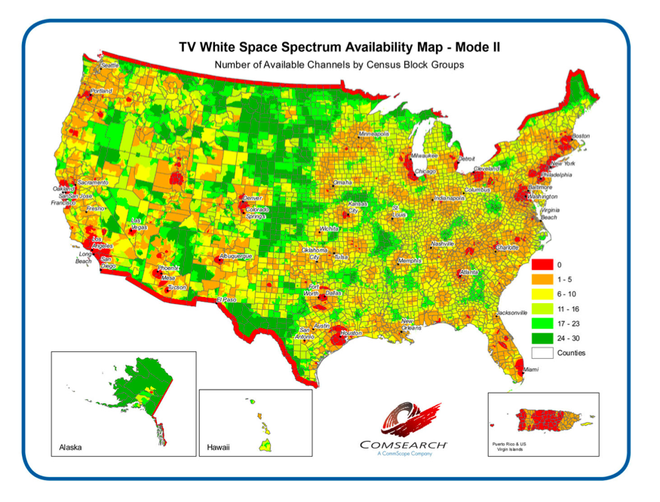
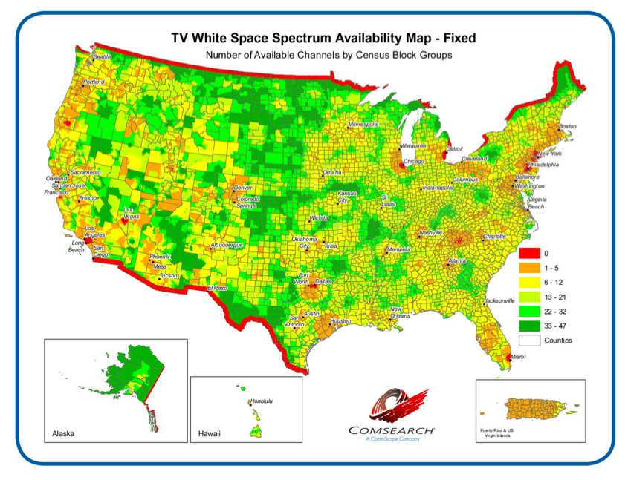
Business model shift?
Gradual trend away from ‘WiFi on Steroids’ to Machine-to-machine applications:
Fixed devices – professionally installed with
access to a data base
Type II (Mobile / portable) devices

Slide 15
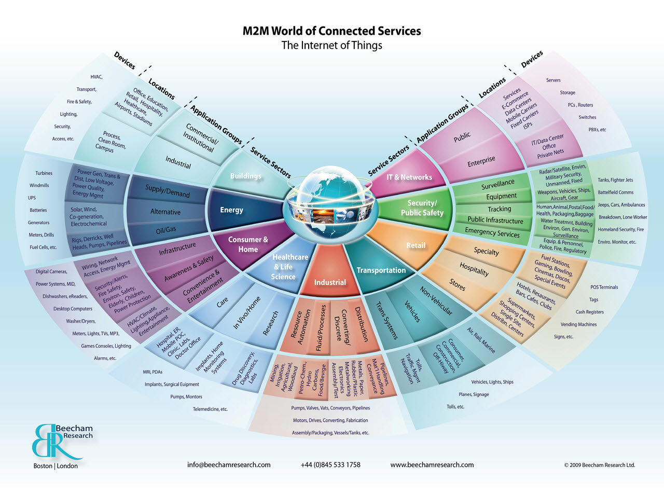
TVWS as an M2M Opportunity

