Slide 1
Project: IEEE P802.15 Working Group for Wireless Personal Area Networks (WPANs)
Submission Title: Wireless ECG Device
Date Submitted: Spet12, 2012
Source: Xiang Fei, Feng Xu (CHOICEMMED Electronic Inc.), Liang Li (Vinno);
Suite 202, Building D, No.2 Xinxi Lu, Beijing, China,
Voice: 1-914-333-9687, FAX: 1-914-332-0615,
E-Mail: liangli@vinnotech.com
Abstract: Opening report for TG4n(MBAN) Task Group
Purpose: Outline accomplishments from the March 2012 meeting and planned tasks for this meeting.
Notice: This document has been prepared to assist the IEEE P802.15. It is offered as a basis for discussion and is not binding on the contributing individual(s) or organization(s). The material in this document is subject to change in form and content after further study. The contributor(s) reserve(s) the right to add, amend or withdraw material contained herein.
Release: The contributor acknowledges and accepts that this contribution becomes the property of IEEE and may be made publicly available by P802.15.

Slide 2
Standards for Wireless ECG Telemetry Device
Safety Standards for ECG Device(Medical Devices)
IEC 60601-1：2005
IEC 60601-1-2：2007
IEC 60601-1-8：2006
Characters and Features of ECG Device
YY 1079：2008
ANSI/AAMI EC13：2002

Slide 3
Wireless ECG Design

Slide 4
System Description
Adopting IEEE 802.15.4-2009 Std and Mesh Networking.
Real-time ECG Wireless System including:
-- Server: 1.
-- Wireless Collector to Server: 1
-- Wireless Nodes: Unsure；
-- Wireless Terminal + ECG : 4-8。
-- Battery for lower power consumption

Slide 5
Sampling & Data Rates
3-channel ECG data. ECG sampling rate is 500 Hz.
Compressed Data Rate is 150byes/second.
One wireless terminal transfers date in 176 bytes /second to one wireless collector + server

Slide 6
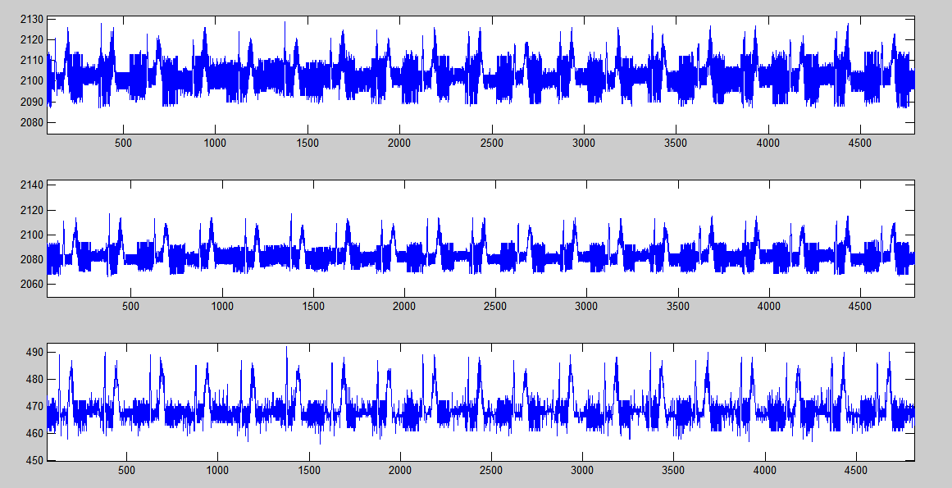
Testing Data
ECG signals on Wireless Terminal

Slide 7
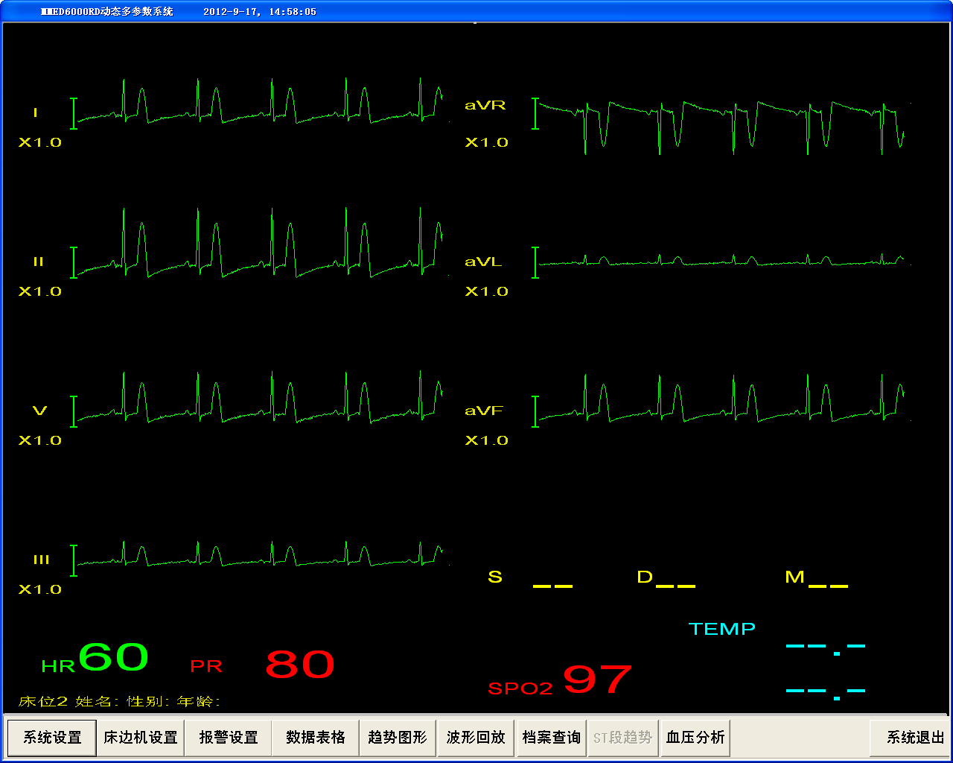
Testing Data
Show on Collector

Slide 8
系统测试
1 无线终端的ECG信号采集

Slide 9
系统测试
2 中央主机显示

Slide 10
Data Packet Design
First Data Packet:
0 | 1 | 2 | 3 | 4 | 5-76 | 77-82 | 83-87 | 88
0xA0 | 0x00 | 0x00 | 0x00 | 0x60 | 72Byte ECG | 6Byte Base | Status | CheckSum
Second Data Packet:
0 | 1 | 2 | 3 | 4 | 5-82 | 83---86 | 87 | 88
0xA1 | 0x00 | 0x00 | 0x00 | 0x45 | 78Byte ECG | Status | Xor | CheckSum

Slide 11
Power Consumption Requirement
MCU：8.14mA；
ECG Sampling：2.6mA；
RFIC：1.14mA；
Others：1.5mA。
Total：17.4mA；
Total Testing：48h。

Slide 12
Thank you !
2012/9/18
12
Notes:
12

