Slide 1
Project: IEEE P802.15 Working Group for Wireless Personal Area Networks (WPANs)
Submission Title: Detail Report for Interference on Chinese Medical Bands
Date Submitted: Jan 10, 2013
Source: Ning Li , BUPT; Liang Li, Vinno; Tul Shui, Lin Zhang, Sen Li, Guang-Long Du, BUPT
Suite 202, Building D, No.2 Xinxi Lu, Beijing, China,
Voice: 1-914-333-9687, FAX: 1-914-332-0615,
E-Mail: liangli@vinnotech.com
Abstract: Opening report for TG4n(MBAN) Task Group
Purpose: Outline accomplishments from the March 2012 meeting and planned tasks for this meeting.
Notice: This document has been prepared to assist the IEEE P802.15. It is offered as a basis for discussion and is not binding on the contributing individual(s) or organization(s). The material in this document is subject to change in form and content after further study. The contributor(s) reserve(s) the right to add, amend or withdraw material contained herein.
Release: The contributor acknowledges and accepts that this contribution becomes the property of IEEE and may be made publicly available by P802.15.

Slide 2
INDEX
Interference Descriptions on Each Band
The Math Models
  Model of Digital TV (CBMM)
  Model for Wireless Microphone
  Model of Digital Phone (Walkie-talkie)

Slide 3
Interference Descriptions on Each Band
The Math Models
  Model of Digital TV (CBMM)
  Model for Wireless Microphone
  Model of Digital Phone (Walkie-talkie)

Slide 4
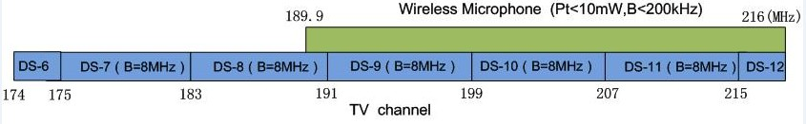
The usage on 174-216MHz Band
174-216MHz
VHF Radio and TV
Wireless Microphone

Slide 5
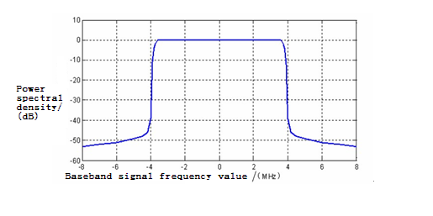
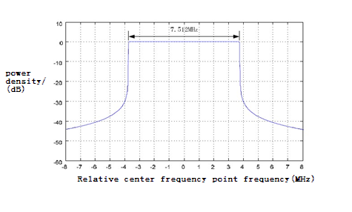
The Usage on 174-216MHz band
VHF Radio and TV
 | Channel | Standard
Digital radio and TV | DS-6：174-175MHz DS-7：175-183MHz DS-8：183-191MHz DS-9：191-199MHz DS-10：199-207MHz DS-11：207-215MHz DS-12：215-216MHz | DTMB(OFDM) | CMMB(OFDM)
Analog radio and TV |  | GB/T 14433-93 Color Radio and TV Coverage Network Technical requirements
Remark: The analog radio and TV will stop in 2015.

Slide 6
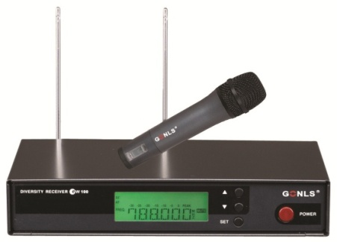
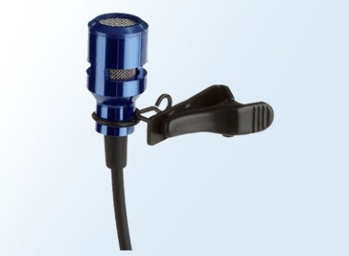
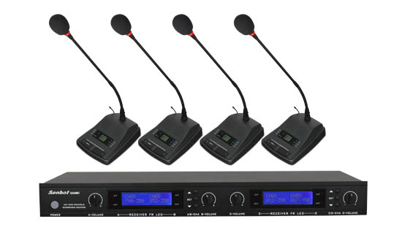
The Usage on 174-216MHz band
Wireless Microphone
Wireless Microphones on the market:
On Chinese Markets, More China's wireless microphones shifts from VHF to UHF(most 500-900MHz), especially in the high-end products.

Slide 7
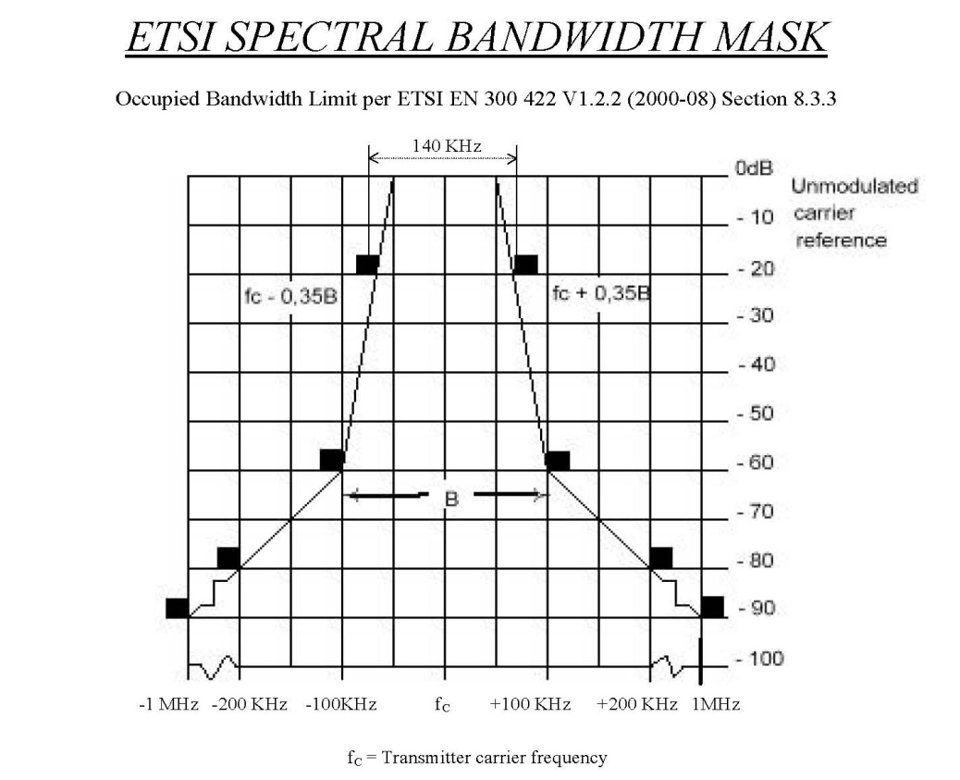
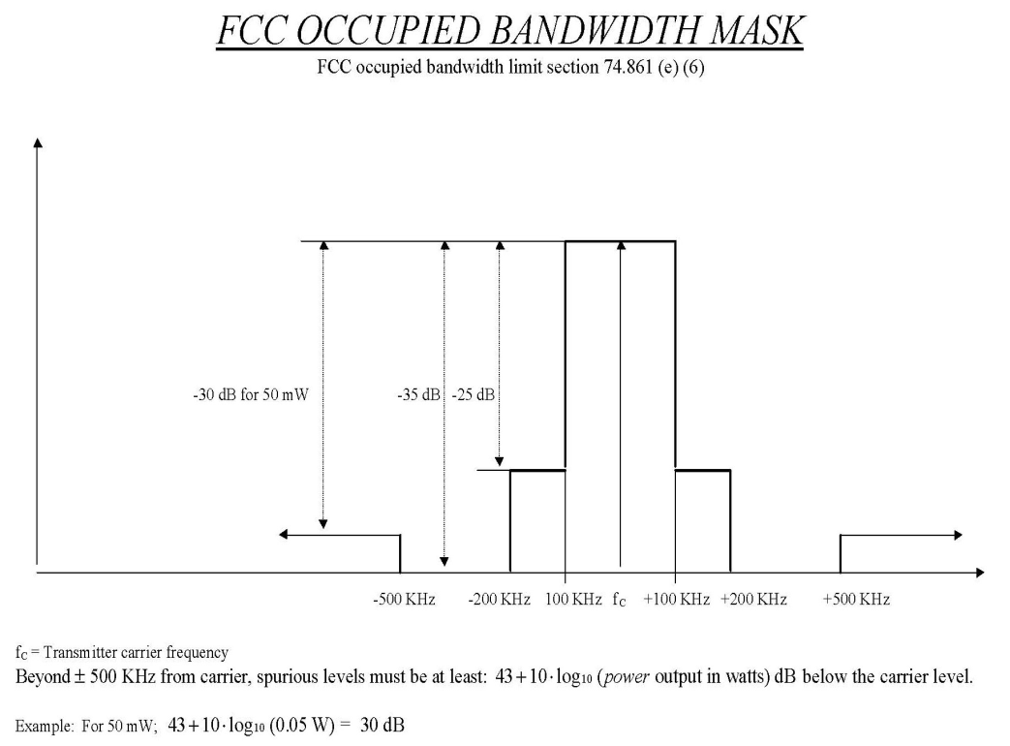
The Usage on 174-216MHz band
Wireless Microphone
Operation frequency 189.9-216MHz, Pt <10mW , Bandwidth<200kHz. But, there is no rule about PSD of wireless microphone in china ,so we refer bandwidth mask in America and Europe.

Slide 8
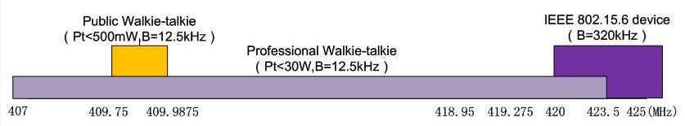
The Usage on 407-425MHz band
Interphone (Walkie-talkie)
IEEE 802.15.6 Devices
407- 425MHz

Slide 9
The Usage on 407-425MHz band
Interphone (Walkie-talkie)
Interphone | Different Frequency Bands | Dedicated interphone (Pt<30W) | 137-144、146-167、403-409.75、409.9875-423.5MHz
 |  | Public interphone (Pt<500mW) | 409.7500-409.9875MHz | Analog | Channel number:20 Operation frequency:409.7500-409.9875MHz Channel spacing:12.5kHz Modulation:8K5F3E
 |  |  |  | Digital | Channel spacing:12.5kHz 6.25kHz multi-access mode : FDMA/TDMA
 | Individual Technology | Analog interphone
 |  | Digital interphone Standards: | DMR（base on TDMA）、DPMR（base on FDMA）、DSRR ,P25 standard

Slide 10
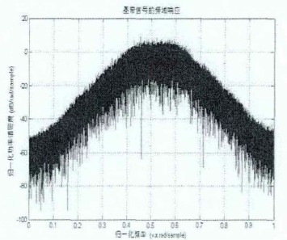
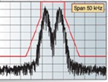
The Usage on 407-425MHz band
Interphone (Walkie-talkie)
DPMR ：
4FSK ， FDMA，B=6.25kHz
DMR ：
4CPFSK ， TDMA，B=12.5kHz

Slide 11
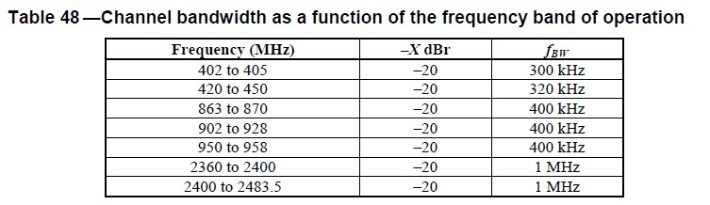
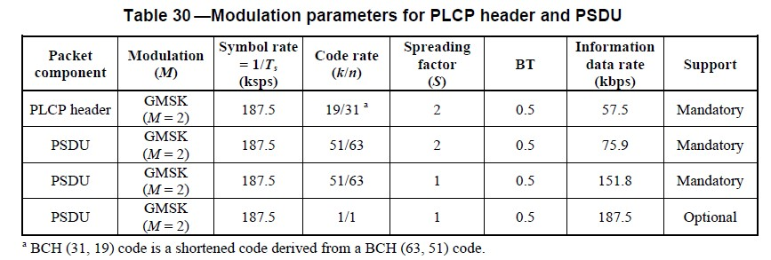
The Usage on 407-425MHz band
IEEE 802.15.6 devices（ Potential ）
Operation frequency and channel bandwidth
(section 8.8.1)
Modulation parameters
(Narrow Band PHY,420-450MHz)
(Section 8.1.2)

Slide 12
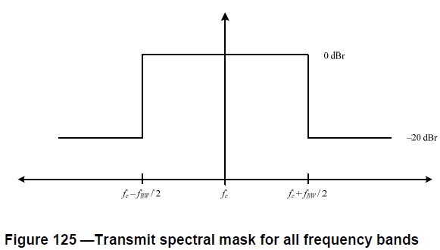
The Usage on 407-425MHz band
IEEE 802.15.6 devices（ Potential ）
The transmit spectral mask for narrow band PHY is : (Section 8.8.1)

Slide 13
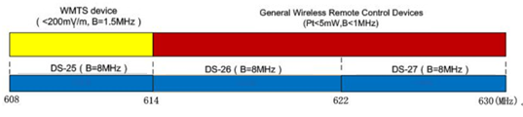
The Usage on 608-630MHz band
UHF radio and TV
WMTS devices
General Wireless Remote Control Devices
608-630MHz

Slide 14
The Usage on 608-630MHz band
UHF Radio and TV
 | Channel | Standard
Digital radio and TV | DS-25：608-614MHz DS-26：614-622MHz DS-27：622-630MHz | DTMB(OFDM) | CMMB(OFDM)
Analog radio and TV |  | GB/T 14433-93 Color TV Broadcast Coverage Network Technical Regulations
Remark: And China will stop the analog signal in 2015.

Slide 15
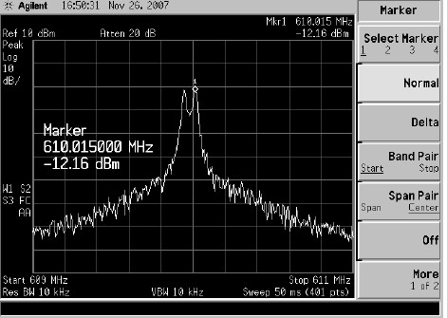
The Usage on 608-630MHz band
WMTS Standard（Potential）
WMTS :Wireless Medical Telemetry
WMTS devices need to get the FCC authorization to product and we don`t find this device using in China yet.
Parameters
Channel number | 4（608.0-609.5MHz、609.5-611.0MHz、611.0-612.5MHz、612.5-614.0MHz）
Channel Bandwidth | 1.5MHz
Modulation | No specified. The right Fig is FSK for example.

Slide 16
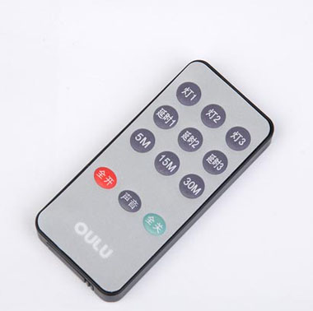
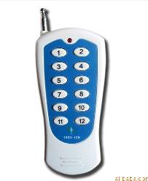
The Usage of 608-630MHz
General Wireless Remote Control Devices
General wireless remote control
devices on the market mainly
refers to the radio remote control
(RF Remote Control).
It has been widely used in garage
door ,electric gate, Barrier remote
control, burglar alarm, industrial
control and wireless intelligent
home field.

Slide 17
The Usage of 608-630MHz
General Wireless Remote Control Devices
operation frequency : 470-566MHz，614-787MHz
Pt: <5mW(e.r.p)
channel bandwidth : <1MHz
Modulation： No specified . There are different
modulations in varied products , FSK or ASK for example.
Most of the wireless remote control operation frequency in the Chinese market is in the 315MHz and 433MHz.

Slide 18
Interference Summary
Main interference sources | Digital TV and Radio
Random interference sources | Wireless microphone | Digital Phones (Walkie-talkie)

Slide 19
Interference Descriptions on Each Band
The Math Models
  Model of Digital TV (CBMM)
  Model for Wireless Microphone
  Model of Digital Phone (Walkie-talkie)

Slide 20
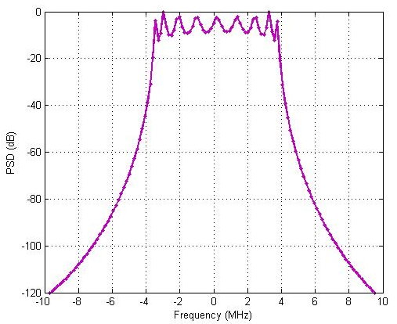
  Model of Digital TV (CBMM) (1)
CBMM Interference Models
  Bandwidth for CMMB signal is 8MHz
  BPSK, QPSK and16QAM modulation, OFDM technology with 4096 sub-carrier (3076 been used)
  It is feasible to use the white Gaussian noise to simulate the digital TV signal.
Right figure: Power Spectrum Density (PSD) of CMMB signal (in QPSK modulation scheme).

Slide 21
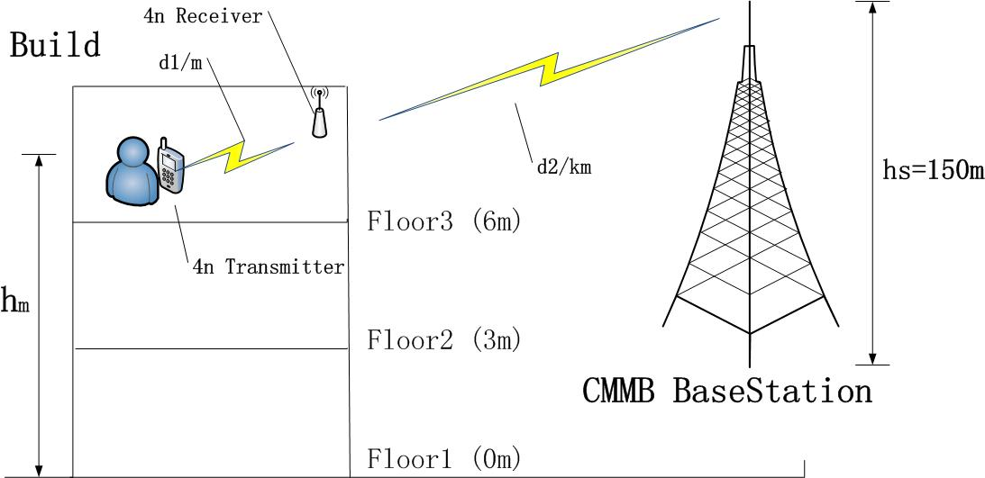
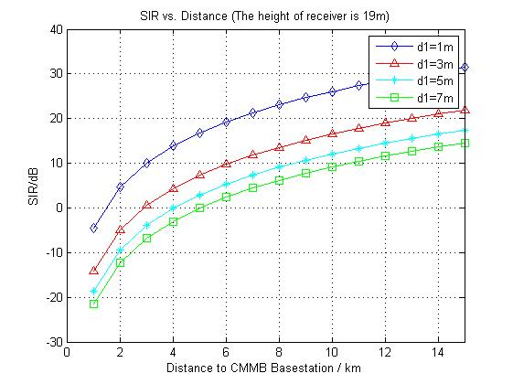
Model of Digital TV (CBMM) (2)
Interference scenario
SIR calculation result with different distance between 4n devices
the 4n device is assumed in 19m high, or floor 5 ~ floor 6.
In the figure:
d1: distance between 4n transmitter and 4n receiver;
d2: distance between 4n devices and the CMMB base station;
hm: the height of 4n devices for ground;
hs: the height of CMMB base station;

Slide 22
Model of Digital TV (CBMM) (3)
The interference math model is as:
I_{C}=A_{m}×[h*x_{C}(t)]
So the interference power is estimated as
P_{icmmb}=1kW×f(d)×B_{r}≈1kW×d⁻²×0.25=54-20log₁₀(d) dBm
Where
f(d) ≈d⁻² is path loss factor, and d is the distance to CMMB base station (m);
B_{r}=2MHz/8MHz=0.25 is relatively bandwidth factor;
So the amplitude of interference signal is
A_{m}=P_{icmmb}^{1/2}

Slide 23
Interference Descriptions on Each Band
The Math Models
  Model of Digital TV (CBMM)
  Model for Wireless Microphone
  Model of Digital Phone (Walkie-talkie)

Slide 24

Model for Wireless Microphone
(1)
Operation Modes
Transmission Signal
: sound signal
: amplitude (0.3 in this modulation)
: carrier frequency (200MHz in this modulation)
: frequency deviation

Slide 25
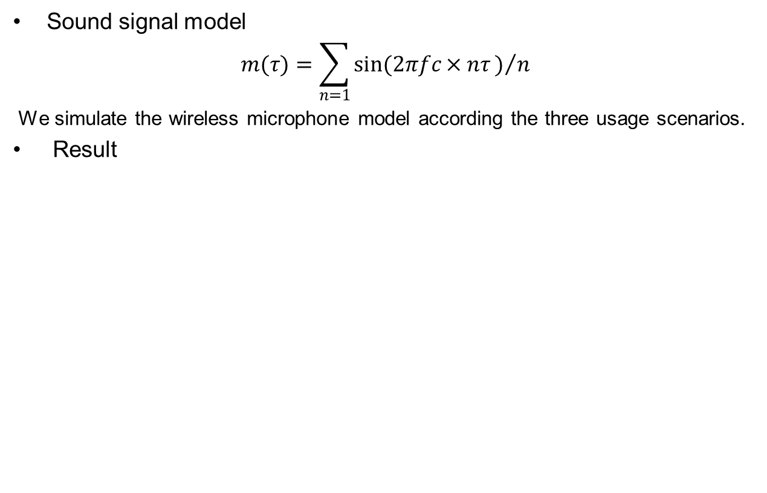
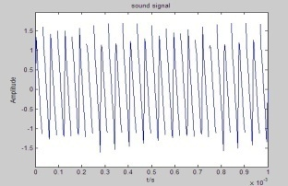
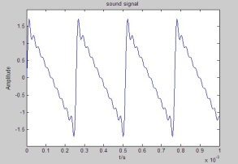
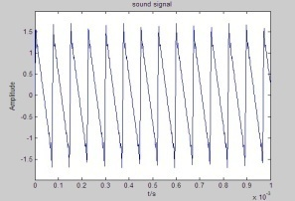
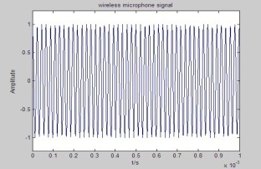
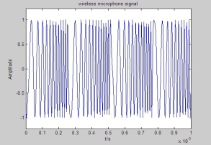
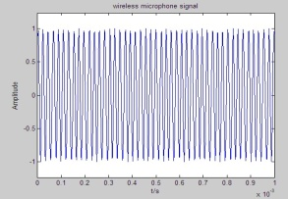
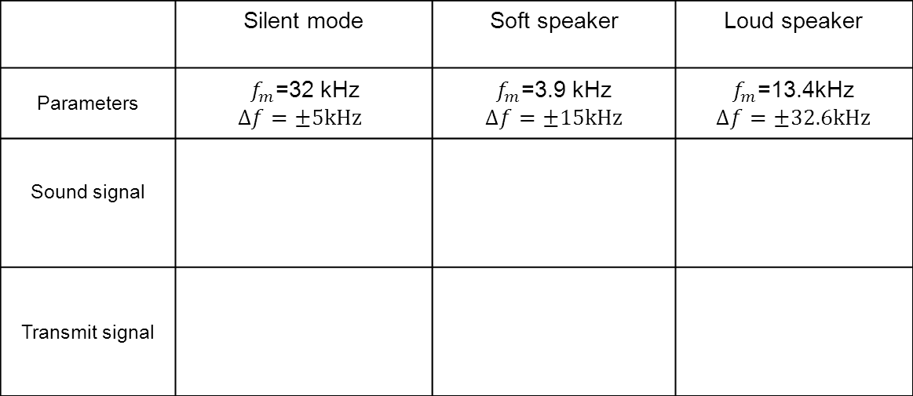
Model for Wireless Microphone
(2)
 | Silent mode | Soft speaker | Loud speaker
Parameters
Sound signal
Transmit signal

Slide 26
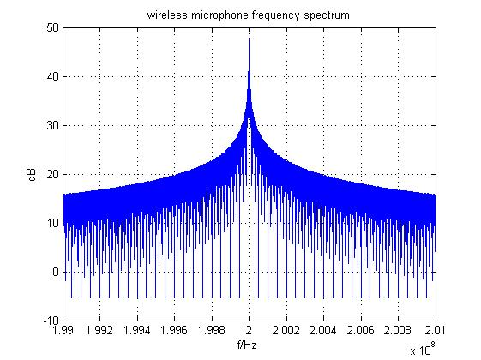
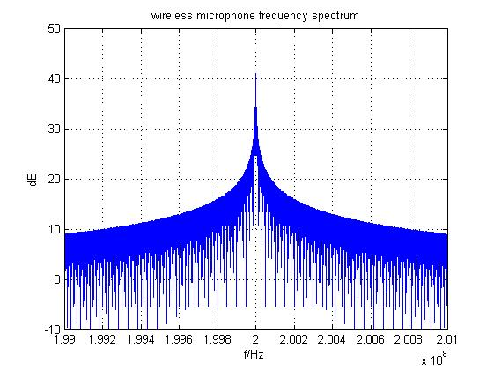
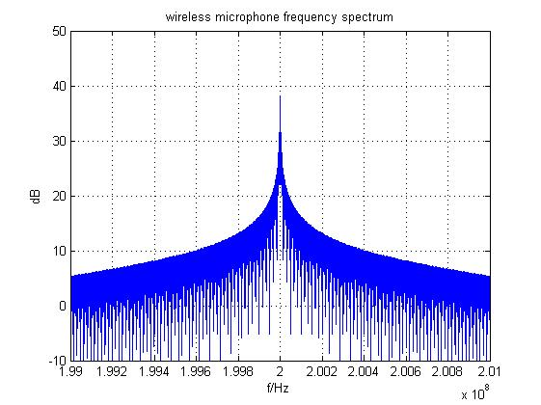
Model for Wireless Microphone
(3)
Spectrum analysis and verification
Silent mode
Soft speaker
As it is seen in the three spectrum figure, 200kHz around the Fc, the signal decays at least 25dB. And beyond 500kHz around Fc, the decay is 30dB at least.
Loud speaker

Slide 27
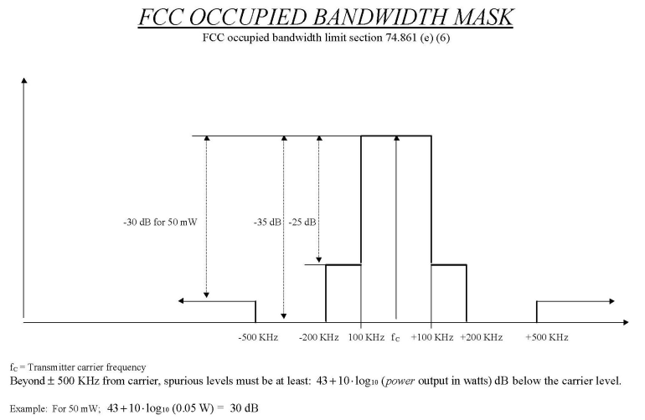
Model for Wireless Microphone
(4)
Spectrum analysis and verification
FCC requirements:
Frequency bands: 174-216, 470-608, 614-806 MHz
Maximum transmit power: 50 mW (VHF), 250 mW (UHF), Most units operate with 10-50 mW output
Occupied bandwidth: 200 kHz or less
By the comparison and analysis, the model for WM meets the FCC requirements.

Slide 28
Interference Descriptions on Each Band
The Math Models
  Model of Digital TV (CBMM)
  Model for Wireless Microphone
  Model of Digital Phone (Walkie-talkie)

Slide 29
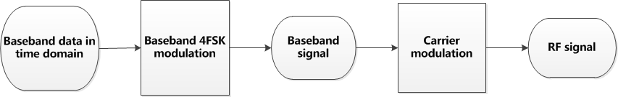
Model of Digital Phone (Walkie-talkie)
(1)
Simulation Models
This baseband data is based on frame format which set by DPMR standard.

Slide 30
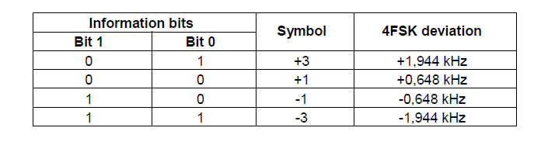
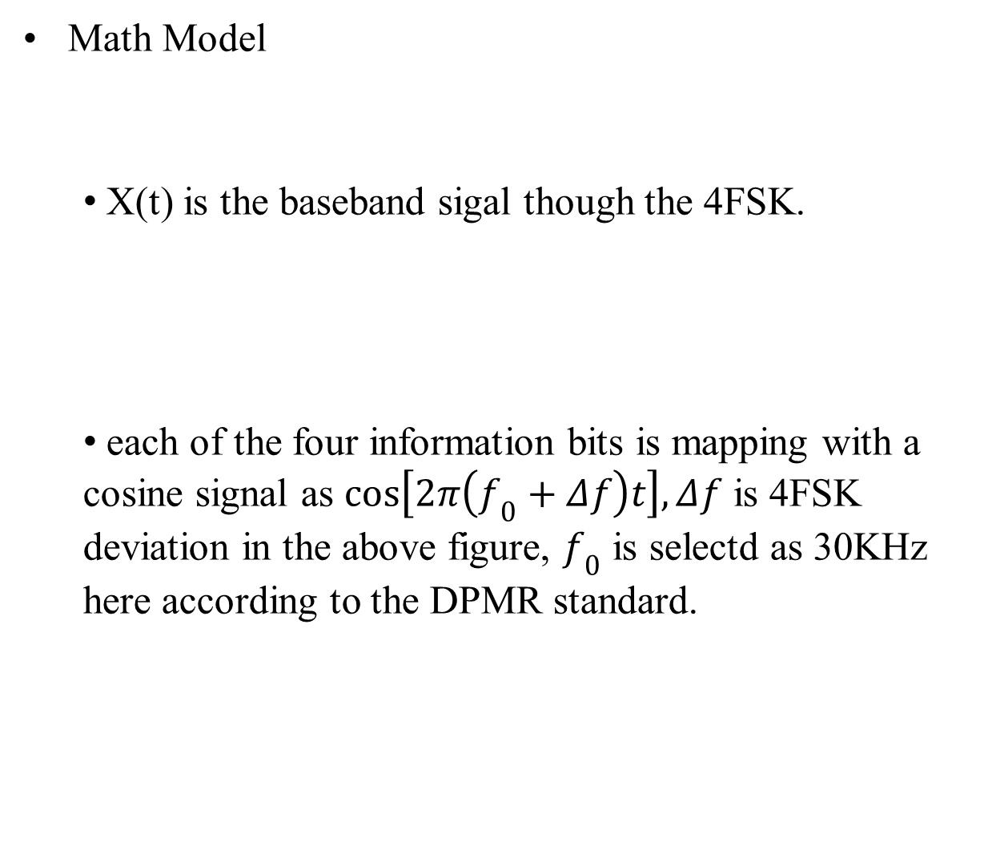
Model of Digital Phone (Walkie-talkie)
(2)
Math Model
  X(t) is the baseband sigal though the 4FSK.
  each of the four information bits is mapping with a cosine signal as $cos\left[2π\left(f_{0}+Δf\right)t\right],Δf$ is 4FSK deviation in the above figure, $f_{0}$ is selectd as 30KHz here according to the DPMR standard.

Slide 31
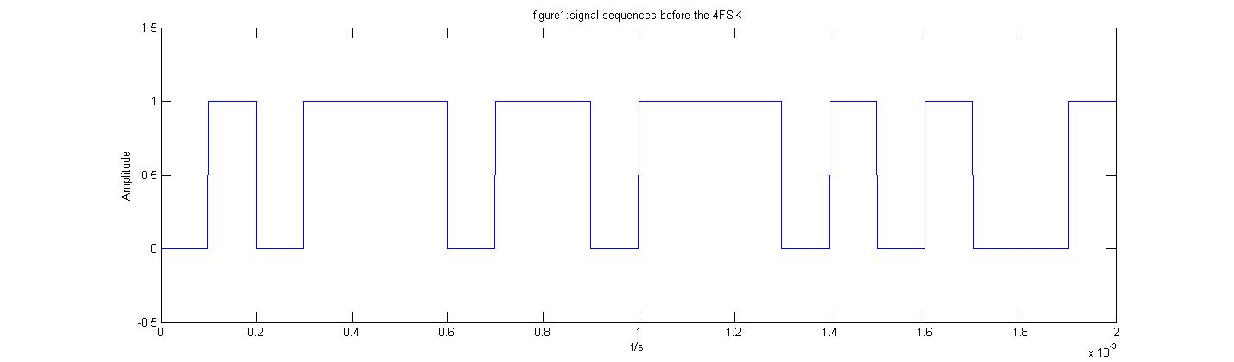
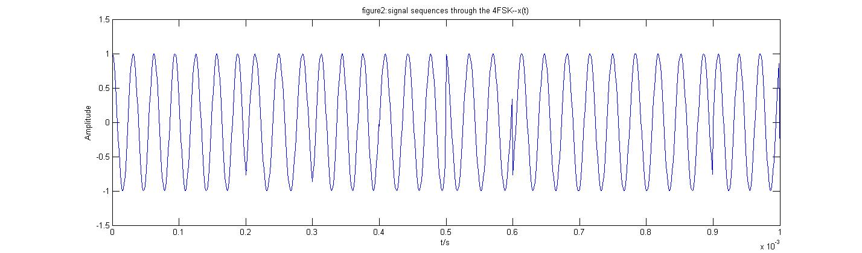
Figure1 is the data sequences before the 4FSK and figure 2 is the signal sequences through the 4FSK. The data sequences we simulate is 01 01 11 01..., based on the corresponding relation from the mapping figure in previous page ,the signal sequences through the 4FSK which is x(t) actually,is shown in figure 2.

Slide 32
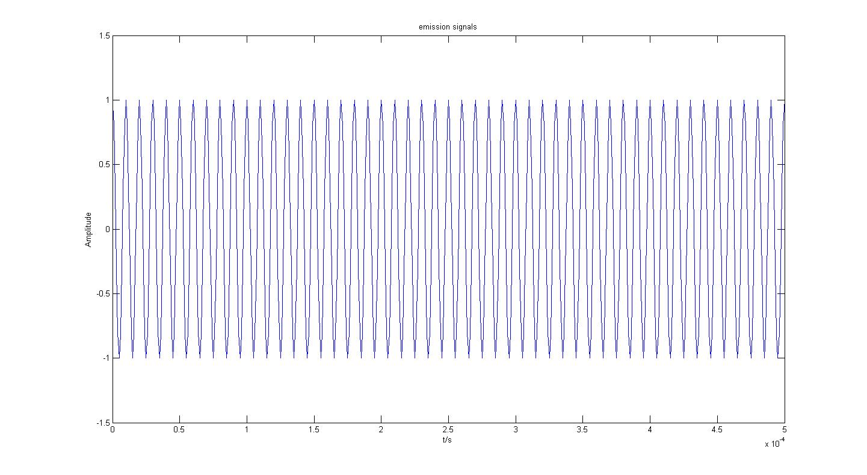

Results
In this figure, this is the emission signals.The emission signals is simulate by the formula $I_{dt}=cos\left(2π\left[f_{c}+x\left(t\right)\right]t\right)$,the $x\left(t\right)$ is signal sequences through the 4FSK, $f_{c}$ is selected as 409.9MHz.

Slide 33
Conclusion and Further works
TBD

