Slide 1
Project: IEEE P802.15 Working Group for Wireless Personal Area Networks (WPANs)
Submission Title: Detail Summary of Interference on Chinese Medical Bands
Date Submitted: August 12, 2012
Source: Ning Li, Shu Tul BUPT, Liang Li, Liang Zhang Vinno;
Suite 202, Building D, No.2 Xinxi Lu, Beijing, China,
Voice: 1-914-333-9687, FAX: 1-914-332-0615,
E-Mail: liangli@vinnotech.com
Abstract: Opening report for TG4n(MBAN) Task Group
Purpose: Outline accomplishments from the March 2012 meeting and planned tasks for this meeting.
Notice: This document has been prepared to assist the IEEE P802.15. It is offered as a basis for discussion and is not binding on the contributing individual(s) or organization(s). The material in this document is subject to change in form and content after further study. The contributor(s) reserve(s) the right to add, amend or withdraw material contained herein.
Release: The contributor acknowledges and accepts that this contribution becomes the property of IEEE and may be made publicly available by P802.15.

Slide 2
Informative Abstract
General View
Interference on 174-216MHz Band
Interference on 407-425MHz Band
Interference on 608-630MHz Band
Conclusion

Slide 3
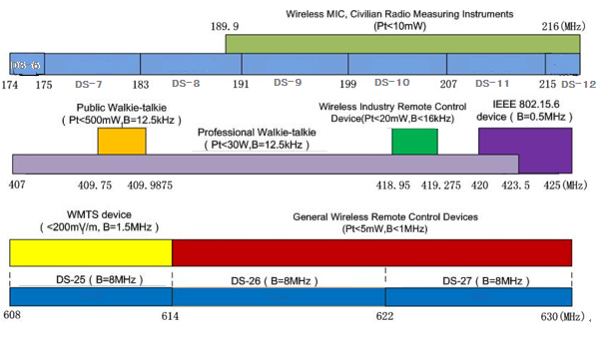
General View
All of usages on 174-216、407-425、608-630MHz Bands

Slide 4
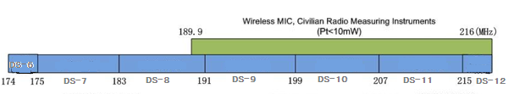
Current Usages on 174-216MHz Band
VHF Radio and TV
Wireless MIC
Civilian Radio Measuring Instruments
174-216MHz

Slide 5
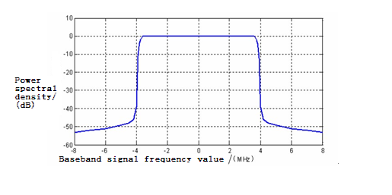
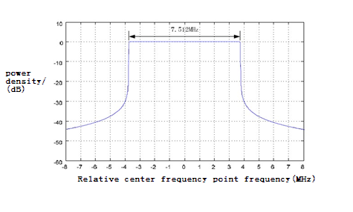
VHF Radio and TV on 174-216MHz
 | Channel | Standard
Digital radio and TV | DS-6：174-175MHz DS-7：175-183MHz DS-8：183-191MHz DS-9：191-199MHz DS-10：199-207MHz DS-11：207-215MHz DS-12：215-216MHz | DTMB(OFDM) | CMMB(OFDM)
Analog radio and TV |  | GB/T 14433-93 Color Radio and TV Coverage Network Technical requirements
Remark: The analog radio and TV will stop in 2015.

Slide 6
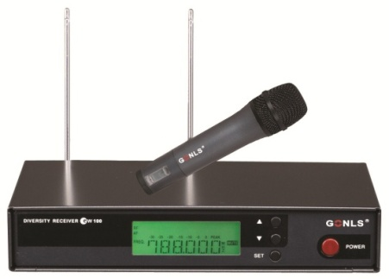
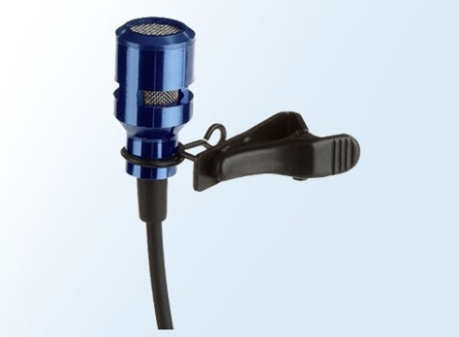
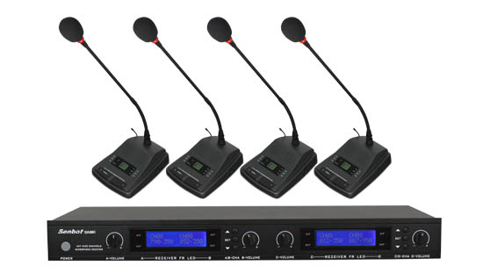
Wireless MIC on 174-216MHz
Wireless Microphones on the market:
On Chinese Markets, More China's wireless microphones shifts from VHF to UHF(most 500-900MHz), especially in the high-end products.

Slide 7
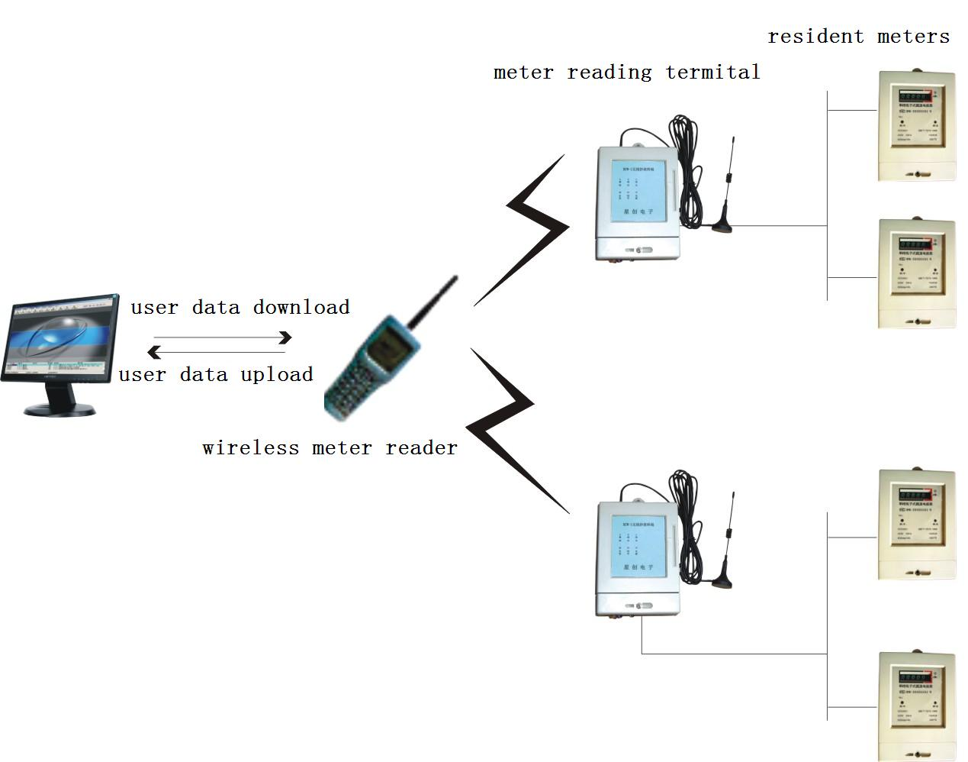
The Usage of 174-216MHz
Civilian Radio Measuring Instruments
Civilian radio measuring instruments mainly refers to the wireless meter reading devices, wireless water meter, wireless electronic meter and wireless gas meter.
Currently, the vast majority of companies are widely used in AMR downlink communication -CFDA ,its working frequency band of 480-510MHz for micro-power is free to apply for amateur bands (maximum transmit power of 50 mW)
Wireless meter system

Slide 8
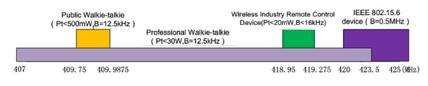
The Usages on 407-425MHz
Interphone
802.15.6 Devices
Industrial Wireless Remote Control Device
407-425MHz

Slide 9
The Usage of 407-425MHz
Interphone
Interphone | Different Frequency Bands | Dedicated interphone | 137-144、146-167、403-409.75、409.9875-423.5MHz
 |  | Public interphone | 409.7500-409.9875MHz | Analog | Channel number:20 Operation frequency:409.7500-409.9875MHz Channel spacing:12.5kHz Modulation:8K5F3E
 |  |  |  | Digital | Channel spacing:12.5kHz 6.25kHz multi-access mode : FDMA/TDMA
 | Individual Technology | Analog interphone
 |  | Digital interphone | DMR（base on TDMA）、DPMR（base on FDMA）、DSRR ,P25 standard

Slide 10
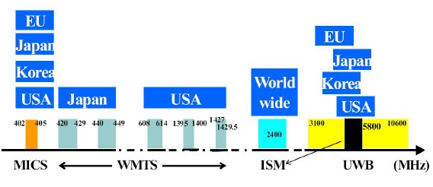
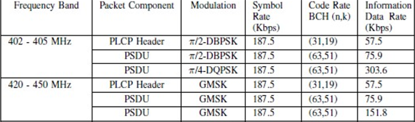
Usages on 407-425MHz
IEEE 802.15.6 Standard（ Potential ）
Operation frequency
Modulation parameters

Slide 11
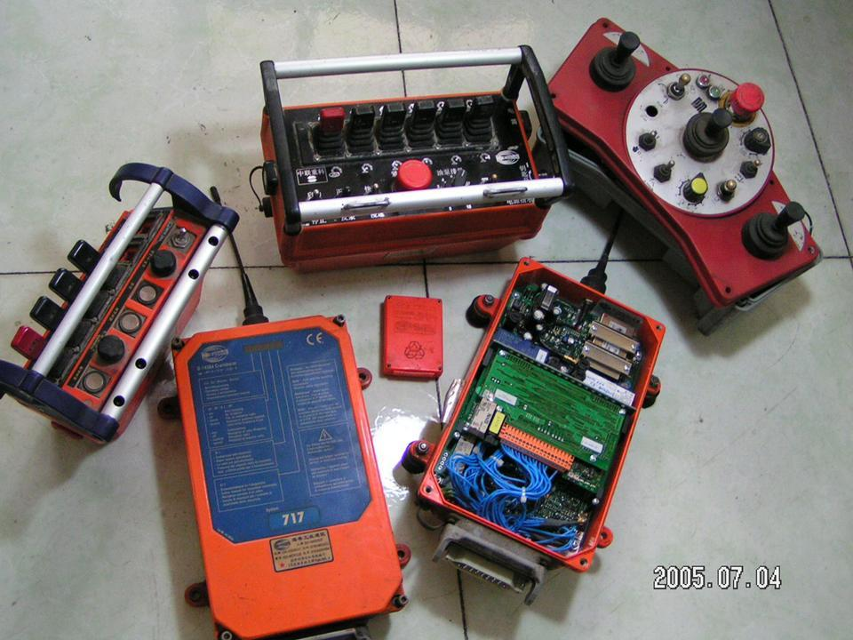
Industrial Wireless Remote Control Device on 407-425MHz
Micro-power (short-range) radio equipment technical requirements limits this device in the industrial plant (or buildings) using 。
Operation frequency | 418.950MHz，418.975MHz，419.000MHz，419.025MHz，419.050MHz，419.075MHz，419.100MHz，419.125MHz， 419.150MHz，419.175MHz，419.200MHz，419.250MHz，419.275MHz
Transmit power limit | 20mW (e.r.p)
Occupied bandwidth | No more than 16kHz
Frequency tolerance | 4×10-6

Slide 12
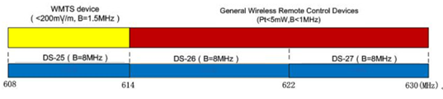
Usages on 608-630MHz
UHF radio and TV
608-630MHz

Slide 13
UHF Band Radio and TV on 608-630MHz
 | Channel | Standard
Digital radio and TV | DS-25：608-614MHz DS-26：614-622MHz DS-27：622-630MHz | DTMB(OFDM) | CMMB(OFDM)
Analog radio and TV |  | GB/T 14433-93 Color TV Broadcast Coverage Network Technical Regulations
Remark: And China will stop the analog signal in 2015.

Slide 14
Conclusion
Main interference sources | radio and TV |  | interphone
Less interference sources | wireless MIC | civilian radio measuring instruments | industrial wireless remote control device | general wireless remote control devices

