Slide 1
Project: IEEE P802.15 Working Group for Wireless Personal Area Networks (WPANs)
Submission Title: [Interference and Fading in the 220 MHz Band]
Date Submitted: [29 August 2012]
Source: [Jon Adams] Company [Lilee Systems]
Address [2905 Stender Way, Suite 78, Santa Clara CA, 95054 USA]
Voice:[+1 480.628.6686], FAX: [Add FAX number], E-Mail:[jonadams@ieee.org]
Re: [If this is a proposed revision, cite the original document.]
[If this is a response to a Call for Contributions, cite the name and date of the Call for Contributions to which this document responds, as well as the relevant item number in the Call for Contributions.]
[Note: Contributions that are not responsive to this section of the template, and contributions which do
not address the topic under which they are submitted, may be refused or consigned to the “General Contributions” area.]
Abstract: []
Purpose: []
Notice: This document has been prepared to assist the IEEE P802.15. It is offered as a basis for discussion and is not binding on the contributing individual(s) or organization(s). The material in this document is subject to change in form and content after further study. The contributor(s) reserve(s) the right to add, amend or withdraw material contained herein.
Release: The contributor acknowledges and accepts that this contribution becomes the property of IEEE and may be made publicly available by P802.15.

Slide 2
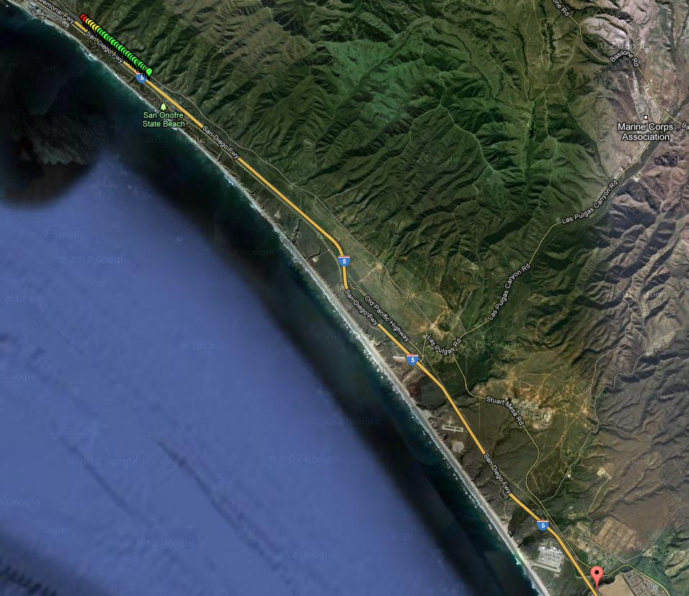
Test Run in San Diego County
August 2012
15.5km
Jon Adams, Lilee Systems

Slide 3
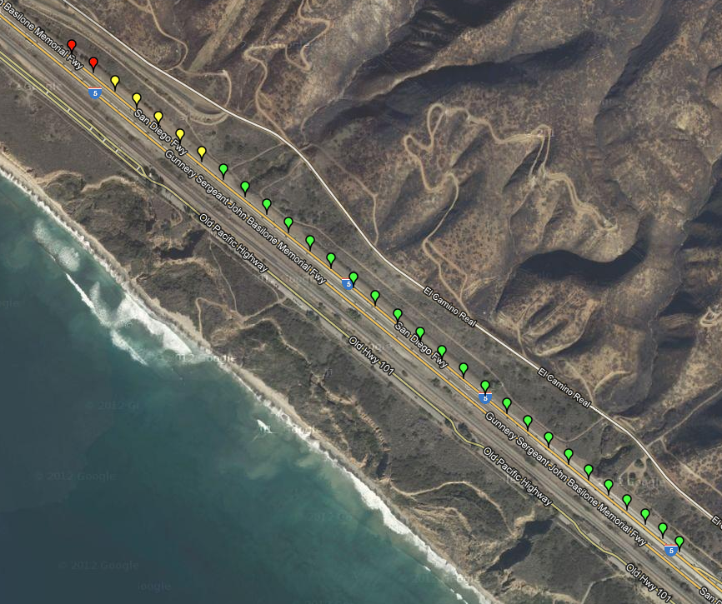
Closeup
August 2012
SEQ29
1.85km
SEQ01
Jon Adams, Lilee Systems

Slide 4
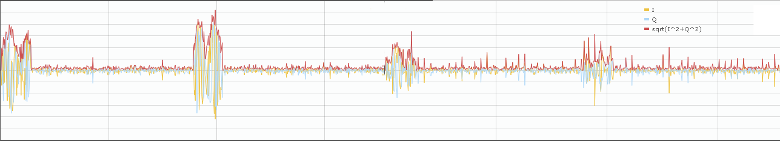
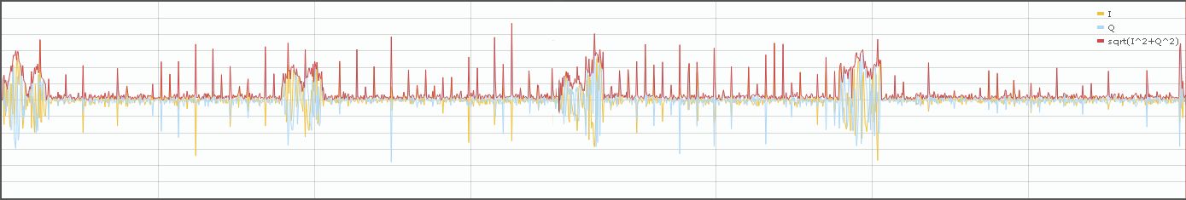
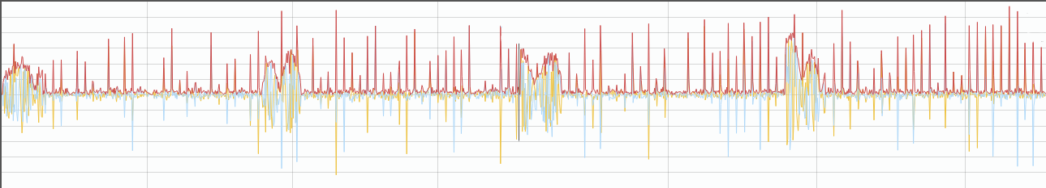
Seq 09 - 14
August 2012
Jon Adams, Lilee Systems

Slide 5
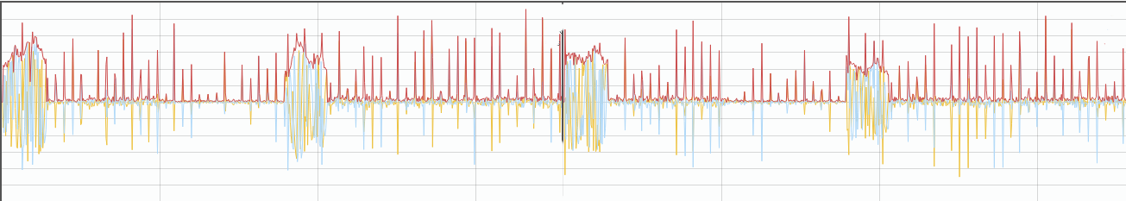
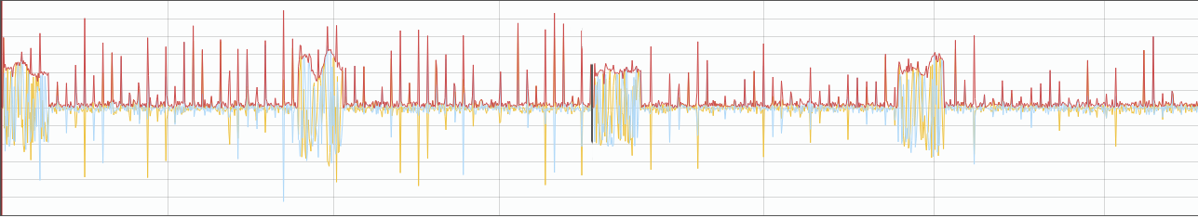
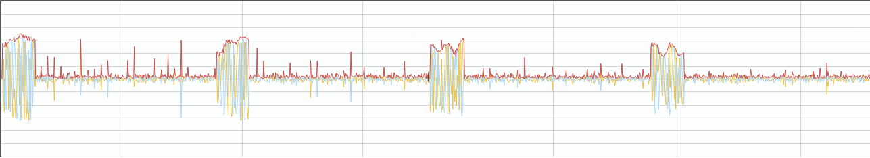
Seq 15-20
August 2012
Jon Adams, Lilee Systems

Slide 6
Challenges with Propagation
August 2012
Jon Adams, Lilee Systems
Mobile faded environment
Long distance to base station
In-band high power impulse interferer

