Slide 1
Project: IEEE P802.15 Working Group for Wireless Personal Area Networks (WPANs)
Submission Title: [Potential Utilization of DSRC band (5.850-5.925 GHz) for PTC]
Date Submitted: [14 August 2012]
Source: [Ibrahim Muftic] Company [Parsons Brinckerhoff]
Address [303 2nd Street, Suite 700N, San Francisco, CA 94121 USA]
Voice:[Add phone number], FAX: [Add FAX number], E-Mail:[ibrahim.muftic@ieee.org]
Re: [If this is a proposed revision, cite the original document.]
Abstract: [In December 2003 , FCC adopted a Report and Order establishing licensing and service rules for the DSRC Service in the ITS Radio Service in the 5.850-5.925 GHz band. What are the possibilities to utilize this spectrum for PTC deployment?
Purpose: [Explore possibilities to include this band in the standard amendment]
Notice: This document has been prepared to assist the IEEE P802.15. It is offered as a basis for discussion and is not binding on the contributing individual(s) or organization(s). The material in this document is subject to change in form and content after further study. The contributor(s) reserve(s) the right to add, amend or withdraw material contained herein.
Release: The contributor acknowledges and accepts that this contribution becomes the property of IEEE and August be made publicly available by P802.15.

Slide 2
History
In 1997, ITS America petitioned FCC to allocate 75 megahertz of spectrum in the 5.9 GHz band for Intelligent Transportation Systems (ITS), in particular for the Dedicated Short Range Communications (DSRC).
The Transportation Equity Act for the 21st Century ("TEA-21") of 1998, directs FCC with DOT to consider spectrum needs for ITS (and DSRC)
In October 1999, FCC allocated the 5.9 GHz band for DSRC-based ITS applications and adopted basic technical rules for DSRC operations.
In December 2003, FCC adopted a Report and Order establishing licensing and service rules for the DSRC Service in the ITS Radio Service in the 5.850-5.925 GHz band.

Slide 3
DSRCS - Introduction
  Equipment in the DSRC Service comprises On-Board Units (OBUs) and Roadside Units (RSUs). An OBU is a transceiver that is normally mounted in or on a vehicle, or in some instances August be a portable unit. OBUs mounted in vehicles and portable units are licensed by rule under Part 95 of the Rules.

Slide 4
DSRCS – Introduction Contd.
  An RSUs is a transceiver that is mounted along a road or pedestrian passageway or even on a vehicle but needs to be stationary when operates.
  An RSU broadcasts data to OBUs or exchanges data with OBUs in its communications zone. RSUs operate under Part 90 of the Rules.

Slide 5
DSRCS – Channel Allocation
  Frequencies available for assignment to eligible applicants within the DSRC band for RSUs and the maximum EIRP permitted for an RSU with an antenna height not exceeding 8 meters above the roadway bed surface are given on the figure. For Ch. 178&184 2 EIRP limits are given, the higher limit is permitted only for state or local governmental entities.

Slide 6
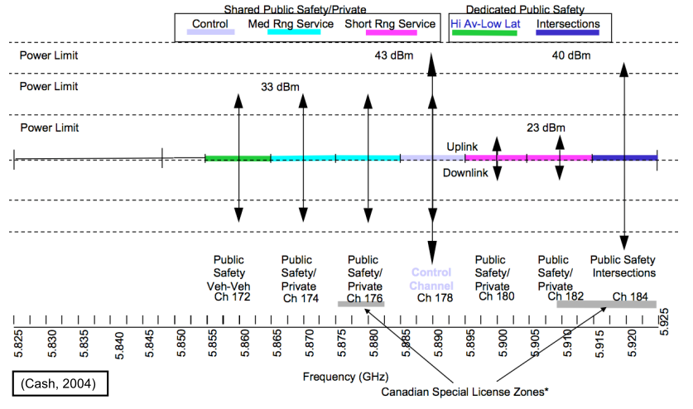
DSRCS – Channel Allocation

Slide 7
ASTM E2213–03 DSRC Standard (ASTM-DSRC Standard)
  RUs operating in the DSRC band shall comply with the technical standard ASTM E2213–03, “Standard Specification for Telecommunications and Information Exchange Between Roadside and Vehicle Systems—5 GHz Band Dedicated Short Range Communications (DSRC) Medium Access Control (MAC) and Physical Layer (PHY) Specifications” published September 2003.

Slide 8
Licensing - Eligibility
The following entities are eligible to hold an authorization to operate RSUs in the DSRCS:
  Any territory, possession, state, city, county, town or similar governmental entity, and
  any public safety or industrial/business entity meeting the eligibility requirements of CFR 90.33 or 90.35.

Slide 9
Licensing – Co-Primary Users
  There is also a co-primary Federal Government radiolocation allocation (for use by high-powered military services) in the 5.850-5.925 GHz band, a co-primary fixed satellite (earth-to-space) allocation, and the amateur service has a secondary allocation in the band. Industrial, Scientific and Medical (ISM) equipment August also operate in the 5.850-5.875 MHz portion of the band.

Slide 10
Licensing – Numbers and Exclusivity
    FCC issues an unlimited number of non-exclusive geographic-area licenses to eligible entities authorizing operation on seventy-megahertz of co-primary spectrum, excluding the reserve channel.
    Governmental applicants will be issued a geographic area license based on the geo-political area encompassing the legal jurisdiction of the entity. All other applicants will be issued a geographic area license for their proposed area of operation.
    This spectrum is not subject to any aggregation limit, so each licensee uses channels in accordance with the ASTM-DSRC Standard.

Slide 11
Licensing - Registration
  Licensees must register RSU sites, channels, and other relevant data on the Universal Licensing System (ULS). ULS will refer RSU registrations through NTIA that are within seventy-five kilometers of any of the existing Government radar sites listed in Section 90.371(b).

Slide 12
Next Steps
  Explore possibility of getting 5850-5855 MHz Reserve channel for exclusive PTC system deployment (possibly nation-wide)
  Explore possibility of changing the rule to allow using IEEE 802.15.4p with different channelization and other parameters
  Check industry support to supply products in this band (IEEE 802.15.4 and others)

Slide 13
References
    (Jones, 2005) “DSRC - Linking the Vehicle and the Road”
    (FC, 2004) W. Fisher and B. Cash, “IEEE 802.11p Draft Review”
    (Weigle, 2008) “Standards: WAVE / DSRC / 802.11p”
    (Notor, 2011) “ITS Spectrum in the 5.9 GHz Band“
    http://www.fcc.gov/, August 2012

