Slide 1
Project: IEEE P802.15 Working Group for Wireless Personal Area Networks (WPANs)
Submission Title: [Preliminary Technical Proposal for PTC Communications]
Date Submitted: [18 July 2012]
Source: [J. Li, Y Lee, H. Movahedi, M-C Doong] Company [Lilee Systems]
Address [2905 Stender Way, Suite 78, Santa Clara CA, 95054 USA]
Voice:[+1 408-988-8672], FAX: [Add FAX number], E-Mail:[jiaruli, yjlee, hmovahedi, mdoong@lileesystems.com]
Re: []
[If this is a response to a Call for Contributions, cite the name and date of the Call for Contributions to which this document responds, as well as the relevant item number in the Call for Contributions.]
[Note: Contributions that are not responsive to this section of the template, and contributions which do
not address the topic under which they are submitted, may be refused or consigned to the “General Contributions” area.]
Abstract: []
Purpose: []
Notice: This document has been prepared to assist the IEEE P802.15. It is offered as a basis for discussion and is not binding on the contributing individual(s) or organization(s). The material in this document is subject to change in form and content after further study. The contributor(s) reserve(s) the right to add, amend or withdraw material contained herein.
Release: The contributor acknowledges and accepts that this contribution becomes the property of IEEE and may be made publicly available by P802.15.

Slide 2
Overview
Class 1 Freight Railroads in US have selected 220 MHz for their PTC needs
US transits looking at 220 MHz but also concerned about availability of spectrum, cost of spectrum, and may have existing spectrum in 160, 450, 700/800 or 900MHz spectrum
15.4p should consider accommodating 220 MHz as well as these other spectrum segments to allow future interoperability through firmware changes to software-defined radios

Slide 3
220 MHz
217 – 222 MHz
  Includes services in FCC Part 80, Part 90, Part 95, Part 97
  Different services have different uses, different interference environments
  Little or no coordination between services and users
  Constraints on use due to extant licensees and intended uses
  Special rules and exclusions within 120km of border
  US Air Force Space Surveillance System (ex-NAVSPASUR) at 217MHz
    768 kW ERP at 216.97927 MHz, Lake Kickapoo, TX
    2 other transmit sites at Maricopa, AZ, and Jordan Lake, AZ
    6 receive sites in CA, NM, AR, MS, and GA
  Out-of-band interferers
    TV Channel 13 @ 210-216MHz with ERP >+80dBm
    2nd harmonic of broadcast FM stations as high as 216MHz
    2nd harmonic of airport instrument landing systems (Localizer, VOR) at 216-224 MHz
    Amateur Radio Service 222-225 MHz (as high as +60dBm + antenna gain)
    Military ground and airborne, and Federal government communications at 225 MHz and above

Slide 4
450-470 MHz
Primarily Parts 90 and 95
Many radios digital voice
  P25, DMR, NXDN, TETRA
Land Mobile radio, both business, industrial, and municipal, state, federal government
In US, Association of American Railroads holds 38-1/2 channel pairs in the 452/457MHz area
Subject to narrowbanding mandate
Band already included as a part of published 15.4g amendment
Voice/data and data-only channels

Slide 5
160.20-161.59 MHz
US FCC Part 90
Land mobile radio specifically for rail operations
In US, Association of American Railroads hold 91 15kHz channels, and 181 7.5 kHz channels after narrowbanding
  http://www.fl9.com/files/Frequencies/AAR_Channel_Assignments.pdf
Band well controlled due to harmonized use
Adjacent uses are marine and US government, but similar usage, transmit power, radio performance, occupied bandwidth
Voice primary usage, but plenty of sharing with data
Potential for train control data communications

Slide 6
700/800 MHz Trunked
US FCC Part 90
Land mobile radio, used for police, fire, municipal, private
Band well controlled due to harmonized use
Voice primary usage, most radios digital, so can carry data as well
  P25, TETRA, DMR, NXDN
Potential for train control data communications
Currently not covered in 802.15.4

Slide 7
896/935 Data Communications
US FCC Part 90
Land mobile radio, used for police, fire, municipal, private
Six channel pairs under AAR control
Harmonized uses
Voice primary usage, AAR channels used exclusively for data
Currently used for legacy train control data communications
Covered by 15.4g

Slide 8
802.15.4 in general
Narrow-band channelization
  12.5, 25, 100, 200 kHz centers
Data rates
  4.8, 9.6, 10, 20, 40, 50, 100, 150, 200 kbps (and greater)
Frequency bands from 450-2483.5 MHz
  450 – 470 MHz
  470 – 510 MHz
  779 – 787 MHz
  863 – 870 MHz
  896 – 901 MHz
  901 – 902 MHz
  902 – 928 MHz
  928 – 960 MHz
  1427 – 1518 MHz
  2400 – 2483.5 MHz
Modulation Modes
  Filtered 2FSK, 4FSK; GFSK; O-QPSK

Slide 9
Suggested Additions
Data rates
  8, 16 (ITC-R), 19.2, 32 (ITC-R) Kbps
  Allowance of all other data rates in appropriate channel widths
Frequency bands (all US FCC Part 90 rules)
  159.80 – 161.59 MHz (includes Canada)
  216 – 217 MHz
  217-218/219-220 MHz
  218 – 219 MHz
  220 – 222 MHz
Modulation Modes
  GMSK (same as filtered 2-FSK with ModIndex=0.5)
  C4FM (same as filtered 4-FSK)
  Pi/4 DQPSK
Guaranteed service separation between voice and train control traffic to allow use of same radio for both

Slide 10
Two Radio Approaches used Today
Advanced Civil Speed Enforcement System (ACSES) | Data Radio Mfgr A
Channel BW | 12.5 KHz
Access Method | TDMA (8 X 125ms timeslots/second)
Modulation | GMSK
Data Rate | 9.6 kbps
Frequency Range | 900 MHz moving to 220 MHz
Mode | Half Duplex
Electronic Train Management System (ETMS) | Data Radio Mfgr B
Channel BW | 25 KHz
Access Method | FDMA, TDMA, CSMA
Modulation | 4FM, π/4DQPSK
Data Rate | 16kbps, 32kbps
Frequency Range | 220-222MHz
Mode | Half Duplex
Compiled by Ed Thorngren, Parsons

Slide 11
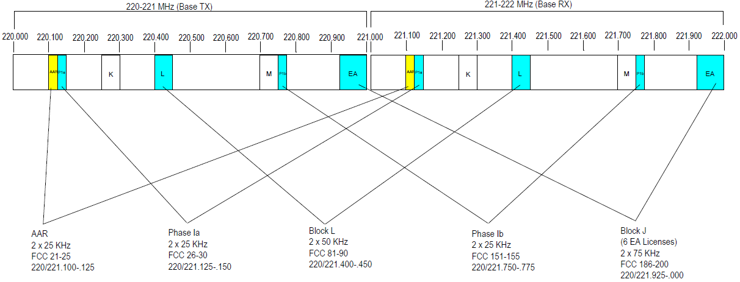
FCC: 220-222 MHz Channel Summary
Summary : 200 kHz (TX ) + 200 kHz (RX)
Total Spectrum nationwide (= 25+25+25+50+75)
Two Nationwide Commercial 5 Channel blocks, (five 5kHz channels)
  Block 1 = 25 kHz + 25 kHz Block 2 = 25 kHz + 25 kHz
AAR = 25khz + 25khz
NWA255 - U.S. and Possessions = 50 kHz + 50 kHz
ALL EAGs in Channel BLOCK J = 75 kHz + 75 kHz
11

Slide 12
PHY Considerations for a 220MHz Default Mode
For the 216-222 MHz spectrum
  Channel spacing: 12.5 kHz
  Channel bandwidth: 12.5 kHz
  Default data rate: 9.6 kbps
  Default modulation mode: GMSK

Slide 13
Suggested Data Rate/Channel BW
Data Rate (kbps) | Channel Bandwidth (kHz) |  | Modulation Mode(s)
 | Relaxed FCC Mask | Tight FCC Mask
4.8 | 6.25 |  | GMSK
9.6 | 12.5 | 25 | GMSK
16 |  | 25 | Pi/4 DQPSK
19.2 | 25 |  | GMSK
32 |  | 25 | Pi/4 DQPSK
50 | 50 |  | GMSK
100 | 100 |  | GMSK
200 | 200 |  | GMSK

Slide 14
MAC Considerations
Use of default features brought in through 15.4e
  DSME, frameslotting, multi-superframe
  Contention-free and Contention-based (CSMA-CA) periods
  Use of Beacon to announce supported modulation modes, data rates
  Association, disassociation, reassociation
  AES-128 security built in
  Any changes to the MAC that are required to support the PHY changes

Slide 15
802.15.4 – Specifying Radio Frequency Bands
Why do new frequency bands need to be brought in by amendment?
Why can’t 15.4 specify “may be used in any band, subject to local regulatory restrictions”?
Something to consider as possibly a general improvement to 15.4

Slide 16
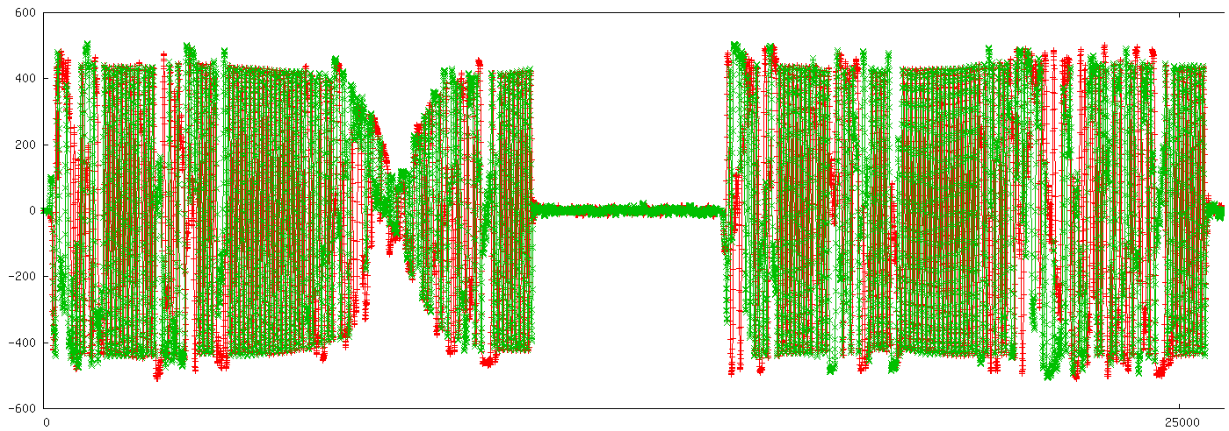
Effects of Fading Measured at Baseband
Good Packet
Faded Packet
Good Packet
Faded Packet

Slide 17
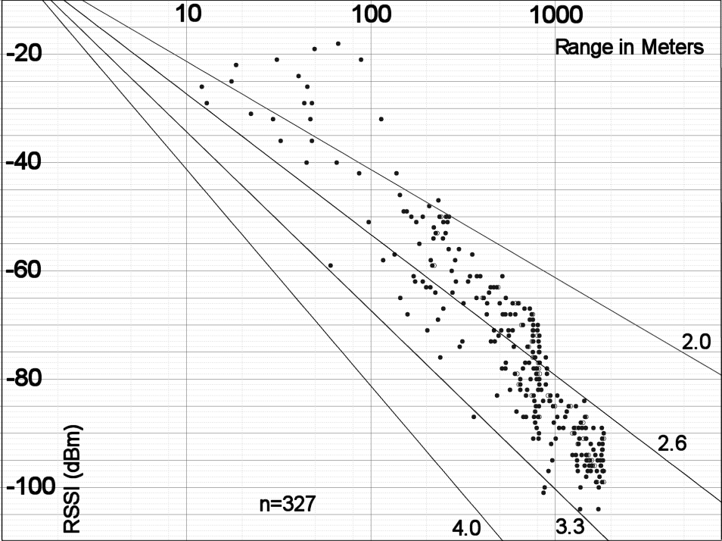
Measured 220 MHz Path Loss
Propagation model for 220 MHz band may need to consider path loss exponents of 2.6 to 3.2, to be on the safe side

Slide 18
Adaptive Schemes to Combat Fading
Multiple data rates
Different coding rates and interleavers
Different modulation methods
Existing well vetted examples include 802.11a/b/g/n, 802.16e, and many more

Slide 19
Questions?

