Slide 1
doc.: IEEE 15-12-0397-00-0led
Project: IEEE P802.15 Working Group for Wireless Personal Area Networks (WPANs)
Submission Title: [Technical Issues for LED Commercialization]
Date Submitted: [17 July, 2012]
Source: [Yeong Min Jang, Nirzhar Saha, Le Nam Tuan and Ratan Kumar Mondal, Jaesang Cha, Jinyoung Kim, Sangkook Han, S. O. Han]
[Kookmin University, Seoul National Univ. of Science & Tech., Kwangwoon University, Yonsei University, Korea Photonics Research Institute]
Address [Kookmin University, Seoul, Korea]
Voice:[82-2-910-5068], FAX: [82-2-910-5068], E-Mail:[yjang@kookmin.ac.kr]
Re: []
Abstract: [Technical Issues for LED Commercialization]
Purpose: [Contribution to IEEE 802.15 IG-LED]
Notice: This document has been prepared to assist the IEEE P802.15. It is offered as a basis for discussion and is not binding on the contributing individual(s) or organization(s). The material in this document is subject to change in form and content after further study. The contributor(s) reserve(s) the right to add, amend or withdraw material contained herein.
Release: The contributor acknowledges and accepts that this contribution becomes the property of IEEE and may be made publicly available by P802.15.
Notes:
doc.: IEEE 802.15-09-0117-00-0007
<month year>

Slide 2
Contents
doc.: IEEE 15-12-0278-00-wng0
Motivation for LED Commercialization
LED Market Trend
Applications of LED
Possible Standardization Directions for Commercialization
Current Status of LED Technology
Issues to be Considered for Commercialization
Conclusions

Slide 3
Motivation for LED Commercialization
The whole world is in energy crisis and moving towards
  Saving of energy
  Lowering of CO₂ content
  Protection of environment
  Save EARTH mission
  LED is such a “Green” technology provides
  Energy efficiency.
  Emunity from IR or UV.
  Directional lighting.
  Optical precision.
  Longer life.

Slide 4
Why LED ?
Lower energy consumption
  consumes only 20~ 30% of incandescent lamps, 50% of halogen lamps.
Longer life span
  50000 ~ 100000 hours (10-12 years)
Lower light decay
  A well managed LED light has less than 5% light decay after thousands of hours operation.
Environmental friendly
  No filament – No Gas - No Mercury - No UV rays - No Pb - No hazardous substance

Slide 5
Eye – protective
  LED lighting is free from strobe flash lighting that incandescent lamps and other lamps have.
High brightness
  A more vivid color of lighting, giving clearer images than low brightness lamps
Wide color Temperatures
  Warm white, Cool White, RGB, Ranging from 2700K – 7000K
Combination with renewable energy
  Wind power, Solar power – 100% Green technology to save earth

Slide 6
Applications of LED
doc.: IEEE 15-12-0278-00-wng0
Applications of LED
  Illumination
    Street lighting
    Indoor lighting
  Wireless Communication
    Fiber Optic Communication
    Visible light communication
    Indoor Navigation
  Sensor Applications
    LED-ID technology
    Medical Instrumentation
  Display
    Entertainment: Television, Mobile, Camera
    LED Digital Signage
  Automotive Uses
  Indication
    Security and household applications

Slide 7
Key Factors of LED Lighting
Constant Current Driver Technology
  Power factor
  Efficiency
  Stability in static current driving
Light Decay
  Maintenance of brightness at a longer period
Heat Dissipation
  Maintaining LED junction temperature at low to increase its lifespan
Cost
  To be economical in mass application

Slide 8
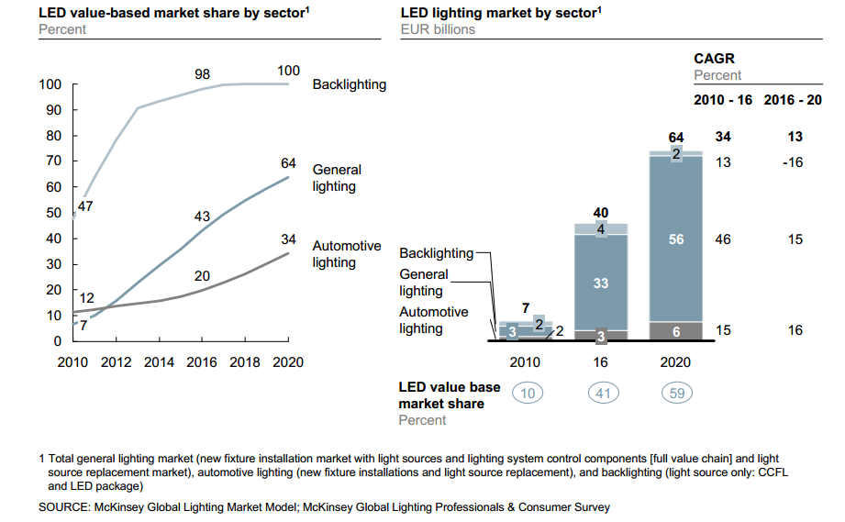
Market Trend (Current Situation)

Slide 9
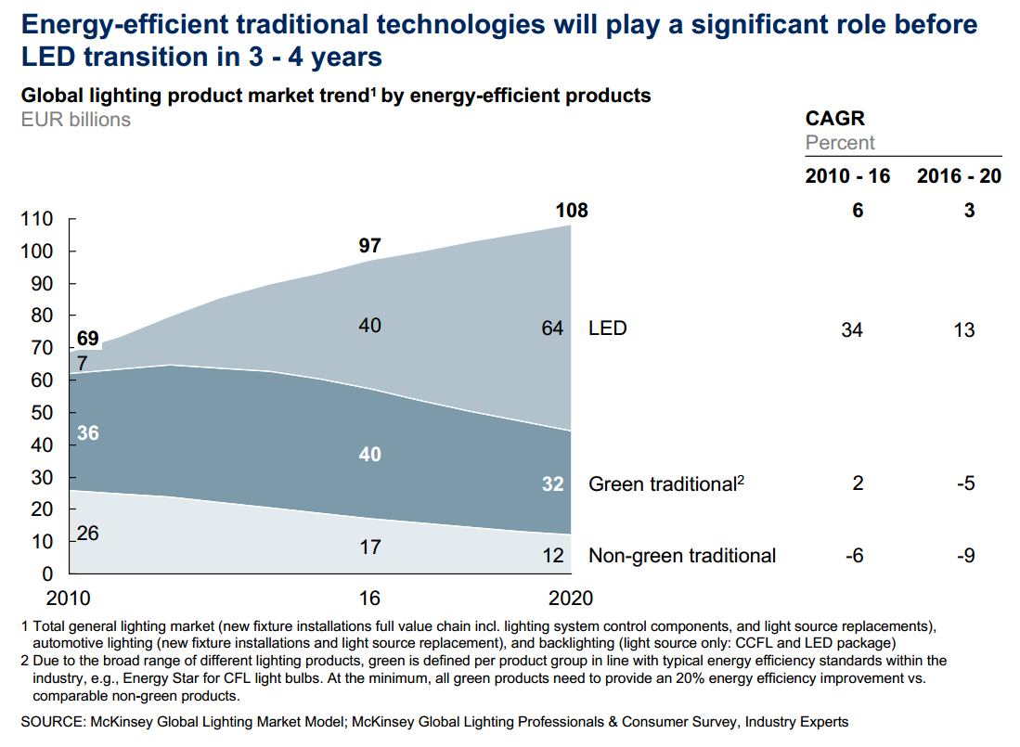
Market Trend (Future Prediction)

Slide 10
Current LED Technology
Currently white LED is using phosphor conversion(PC) technique.
  Colour characteristics may suffer from phosphor degradation or variable lumen depreciation.
Research is going on mixed system using combinations of red, green and blue(RGB).
  Higher theoretical maximum efficiency.
  Allow dynamic control of color.
  Suffers from poor color rendition properties.
  Require complex system for proper mixing of color.
  Hybrid systems which combine PC LEDs with red LEDs

Slide 11
Issues to be Considered for Commercialization
Require improvement of the following properties of LED.
  Accurate color rendition
    Fidelity
    Appeal
    Discrimination
  High correlated color temperature (CCT)
  Color Consistency (Uniformity) and Constancy (Stability) improvement for RGB LEDs.

Slide 12
PHY Layer for LED Communication
The PHY technology issues:
  RGB CDMA, Dimming control CDMA
  M-array/ VLC-OFDM
  Imaging sensor MIMO
  Watermarking
  Etc.

Slide 13
MAC Sub-layer for LED Communication
The MAC layer handles all access to the physical layer and is responsible for the following tasks:
  Generating network beacons if the device is a coordinator
  Synchronizing to network beacons
  Supporting VPAN association and disassociation
  Supporting color function
  Supporting visibility
  Supporting dimming
  Flicker removal scheme
  Supporting visual indication of device status and channel quality
  Supporting device security
  Providing a reliable link between two peer MAC entities
  Supporting mobility

Slide 14
MAC Layer for LED Communication
The MAC technology issues:
  Diversity, Cooperative and Relay communications
  Multi-channel broadcasting
  Cognitive radio MAC
  MAC for dynamic FOV
  Cooperation of device coordinators
  SON based integrated PLC and LED communications
  Etc.

Slide 15
Conclusions
doc.: IEEE 15-12-0278-00-wng0
Overviewed some technical issues about LED communication
LED is a promising technology for illumination, display, location, communication, and etc.
Some applications related commercial applications such as lighting device and smart device will be necessary.
A call for contribution in next meeting.

