Slide 1
doc.: IEEE 15-12-0396-00-0led
Project: IEEE P802.15 Working Group for Wireless Personal Area Networks (WPANs)
Submission Title: [Standardization Directions in IEEE802.15 IG-LED]
Date Submitted: [July, 2012]
Source: [Yeong Min Jang, Tuan Nguyen, and Vu Van Huynh]
[Kookmin University]
Address [Kookmin University, Seoul, Korea]
Voice:[82-2-910-5068], FAX: [82-2-910-5068], E-Mail:[yjang@kookmin.ac.kr]
Re: []
Abstract: [Standardization Directions in IEEE802.15 IG-LED]
Purpose: [Contribution to IEEE 802.15 IG-LED]
Notice: This document has been prepared to assist the IEEE P802.15. It is offered as a basis for discussion and is not binding on the contributing individual(s) or organization(s). The material in this document is subject to change in form and content after further study. The contributor(s) reserve(s) the right to add, amend or withdraw material contained herein.
Release: The contributor acknowledges and accepts that this contribution becomes the property of IEEE and may be made publicly available by P802.15.
Notes:
doc.: IEEE 802.15-09-0117-00-0007
<month year>

Slide 2
Contents
doc.: IEEE
Current Issues of IEEE802 IG-LED standardization
Promising Directions of IEEE802 IG-LED standardization
LED localization based on TDOA techniques
Deployment strategies for LED implementation
Conclusions

Slide 3
Current Issues of IG-LED
doc.: IEEE
commercial services of LED communications
implementation issues of LED communications
use cases of LED communications
applications for automobile, smart phone, and smart devices
applications for LBS
applications of indoor and outdoor LED for safety, orientation/positioning, and face-­to-face communication

Slide 4
Current Issues of IG-LED
doc.: IEEE
supporting multi-frame type
fast link switching
interference management
PHY and MAC issues: dynamic FOV, hidden terminal problems, and etc.
interworking issues
cooperative and relay network
low power LED sensor networks

Slide 5
Current Issues of IG-LED
doc.: IEEE
LED-ID and VLC-ID
hybrid RF and visible light: visible RFID (RFID+VLC), VLC+IR (infrared ray)
spectrum relief issues
visible light sensor networks with multi-sensors (dimming control, temperature control, context aware control, and etc.)
entertainment technology: lighting, color and sound control systems
LED engine

Slide 6
LED Localization based on TDOA Techniques
doc.: IEEE
Indoor positioning techniques:
Time Different of Arrival(TDOA)
Received Signal Strength Indication(RSSI)
Angle of Arrival(AOA)
Optical tracking
Magnetic tracking
Pseudolite
Multipath pattern

Slide 7
LED Localization based on TDOA Techniques
doc.: IEEE
Advantages of TDOA over other existing indoor positioning techniques:
High accuracy.
Low deployment and operation cost.
Consistent performance.
High scalability.
$$\left(x_{3},y_{3}\right)$$
$$\left(x_{2},y_{2}\right)$$
$$\left(x_{k},y_{k}\right)$$
$$\left(x_{1},y_{1}\right)$$

Slide 8
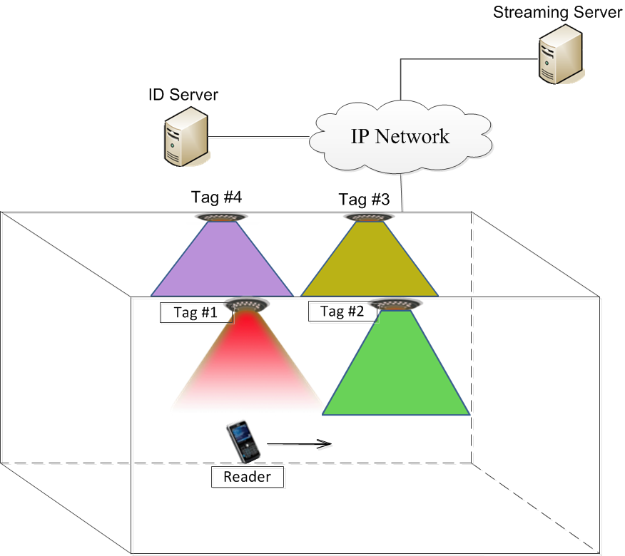
Deployment Strategies for LED Implementation
doc.: IEEE
Requirements for LED deployment:
Area-coverage.
Location-coverage.
Connectivity and energy efficiency.

Slide 9
Deployment Strategies for LED Implementation
doc.: IEEE
Deployment for area-coverage:
Each location within a field must be covered by at least a specific number of LED tags.
Two common solutions: random deployment and grid deployment.
Deployment for location-coverage:
LED tags have to be implemented to specific locations based on applications and usage density.
Manual deployment.

Slide 10
Conclusions
doc.: IEEE
LED communication is a promising indoor wireless communication technology.
A call for contribution in next meeting.

