Slide 1
Project: IEEE P802.15 Working Group for Wireless Personal Area Networks (WPANs)
Submission Title: [Review of IEEE 802.15.4 MAC Layer Power Save Mechanisms]
Date Submitted: [7/17/2012]
Source: [Chunhui (Allan) Zhu, Youngsoo Kim] Company [Samsung]
Address [75 W Plumeria Dr. San Jose, CA, USA]
Voice:[+408-544-2751], FAX: [+], E-Mail:[c.zhu@samsung.com]
Re: []
Abstract: [This presentation reviews the power saving mechanisms used by the current IEEE 802.15.4 MAC layer.]
Purpose: [To provide background information on the discussion regarding MAC layer power save improvements]
Notice: This document has been prepared to assist the IEEE P802.15. It is offered as a basis for discussion and is not binding on the contributing individual(s) or organization(s). The material in this document is subject to change in form and content after further study. The contributor(s) reserve(s) the right to add, amend or withdraw material contained herein.
Release: The contributor acknowledges and accepts that this contribution becomes the property of IEEE and may be made publicly available by P802.15.

Slide 2
Review of IEEE 802.15.4 MAC Layer Power Save Mechanisms
Chunhui (Allan) Zhu, Youngsoo Kim
Samsung Electronics Corp
July 17th, 2012

Slide 3
Abstract
This presentation targets at providing background information in order to facilitate the discussion on whether (or how much) further improvement on MAC layer power save is needed in the scope of 802.15.4q (ULP).

Slide 4
Table of Content
General approaches for power efficient MAC design
The basic power save mechanisms of 802.15.4
Low-energy mechanisms introduced by 802.15.4e
  CSL: coordinated sampled listening
  RIT: receiver initiated transmission

Slide 5
Undesired Power Consumptions at MAC
Source of Power Consumption | Solutions
Random access collision and the consequent retransmission | Minimize collision
Unnecessary idle listening (listen even when the sender is not transmitting) | Power the radio only when it needs to transmit or receive
Unnecessary overhearing (nodes receiving data frames that are not targeted at them) | Only let the targeted nodes wake up and receive, keep others sleeping
Management overhead | Reduce association time, channel acquisition time, etc.
Packet header overhead | Header compression, packet aggregation and etc.

Slide 6
Basic Power Save Mechanism of 802.15.4
The superframe structure and periodical beacons reduce unnecessary idle listening and overhearing
GTS reduces random access collision
Beacon-assisted data transmission
Light management overhead
Light packet header overhead

Slide 7
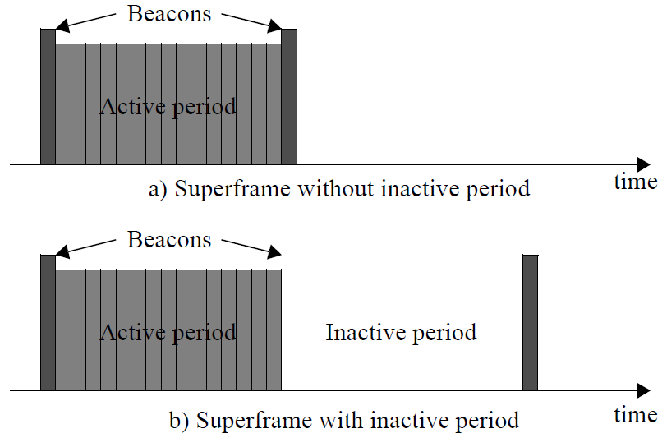
Superframe Structure (1)
The structure of the superframe is determined by the values of macBeaconOrder and macSuperframeOrder.
During the inactive period, the coordinator is able to enter sleep mode. Other devices, once synced with the coordinator, can also enter sleep mode during the inactive period.

Slide 8
Superframe Structure (2)
The relationship between Beacon Interval (BI) and Superframe Duration (SD) is as below
By setting appropriate Beacon Order (BO) and Superframe Order (SO), a coordinator can adjust the duration of the active period and inactive period.

Slide 9
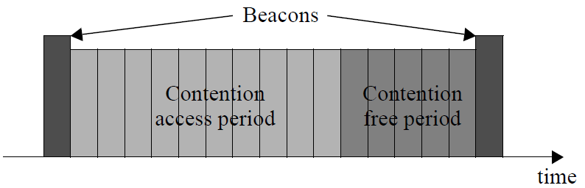
Guaranteed Time Slot (GTS)
At the end of a superframe, there can be up to 7 GTSs for contention-free channel access.
GTS benefits low-latency applications and applications requiring specific data bandwidth.
A GTS is allowed to occupy more than one slot period.

Slide 10
Beacon-assisted Data Transmission
Data transfer to a coordinator
  When a device wishes to transfer data to a coordinator listens for the network beacon.
  When the beacon is found, the device synchronizes to the superframe structure.
  At the appropriate time, the device transmits its data frame to the coordinator.
Data transfer from a coordinator
  When the coordinator wishes to transfer data to a device, it indicates in the network beacon that the data message is pending.
  The device periodically listens to the network beacon and, if a message is pending, transmits a MAC command requesting the data.
These two processes allow a device to remain in sleep mode until the next scheduled beacon transmission time.

Slide 11
Light Management Overhead
With simpler PHY and MAC comparing to 802.11, the management overhead of 802.15.4 is a lot lighter
  No QoS related functions, such as different user priorities and traffic streams
  No MIMO related functions, such as channel sounding

Slide 12
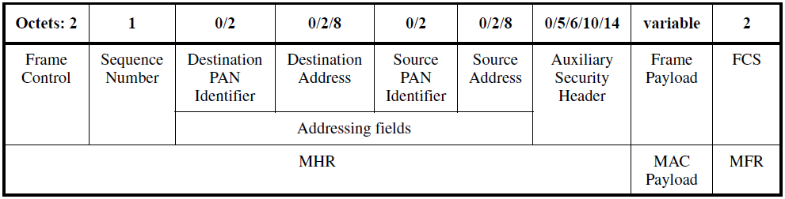
Light Frame Header Overhead
16-bit short addresses are used most of the time instead of 64-bit extended IEEE addresses
PAN ID compression - when the source and the destination are within the same PAN, the Source PAN ID can be saved (not transmitted)
Example:
  when transmitting in the same PAN using short addresses and without Auxiliary Security header, the MAC frame overhead is only 11 octets.

Slide 13
Low-energy mechanisms introduced by 802.15.4e
Coordinated Sampled Listening (CSL)
  Operates in the CAP in the beacon mode
  Suitable for applications with relatively low latency requirements, e.g. < 1 second
Receiver Initiated Transmission (RIT)
  Only operates in the non-beacon mode
  Suitable for low duty cycle, low traffic load type of applications with a high latency tolerance, e.g. tens of seconds.
CSL and RIT cannot be used at the same time
Both can be temporarily turned off (operate at 100% duty cycle)

Slide 14
Coordinated Sampled Listening
With CSL, the Beacon Interval is longer than the regular BI.
  Beacon frames are not transmitted in every beacon interval, but once in every beacon interval time macLowEnergySuperframeSyncInterval, except when requested to do so.
  This makes the duty cycle even lower than the original 802.15.4 where beacon is transmitted every beacon interval.
CSL was designed for a coordinator to transmit pending data frames to a sleeping device.

Slide 15
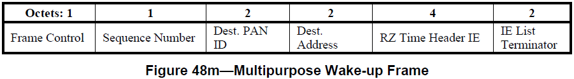
Multipurpose Wake-up frame
The LE Wake-up frame is a multipurpose frame containing an RZ Time header IE.
The LE Wake-up frame has no payload.
The Rendezvous Time (RZ Time) IE is 2 octets in length.
The RZ Time is the expected length of time in units of 10 symbols between the end of the transmission of the wakeup frame and the beginning of the transmission of the payload frame.
The RZ Time shall be set by the next higher layer when requesting the MAC sublayer to transmit.
The last wakeup frame in a wakeup sequence shall have RZ Time set to the value zero.

Slide 16
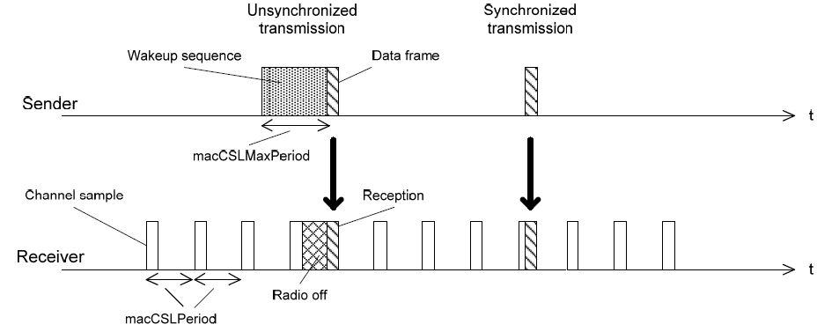
Basic CSL Operations
Back-to-back (many) wakeup frames
macCSLPeriod : CSL sampled listening period in unit of 10 symbols. 0 means always listening, i.e., CSL off.
macCSLMaxPeriod: Maximum CSL sampled listening period in unit of 10 symbols in the entire PAN. This determines the length of the wakeup sequence when communicating to a device whose CSL listen period is unknown. NHL may set this attribute to 0 to stop sending wakeup sequences with proper coordination with neighboring devices.

Slide 17
Receiver Initiated Transmission
RIT is an alternative low energy MAC for non-beacon-enabled PAN (BO=15).
RIT mode
  is turned on when macRITPeriod is set to non-zero
  is turned off when macRITPeriod is set to zero.
macCSLPeriod and macRITPeriod shall not be nonzero at the same time.
  This means CSL and RIT cannot be used at the same time.

Slide 18
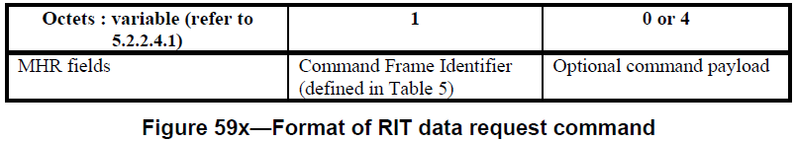
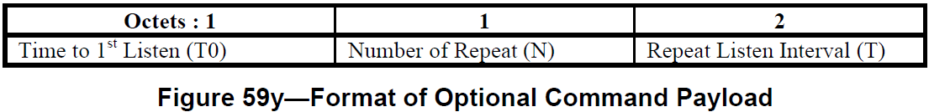
RIT Data Request Command
Allows a device to request data from its neighboring devices in the RIT mode.
Shall only be sent and received by a device supporting RIT mode.
Optional and applicable for FFD only.

Slide 19
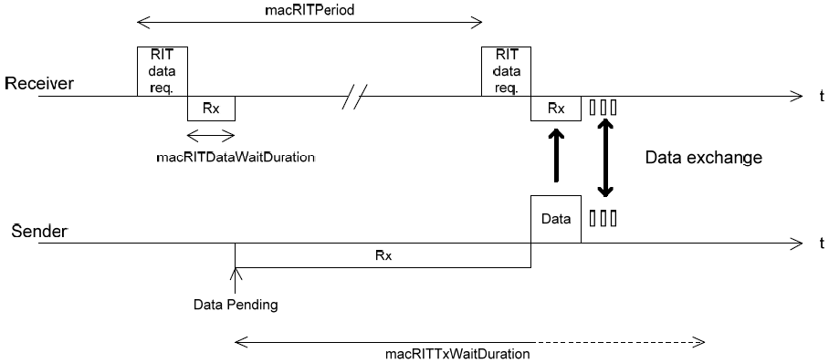
Basic RIT Operations
The Sender turns on the receiver and wait for the incoming RIT data req.
The Sender missed the first RIT data req

Slide 20
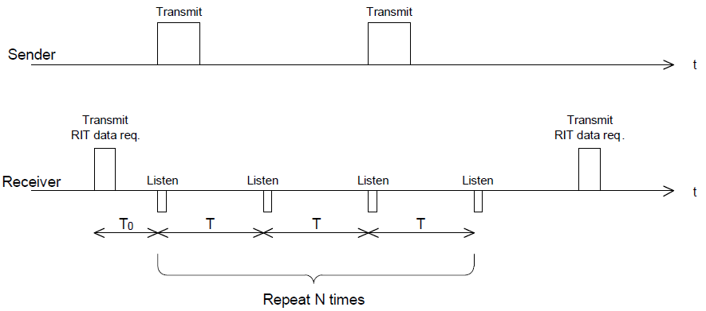
RIT Operations when DataReq Carries Schedule Information

Slide 21
Summary
The original 802.15.4 MAC layer protocol (before 15.4e) provides very good power efficiency.
The newly introduced CSL and RIT mechanisms improves power efficiency for applications with even lower duty cycles, for beacon-enabled and non-beacon-enabled PANs respectively.

