Slide 1
Project: IEEE P802.15 Working Group for Wireless Personal Area Networks (WPANs)
Submission Title: A Limitation of Coin Cell Batteries
Date Submitted: July 2012
Source: : Shahriar Emami, Samsung
E-Mail: [Shahriar.e@samsung.com]
Re:
Abstract: Describes limitation of coin cell batteries
Purpose: ULP related information
Notice: This document has been prepared to assist the IEEE P802.15. It is offered as a basis for discussion and is not binding on the contributing individual(s) or organization(s). The material in this document is subject to change in form and content after further study. The contributor(s) reserve(s) the right to add, amend or withdraw material contained herein.
Release: The contributor acknowledges and accepts that this contribution becomes the property of IEEE and may be made publicly available by P802.15.

Slide 2
A Limitation of Coin Cell Batteries
July 2012

Slide 3
Smaller Form Factor
Sensor nodes can have a smaller form factor if they use coin cell batteries

Slide 4
Coin cell Batteries
CR1025, CR1216, CR1220, CR1225,
CR1616,CR1620, CR1632, CR2012,
CR2016, CR2025, CR2032, CR2320,
CR2325, CR2330, CR2354, CR2430,
CR2450, CR2477, CR3032, CR11108
- Used in many applications
Available from many vendors
Relatively inexpensive

Slide 5
Chemistry
Silver Oxide
Lithium Manganese dioxide (LiMnO₂)
Lithium/carbon monofluoride
Alkaline

Slide 6
Coin Cell Battery Specs
IEC Name Voltage (v) Capacity (mAh) Dimensions (mm) Weight (g)
CR2025 3 160 20x2.5 2.5
CR2032 3 225 20x3.2 3
CR1632 3 140 16x3.2 1.6
CR2330 3 265 23x3.0 4
CR2430 3 270 24.5x3.0 4.2
CR3032 3 500 30x3.2 8

Slide 7
Max Operating Current (Pulse)
CR1025 5mA
CR1212, CR1216, CR1220, CR1225 5mA
CR1616, CR1620, CR1625 8 mA
CR1632, CR2016 10 mA
CR2450, CR 2477 15 mA

Slide 8
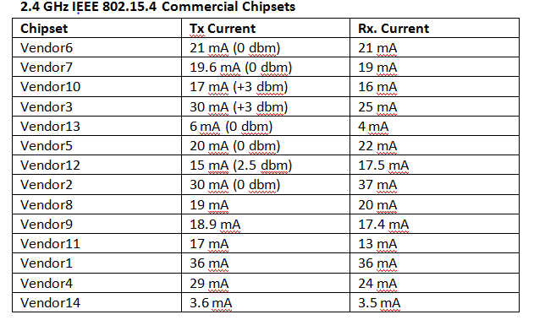
Commercial Chipsets

Slide 9
Summary
To support a small form factor for WSN, one can utilize coin cell batteries
Coin cell batteries have a max operating current
The max operating current of most coin cells is below tx/rx of most 802.15.4 chipsets
Only a couple of the existing 802.15.4 chipsets can utilize coin cell batteries
Most existing 802.15.4 chipsets can not utilize coin cell batteries

Slide 10
References
[1] N. M. Pletcher, S. Gambini and J. Rabaey, “A 52 micro-W Wake-Up Receiver With -72 dBm Sensitivity Using an Uncertain-IF Architecture,” IEEE Journal of Solid-State Circuits, vol. 44, no. 1, Jan. 2009.
[2] F. X. Moncunill-Geniz, P. Palà-Schönwälder, and O. Mas-Casals, “A generic approach to the theory of super regenerative reception,”IEEE Trans. Circuits Syst. I, vol. 52, no. 1, pp. 54–70, Jan. 2005.
[3] <http://www.jpier.org/PIERB/pierb12/12.08122303.pdf> >.
[4] <http://www.ti.com/lit/ds/symlink/cc2520.pdf>.
[5] <http://www.freescale.com/files/rf_if/doc/data_sheet/MC13192.pdf>.
[6] <http://www.scantec.de/uploads/media/JN-DS-JN5148-1v2.pdf>.
[7] <http://www.microbattery.com/micro-batteries.htm>.
[8] <http://www.aliexpress.com/fm-store/206421/210983097-443224029/3-0V-CR2032-CR2025-CR1220-CR1620-CR2477-CR2450-CR2016-Lithium-Button-cell-battery.html>.
[9] <http://www.eemb.com/Li-MnO2_battery.html>.
[10] N. Stanic, A. Balankutty, P. R. Kinget and Y. Tsivids,”A 2.4-GHz ISM-band sliding-IF receiver
with a 0.5-V supply,” IEEE Journal of solid-state circuits, vol. 43, no. 5, May 2008.

