Slide 1
Project: IEEE P802.15 Working Group for Wireless Personal Area Networks (WPANs)
Submission Title: [Technical requirements for ULP Sensor applications]
Date Submitted: [7/17/2012]
Source: [Kiran Bynam, Sandhya Patil, Chunhui (Allan) Zhu, Youngsoo Kim] Company [Samsung]
Address [Samsung India Software Operation, Bagmane Tech Park, Bangalore]
Voice:[+91-9986154930], FAX: [+], E-Mail:[kiran.bynam@samsung.com]
Re: []
Abstract: [This presentation examines requirements of potential applications of Ultra Low Power wireless sensors]
Purpose: [To initiate the discussion on the applications of Ultra Low Power wireless sensors]
Notice: This document has been prepared to assist the IEEE P802.15. It is offered as a basis for discussion and is not binding on the contributing individual(s) or organization(s). The material in this document is subject to change in form and content after further study. The contributor(s) reserve(s) the right to add, amend or withdraw material contained herein.
Release: The contributor acknowledges and accepts that this contribution becomes the property of IEEE and may be made publicly available by P802.15.

Slide 2
Application technical requirements for ULP SG
Kiran Bynam, Sandhya Patil, Allan Zhu, Youngsoo kim

Slide 3
Objective
To define the tech requirements of applications for ULP sensor networks
To enable the PAR discussions and drafting by defining the range and data rate requirements for ULP applications operating in 2.4 GHz spectrum

Slide 4
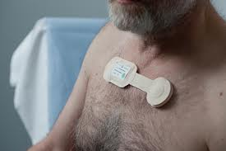
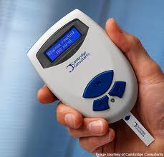
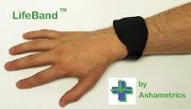
Health applications
Short range,periodic, non-continuous(< 5m)
Personal health montiroing, Glucose meters, single node ECG sensor, BP monitor, asthma monitor
Periodicity of less than 10 times a day
Data rates typically upto 20 kbps
Short range, continuous( < 5 m)
ECG sensor, EEG sensor applications,
Data rate goes upto 1 Mbps
Relatively long range(> 10 m)
Elderly personnel, alzheimers patient montiroing
Periodicity of once in 10 seconds
Data rates < 10 kbps

Slide 5
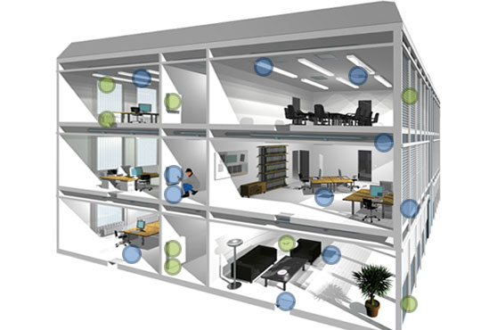
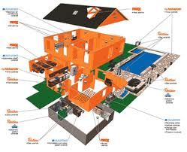
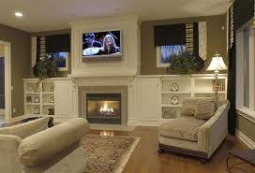
Home Automation applications
Building automation (upto 100 m Range)
Ligting, HVAC sensors
Low periodicity, event based, few times an hour
Data rates as low as 10 kbps
Home level automation(< 15 m)
Windows , doors automation
Data rates less than 10 kbps

Slide 6
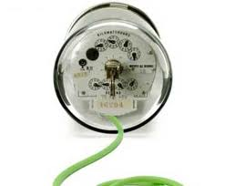
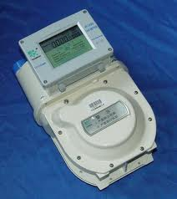
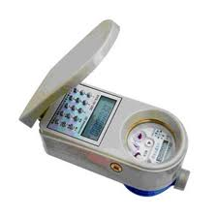
Smart Utility applications
Smart Gas , water meter applications
Typical range upto 50 m
Data rates less than 10 kbps
Periodicity of once in a day
Applications like Smart water meter, Gas meters etc

Slide 7
Inventory and Retail management
Large scale inventory management
Range greater than 100 m
Helps in monitoring the stock /inventory on timely basis
Thousands of sensors
Each node requires < 40 bytes
Aggregate data rate within 320 Kbps for 1000 nodes
Retail management (< 5 m)
Regular purchase/sale and stock monitoring
Poll based
Data rates less than 10 kbps

Slide 8
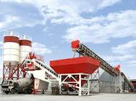
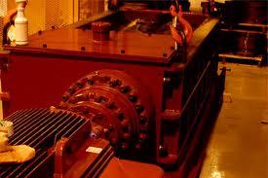
Industrial monitoring
Typically large network of sensors
Periodic monitoring, event driven monitoring of sensors required
Periodicity can range from few sec to few times in a day
hundreds of sensors in network with data rate requirement as low as 40 bytes in 10 seconds
Data rates required are less than 100 kbps for 1000 nodes

Slide 9
Telecom Service
Low data rate , Low range mobile applications
secure mobile payments zone billing, mobile office access control, payments.
Majorly a peer-peer type of network
Range less than 2 m
Data rates upto 100 kbps
High data rate applications
Mobile gaming, peer-to-peer data-sharing services
Data rates upto 1 Mbps
Link Range upto 10 m
Information Delivery (charged)

Slide 10
Co-existence of applications
The cross domain application co-existence is not required
Some applications in the same domain may co-exist
Health( ECG sensors, Glucometer etc)
Home automation ( PDA control of home devices, consumer equipment)
But, the data rates of such applications are much less than 100 kbps
Data rate requirement could be limited to the maximum data rate of the majority of applications

Slide 11
Applications summary
Application domain | Data rate | Range | Number of nodes | ULP Requirement
Health (gluco meters, single node ECG sensor, patient monitoring) | upto 20 kbps | 10 m | 10 | High
Health(ECG, EEG) | Upto 1 Mbps | 5 m | 15 | Moderate
Home Automation | Upto 10 Kbps | 15 - 100 m | 10 | Moderate
Inventory management | Upto 320 Kbps | 100 m | 1000 | High
Industrial monitoring | Upto 100 kbps | 100 m | 1000 | High
Telecom service | Upto 1 Mbps | 15 m | 1 | Moderate

Slide 12
Min and Maximum data rates
Minimum data rate of around 200 kbps
Minimum Bandwidth requirements will make very less data rate (< 100 kbps) not energy efficient
Balance for throughput and power as higher data rate involves increase in transmit power
Maximum data rate of 1 Mbps
Primarily limited by aplications

Slide 13
Conclusion
Typical Range requirement
upto15 m as mandatory
Scalable upto 100 m
Typical data rate requirements
Minimum of 200 kbps
Is low enough to achieve the range of 30 m
Scalability upto 1 Mbps
To accommodate the applications like health, telecom applications with higher data rates
Having more data rate required helps in reducing the duty cycle

