Slide 1
Project: IEEE P802.15 Working Group for Wireless Personal Area Networks (WPANs)
Submission Title: Spectra and bandwidth overhead with and without filtering for TG4m OFDM
Date Submitted: July 15, 2012
Source: Soo-Young Chang (CSUS) and Cristina Seibert (Silver Spring Networks)
Voice: +1 530 574 2741, E-mail: sychang@ecs.csus.edu
Re: [802.15.4m]
Abstract: Raised cosine filters are examined for OFDM signals to meet the regulatory spectral requirements of white space bands through real data simulations for four proposed OFDM options.
Purpose: To provide information on filtering OFDM signals to the 802.15 TG4m group
Notice: This document has been prepared to assist the IEEE P802.15. It is offered as a basis for discussion and is not binding on the contributing individual(s) or organization(s). The material in this document is subject to change in form and content after further study. The contributor(s) reserve(s) the right to add, amend or withdraw material contained herein.
Release: The contributor acknowledges and accepts that this contribution becomes the property of IEEE and may be made publicly available by P802.15.

Slide 2
Spectra and bandwidth overhead with and without filtering for TG4m OFDM
Soo-Young Chang
July 15, 2012

Slide 3
SUMMARY OF PROPOSED TG4m OFDM PARAMETERS *
Subcarrier spacing
(10416 and 2/3) Hz or (31250/3) Hz
OFDM symbol rate
(8 and 1/3) ksymbol/s, which corresponds (4/5)x(31250/3) or 120 μs per symbol
a quarter-duration cyclic prefix (CP; 24 μs) + a base symbol (96 μs)
Four OFDM options
parameter | Option 1 | Option 2 | Option 3 | Option 4
Channel spacing (kHz) | 1200 | 600 | 400 | 200
Nominal bandwidth (kHz) | 1094 | 552 | 281 | 156
DFT size | 128 | 64 | 32 | 16
modulation | BPSK, QPSK, 16QAM | BPSK, QPSK, 16QAM | BPSK, QPSK, 16QAM | BPSK, QPSK, 16QAM
* 15-12-0338-00-004m-phy-proposal-for-tg4m

Slide 4
OFDM SPECTRAL SHAPES WITHOUT FILTERING

Slide 5
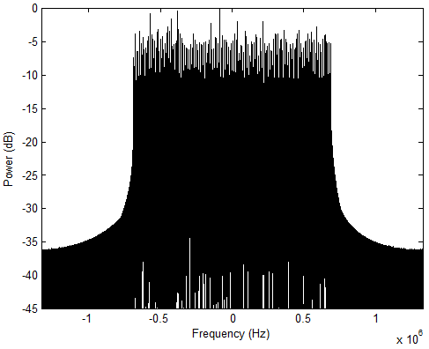
SPECTRUM WITHOUT FILTERING, 128 SUBCARRIERS (OPTION 1)

Slide 6
SPECTRUM WITHOUT FILTERING, 64 SUBCARRIERS (OPTION 2)

Slide 7
SPECTRUM WITHOUT FILTERING, 32 SUBCARRIERS (OPTION 3)

Slide 8
SPECTRUM WITHOUT FILTERING, 16 SUBCARRIERS (OPTION 4)

Slide 9
BANDWIDTH OVERHEAD ANALYSIS WITHOUT FILTERING
No. of Subcarriers | Total bandwidth Use (MHz) | Guard band needed at each side of TV band (MHz)
128 (Option 1) | 23.3 | 10.9
64 (Option 2) | 16.2 | 8.1
32 (Option 3) | 6.7 | 3.2
16 (Option 4) | 4.5 | 2.2
OFDM signals without filtering do not meet the out-of-band (OOB) -55dB requirement (unless we allow impractical amount of bandwidth overhead).
We need filtering (or pulse shaping) to filter out the out-of-band components.

Slide 10
OFDM SPECTRAL SHAPES WITH Raised cosine filtering FOR VARIOUS ROLLOFF FACTORS

Slide 11
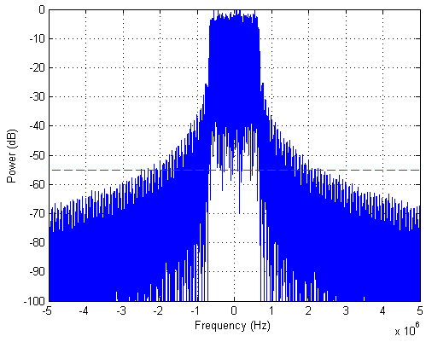
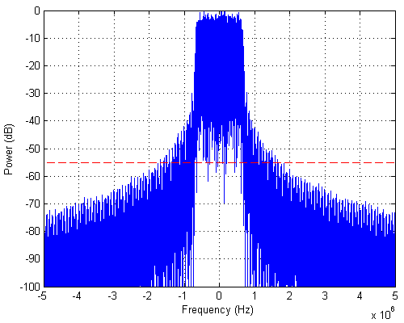
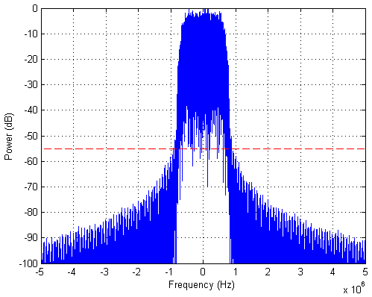
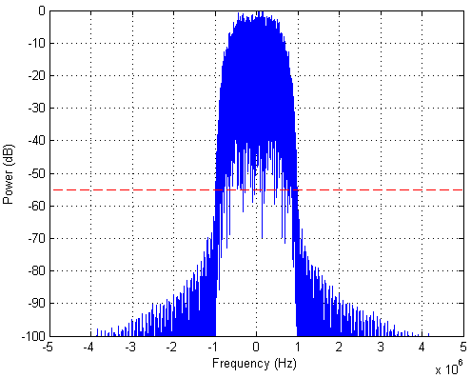
SPECRUM WITH FILTERING, OPTION 1
rolloff=0
rolloff=0.1
Filter order of 256
rolloff=0.25
rolloff=0.5
* Filter order of 256

Slide 12
BANDWIDTH OVERHEAD ANALYSIS FOR VARIOUS ROLLOFF FACTORS (1)
No. of subcarriers | Rolloff factor | Total bandwidth Use (MHz) | Guard band needed at each side of TV band (MHz)
128 (Option 1) | 0 | 4.10 | 1.51
 | 0.1 | 2.75 | 0.83
 | 0.25 | 1.58 | 0.25
 | 0.5 | 1.61 | 0.26
 | 1 | 2.13 | 0.52
64 (Option 2) | 0 | 1.64 | 0.55
 | 0.1 | 1.30 | 0.38
 | 0.25 | 0.79 | 0.12
 | 0.5 | 0.80 | 0.13
 | 1 | 1.04 | 0.25
* Filter order of 256

Slide 13
BANDWIDTH OVERHEAD ANALYSIS FOR VARIOUS ROLLOFF FACTORS (2)
No. of subcarriers | Roll off factor | Total bandwidth Use (MHz) | Guard band needed at each side of TV band (MHz)
32 (Option 3) | 0 | 0.98 | 0.36
 | 0.1 | 0.69 | 0.21
 | 0.25 | 0.38 | 0.06
 | 0.5 | 0.40 | 0.07
 | 1 | 0.52 | 0.13
16 (Option 4) | 0 | 0.48 | 0.17
 | 0.1 | 0.36 | 0.11
 | 0.25 | 0.27 | 0.07
 | 0.5 | 0.20 | 0.03
 | 1 | 0.26 | 0.06
* Filter order of 256

Slide 14
BANDWIDTH OVERHEAD ANALYSIS FOR VARIOUS ROLLOFF FACTORS (3)
Option 1
Bandwidth overhead (MHz)
1.0
Option 2
Option 3
0.75
Option 4
0.5
0.25
0
0.1
0.25
0.5
1.0
Rolloff factor

Slide 15
BANDWIDTH OVERHEAD ANALYSIS FOR VARIOUS ROLLOFF FACTORS (4)
Observations regarding bandwidth and height of skirts of spectra
The width of the required band increases as roll-off increases - the relationship should be proportional to (1 + rolloff).
The height of the skirts outside the main lobe of the band decreases as rolloff increases .
Control of rolloff factors is a very useful way to adjust the out-of-band attenuation, in addition to that of filter orders.

Slide 16
OFDM SPECTRAL SHAPES WITH Raised cosine filtering FOR COMBINATIONS OF ROLLOFF FACTORS AND FILTER ORDERS

Slide 17
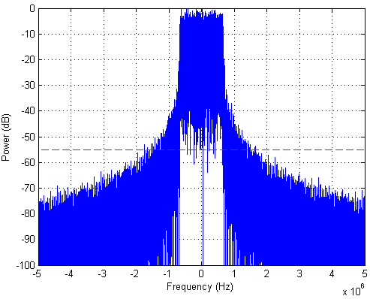
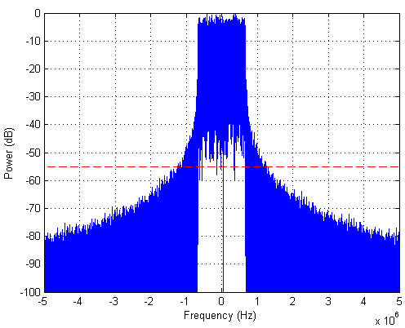
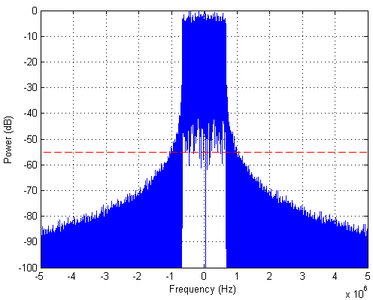
SPECTRUM WITH FILTERING, 128 SUBCARRIERS ROLLOFF OF 0
Filter order=256
Filter order=512
Option 1
Filter order=1024
Filter order=2048

Slide 18
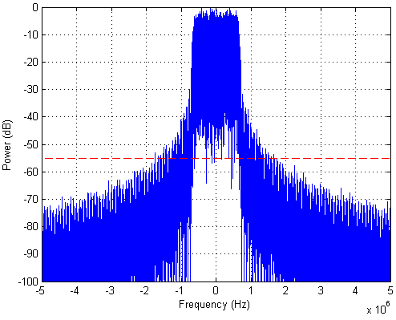
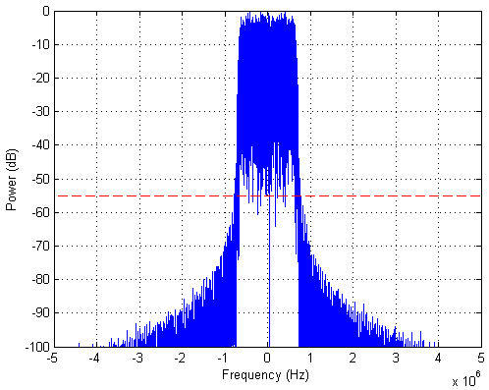
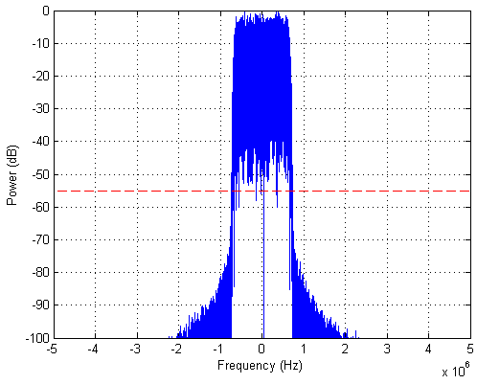
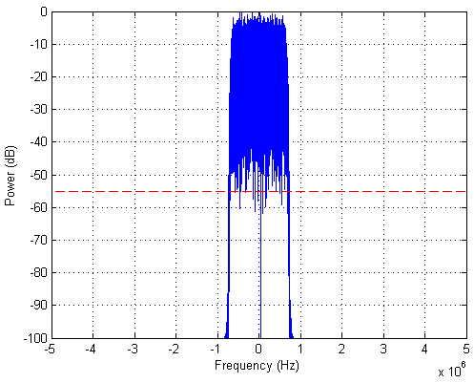
SPECTRUM WITH FILTERING, 128 SUBCARRIERS ROLLOFF OF 0.1
Filter order=256
Filter order=512
Option 1
Filter order=1024
Filter order=2048

Slide 19
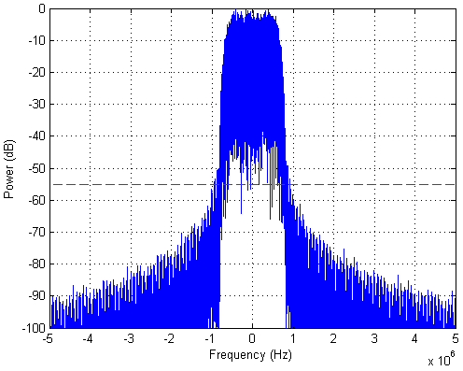
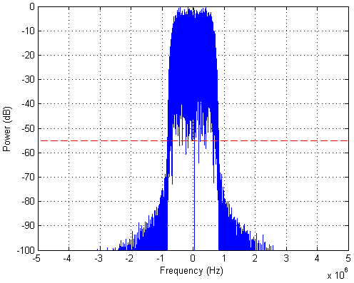
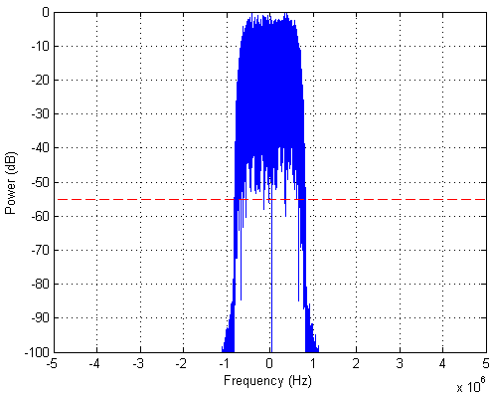
SPECTRUM WITH FILTERING, 128 SUBCARRIERS ROLLOFF OF 0.25
Filter order=256
Filter order=512
Option 1
Filter order=1024
Filter order=2048

Slide 20
BANDWIDTH OVERHEAD ANALYSIS FOR VARIOUS FILTER ORDERS, OPTION 1 (1)
Rolloff factor | Filter order | Total bandwidth Use (MHz) | Guard band needed at each side of TV band (MHz)
0 | 256 | 3.85 | 1.38
 | 512 | 2.87 | 0.89
 | 1024 | 2.05 | 0.48
 | 2048 | 1.72 | 0.32
0.1 | 256 | 2.87 | 0.89
 | 512 | 1.28 | 0.10
 | 1024 | 1.20 | 0.06
 | 2048 | 1.19 | 0.05
0.25 | 256 | 1.54 | 0.23
 | 512 | 1.35 | 0.13
 | 1024 | 1.34 | 0.12
 | 2048 | 1.34 | 0.12

Slide 21
BANDWIDTH OVERHEAD ANALYSIS FOR VARIOUS FILTER ORDERS, OPTION 1 (2)
Rolloff: 0
Bandwidth overhead (MHz)
1.0
Rolloff: 0.1
Rolloff: 0.25
0.75
0.5
0.25
0
500
1000
1500
2000
Filter order

Slide 22
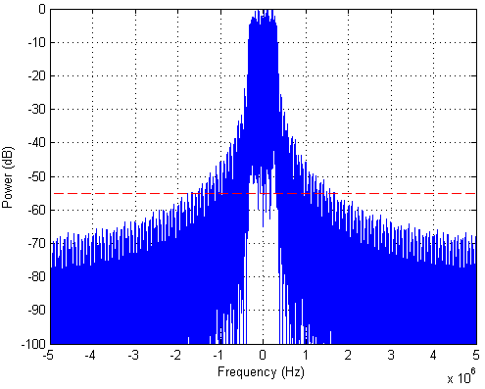
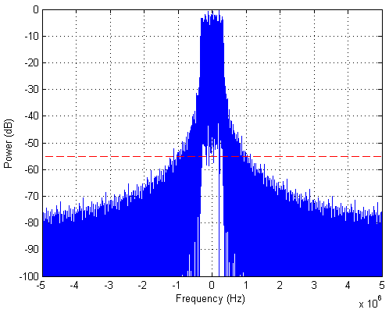
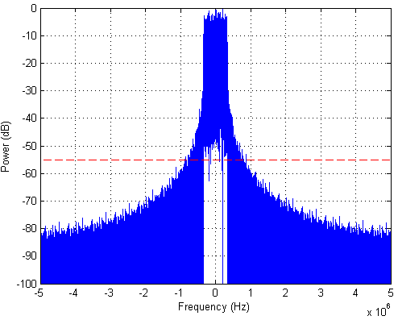
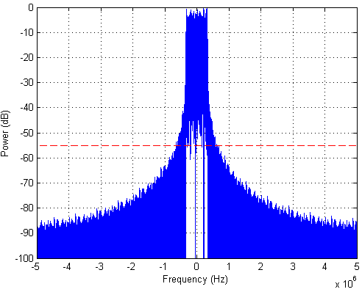
SPECTRUM WITH FILTERING, 64 SUBCARRIERS ROLLOFF OF 0
Filter order=128
Filter order=256
Option 2
Filter order=512
Filter order=1024

Slide 23
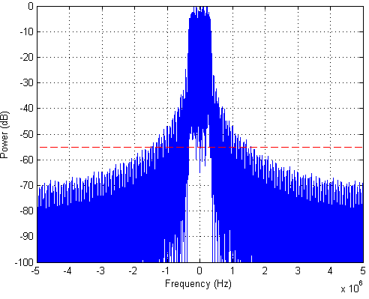
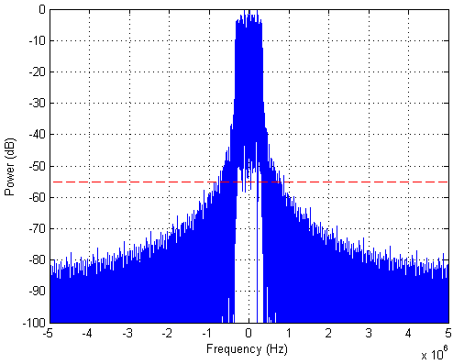
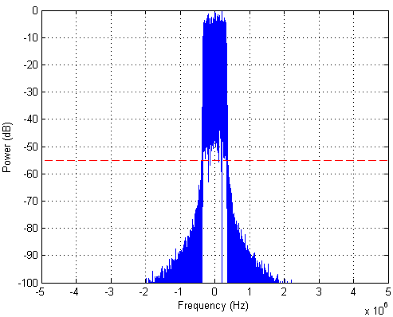
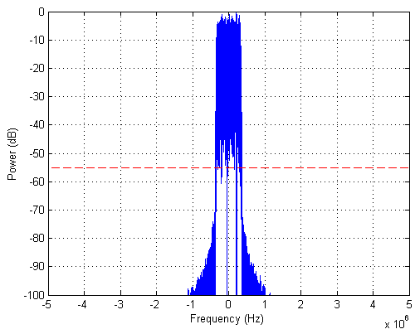
SPECTRUM WITH FILTERING, 64 SUBCARRIERS ROLLOFF OF 0.1
Filter order=128
Filter order=256
Option 2
Filter order=512
Filter order=1024

Slide 24
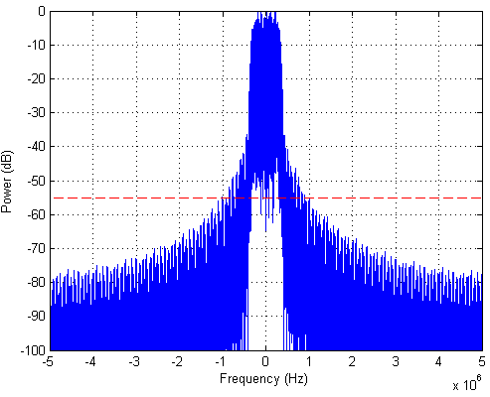
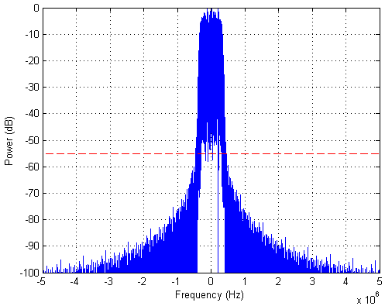
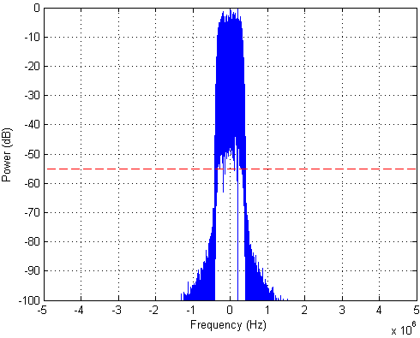
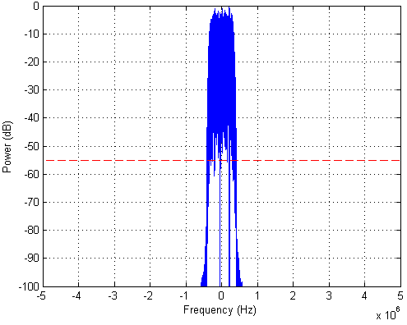
SPECTRUM WITH FILTERING, 64 SUBCARRIERS ROLLOFF OF 0.25
Filter order=128
Filter order=256
Option 2
Filter order=512
Filter order=1024

Slide 25
BANDWIDTH OVERHEAD ANALYSIS FOR VARIOUS FILTER ORDERS, OPTION 2 (1)
Rolloff factor | Filter order | Total bandwidth Use (MHz) | Guard band needed at each side of TV band (MHz)
0 | 128 | 2.76 | 1.11
 | 256 | 1.85 | 0.65
 | 512 | 1.39 | 0.42
 | 1024 | 1.07 | 0.26
0.1 | 128 | 2.71 | 1.08
 | 256 | 1.25 | 0.35
 | 512 | 0.62 | 0.04
 | 1024 | 0.60 | 0.03
0.25 | 128 | 1.64 | 0.55
 | 256 | 0.85 | 0.15
 | 512 | 0.67 | 0.06
 | 1024 | 0.67 | 0.06

Slide 26
BANDWIDTH OVERHEAD ANALYSIS FOR VARIOUS FILTER ORDERS, OPTION 2 (2)
Rolloff: 0
Bandwidth overhead (MHz)
1.0
Rolloff: 0.1
Rolloff: 0.25
0.75
0.5
0.25
0
250
500
750
1000
Filter order

Slide 27
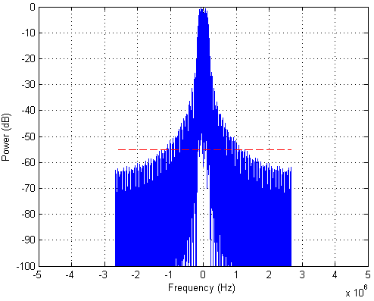
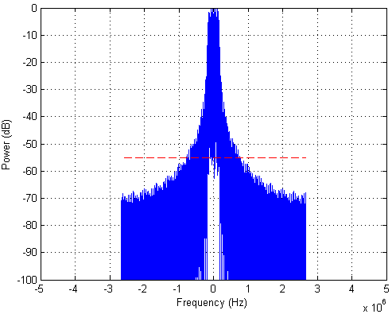
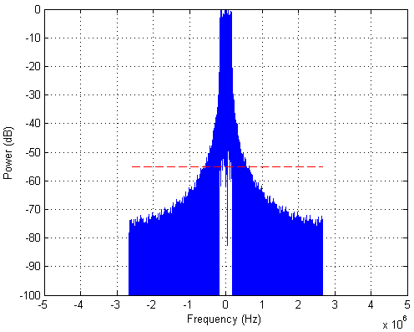
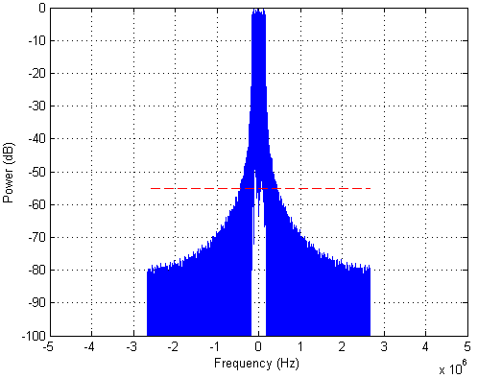
SPECTRUM WITH FILTERING, 32 SUBCARRIERS ROLLOFF OF 0
Filter order=64
Filter order=128
Option 3
Filter order=256
Filter order=512

Slide 28
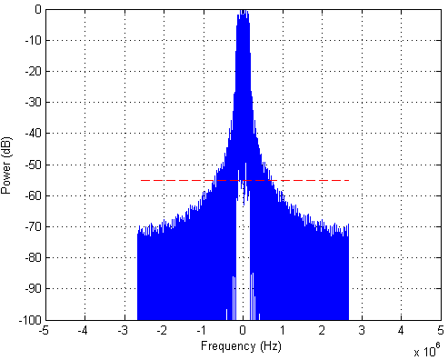
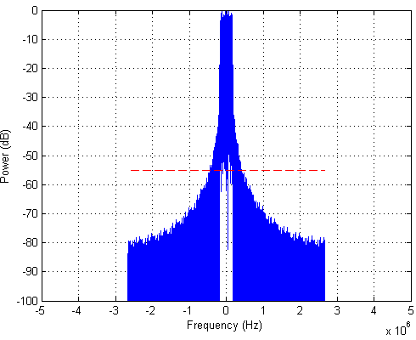
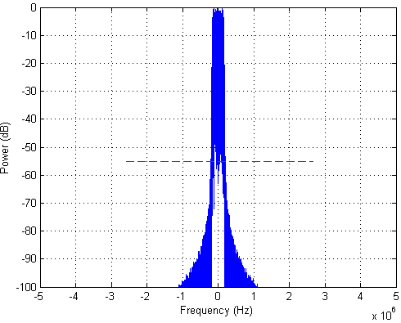
SPECTRUM WITH FILTERING, 32 SUBCARRIERS ROLLOFF OF 0.1
Filter order=64
Filter order=128
Option 3
Filter order=256
Filter order=512

Slide 29
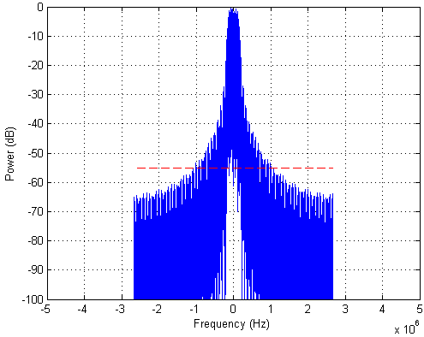
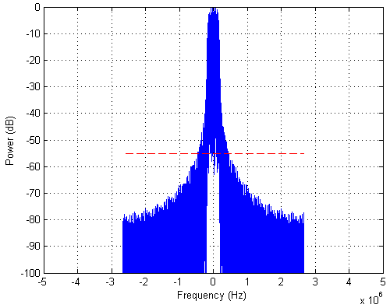
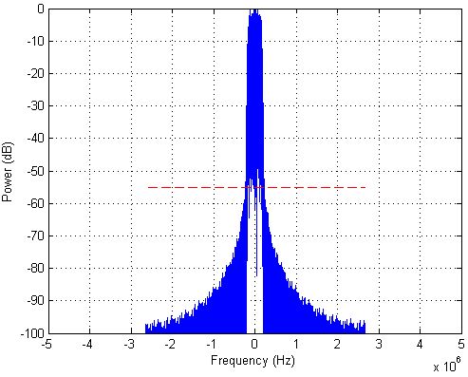
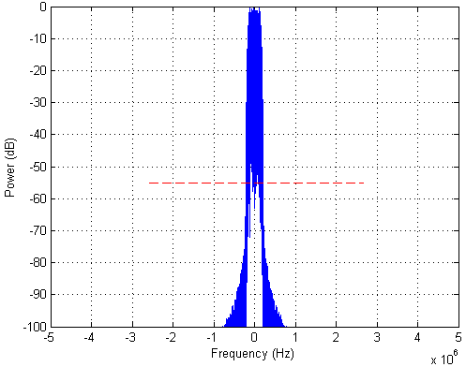
SPECTRUM WITH FILTERING, 32 SUBCARRIERS ROLLOFF OF 0.25
Filter order=64
Filter order=128
Option 3
Filter order=256
Filter order=512

Slide 30
BANDWIDTH OVERHEAD ANALYSIS FOR VARIOUS FILTER ORDERS, OPTION 3 (1)
Rolloff factor | Filter order | Total bandwidth Use (MHz) | Guard band needed at each side of TV band (MHz)
0 | 64 | 1.80 | 0.77
 | 128 | 1.30 | 0.52
 | 256 | 0.98 | 0.36
 | 512 | 0.72 | 0.23
0.1 | 64 | 1.80 | 0.77
 | 128 | 1.16 | 0.45
 | 256 | 0.72 | 0.23
 | 512 | 0.33 | 0.03
0.25 | 64 | 1.67 | 0.70
 | 128 | 0.75 | 0.24
 | 256 | 0.36 | 0.05
 | 512 | 0.34 | 0.04

Slide 31
BANDWIDTH OVERHEAD ANALYSIS FOR VARIOUS FILTER ORDERS, OPTION 3 (2)
Rolloff: 0
Bandwidth overhead (MHz)
1.0
Rolloff: 0.1
Rolloff: 0.25
0.75
0.50
0.25
0
125
250
375
500
Filter order

Slide 32
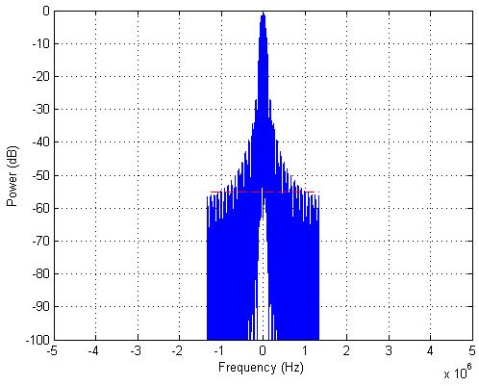
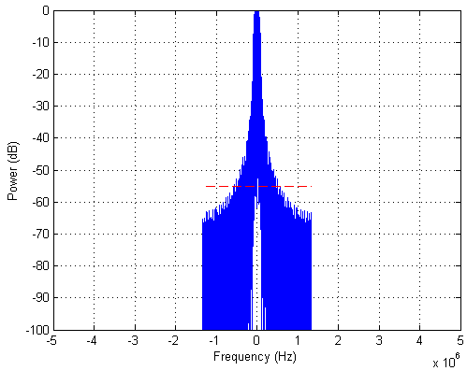
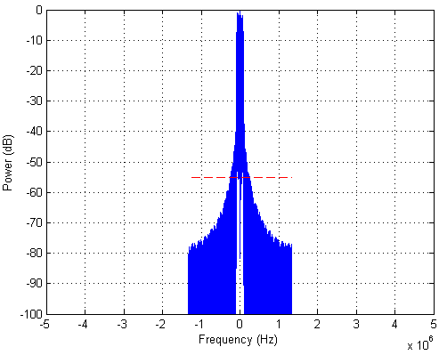
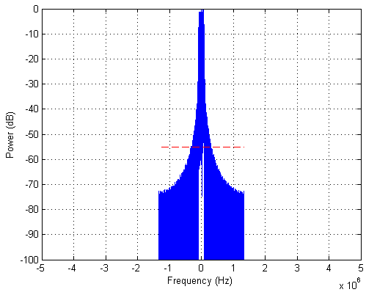
SPECTRUM WITH FILTERING, 16 SUBCARRIERS ROLLOFF OF 0
Filter order=32
Filter order=64
Option 4
Filter order=128
Filter order=256

Slide 33
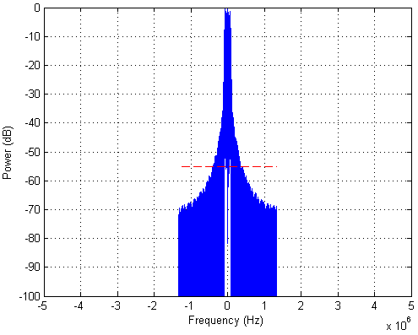
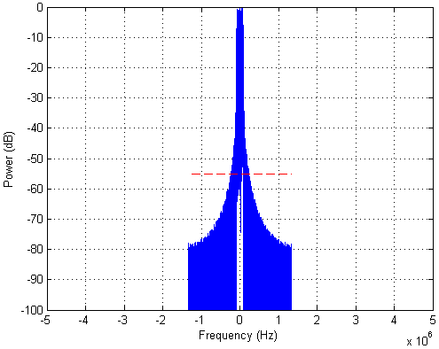
SPECTRUM WITH FILTERING, 16 SUBCARRIERS ROLLOFF OF 0.1
Filter order=32
Filter order=64
Option 4
Filter order=128
Filter order=256

Slide 34
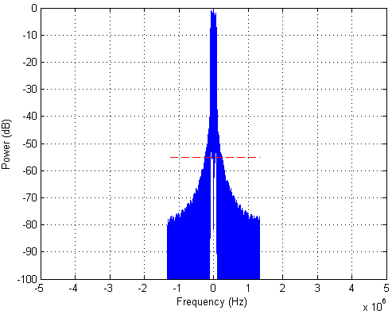
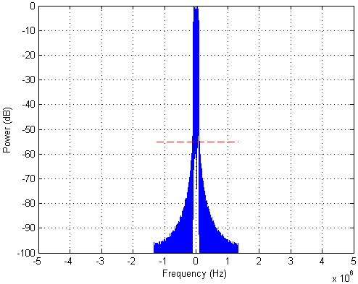
SPECTRUM WITH FILTERING, 16 SUBCARRIERS ROLLOFF OF 0.25
Filter order=32
Filter order=64
Option 4
Filter order=128
Filter order=256

Slide 35
BANDWIDTH OVERHEAD ANALYSIS FOR VARIOUS FILTER ORDERS, OPTION 4 (1)
Rolloff factor | Filter order | Total bandwidth Use (MHz) | Guard band needed at each side of TV band (MHz)
0 | 32 | 1.77 | 0.82
 | 64 | 0.95 | 0.41
 | 128 | 0.69 | 0.28
 | 256 | 0.53 | 0.20
0.1 | 32 | 1.77 | 0.82
 | 64 | 0.97 | 0.42
 | 128 | 0.65 | 0.25
 | 256 | 0.38 | 0.12
0.25 | 32 | 1.64 | 0.75
 | 64 | 0.90 | 0.38
 | 128 | 0.41 | 0.14
 | 256 | 0.19 | 0.03

Slide 36
BANDWIDTH OVERHEAD ANALYSIS FOR VARIOUS FILTER ORDERS, OPTION 4 (2)
Rolloff: 0
Bandwidth overhead (MHz)
.10
Rolloff: 0.1
Rolloff: 0.25
.75
.05
.025
0
62.5
125
187.5
250
Filter order

Slide 37
JOINT CONSIDERATION OF ROLLOFF FACTORS AND FILTER ORDERS TO MINIMIZE BANDWIDTH OVERHEAD AT EDGE OF a Tv band

Slide 38
BANDWIDTH OVERHEAD ANALYSIS FOR VARIOUS ROLLOFF FACTORS
Option 1
Bandwidth overhead (MHz)
1.0
Filter order: 256
Option 2
Option 3
0.75
Option 4
0.5
0.25
0
0.1
0.25
0.5
1.0
Rolloff factor

Slide 39
BANDWIDTH OVERHEAD ANALYSIS FOR VARIOUS FILTER ORDERS (1)
For Option 1
Roll off: 0
Bandwidth overhead (MHz)
1.0
Roll off: 0.1
Roll off: 0.25
0.75
0.5
0.25
0
500
1000
1500
2000
Filter order

Slide 40
BANDWIDTH OVERHEAD ANALYSIS FOR VARIOUS FILTER ORDERS (2)
For Option 2
Roll off: 0
Bandwidth overhead (MHz)
1.0
Roll off: 0.1
Roll off: 0.25
0.75
0.5
0.25
0
250
500
750
1000
Filter order

Slide 41
BANDWIDTH OVERHEAD ANALYSIS FOR VARIOUS FILTER ORDERS (3)
For Option 3
Roll off: 0
Bandwidth overhead (MHz)
1.0
Roll off: 0.1
Roll off: 0.25
0.75
0.50
0.25
0
125
250
375
500
Filter order

Slide 42
BANDWIDTH OVERHEAD ANALYSIS FOR VARIOUS FILTER ORDERS (4)
For Option 4
Roll off: 0
Bandwidth overhead (MHz)
1.0
Roll off: 0.1
Roll off: 0.25
0.75
0.5
0.25
0
62.5
125
187.5
250
Filter order

Slide 43
BANDWIDTH OVERHEAD ANALYSIS FOR VARIOUS ROLLOFFS AND FILTER ORDERS
Observations regarding bandwidth and height of skirts of spectra
The width of the required band increases as roll-off increases - the bandwidth should be proportional to (1 + rolloff).
The height of the skirts outside the main lobe of the band decreases as roll-off increases .
The height of the skirts outside the main lobe of the band decreases as filter order increases.
Rolloff factor is a very useful parameter to control the out-of-band attenuation, in addition to the filter order.
To achieve out-of-band requirement, the design parameter choice should depend on the tradeoff between rolloff factor (which requires additional bandwidth) and filter order (which affects computation complexity).
For filter order of 512 and greater, rolloff of 0.1 results in less bandwidth overhead than rolloff of 0.25.

Slide 44
JOINT CONSIDERATION AND CONCULUSION (1)
Factors for joint optimization of the two parameter choices of rolloff factor and filter order
Each OFDM option can have a different combination of rolloff factor and filter order to achieve an appropriate bandwidth overhead.
Option 1 needs the largest bandwidth overhead to satisfy -55.4 dB attenuation requirement for a fixed rolloff and a fixed filter order. Other options need smaller rolloffs and filter orders for the same bandwidth overhead.
Simple system implementation should be considered.
Smaller filter order is more desirable.
Required bandwidth increases as rolloff increases.
Smaller rolloff is more desirable.
From the above three factors, for pulse shaping of TG4m systems a raised cosine filter with
rolloff factor of 0.1 and filter order of 512 for Option 1,
rolloff factor of 0.2 and filter order of 256 for Option 2,
rolloff factor of 0.1 and filter order of 256 for Option 3, and
rolloff factor of 0.1 and filter order of 128 for Option 4
is recommended so that the bandwidth overhead at the edge of TV band is at most 0.25MHz.

Slide 45
JOINT CONSIDERATION AND CONCULUSION (2)
By using the above recommended raised cosine filtering, the following channels can be accommodated in a 6MHz TV band.
OFDM option | Recommended filter parameters |  | Bandwidth overhead for -55dB attenuation (MHz) | Channel spacing (MHz) | No. of channels in a 6MHz TV band * | Guard band at edge of TVBD (MHz)
 | Rolloff factor | Filter order
Option 1 | 0.25 | 256 | 0.23 | 1.2 | 4 | 0.6
Option 2 | 0.2 | 256 | 0.21 | 0.6 | 9 | 0.3
Option 3 | 0.1 | 256 | 0.23 | 0.4 | 13 | 0.4
Option 4 | 0.1 | 128 | 0.25 | 0.2 | 27 | 0.3
* At least 0.25MHz bandwidth overhead should be considered to meet the FCC’s new out-of-band emission constraints. (FCC Third MO&O, FCC-12-36A1, April. 2012.)

