Slide 1
Project: IEEE P802.15 Working Group for Wireless Personal Area Networks (WPANs)
Submission Title: Human Physiological Parameter Monitoring (Application of IEEE802.15.4N)
Date Submitted: July 12, 2012
Source: Ning Li, Tu Shu (BUPT) ; Liang Li (Vinno)
Suite 202, Building D, No.2 Xinxi Lu, Beijing, China,
Voice: 1-914-333-9687, FAX: 1-914-332-0615,
E-Mail: liangli@vinnotech.com
Abstract: Opening report for TG4n(MBAN) Task Group
Purpose: Outline accomplishments from the March 2012 meeting and planned tasks for this meeting.
Notice: This document has been prepared to assist the IEEE P802.15. It is offered as a basis for discussion and is not binding on the contributing individual(s) or organization(s). The material in this document is subject to change in form and content after further study. The contributor(s) reserve(s) the right to add, amend or withdraw material contained herein.
Release: The contributor acknowledges and accepts that this contribution becomes the property of IEEE and may be made publicly available by P802.15.

Slide 2
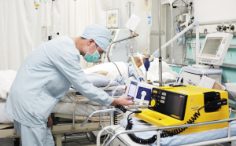
Human physiological parameter monitoring at Different Sites (1)
☆ ICU Room：
Continue and High Accurate Physiological Parameter Monitoring
Crown Staff and Medical devices (complex EM environment)
few Patients in one ICU room
☆ Ward：
Continual Physiological Parameter Monitoring
Few Medical devices (simple EM environment)
Over 10 Patients in one ward

Slide 3
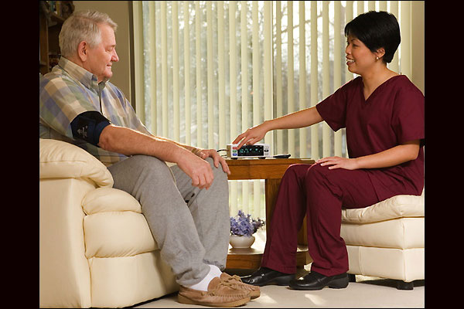
Human physiological parameter monitoring at Different Sites (2)
☆ Family Ward for Patients and Seniors
Less medical devices and Staff
Complex EM environment
☆ Long-Term Chronic Monitoring
Mobility for indoor and outdoor applications
Easy connecting to Internet
g

Slide 4
Monitoring and Tech Requirement (1)
Project | Data Rate | Topology | Distance | duty cycle） | Sensor Power consumption | SAR | Sensor Number
EEG | TBD | Star | <5m | <10% | Low | Max | >24
ECG | <36kbps | Star or P2P | <5m | <10% | Low | High | <24
EMG | TBD | Star | <5m | <10% | Low | High | <12
Temp | <16bps | Star or P2P | <5m | <1% | Low | High | <12
Breath | TBD | Star | <5m | <1% | Low | High | <12
Heart Rate | TBD | Star or Tree | <5m | <1% | Low | High | <12
Oxygen Content | 32kbps | Start, Tree or P2P | <5m | <1% | <50mW | High | <12

Slide 5
Monitoring and Tech Requirement (1)
Project | Data Rate | Topology | Distance | duty cycle） | Sensor Power consumption | SAR | Sensor Number
Blood Pressure | <10bps | Star or Tree | <5m | <1% | 1.5W（ | High | <12
pH | TBD | Star or Tree | <5m | <1% | low | High | <12
Glucose content | TBD | Star or Tree | <5m | <1% | Low低 | High | <12

Slide 6
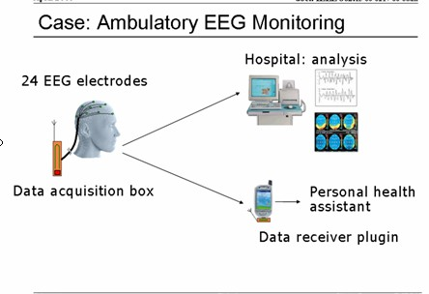
Example (1)

Slide 7
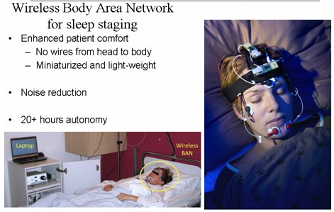
Example (2)

Slide 8
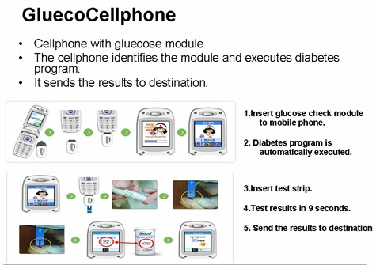
Example (3)

Slide 9
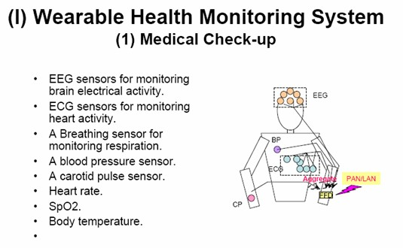
Example (4)

Slide 10
Thank you

