Slide 1
Project: IEEE P802.15 Working Group for Wireless Personal Area Networks(WPANs)
Submission Title: IEEE802.15.4m MAC Proposal: TVWS Multi-Channel Utilization (TMCU)
Date Submitted: July 17, 2012
Source: Youngae Jeon, Sangjae Lee, and Sangsung Choi (ETRI), Soo-Young Chang (SYCA)
Contact: yajeon@etri.re.kr
Voice: +82 42 860 6497, E-Mail: yajeon@etri.re.kr
Re: Call for proposals
Abstract: This contribution presents a MAC proposal for the TG4m
Purpose: Preliminary proposal to 802.15m
Notice: This document has been prepared to assist the IEEE P802.15. It is offered as a basis for discussion and is not binding on the contributing individual(s) or organization(s). The material in this document is subject to change in form and content after further study. The contributor(s) reserve(s) the right to add, amend or withdraw material contained herein.
Release: The contributor acknowledges and accepts that this contribution becomes the property of IEEE and may be made publicly available by P802.15.
Slide 1

Slide 2
Outline
Motivation
Network Architecture
Basic Operational Procedure
Message Sequence Charts
Benefits of TMCU
Required Modifications
  Modified and added Frames
  Modified and added Service Primitives
  Extended Superframe Structure
Slide 2

Slide 3
Motivation
Major Differences from conventional 802.15.4 networks
  A WPAN cannot assign its own operation frequency band for itself.
    Operational frequency bands are determined totally among available TVWS bands obtained from TVWS DB.
  A super PAN coordinator is required to access DB, assign WPAN channels, and manage TVWS channels of WPANs in the proximity.
Beacon scheduling is one of the major issues in multi hop enabled LR-WPAN.
  Need a scheme for easy synchronization among multiple channels.
A single channel communication for all devices in a network may increase the possibility of collisions and degrade the network performance.
  Multi-channel utilization may be useful to reduce collisions between coordinators and allow each cluster to have independent operations at the same time.

Slide 4
Network Architecture (Example)
Internet
Device 1
Utility Provider
Device 2
Data Collector Unit
Device 4
Data Collector Unit
Device 3
Data Collector Unit
Device 5
Data Collector Unit
Super PAN Coordinator (FFD)
PAN Coordinator (FFD)
End Device (FFD or RFD)

Slide 5
Basic Operational Procedure (1/5)
Device Types
  SPC (Super PAN Coordinator):
    FFD, Fixed/Mode II/Mode I Device
    DB access (direct or Indirectly) to obtain available TVWS bands and manage WPAN channels
  PC (PAN Coordinator):
    FFD, Fixed/Mode II/Mode I Device
    If PC is a relay coordinator, it has Channel Assignment/Management Capability.
  Device:
    RFD/FFD, Fixed/Mode II/Mode I Device

Slide 6
Basic Operational Procedure (2/5)
Superframe Structure between SPC 1 and PC 2 before Allocation
Superframe Structure between SPC 1 and PC 2 after Allocation

Slide 7
Basic Operational Procedure (3/5)
Superframe Structure between SPC 1 and PC 2/3/4/5 after Allocation

Slide 8
Basic Operational Procedure (4/5)
Basic Operation
  The SPC obtains the list of available TV channels from the GDB through the Internet.
    The SPC may also obtain the list of available TV channels from other Fixed/Mode II/Mode 1 Device indirectly.
  The SPC maps the TV channels to corresponding WPAN channels, selects one of the available channels, and transmits its beacon through that channel.
    A Beacon contains Extended Superframe Specification fields.
  After performing scanning over all WPAN channels and association procedures, a PAN coordinator tries to get a channel and a slot by sending DBS (Dedicated Beacon Slot) request to the SPC.
  Upon receiving the DBS request, the SPC allocates a slot and a channel to the requester, and indicates pending data in its beacon frame.
  Upon receiving the Data request, the SPC replies with the DBS response containing an allocated slot and an allocated channel information.

Slide 9
Basic Operational Procedure (5/5)
Basic Operation (cont’d)
  During CAP (Contention Access Period), the SPC receives all DBS requests and allocates slots and channels.
  During BOP (Beacon Only Period), the SPC switches into the channel allocated to each PAN coordinator and receives the beacon frame from the PAN coordinator
  During CAP of SPC, each PAN coordinator receives DBS response and switches into the allocated channel before the allocated DBS slot time.
  Each PAN coordinator manages its own WPAN by transmitting its beacon at the allocated DBS slot time.
  If there are any DBS requests from others during CAP in its superframe, the PAN coordinator can relay the DBS request.
    The relay coordinator may obtain the list of available channel information from the SPC and allocate a channel and a slot.

Slide 10
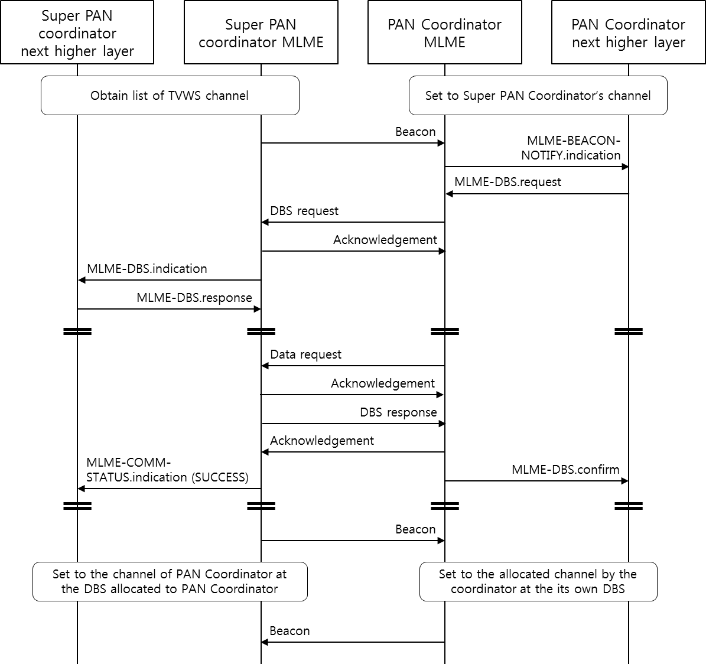
Message Sequence Chart (1/2)

Slide 11
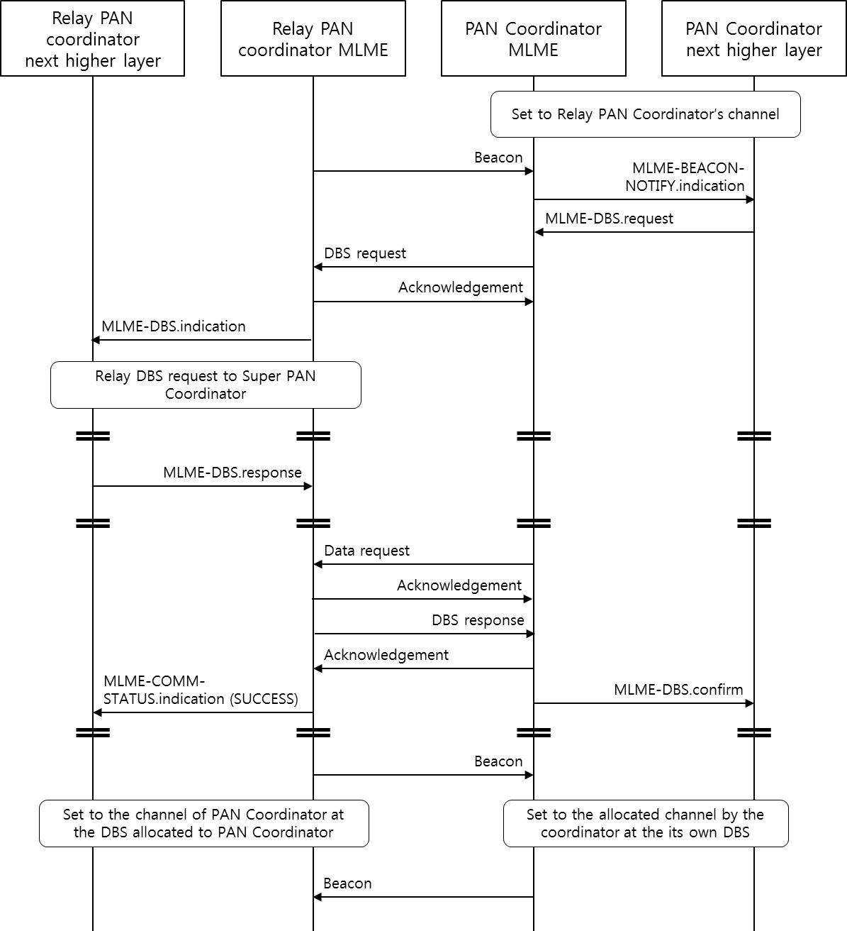
Message Sequence Chart (2/2)
Multi-hop Extension
For the case that a PC is connected to an SPC through another PC. For example, PC 5 is connected through PC 4 in Slide 4.

Slide 12
Benefits of TMCU
Provides an efficient beacon scheduling among coordinators (cluster headers) to facilitate multi-hop enabled WPAN operation.
Enables each cluster to operate independently at the same time.
Minimizes time to gather data from all descendants since TMCU allows each cluster to concurrently gather data from its devices on different channels.
  e.g., metering data in SUN

Slide 13
Required Modifications
For the frames,
  existing frames can be reused with the addition of sub fields and
  new frames (DBS request and DBS response ) should be defined.
For the service primitives,
  existing primitives can be reused with the addition of new parameters and new primitives with regard to DBS request and response.
For the superframe structure,
  extended superframe structure should be applied.

Slide 14
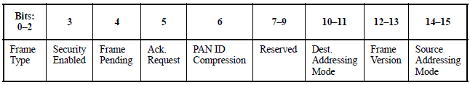
Modified Beacon Frame (1/2)
Beacon frame contains the following fields additionally:
  Frame control field of MHR fields
    Change bit number 7 of Frame Control field
      From Reserved to ESS (Extended Superframe Specification) Present
        0x1: if ESS Present field is contained, 0x0: otherwise
    Change bit number 8 of Frame Control field
      From Reserved to SPC (Super PAN Coordinator)
        0x1: If a device is an SPC, 0x0: otherwise
Octets: 2 | 1 | 4/10 | 0/5/6/10/14 | 2 | variable | variable | 1 | variable | 2/4
Frame Control | Sequence Number | Addressing fields | Auxiliary Security Header | Superframe Specification | GTS fields | Pending address fields | Extended Superframe Specification | Beacon Payload | FCS
MHR |  |  |  | MAC Payload |  |  |  |  | MFR

Slide 15
Modified Beacon Frame (2/2)
Beacon frame contains the following fields additionally:
  Extended Superframe Specification fields
    Beacon Only Period Order field (4bits)
    Dedicated Beacon Slot Allocation Capability (1bit)
    Channel Allocation Capability (1bit)
    Channel Allocation Relay Capability (1bit)
Additional Contents in Beacon Frame (TBD)
  - Channel allocation Status
  - Dynamic Channel Switching information
Octets: 2 | 1 | 4/10 | 0/5/6/10/14 | 2 | variable | variable | 1 | variable | 2/4
Frame Control | Sequence Number | Addressing fields | Auxiliary Security Header | Superframe Specification | GTS fields | Pending address fields | Extended Superframe Specification | Beacon Payload | FCS
MHR |  |  |  | MAC Payload |  |  |  |  | MFR

Slide 16
New DBS Request Frame
DBS request frame contains the following fields:
  MHR fields
  Command Frame Identifier field (1byte)
  DBS Request Information fields
    Requester Short Address field (2bytes)
    DBS Length field (4bits)
    Characteristics Type field (1bit)
      0x0: Deallocation of an existing DBS
      0x1: Allocation of a new DBS
  FCS
Octets: 11~25 | 1 | 3 | 2/4
MHR fields | Command Frame Identifier | DBS Request Information fields | FCS

Slide 17
New DBS Response Frame
DBS response frame contains the following fields:
  MHR fields
  Command Frame Identifier field
  DBS Response Information fields
    Requester Short Address field (2bytes)
    Allocated DBS Starting Slot field (1byte)
    Allocated DBS Length field (1byte)
    Allocated channel Number field (1byte)
    Allocated channel Page field (1byte)
  FCS
Octets: 11~25 | 1 | 6 | 2/4
MHR fields | Command Frame Identifier | DBS Response Information fields | FCS

Slide 18
Modified MLME-START.request Primitive
  MLME-Start.request contains the following parameters:
  PANId
  …
  BeaconOrder
  SuperframeOrder
  ExtendedOrder (added)
    The length of the extended superframe, consisting of the DBS slots.
  PANCoordinator
  SuperPANCoordinator (added)
    If this value is TRUE, the device will become the Super PAN coordinator of a PAN.
  …
  KeyIndex

Slide 19
New MLME-DBS.request Primitive
  MLME-DBS.request contains the following parameters:
  DBSRequestInfo
    Requester Short Address
      The short address of the Coordinator requesting DBS
    DBS Length
      The number of slots being requested for DBS
    Characteristics Type
      Allocation or Deallocation
  SecurityLevel
  KeyIdMode
  KeySource
  KeyIndex

Slide 20
New MLME-DBS.indication Primitive
  MLME-DBS.indication contains the following parameters:
  CoordAddress
    The short address of the Coordinator requesting DBS or relaying DBS request
  DBSRequestInfo
  SecurityLevel
  KeyIdMode
  KeySource
  KeyIndex

Slide 21
New MLME-DBS.response Primitive (1/2)
  MLME-DBS.response contains the following parameters:
  CoordAddress
    The short address of the Coordinator requesting DBS or relaying DBS request
  DBSResponseInfo
    Requester Short Address
      The short address of the Coordinator requesting DBS
    Allocated DBS Starting Slot
      The slot at which the GTS is to begin
    Allocated DBS Length
      The number of contiguous slots over which the DBS is active.
    Allocated channel Number
      The channel number to be allocated
    Allocated channel Page
      The channel page to be allocated

Slide 22
New MLME-DBS.response Primitive (2/2)
  MLME-DBS.response contains the following parameters (cont’d):
    - SecurityLevel
    - KeyIdMode
  - KeySource
  - KeyIndex

Slide 23
New MLME-DBS.confirm Primitive
  MLME-DBS.confirm contains the following parameters:
    - DBSResponseInfo
    - Status
    SUCCESS
    DENIED
    NO_SHORT_ADDRESS
    CHANNEL_ACCESS_FAILURE
    NO_ACK
    NO_DATA
    …
    UNAVAILABLE_KEY
    UNSUPPORTED_SECURITY
    INVALID_PARAMETER

Slide 24
Extended Superframe Structure (1/2)
Beacon
CAP
CFP
BOP
Inactive
SD
ED
ESD
Beacon Interval
  BOP (Beacon Only Period) in Extended Duration shall be divided into aNumDBSSlots (= aNumSuperframeSlots x 2^{EO}) equally spaced slots of duration aBaseDBSSlot Duration (= aBaseSlotDuration)
CAP (Contention Access Period), CFP (Contention Free Period), BOP (Beacon Only Period),
ED (Expanded Duration), SD (Superframe Duration), ESD (Expanded Superframe Duration)

Slide 25
Extended Superframe Structure (2/2)
Beacon Interval (BI)
  BI = aBaseSuperframeDuration × 2^{macBeaconOrder}
  0 ≤ macBeaconOrder ≤ 14
Superframe Duration (SD)
  SD = aBaseSuperframeDuration × 2^{macSuperframeOrder}
  0 ≤ macSuperframeOrder ≤ macBeaconOrder ≤ 14
Extended Duration (ED)
  ED = aBaseSuperframeDuration × 2^{macExtendedDurationOrder}
  0 ≤ macExtendedDurationOrder ≤ macBeaconOrder - macSuperframeOrder ≤ 14

