Slide 1
Project: IEEE P802.15 Working Group for Wireless Personal Area Networks(WPANs)
Submission Title: ETRI OFDM PHY Proposal for TG4m
Date Submitted: July 2012
Source: Cheol-ho Shin , Mi-Kyung Oh and Sangsung Choi (ETRI), Soo-Young Chang (SYCA)
Contact: chshin@etri.re.kr
Voice: +82 42 860 6831, E-Mail: chshin@etri.re.kr
Re: Call for proposals
Abstract: This contribution presents a proposal for the TG4m
Purpose: Final proposal to 802.15m
Notice: This document has been prepared to assist the IEEE P802.15. It is offered as a basis for discussion and is not binding on the contributing individual(s) or organization(s). The material in this document is subject to change in form and content after further study. The contributor(s) reserve(s) the right to add, amend or withdraw material contained herein.
Release: The contributor acknowledges and accepts that this contribution becomes the property of IEEE and may be made publicly available by P802.15.
Slide 1

Slide 2
Contents
Requirements overview
Dual PHY for TVWS WPAN
OFDM PHY for TVWS
Summary

Slide 3
Requirements Overview
Key requirements for TVWS WPAN
Operations in TVWS frequency bands under regulatory constraints
Data rate of typically 40Kbps to 2Mbps & optionally 10Mbps
Optimal & power efficient device command & control applications
Operating range of at least 1Km
At least 1000 direct neighboring devices
Opportunistic coexistence with primary users (TV broadcasting): not interfere with other primary users

Slide 4
Dual PHY for TVWS WPAN
PHY data rate in TG4m PAR
Typically 40Kbps~2Mbps, optionally ~10Mbps
Various applications in TGD (doc.11-0684-12)
Single PHY cannot cover all the applications.
FSK PHY: Low data rate & low complexity PHY
OFDM PHY: High data rate & high reliability PHY
Application | Candidate PHY
Smart Utility Networks | FSK
Infrastructure Monitoring Networks | FSK
Intelligent Transportation System | OFDM
Surveillance Control & Monitoring Networks | OFDM

Slide 5
OFDM PHY for TVWS

Slide 6
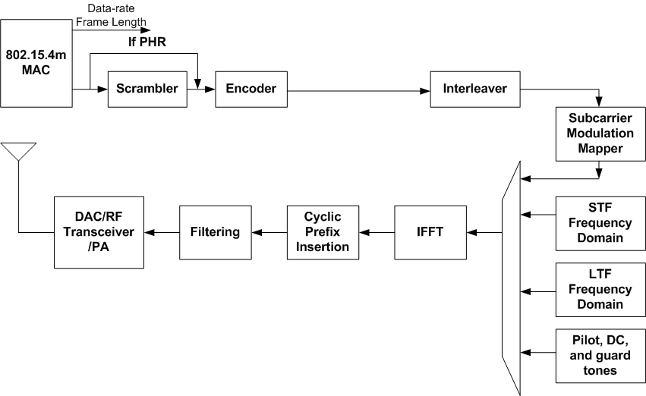
OFDM PHY for TVWS WPAN (1)
Reference modulator diagram

Slide 7
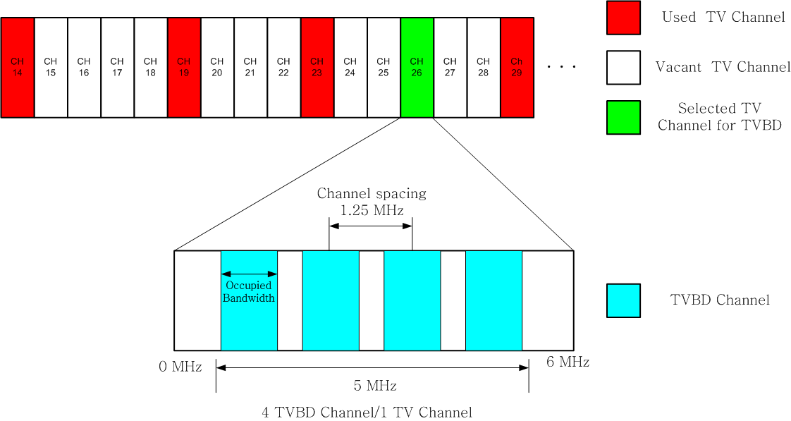
July, 2009
OFDM PHY for TVWS WPAN (2)
Channel plan for TVWS OFDM
Channel spacing : 1,25MHz, Guard band : 0.5MHz
Can use 4 TVBD Channels per 1 TV Channel
Slide 7

Slide 8
OFDM PHY for TVWS WPAN (3)
Timing-related parameter
Parameter | Description | Value
fs | Sampling frequency | 1250 KHz
NFFT | FFT Size | 128
∆f | Subcarrier frequency spacing | 1250/128 KHz
TFFT | IFFT and FFT period | 102.4 us
NCP | Number of samples in cyclic prefix | 32
TCP | Cyclic prefix duration in time | 25.6 us
NSYM | Total Number of samples per symbol | 160
TSYM | Symbol Duration | 128 us

Slide 9
OFDM PHY for TVWS WPAN (4)
Mandatory modes for TVWS OFDM
Parameter | TVWS OFDM (Mandatory)
Approximate signal bandwidth (KHz) | 1060
DFT Size | 128
Pilot tones | 8
Data tones | 100
MCS0 (kb/s) (BPSK rate ½)) | 390.625
MCS1 (kb/s) (QPSK rate ½) | 781.250
MCS2 (kb/s) (16-QAM rate ½) | 1562.5

Slide 10
OFDM PHY for TVWS WPAN (5)
Optional modes for TVWS OFDM
- Using 4x over-clock of TVWS OFDM
Parameter | TVWS OFDM (Optional)
Approximate signal bandwidth (KHz) | 4240
DFT Size | 128
Pilot tones | 8
Data tones | 100
MCS0 (kb/s) (BPSK rate ½)) | 1562.5
MCS1 (kb/s) (QPSK rate ½) | 3125
MCS2 (kb/s) (16-QAM rate ½) | 6250

Slide 11
OFDM PHY for TVWS WPAN (6)
Available TX maximum power defined by FCC 12-36
Parameter | PSD limit (100KHz) | TVWS OFDM (Mandatory) | TVWS OFDM (Optional)
Nominal bandwidth (KHz) |  | 1060 | 4240
Fixed | 12.6 dBm | 22.85 dBm | 28.87 dBm
Personal/portable (adj. channel) | -1.4 dBm | 8.85 dBm | 14.87 dBm
Sensing only | -0.4 dBm | 9.85 dBm | 15.87 dBm
All other Personal/portable | 2.6 dBm | 12.85 dBm | 18.87 dBm

Slide 12
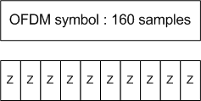
OFDM PHY for TVWS WPAN (7)
Format of the OFDM PPDU
SHR
STF : The repetition cycle is the same as that of the TG4g OFDM Option 1
- Formulas
LTF and PHR: TBD

Slide 13
OFDM PHY for TVWS WPAN (8)
Bit-to-symbol mapping
same as TG4g SUN
Forward error correction (FEC)
same as TG4g SUN
Interleaver
same as TG4g SUN
Ncbps is defined as follows;
100 bits for BPSK, 200 bits for QPSK , 400 bits for 16-QAM

Slide 14
July, 2009
OFDM PHY for TVWS WPAN (9)
128 IFFT
Total of 128 tones:
100 data tones
(constellation: BPSK/QPSK/16-QAM).
- 8 pilot tones
- Remaining 20 tones including DC are NULL tones.
Slide 14

Slide 15
OFDM PHY for TVWS WPAN (10)
Cyclic prefix (CP)
same as TG4g SUN
Structure of OFDM Symbol

Slide 16
OFDM PHY for TVWS WPAN (11)
PPDU Tail Bit field (TAIL)
same as TG4g SUN
Pad bits (PAD)
same as TG4g SUN
Scrambler
same as TG4g SUN

Slide 17
Summary of OFDM PHY for TVWS
OFDM PHY
Proposes the OFDM PHY based on the OFDM Option 1 of TG4g SUN to support the duel PHY
Adds optional modes using 4x over-clock of TVWS OFDM to achieve the optional data rate of 10 Mbps, and these modes are very useful to track the position of TVBDs.

