Slide 1
Project: IEEE P802.15 Working Group for Wireless Personal Area Networks(WPANs)
Submission Title: ETRI OFDM PHY Proposal for TG4m
Date Submitted: July 2012
Source: Cheol-ho Shin , Mi-Kyung Oh and Sangsung Choi (ETRI), Soo-Young Chang (SYCA)
Contact: chshin@etri.re.kr
Voice: +82 42 860 6831, E-Mail: chshin@etri.re.kr
Re: Call for proposals
Abstract: This contribution presents a preliminary proposal for the TG4m
Purpose: Final proposal to 802.15m
Notice: This document has been prepared to assist the IEEE P802.15. It is offered as a basis for discussion and is not binding on the contributing individual(s) or organization(s). The material in this document is subject to change in form and content after further study. The contributor(s) reserve(s) the right to add, amend or withdraw material contained herein.
Release: The contributor acknowledges and accepts that this contribution becomes the property of IEEE and may be made publicly available by P802.15.
Slide 1

Slide 2
Contents
Requirements overview
TVWS WPAN considerations
Dual PHY for TVWS WPAN
OFDM PHY for TVWS
Summary

Slide 3
Requirements Overview
Key requirements for TVWS WPAN
  Operations in TVWS frequency bands under regulatory constraints
  Data rate of typically 40Kbps to 2Mbps & optionally 10Mbps
  Optimal & power efficient device command & control applications
  Operating range of at least 1Km
  At least 1000 direct neighboring devices
  Multi-band capability
  Coexistence with primary users (TV broadcasting)

Slide 4
TVWS WPAN Considerations (1)
Rural areas
  Easy to find available TVWS channels
  Usually not crowded: free from interference
  Max. 100mW TX power for Mode I/II devices
  1km service coverage is easily met
Metropolitan areas
  Difficult to find TVWS channels due to rebroadcast TV signals
  Reduced TX power in adjacent channel: Max. 40mW TX power for Mode I/II devices
  Usually crowded: several services in one TVWS channel

Slide 5
TVWS WPAN Considerations (2)
Interoperability requirement
  TVWS channel availability is not guaranteed, especially in metropolitan areas
  Seamless WPAN services should be maintained regardless of TVWS channel status
  Transition to 900MHz band may be required
    IEEE 802.15.4g SUN standard is well established in 900MHz band

Slide 6
Dual PHY for TVWS WPAN
PHY data rate in TG4m PAR
  Typically 40Kbps~2Mbps, optionally ~10Mbps
Various applications in TGD (doc.11-0684-10)
  Single PHY cannot cover all the applications.
  FSK PHY: Low data rate & low complexity PHY
  OFDM PHY: High data rate & high reliability PHY
Application | Candidate PHY
Smart Utility Networks | FSK
Infrastructure Monitoring Networks | FSK
Intelligent Transportation System | OFDM
Surveillance Control & Monitoring Networks | OFDM

Slide 7
OFDM PHY for TVWS

Slide 8
TG4g MR-OFDM Modes
Parameter | OFDM Option 1 | OFDM Option 2 | OFDM Option 3 | OFDM Option 4
Nominal bandwidth (KHz) | 1094 | 552 | 281 | 156
DFT Size | 128 | 64 | 32 | 16
MCS0 (kb/s) (BPSK rate ½ with 4x frequency repetition) | 100 | 50 | - | -
MCS1 (kb/s) (BPSK rate ½ with 2x frequency repetition) | 200 | 100 | 50 | -
MCS2 (kb/s) (QPSK rate ½ with 2x frequency repetition) | 400 | 200 | 100 | 50
MCS3 (kb/s) (QPSK rate ½) | 800 | 400 | 200 | 100
MCS4 (kb/s) (QPSK rate 3/4) | ­ | 600 | 300 | 150
MCS5 (kb/s) (16-QAM rate ½) | - | 800 | 400 | 200
MCS6 (kb/s) (16-QAM rate 3/4) | - | - | 600 | 300

Slide 9
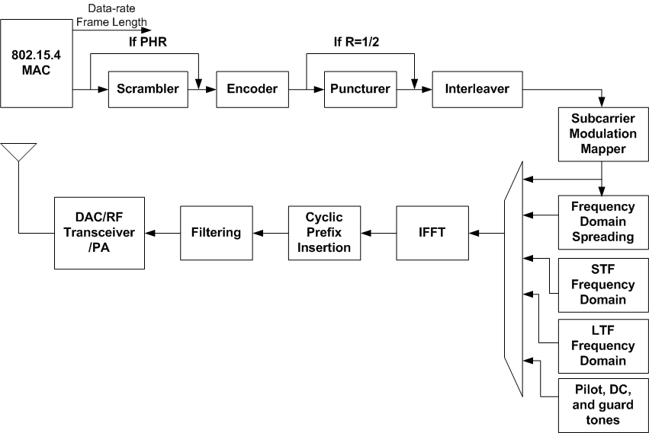
OFDM PHY for TVWS WPAN (1)
Reference modulator diagram

Slide 10
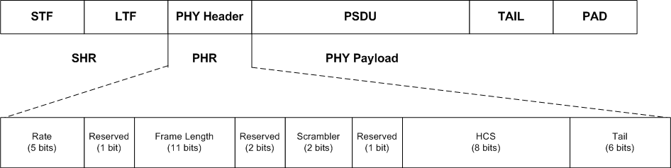
OFDM PHY for TVWS WPAN (2)
Format of the OFDM PPDU
  SHR
    STF : same as TG4g SUN
    LTF : same as TG4g SUN
  PHR
    Basically, same as TG4g SUN
    Ranging packet indication can be set among reserved bits

Slide 11
OFDM PHY for TVWS WPAN (3)
Mandatory modes for TG4m OFDM
- Add high data rate mode to TG4g MR-OFDM modes
Parameter | OFDM Option 1 | OFDM Option 2 | OFDM Option 3
Nominal bandwidth (KHz) | 1094 | 552 | 281
DFT Size | 128 | 64 | 32
MCS0 (kb/s) (BPSK rate ½ with 4x frequency repetition) | 100 | 50 | -
MCS1 (kb/s) (BPSK rate ½ with 2x frequency repetition) | 200 | 100 | 50
MCS2 (kb/s) (QPSK rate ½ with 2x frequency repetition) | 400 | 200 | 100
MCS3 (kb/s) (QPSK rate ½) | 800 | 400 | 200
MCS4 (kb/s) (16-QAM rate ½) | 1600 | 800 | 400

Slide 12
OFDM PHY for TVWS WPAN (4)
Optional modes for TG4m OFDM
- Using 4x over-clock of TG4g MR-OFDM Option 1
Parameter | OFDM Option 1 Extension
Nominal bandwidth (KHz) | 4376
DFT Size | 128
MCS5 (kb/s) (QPSK rate ½) | 3200
MCS6 (kb/s) (16-QAM rate ½) | 6400

Slide 13
OFDM PHY for TVWS WPAN(5)
Available TX maximum power defined by FCC 12-36
Parameter | PSD limit (100KHz) | OFDM Option 1 | OFDM Option 2 | OFDM Option 3 | OFDM Option 1 Extension
Nominal bandwidth (KHz) |  | 1094 | 552 | 281 | 4376
Fixed | 12.6 dBm | 22.99 dBm | 20.02 dBm | 17.09 dBm | 29.01 dBm
Personal/portable (adj. channel) | -1.4 dBm | 8.99 dBm | 6.02 dBm | 3.09 dBm | 15.01 dBm
Sensing only | -0.4 dBm | 9.99 dBm | 7.02 dBm | 4.09 dBm | 16.01 dBm
All other Personal/portable | 2.6 dBm | 12.99 dBm | 10.02 dBm | 7.09 dBm | 19.01 dBm

Slide 14
OFDM PHY for TVWS WPAN (6)
Bit-to-symbol mapping
  same as TG4g SUN
Forward error correction(FEC)
  same as TG4g SUN
Interleaver
  Basically, the interleaving process is the same as that of one for the PIB attribute phyOFDMInterleaving of TG4g OFDM.
  → Devices may support an interleaving depth of the number of symbols equal to the frequency domain spreading factor.
  In this case, N_{cbps} is defined as follows;
  96 bits for BPSK, 192 bits for QPSK , 384 bits for 16-QAM in Option 1,
  48 bits for BPSK, 96 bits for QPSK , 192 bits for 16-QAM in Option 2,
  24 bits for BPSK, 48 bits for QPSK , 96 bits for 16-QAM in Option 3,

Slide 15
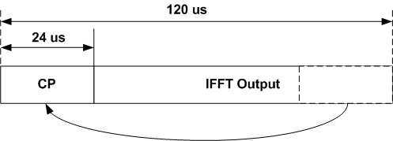
OFDM PHY for TVWS WPAN (7)
Frequency spreading
  same as TG4g SUN
Pilot tones/null tones
  same as TG4g SUN
Cyclic prefix (CP)
  same as TG4g SUN

Slide 16
OFDM PHY for TVWS WPAN (8)
PPDU Tail Bit field (TAIL)
  same as TG4g SUN
Pad bits (PAD)
  Basically, the computing process of PAD is the same as that of one for the PIB attribute phyOFDMInterleaving of TG4g OFDM SUN.
Scrambler and scrambler seeds
  same as TG4g SUN

Slide 17
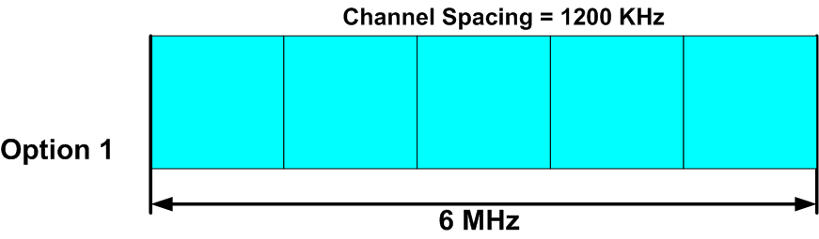
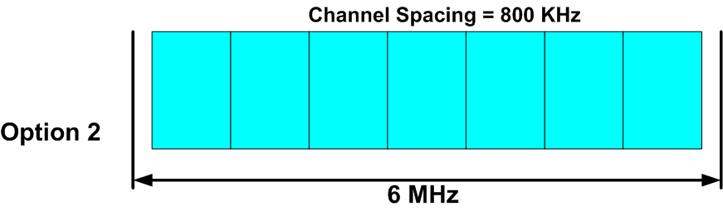
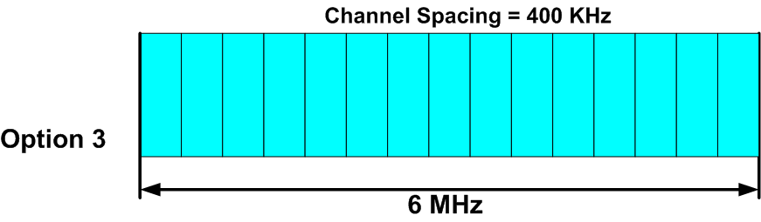
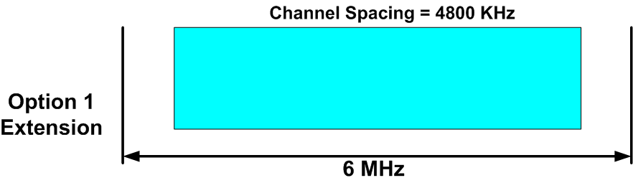
OFDM PHY for TVWS WPAN (9)
Channel Plan for TVWS-OFDM
5 TVBD Channels / 1 TV Channel
7 TVBD Channels / 1 TV Channel
Guard band = 200KHz
15 TVBD Channels / 1 TV Channel
1 TVBD Channels / 1 TV Channel

Slide 18
Summary of OFDM PHY for TVWS
OFDM PHY
  Basically, reuses TG4g MR-OFDM Specifications
  and extends the frequency range to TV White space,
  Should support communication with TG4g MR-OFDM PHY of for the case of the lack of available TVWS,
  Adds mandatory mode to TG4g MR-OFDM Modes to increase the data rates,
  Simplify the data rate modes and OFDM Options for TVWS WPAN
  Adds optional modes using 4x over-clock of TG4g MR-OFDM Option 1 to achieve the optional data rate of 10 Mbps, and

