Slide 1
Project: IEEE P802.15 Working Group for Wireless Personal Area Networks (WPANs)
Submission Title: [Discussion on the enhancement of 15.4]
Date Submitted: [6 July, 2012]
Source: [Nan Hu] Company [China Mobile Communication Corporation]
Address [32 Xuanwumen West Street, Beijing, China]
Voice:[+86 10 6600 6688], FAX: [+86 10 6313 5379], E-Mail:[hunan@chinamobile.com]
Re: [This is the original document]
Abstract: [This documents describes demands of enhancement for 15.4.]
Purpose: [To identify the companies’ interest.]
Notice: This document has been prepared to assist the IEEE P802.15. It is offered as a basis for discussion and is not binding on the contributing individual(s) or organization(s). The material in this document is subject to change in form and content after further study. The contributor(s) reserve(s) the right to add, amend or withdraw material contained herein.
Release: The contributor acknowledges and accepts that this contribution becomes the property of IEEE and may be made publicly available by P802.15.

Slide 2
Discussion on the enhancement of 15.4
WNG Session Presentation
18th July 2012 San Diego, CA
Nan Hu
China Mobile Communication Corporation

Slide 3
Contents
Requirements
  Operator’s requirements of short range communication technology for Internet of Things applications
Gap
  Gap between 15.4 and operator’s requirements
Enhancement
  QoS guarantee
  High frequency efficiency
  Tight coupling with cellular technology

Slide 4

Requirements
Typical scenario
  Sensor->concentrator->BS
  Short range communication widely used in s->c
For operators, short range communication (SRC) should
  QoS guarantee, which is the basic requirement for service provider
  Low cost, which is the key feature to deploy a large quantity of terminals
  Controllable, which aims to make operation and maintenance easily
  Low power consumption
sensor
concentrator
Short range communication
Cellular communication
BS

Slide 5
Requirements
Typical using scenario
  Sensor->concentrator->BS
  Short range communication widely used in s->c
For operators, short range communication (SRC) should
  QoS guarantee, which is the basic requirement for service provider
  Low cost, which is the key feature to deploy a large quantity of terminals
  Controllable, which aims to make operation and maintenance easily
  Low power consumption
Short range communication
Cellular communication

Slide 6
Gap
There is gap between 15.4 and operator’s requirements of SRC
For 15.4,
QoS cannot be guaranteed
  Unlicensed frequency means uncontrollable interference
No “straightforward” way to operation and maintenance
  Interworking mechanism with cellular network is absent
Easily be interfered due to unlicensed frequency and low TX power
Short range communication
Cellular communication
The last controllable end for core network through control plane

Slide 7
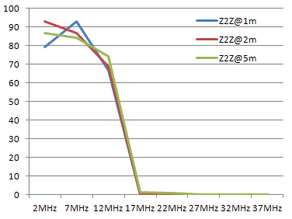
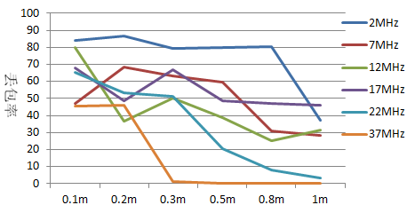
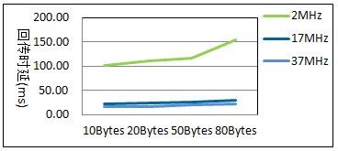
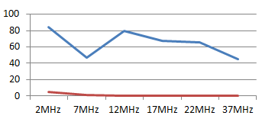

Gap
Unlicensed frequency means uncontrollable interference
Impact of frequency distance impact
Impact of distance of WiFi interferers
802.11gFTP@40Mbps， W2Z:2m
802.11g，FTP@40Mbps，Z2Z: 1m
0.1m
Frequency offset between both networks should be at least 20 MHz
If distance of WiFi interferers to ZigBee nodes is smaller than 2 m, the interference is unacceptable

Slide 8


Gap
Interworking mechanism with cellular network is absent
How can I manage the sensor node?
Concentrator
(PAN Coordinators)
FFD
OAM -- Operation Administration and Maintenance
RFD

Slide 9

Enhancement
To bridge the gap and make 15.4 more attractive to operators
QoS guarantee
  Using licensed frequency and making higher quality of service
High spectrum efficiency
  If using licensed frequency, high spectrum efficiency is necessary
Tight coupling with cellular technology
  aims to make operation and maintenance easily

