Slide 1
Project: IEEE P802.15 Working Group for Wireless Personal Area Networks (WPANs)
Submission Title: [The Usage of Polarized Antenna System]
Date Submitted: [29 June, 2012]
Source: [KyungHi Chang] Company [Inha University]
Address [Inha University, 253 Yonghyun-dong, Namgu, Incheon 402-751, Korea]
Voice:[+82 10 5431 9187], FAX: [+82 32 865 0480], E-Mail:[khchang@inha.ac.kr]
Re: [In response to 802.15 TG4m call for presentations.]
Abstract: [A introduction to the employment of multi-polarized antennas]
Purpose: [Information for the New Technology: Polarized Antenna System]
Notice: This document has been prepared to assist the IEEE P802.15. It is offered as a basis for discussion and is not binding on the contributing individual(s) or organization(s). The material in this document is subject to change in form and content after further study. The contributor(s) reserve(s) the right to add, amend or withdraw material contained herein.
Release: The contributor acknowledges and accepts that this contribution becomes the property of IEEE and may be made publicly available by P802.15.

Slide 2
The Usage of Polarized Antenna System
2012. 7
Prof. KyungHi Chang, Inha University
khchang@inha.ac.kr

Slide 3
Table of Contents
Motivation
Introduction of Polarized Antenna
  Characteristics of Polarized Antenna Channel
Benefits of Polarized Antenna System
  Employment of SISO Polarized Antenna
  Employment of Polarized Antenna Array
Future Work & Challenges
Conclusions

Slide 4
Motivation
The capacity of communication systems can be enhanced by exploiting
  Spatial domain
    Multiple-input multiple-output (MIMO) antenna systems along with diversity and spatial multiplexing
  Polarization domain
    Polarized antenna systems along with diversity and polarized multiplexing

Slide 5
Motivation
The reduction of cost / size of antennas
  Antennas spacing of several wave lengths is required.
    Increase both the size and cost of base stations
    Make it difficult to render the use of multiple antennas in customer devices.
  Multi-polarized antenna can increase the capacity and often require less space than spatially separated single-polarized elements.
Tx
Rx
Tx
Rx
Fig. Conventional MIMO system
Fig. Polarized antenna system

Slide 6
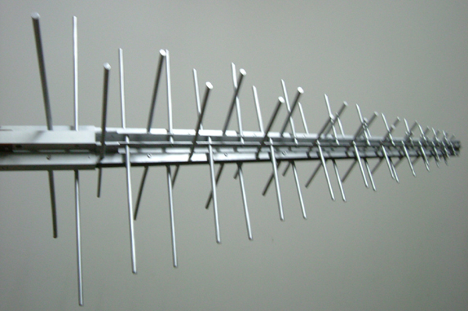
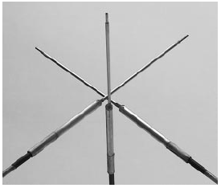
Introduction of Polarized Antenna
Multi-polarized antenna
Fig. Dual-polarized antenna
Fig. Tri-polarized antenna

Slide 7
Characteristics of Polarized Antenna Channel
Depolarization occurs due to two mechanisms.
  Antenna depolarization due to a non-ideal antenna
  Channel depolarization due to the radio propagation environment
Cross-Polarization Discrimination (XPD)
  Measure of the degree of depolarization
  Ratio of co-polarized to cross-polarized average received power
    (VV) : Link(Vertical Tx to Vertical Rx)
    (VH) : Link(Vertical Tx to Horizontal Rx)
    (HV) : Link(Horizontal Tx to Vertical Rx)
    (HH) : Link(Horizontal Tx to Horizontal Rx)

Slide 8


Benefits of Polarized Antenna System
Employment of SISO polarized antenna
(dual-polarized antenna as an example)
  Polarization diversity
    To improve link reliability
  Polarization multiplexing gain
    To increase spectral efficiency
S_{i}’ : different version of S_{i}
S_{i} , S_{j} : two different symbols

Slide 9
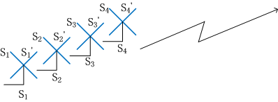
Benefits of Polarized Antenna System
Employment of polarized antenna array
(dual-polarized antenna as an example)
  Polarization diversity
    To improve link reliability
  Polarization multiplexing gain
    To increase spectral efficiency
  Antenna array gain
S_{i} , S_{j} : different symbols
S_{i}’ : different version of S_{i}
Polarization diversity + multiplexing

Slide 10
System Performance Enhancement
Employment of polarized antenna
Simulation Parameters | Values
Target Cell | Macro, Micro
Carrier Frequency | 1.8 GHz
Scatterer Radius | 10 m
System BW | 20 MHz
Rician Factor | 9 dB
LoS XPD Value | 14 dB
NLoS XPD Value | 5.8 dB
Number of Symbols in Packet | 100 symbols
Modulation | QPSK
Combining Techniques | EGC, MRC
Equalizer | 1-tap time-domain equalizer
Fig. Throughput enhancement employing polarization diversity (dual-polarized / tri-polarized antenna vs. single antenna)

Slide 11
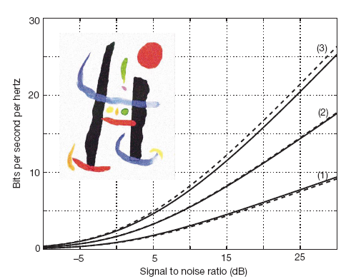
System Performance Enhancement
Employment of polarized antenna
Measurement Parameters | Values
Measurement Environment | 500 m² Cafeteria
Height of Ceilings | 10 m
Carrier Frequency | Baseband
System BW | 20 kHz
Distance between Tx & Rx | 25 m
Antenna Configuration | Single Antenna (1) Dual-polarized Antenna (2) Tri-polarized Antenna (3)
Fig. Throughput of different antenna branches employing polarization multiplexing (tri-polarized antenna)
Cf) Solid line: Experimental results
Dotted line: From the random matrix-based theory
<Ref.> M. R. Andrews, et.al, “Tripling the capacity of wireless communications using electromagnetic polarization,” letters to nature, 2001.

Slide 12
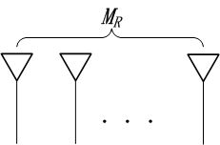
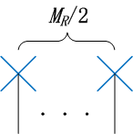
System Performance Enhancement
Achievable Capacity w.o. CSI at Tx Side
  SISO
  MIMO spatial multiplexing
    where M_{T} : Nr. of Tx antenna
    M_{R} : Nr. of Rx antenna
  Polarization multiplexing
(dual-polarized antenna)

Slide 13
Future Work & Challenges
Channel measurement & appropriate polarized channel modeling
  Mathematical model for channel depolarization
    XPD (Cross-Polarization Discrimination)
    SU-MIMO / MU-MIMO
Transceiver design for multi-polarized antenna systems employing diversity & multiplexing
Polarization filtering design
  Detection algorithms
    Co-channel interference cancelation
  Etc.
Polarization Multiplexing with interference reduction

Slide 14
Future Work & Challenges
Standardization Issues
  Channel modeling
    Including XPD (Cross-Polarization Discrimination)
  MIMO techniques
    MIMO antenna pattern
    Polarization diversity
      Tx diversity schemes
    Polarization multiplexing
      Tx precoding for co-channel interference cancelation
  Control signaling in polarization antenna systems
  Etc.

Slide 15
Conclusions
Theoretically triple the capacity of wireless communications using electromagnetic polarization
  Using tri-polarized antenna
Extremely increase the reliability of the wireless links
  Depending on the discrimination between cross-channels.
An efficient way to reduce antenna array dimension

