Slide 1
Project: IEEE P802.15 Working Group for Wireless Personal Area Networks (WPANs)
Submission Title: [The Examples of PAC Use Cases]
Date Submitted: [26 June 2012]
Source: [Jongtaek Oh] Company [Hansung University]
Address [389 Samsun Sungbook, Seoul, Korea]
Voice :[+82 10 6889 6062], FAX: [+82 2 760 4435], E-Mail:[jtoh@hansung.ac.kr]
Re: [In response to 802.15 TG8 call for presentations.]
Abstract: [The examples of PAC use cases and system architecture]
Purpose: [Information for PAC Functional Requirements]
Notice: This document has been prepared to assist the IEEE P802.15. It is offered as a basis for discussion and is not binding on the contributing individual(s) or organization(s). The material in this document is subject to change in form and content after further study. The contributor(s) reserve(s) the right to add, amend or withdraw material contained herein.
Release: The contributor acknowledges and accepts that this contribution becomes the property of IEEE and may be made publicly available by P802.15.

Slide 2
2012. 7.
Prof. Jongtaek Oh, Hansung University
jtoh@hansung.ac.kr

Slide 3
Contents
Motivation
Introduction to PES
The use cases of PES
The architecture of PES
Conclusion

Slide 4
Motivation
One of the PAC use cases is PES: Use case 4, Smart Home/Office
More emphasis on the applications of PES
Use cases from verticals: electronics and vehicle manufacturers

Slide 5
Introduction to PES
(Personal Environment Service)
Machine-to-machine
  Machine-to-machine communication is a type of service which exchanges data without human interaction, such as remote sensor, remote bio-monitoring and personal environment service. This service may transfer a small size of data traffic in a large number of sessions.
Personal environment service
  The electric, electronic, and mechanical machine surrounding users can be automatically configured according to the pre-defined and/or self-growing user preference.
< ref> RECOMMENDATION ITU-R M.1822 Framework for services supported by IMT

Slide 6
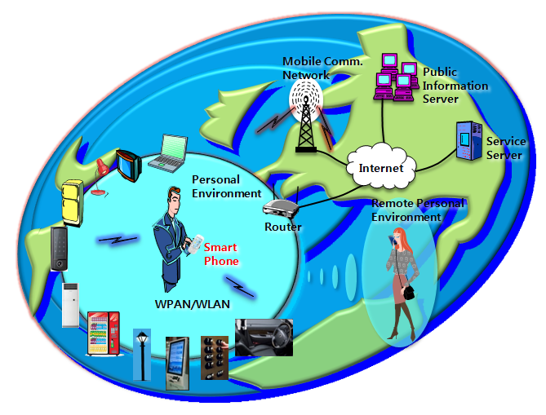
The conceptual diagram of PES
*J.T. Oh and Z. Haas, "Personal environment service based on the integration of mobile communications
and wireless personal area networks," IEEE Comm. Mag. Vol. 48, No. 6, pp. 66-72, June 2010.

Slide 7
Use cases for PES
Categorized based on 17 grouped living appliances
  Appliance/equipment
  Use case
  Event examples
  Operation scenario

Slide 8
Air conditioner
appliance | use case | event | operation scenario
air conditioner, heater, humidifier, air cleaner, fan | auto-configuration | -approaching to the appliance -changing of user preference -changing of climate or indoor conditions -leaving of user | -User configures the preference data into the smart phone, and the appliance is controlled automatically based on the data. -The smart phone updates the preference data according to the user feedback, bio-information, user behavior, climate, and etc. -Power is disconnected when user leaves.
 |  | -approaching to the appliance from remote place | -The smart phone or service server monitor the user behavior and position, and control the appliance from remote place in advance.
 | management | -user ‘s vicinity to the appliance | -The manufacturer accesses the appliance through smart phone, checks the status, and notifies the repairs. -User buys and installs the app for the appliance from app store.
 |  | -the absence of manager | -For the abnormal states, the manager accesses the appliance from remote place through WLAN AP or mobile comm. Modem. (M2M services)

Slide 9
Cleaner
appliance | use case | event | operation scenario
laundry, robot cleaner, bidet | auto-configuration | -cleaning | -finish the job before sleeping
 |  | -approaching to the appliance from remote place | -finish the job before coming back home
 | management | -user ‘s vicinity to the appliance | -The manufacturer accesses the appliance through smart phone, checks the status, and notifies the repairs.

Slide 10
Video/Audio
appliance | use case | event | operation scenario
Smart TV | auto-configuration | -watching TV | -automatically select the TV channel and running app program based on the user preference and behavior
 |  | -leaving from TV | -cut off the TV
 | multi-screen | -moving user | -continuously showing the contents by changing the video terminal near the user (the smart phone configures the setting)

Slide 11
Computers
appliance | use case | event | operation scenario
Personal computer | auto-login | -using and leaving the computer | -automatically log in when sitting in front of the computer by the configuration of the smart phone -the computer screen locking when leaving
Computer for public use | auto-configuration | -using the computer in library and etc. | -The resolution, mouse sensitivity, font size, and program options are configured by user preference, stored in the smart phone.
Printer | auto-configuration | -printing | -The smart phone detects printers nearby, checks the IP address, authority, driver files, and configures the computer.

Slide 12
Vehicle
appliance | use case | event | operation scenario
Navigator | tethering | -driving | -The smart phone repeats traffic information and map information from the service server into the navigator.
Vehicle | integrated memory system | -sitting | -The seat setting, mirror angle, and steering wheel are configured by driver’s preference.
 | energy saving | -driving | -The smart phone analyzes the driver’s driving behavior through on-board diagnosis unit and configures the control profile data in engine control unit.

Slide 13
The architecture of PES
G
Gateway
connection
option
repeater
Smart phone
P
P
P
P
sensor
P
P
G
G
home/office/public place/vehicle
Appliances
S
Service server
Internet server
G
S
S

Slide 14
Conclusion
Before determining the PAC spec., the use cases, service scenario, business model, typical system architecture should be developed, first, in order to draw attention from industry and government.
Context awareness or data mining based technology should be considered, seriously.
Convergence technology should be considered with the verticals.
  Sensors, home network, smart phone, service server, M2M, mobile communications, WLAN, appliances, vehicles, building automations, SNS, and etc.
  It is not simple, PHY and MAC matters.

