Slide 1
Project: IEEE P802.15 Working Group for Wireless Personal Area Networks (WPANs)
Submission Title: Interference Issue in IEEE 802.15.4n Standard
Date Submitted: July 12, 2012
Source: Ning Li, TuShu, BUPT ; Liang Li, Vinno;
Suite 202, Building D, No.2 Xinxi Lu, Beijing, China,
Voice: 1-914-333-9687, FAX: 1-914-332-0615,
E-Mail: liangli@vinnotech.com
Abstract: Opening report for TG4n(MBAN) Task Group
Purpose: Outline accomplishments from the March 2012 meeting and planned tasks for this meeting.
Notice: This document has been prepared to assist the IEEE P802.15. It is offered as a basis for discussion and is not binding on the contributing individual(s) or organization(s). The material in this document is subject to change in form and content after further study. The contributor(s) reserve(s) the right to add, amend or withdraw material contained herein.
Release: The contributor acknowledges and accepts that this contribution becomes the property of IEEE and may be made publicly available by P802.15.

Slide 2
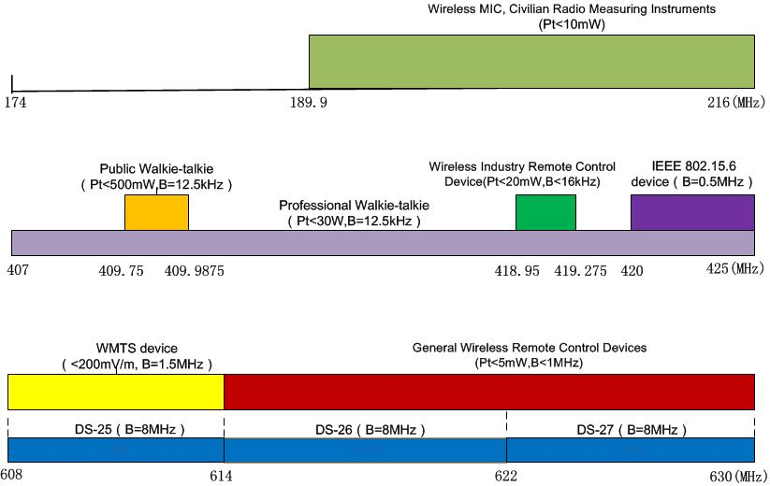
Interference Sources on 4n Frequency Bands
The IEEE 802.15.4n frequency band are : 174-216、407-425、608-630MHz.Fig1 shows interference sources in 4n band.
Fig 1. Interference source in 4n band

Slide 3
The Television Interference on 608-630MHz Band
There are 2 Television Standard in China , one is mandatory stand and the other is industry standard:
● DTMB (GB20600-2006, Mandatory Standard)
● CMMB (GYT 220-2006, Industry Standard)
Those standards define 3 Television Channels in 606-630MHz and every channel has a bandwidth of 8MHz：
● DS-25: 606-614MHz
● DS-25: 614-622MHz
● DS-25: 622-630MHz

Slide 4
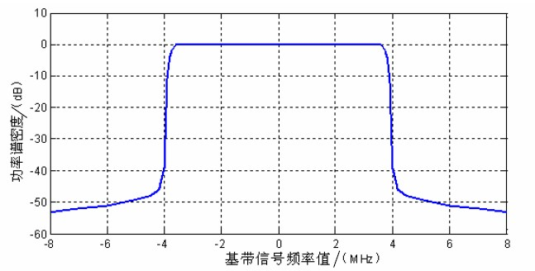
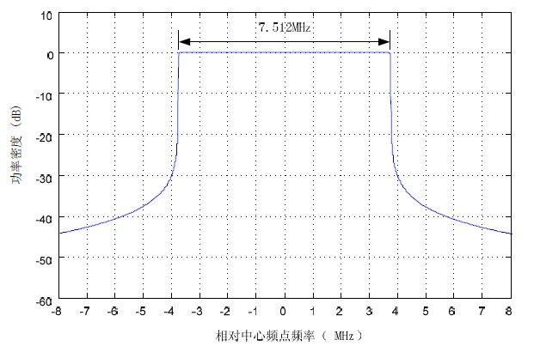
The PSD of Digital Television Signal
Fig 2 and Fig 3 show the PSD of transmit signal of DTMB and CMMB standards. We choose CMMB signal as interference signal in this research.
Fig 2. The PSD of transmit signal of DTMB Standard
Fig 3. The PSD of transmit signal of CMMB Standard

Slide 5
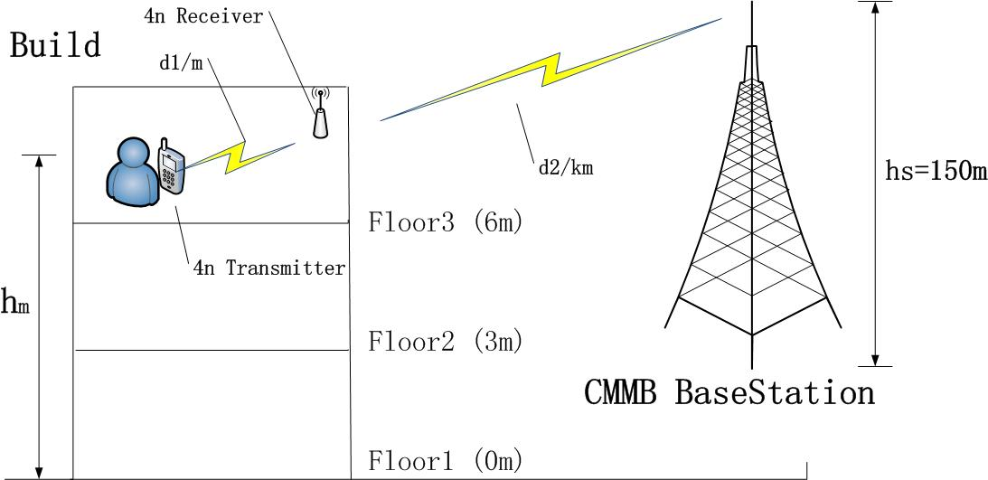
Interference Scene and Path Loss Model
First, we set the interference scene as Fig 4 shows . Then, we select the Path Loss Model for CMMB signal(PL-cmmb ) and 4n signal (PL-4n).
Fig 4. Interference Scene

Slide 6
● For PL-cmmb ,we choose the ITU-Hata-Okumura Model. As follow:
is the Path Loss in dB, it’s not contain Building Penetration Loss.
is the center carrier frequency .we choose DS-26, so .
is the efficient height of antenna of CMMB station, we set .
is the efficient height of antenna of 4n receiver, we set it value accord to
different floor and assume 3m per floor .
is the distance from CMMB BaseStation to 4n receiver. In Fig 4,it’s d2.
is antenna correction factor, we choose :
is distance correction factor when transmit distance over 20km.We set the
longest transmit distance is 15km,so .
is urban building density correction factor , as follow :
and we choose .
Considering the ITU-R BT.1368-7 and ITU-R P.1546-3 , We set Building Penetration Loss is 11dB.So the final PL for CMMB signal is :

Slide 7
● For PL-4n , the document of Coexistence analysis of IEEE 802.15.4 with other IEEE standards and proposed standards(IEEE P802.15-10-0808-00) define a PL model in 900MHz for indoor environment . As follow:
d is the distance between 4n transmitter and receiver, we assume the d<=8m.
In Fig 4, d1 represent d. We will computing SIR beyond d=1,3,5,7m respectively.

Slide 8
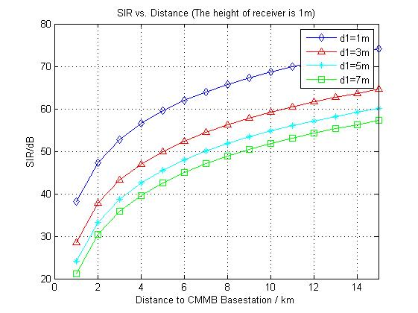
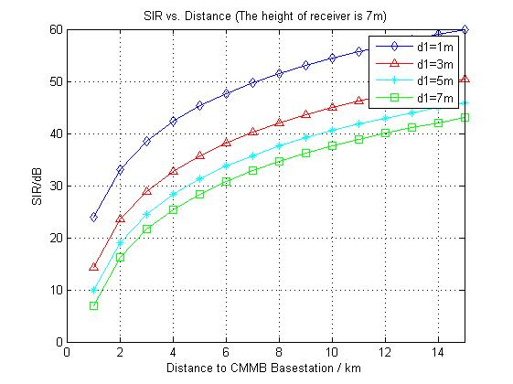
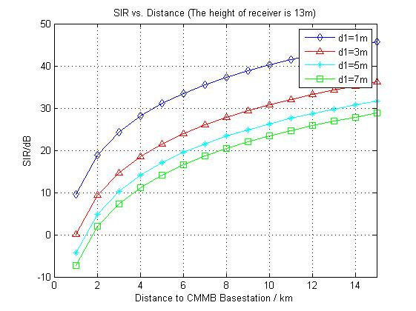
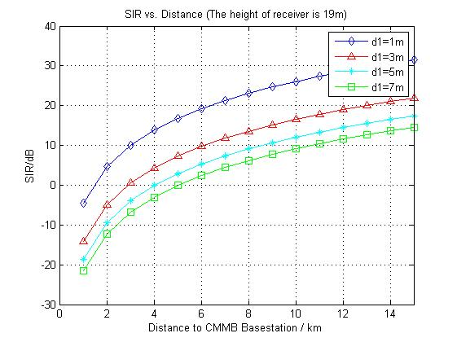
The SIR Result
We computing SIR using MATLAB under different condition . We assume the transmit power of CMMB signal is 1000W(60dBm) and the 4n is 0dBm.The result as follow:

Slide 9
Conclusion
From the SIR result ,we got following conclusion in 608-630MHz:
(1)、There exist a region around the digital television basestation that low transmitter power device, just like IEEE 802.15.4n, can not work normally .
(2)、The range of the region is depend the height of 4n receiver. The range will lager if the 4n receiver is higher.

