Slide 1
Project: IEEE P802.15 Working Group for Wireless Personal Area Networks (WPANs)
Submission Title: [220 MHz Fading Characteristics in PTC Wireless Communications]
Date Submitted: [12 June 2012]
Source: [Yale Lee] Company [Lilee Systems]
Address [2905 Stender Way, Suite 78, Santa Clara CA, 95054 USA]
Voice:[+1 408-988-8672], FAX: [Add FAX number], E-Mail:[yjlee@lileesystems.com]
Re: [If this is a proposed revision, cite the original document.]
[If this is a response to a Call for Contributions, cite the name and date of the Call for Contributions to which this document responds, as well as the relevant item number in the Call for Contributions.]
[Note: Contributions that are not responsive to this section of the template, and contributions which do
not address the topic under which they are submitted, may be refused or consigned to the “General Contributions” area.]
Abstract: [Overview of measured data in 220 Mhz channels and considerations for improving performance.]
Purpose: []
Notice: This document has been prepared to assist the IEEE P802.15. It is offered as a basis for discussion and is not binding on the contributing individual(s) or organization(s). The material in this document is subject to change in form and content after further study. The contributor(s) reserve(s) the right to add, amend or withdraw material contained herein.
Release: The contributor acknowledges and accepts that this contribution becomes the property of IEEE and may be made publicly available by P802.15.

Slide 2
Overview
Characterization of propagation channel is very important
220 MHz region is focus of most US PTC efforts
Measured propagation in highway driving environment
Adaptive methods to combat fading?

Slide 3
Mobility Testing
Automobile on city streets and freeway
  Run waveform recorder in vehicle, measure signal strength, network performance, etc.

Slide 4
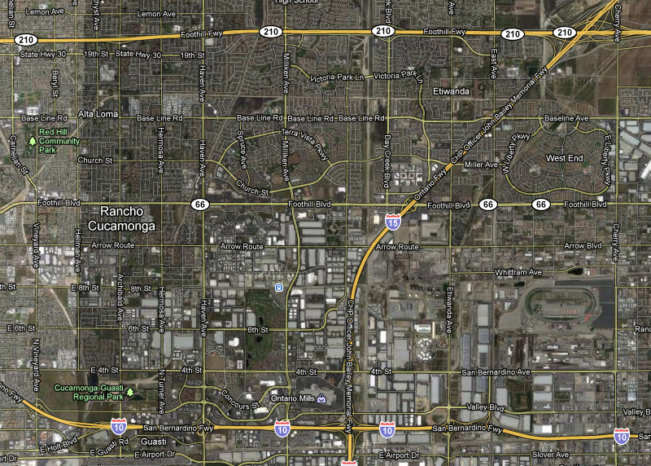
Highway Testing
Highway
Highway

Slide 5
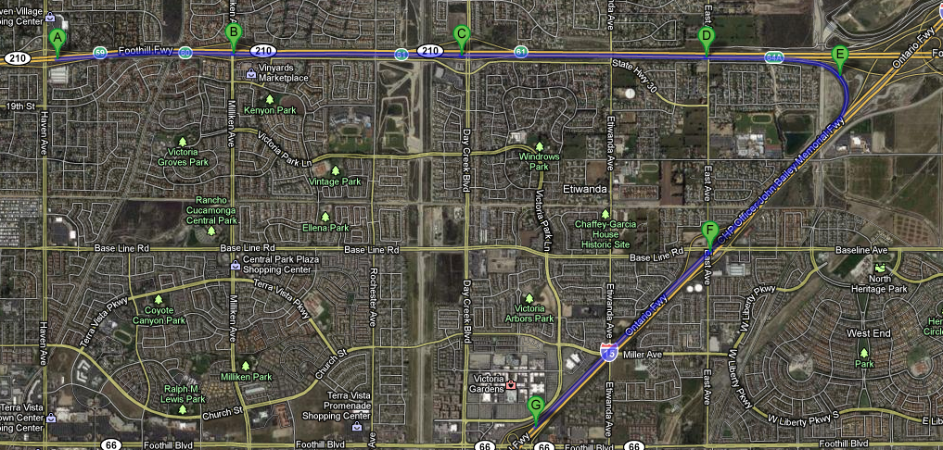
High Speed Mobility Driving Tests
Driving at 130Km/hr
With signal at -85 ~ -100 dbm (weak signal)

Slide 6
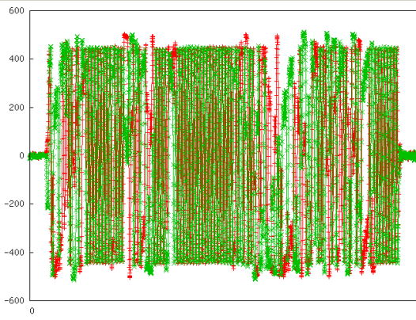
Waveform of a Well-Formed Packet
ADC output
45.6 ms

Slide 7
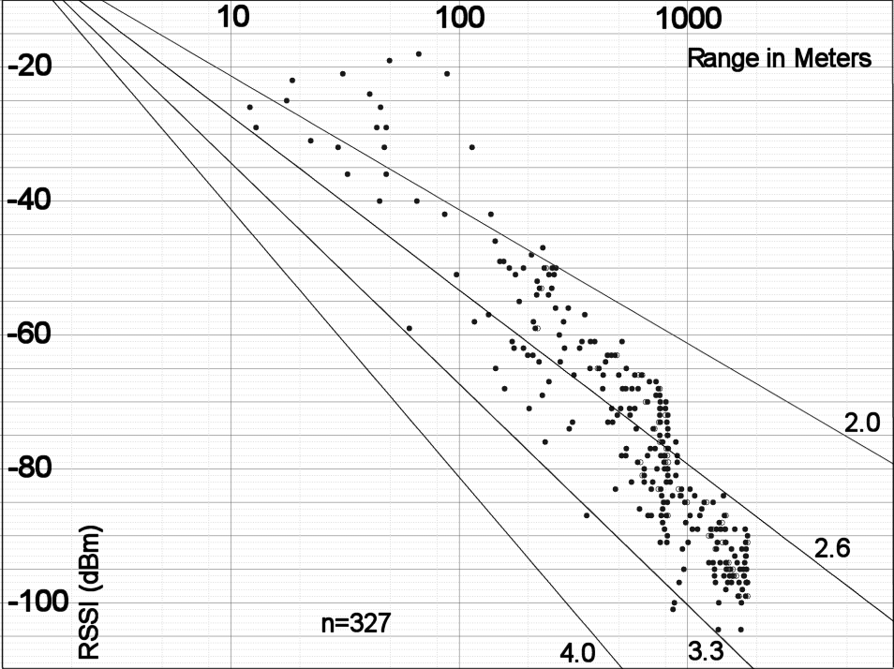
Measured 220 MHz Path Loss

Slide 8
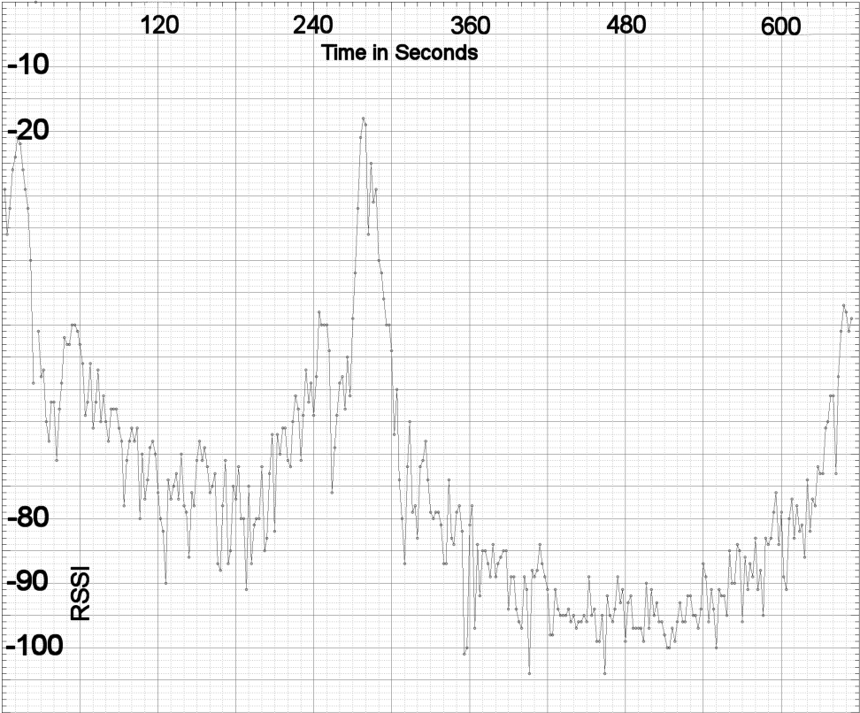
RSSI wrt Time

Slide 9
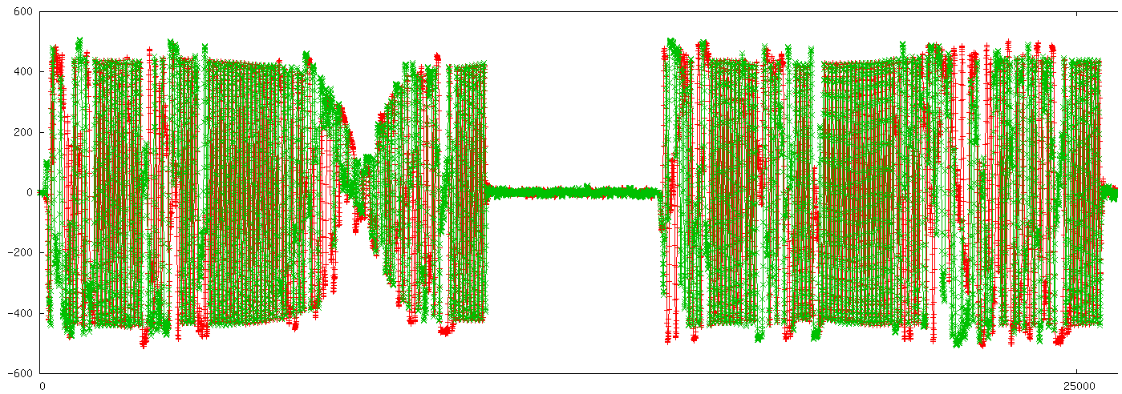
Effects of Fading Measured at Baseband
Good Packet
Faded Packet
Good Packet
Faded Packet

Slide 10
Adaptive Schemes to Combat Fading
Multiple data rates
Different coding rates and interleavers
Different modulation methods
Existing well vetted examples include 802.11a/b/g/n, 802.16e, and many more

Slide 11
Any Questions?

