Slide 1
Project: IEEE P802.15 Working Group for Wireless Personal Area Networks (WPANs)
Submission Title: [PAC Closing Report]
Date Submitted: [May 17, 2012]
Source: Myung-Jong Lee⁷
Company [CUNY]
Address [Dept of EE, CUNY, 140th St, New York, NY 10031] Voice:[+1-212-650-7260], FAX: [],
E-Mail:[lee@ccny.cuny.edu]
Re: [.]
Abstract: []
Purpose: [Report of PAC activities during May 2012 Interim meeting at Atlanta, Georgia]
Notice: This document has been prepared to assist the IEEE P802.15. It is offered as a basis for discussion and is not binding on the contributing individual(s) or organization(s). The material in this document is subject to change in form and content after further study. The contributor(s) reserve(s) the right to add, amend or withdraw material contained herein.
Release: The contributor acknowledges and accepts that this contribution becomes the property of IEEE and may be made publicly available by P802.15.

Slide 2
PAC Closing Report
May 17, 2012

Slide 3
Meeting Objectives
Officer Election (Chair, Vice Chair, Secretary, Technical Editors)
Presentations responding to Call for Applications
Discussion on Applications Matrix
Discussion on Technical Guidance Document

Slide 4
Achievements
8 time slots at this meeting
10 Presentations on Applications & features of PAC
Jinyoung Chun (LGE): Doc. 246r0
Igor Dotlic (NICT) : Doc. 251r0
Eldad Zeira (InterDigital): Doc. 230r1
Byung-Jae Kwak (ETRI): Doc. 227r1
Huan-Bang Li (NICT): Doc. 254r0
Marco Hernandez (NICT): Doc. 259r0
Seunggeun Jin (ETRI): Doc. 2551r0
Eldad Zeira, Qin Li (InterDigital): Doc. 272r0
Seunghoon Park (Samsung): Doc. 248r0
Cheol Ryu (ETRI): Doc. 287r0

Slide 5
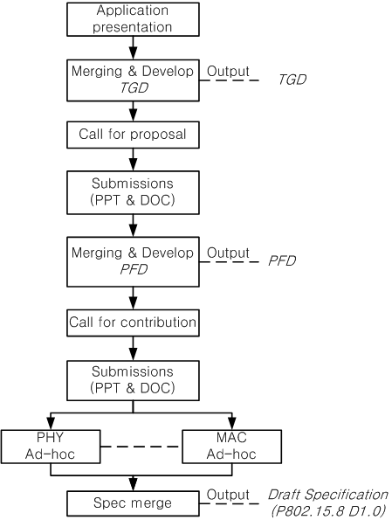
TG Procedure

Slide 6
Timeline
TG formation Mar 12
Call for Application April 12
Application presentation May 12
TGD approval/Call for proposal Sep 12
Preliminary proposal presentation Nov 12
Final proposal presentation Jan 13
PAC Framework Document/Call for contribution May 13
Contribution presentation July 13
Draft spec (P802.15.8 D1.0) complete/Letter Ballot Mar 14
LB Comment resolution/ LB recirculation May 14
Sponsor Ballot Jan 15
RevCom submission July 15
Slide 5

Slide 7
TG8 PAC Officers
Chair:
Myung Lee (CUNY)
Vice Chair:
Hun-Bang Li (NICT), Suhwook Kim (LGE)
Editors:
Shannon Park (Samsung), Seunggeun Jin (ETRI)
Secretary (TBD)

Slide 8
Plan for San Diego
Teleconference (if necessary)
Teleconf. bridge provided by Samsung
International: 1-972-301-6000
Toll Free(USA): 1-877-776-7842
Prepare Application Matrix
Prepare Technical Guidance document

Slide 9
WG Motion
Move to affirm Myung Lee as the Chair for TG8 Peer Aware Communications.
Moved:
Seconded:
Yes: No: Abstain

