Slide 1
Project: IEEE P802.15 Working Group for Wireless Personal Area Networks (WPANs)
Submission Title: Chanel change notification enhancement
Date Submitted: [May 16 2012]
Source:[Benjamin A. Rolfe]
Company [Blind Creek Associates]
Address []
Voice: [+1.408.395.7207], FAX: [None], E-Mail: [ben @ blindcreek.com]
Re:[Progress and MAC work]
Abstract:[proposed solution for comment resolution, working group ballot]
Purpose:[Refine and complete technical content of draft]
Notice: This document has been prepared to assist the IEEE P802.15. It is offered as a basis for discussion and is not binding on the contributing individual(s) or organization(s). The material in this document is subject to change in form and content after further study. The contributor(s) reserve(s) the right to add, amend or withdraw material contained herein.
Release: The contributor acknowledges and accepts that this contribution becomes the property of IEEE and may be made publicly available by P802.15.

Slide 2
Generalized Channel Switch

Slide 3
Summary
Change from MAC command to IE
May be appended to Beacon, Command, Data frame, or Multipurpose frame.
Add PHY specific description of what to switch to
Can support existing PHYs and provides extensible path for the future.
Generalize scale for time

Slide 4
Why IE instead of command
IE can be attached to various frame types and support multiple scenarios
Can add IE to periodic beacon for repetition in beacon enabled PAN
Enhanced reliability, accommodate sleepy devices, blocking, etc.
Advertises to all associated devices
Can be added to directed frame to target a single device
aperiodic beacon, beacon request, data frame, Multi-purpose frame, any command frame
Can be individually acknowledged or repeated (stronger)

Slide 5
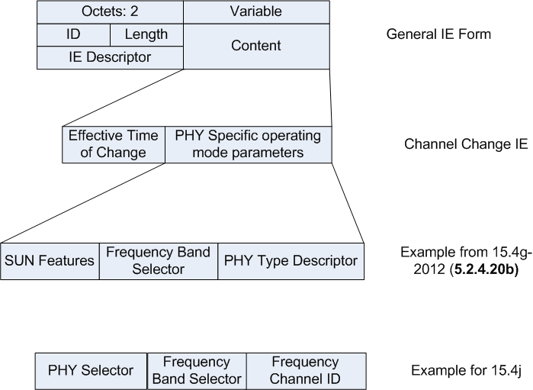
IE format

Slide 6
Detailed Example: LECIM Proposed operating parameters encoding
Bit Number | Description
0:3 | Operating Band: 0 = Invalid 1-9 defined 10-15 reserved
4:12 | Channel Number. The maximum valid value depends on the operating band according to Table 1.
13 | Position Modulation supported.
14:15 | Symbol rate. 0 = 37.5 ksps 1 = 25 ksps 2 = 12.5 ksps
16 | Channel spacing: 0 = Channel spacing for indicated operating band as given in Table 195 1 = Channel spacing for indicated operating band as given in Table 196
17 | FEC Enabled 0 = not enabled 1 = enabled
18 | Interleaving Enabled: 0 = not enabled 1 = enabled
19 | Scrambler enabled: 0 = not enabled 1 = enabled
20 | Short PHR may be used 1= yes, 0 = no
21 | Long PHR may be used 1= yes, 0 = no
22:31 | Reserved

