Slide 1
Project: IEEE P802.15 Working Group for Wireless Personal Area Networks (WPANs)
Submission Title: [DSSS Channelization for TG4K ]
Date Submitted: [20, May, 2012]
Source: [Shu Kato, Hiroyuki Nakase, Hirokazu Sawada [Tohoku University], David Howard [On-Ramp], Kyung Sup Kwak, M. Al Ameen [Inha University], Shusaku Shimada [Yokogawa Co.]
Address: [2-1-1, Katahira, Aoba-ku, Sendai, Miyagi, Japan]
Voice:[+81-22-217-5506], FAX: [+81-22-217-5476], E-Mail:[shukato@riec.tohoku.ac.jp]
Re: [DSSS Channelization for 8082.15.4k]
Abstract: [DSSS Channelization for TG4K is proposed]
Purpose: [Presented to the IEEE802.15.4k LECIM task group for consideration]
Notice: This document has been prepared to assist the IEEE P802.15. It is offered as a basis for discussion and is not binding on the contributing individual(s) or organization(s). The material in this document is subject to change in form and content after further study. The contributor(s) reserve(s) the right to add, amend or withdraw material contained herein.
Release: The contributor acknowledges and accepts that this contribution becomes the property of IEEE and may be made publicly available by P802.15.

Slide 2
DSSS Channelization for TG4K
May 17, 2012
Shu Kato, Hiroyuki Nakase, Hirokazu Sawada (RIEC Tohoku University)
David Howard (On-Ramp)
Kyung Sup Kwak, M. Al Ameen (Inha University)
Shusaku Shimada (Yokogawa Co.)

Slide 3
Summary
A common channelization in Japan, Korea and USA has been reviewed and three (4) formulas have been created for four different chip rates to satisfy 900 MHz band regulations in USA, Korea and Japan, the most stringent regulations.
For this work, a unit channel (200 kHz) regulated by Japanese Ministry of Internal Affairs and Communications has been selected to formulate one formula for three countries by assuming
i. Transmit root raised cosine filters with a roll off factor of 1 for Japanese channelization through this doc. to meet stringent adjacent channel leakage and spurious
ii: Transmit root raised cosine filters with a roll off factor of smaller than 1 for 1 M c/s transmission in Korea and USA where no adjacent channel leakage regulations
The channelization presented in this doc. is useful for harmonized channelization in the three countries and hopefully for more related countries

Slide 4
900 MHz available Band and Transmission power for TG4K
Available band:
i. USA: 902 – 928 MHz, no channelization required
ii. Japan: 918 – 930 MHz (920.5 to 928 MHz for TG4K applications), 200 kHz as a unit channel (100 kHz unit channels for the band, 928 – 930 MHz – not considered)
iii. Korea: 917.1 – 923.5 MHz, 100 kHz as a unit channel
2. Transmission power / antenna gain:
i. USA: ~ 1W / 6 dBi
ii. Japan: ~ 250 mW, ~ 20 mW, (~1 mW: not considered in this doc.) / 3 dBi
iii. Korea: ~ 3 mW, 10 mW

Slide 5
900 MHz Chip Rate and Channelization
Transmission chip rate |  | Japanese Bandwidth | Korea Bandwidth | USA Bandwidth
100 kc/s |  | 200 kHz Select one of pre-allocated channels from 920.5 - 929.7 MHz) | 200 kHz Any 200 kHz out of 917.00 - 923.5 MHz) | Any 200 kHz out of 902.00 – 928.00 MHz
200 kc/s |  | 400 kHz Select one of pre-allocated channels from 920.5 - 929.7 MHz) | 400 kHz Any 400 kHz out of 917.00 - 923.5 MHz) | Any 400 kHz out of 902.00 – 928.00 MHz
500 kc/s |  | 1 MHz Select one of pre-allocated channels from 920.5 - 929.7 MHz) | 1 MHz Any 1 MHz out of 917.00 - 923.5 MHz) | Any 1 MHz out of 902.00 – 928.00 MHz
1Mc/s |  | NA | 2MHz Any 2 MHz out of 917.00 - 923.5 MHz) | Any 2 MHz out of 902.00 – 928.00 MHz

Slide 6
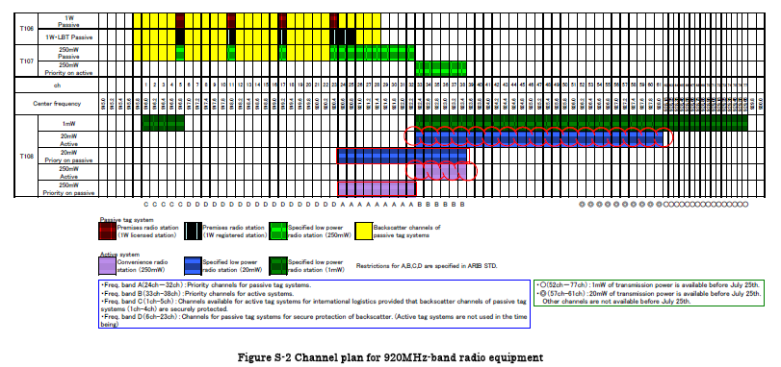
920 MHz Channel plans in Japan: focusing on 20 mW and 250 mW TX power channels(920.5 – 928 MHz)

Slide 7
Middle and Low Power Mode (Basic)
. Applications: Sensor networks, Smart meters
. Frequency : 920.5 – 927.9 MHz
. Antenna power : <= 20 mW (920.5 – 927.9 MHz)
: <= 250 mW (920.5 – 923.5.MHz)
. Antenna gain : <= 3 dBi
. Channel bandwidth: 200 kHz x N (N=1~5)
. Adjacent channel leakage power:
: <= - 5dBm (250 mW Tx power)
: <= – 15 dBm (20 mW Tx power)
. Carrier sense level: -80 dBm
. Transmission control
Carrier sense time | Sending duration | Pause duration | The amount of sending time summed for 1 hour
>= 128 micro s | <= 400 ms | . >= 2 ms (Sending time >= 6 ms), . Not needed (sending time < 6 ms) | <= 360 s

Slide 8
Low Power Mode (Extended)
. Applications: Telemetering, Tele control
. Frequency : 920.5 – 923.5 MHz
. Antenna power : <= 20 mW
. Antenna gain : <= 3 dBi
. Channel bandwidth : 200 kHz x N (N=1~5)
. Adjacent channel leakage power:
: - 18 dBm
. Carrier sense level : -80 dBm
. Transmission control
Carrier sense time | Sending duration | Pause duration | The amount of sending time summed for 1 hour
>= 5ms | <= 4 s* | . >= 50 ms | Don’t care
The sender can transmit again during continuous sending time if it does carrier
Sense longer than 128 micro s at every transmission

Slide 9
920 MHz channelization in Japan - revised
Last time, I presented the channelization (draft) (12-0189-r2) based on the assumptions
(1) the channelization in USA will start at every MHz from 902 to 928 MHz,
(2) accommodating more capacity per channel bandwidth,
However, after the discussions with the proposers of Korea and the representative of DSSS camp in TG4K, Channelization policy has changed as following:
USA 900 band channelization can be done by 200 kHz increment,
USA channelization may not be necessary to start at every MHz,
Korea 900 MHz channelization can be flexible to start with 200 kHz granularity,
Channel bandwidth may be relaxed as 0.5 c/s/Hz,
Due to (4), filtering strategies of with the specific level at channel edge or not may not impact channelization at all
In the following view graphs, Japanese channelization in 920.5 MHz to 927.9 MHz is considered followed by channel coordination between Japan, Korea and USA.

Slide 10
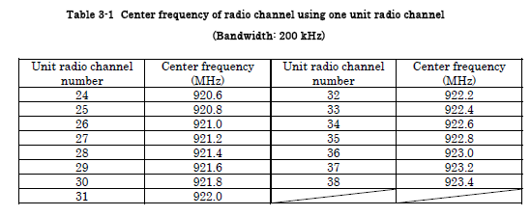
Channelization for Middle and Low Power Mode (Basic) in Japan
Band: 920.5 – 923.5 MHz (Tx Power: 250 mW, Ant gain: 3dBi)
200 kHz channelization for 100kc/s transmission
: 15 channels in all available (ch. 24 – 38)

Slide 11
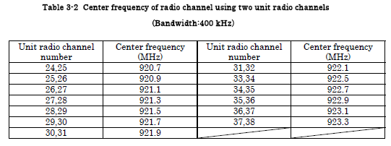
(2) 400 kHz channelization for 200kc/s transmission
: 7channels in all available (ch. 24 &25 – 37&38)

Slide 12
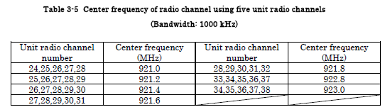
(3) 1 MHz channelization for 500kc/s transmission
: 2 channels in all available
Ch. 28 &29&30&31&32 (921.3 – 922.3 MHz) – (Fc= 921.8 MHz)
Ch. 33&34&35&36&37 (922.3 – 923.3 MHz) – (Fc= 922.8 MHz)

Slide 13
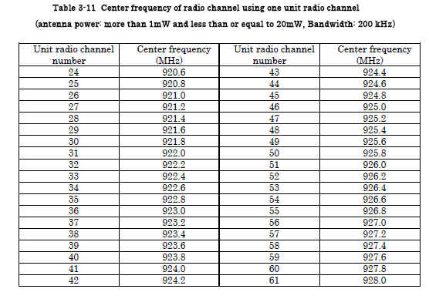
Low Power Mode
Tx Power: 20 mW, Ant gain: 3dBi
Band: 920.5 – 927.9 MHz (Ch. 24 – 60)
(1). 200 kHz channelization for 100kc/s transmission
: 37 channels in all available

Slide 14
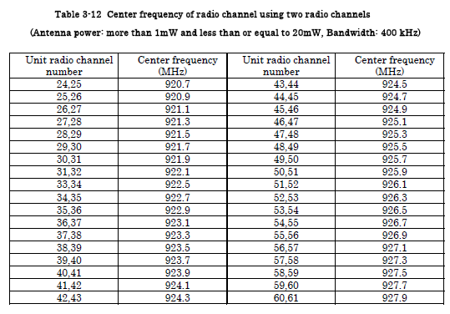
(2) 400 kHz channel bandwidth for 200kc/s transmission
: 18channels in all available (ch. 24 &25 – 37&38)
Examples: Ch. 24&25 (920.5 – 920.9 MHz), Ch. 26&27 (920.9 – 921.3 MHz), …

Slide 15
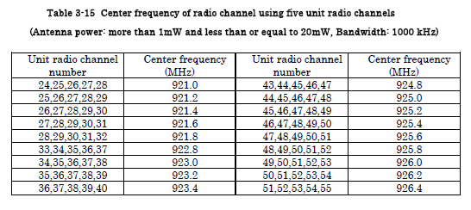
(3) 1 MHz channelization for 500kc/s transmission
: 4 channels in all available
Ch. 28 &29&30&31&32 (921.3 – 922.3 MHz) – Fc = 921.8 MHz
Ch. 33&34&35&36&37 (922.3 – 923.3 MHz) – Fc = 922.8 MHz
Ch. 43&44&45&46&47 (924.3 – 925.3 MHz) – Fc = 924.8 MHz
Ch. 48&49&50&51&52 (925.3 – 926.3 MHz) – Fc = 925.8 MHz
Channelization example:

Slide 16
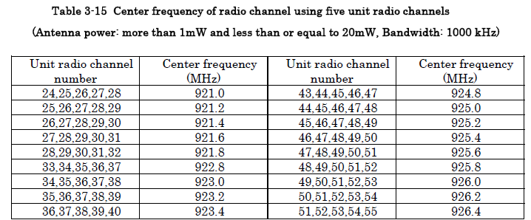
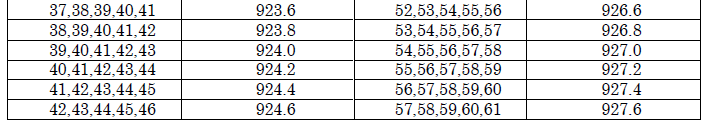
(3) 1 MHz channelization for 500kc/s transmission: 4 channels in all available
Ch. 28 &29&30&31&32 (921.3 – 922.3 MHz) – Fc = 921.8 MHz
Ch. 33&34&35&36&37 (922.3 – 923.3 MHz) – Fc = 922.8 MHz
Ch. 38&39&40&41&42 (923.3 – 924.3 MHz) – Fc = 923.8 MHz
Ch. 43&44&45&46&47 (924.3 – 925.3 MHz) – Fc = 924.8 MHz
Ch. 48&49&50&51&52 (925.3 – 926.3 MHz) – Fc = 925.8 MHz
Ch. 53&54&55&56&57 (926.3 – 927.3 MHz) – Fc = 926.8 MHz

Slide 17
USA and Japanese channelization (in the bracket)
Channel bandwidth:
200 kHz
Fc= 902.2 + (N-1) x 0.2 (1)
N= 1 – 129 (93-129 in Japan)
Ex. N=93 gives Japanese Ch.24 center frequency
400 kHz
Fc = 902. 3 + (N-1) x 0.4 (2)
N= 1- 64 (47 – 64 in Japan)
1 MHz
Fc= 902. 8 + (N-1) x 1 (3)
N= 1 – 25 (20 – 25 in Japan)
4. 2 MHz
Fc= 903+ (N-1) x 2 (4)
N=1 - 13 (NA in Japan)

Slide 18
Korean Channelization (12-0245-r0)
Available band: 917.1 – 923.5 MHz
Chip rate: 100, 200, 500, 1,000 kc/s
Channel bandwidth: 200, 400, 1,000, 2,000 kHz respectively
Channelization policy - suggested
i. 200 kHz incremental bandwidth extension
ii. Starting with 917.1 MHz and flexible
5. For 200 kHz channelization
Fc= 902.2 + (N-1) x 0.2 (1)
N= 76 – 107
6. For 400 kHz channelization
Fc = 902. 3 + (N-1) x 0.4 (2)
N= 39 – 53
7. For 1,000 kHz channelization
Fc= 902. 8 + (N-1) x 1 (3)
N= 16 – 21
8. For 2,000 kHz channelization
Fc 903+ (N-1) x 2 (4)
N=9, 10

Slide 19
Conclusion
A common channelization in Japan, Korea and USA has been reviewed and three (4) formulas have been created for four different chip rates to satisfy 900 MHz band regulations in USA, Korea and Japan, the most stringent regulations.
For this work, a unit channel (200 kHz) regulated by Japanese Ministry of Internal Affairs and Communications has been selected to formulate one formula for three countries by assuming
i. Transmit root raised cosine filters with a roll off factor of 1 for Japanese channelization through this doc. to meet stringent adjacent channel leakage and spurious
ii: Transmit root raised cosine filters with a roll off factor of smaller than 1 for 1 and 2 M c/s transmission in Korea and USA where no adjacent channel leakage regulations
The channelization presented in this doc. this is useful for harmonized channelization in the three countries and hopefully for more related countries

Slide 20
Out of band power leakage regulations: +4 dBm
Out of band power regulation (920MHz band)
STD-108 Pout=250mW (24dBm)
Channel edge regulations
Pout=24dBm
Appendix 1
Channel edge regulation
(In the case of using 920.0~922.3MHz)
+4dBm
Adjacent channel
-5dBm/200kHz
Adjacent channel
-5dBm/200kHz
-29dBm/100kHz
-29dBm/100kHz
-30dBm/1MHｚ
-36dBm/100kHz
-36dBm/100kHz
-36dBm/100kHz
-55dBm/1MHz
-55dBm/100kHz
-55dBm/100kHz
-45dBm/1MHz
710
900
915
920.3
Occupied
bandwidth
200kHz x N
924.3
930
1000
1215
Frequency
[MHz]
-200kHz
+200kHz

Slide 21
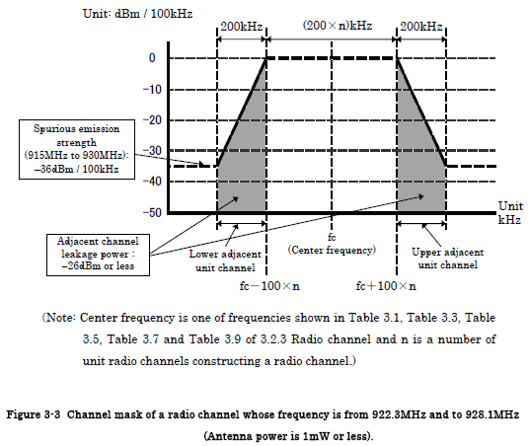
Appendix 2
Adjacent channel leakage regulations: -26 dBm or less
922.3MHz - 928.1MHz (Ch. 33～61)
A. Power level limitation at the edge of occupied band: Not specified – possible to transmit up to 1Mcps
B. Adjacent channel leakage power : less than -26 dBm/200 kHz
C. Further outer bands (shown in the following picture)
: -36 dBm/100 kHz (-36 dBc from the peak power)

