Slide 1
doc.: IEEE 15-12-0279-00-wng0
Project: IEEE P802.15 Working Group for Wireless Personal Area Networks (WPANs)
Submission Title: [Standardization Issues in LED-ID Techniques]
Date Submitted: [May 14, 2012]
Source: [Yeong Min Jang, Vu Van Huynh]
[Kookmin University]
Address [Kookmin University, Seoul, Korea]
Voice:[82-2-910-5068], FAX: [82-2-910-5068], E-Mail:[yjang@kookmin.ac.kr]
Re: []
Abstract: [] 15-12-0279-00-wng0
Purpose: [Contribution to IEEE 802.15 IG-LED]
Notice: This document has been prepared to assist the IEEE P802.15. It is offered as a basis for discussion and is not binding on the contributing individual(s) or organization(s). The material in this document is subject to change in form and content after further study. The contributor(s) reserve(s) the right to add, amend or withdraw material contained herein.
Release: The contributor acknowledges and accepts that this contribution becomes the property of IEEE and may be made publicly available by P802.15.
Notes:
doc.: IEEE 802.15-09-0117-00-0007
<month year>

Slide 2
Contents
doc.: IEEE 15-12-0279-00-wng0
Introduction
Standardization issues in PHY
Standardization issues in MAC
Conclusion

Slide 3
Network Architecture for LED-ID Application
doc.: IEEE 15-12-0279-00-wng0
1 | Wake Up | Tag wakes up when readers send request
2 | Beacon | Tag will be synchronized by superframe
3 | Request | Reader requests traffic
4 | Resource Allocation | Tag allocates slots based on reader’s request
5 | Data Transmission | Data transmission using allocated slot

Slide 4
Comparison of ID Technologies
doc.: IEEE 15-12-0279-00-wng0
 | Bar Code | RFID (Passive) | LED-ID
Signal Format (Transmission medium) | Printed image | RF | LED light (Visible Light Infra-red Light Ultra Violet Light etc)
Reliability | Wrinkled or smeared labels will not be read | Nearly flawless read rate | Flawless read rate
Readable through objects | No, must be line of sight | Yes | Depend on FOV
Orientation dependence | Yes | No
Read speed | Slow | Fast | Variable Speed
Multiple tags | No | Yes (10-1000 tags per second) | Yes
Updateable | No | Yes | Yes
Data type | Non real-time | Non real-time | Non real-time and real-time
Tag and reader position | Scanner needs to see the bar code to read it | No need to bring the tag near the reader | Need to bring within the FOV
QoS | No need | Not support QoS | Support QoS
Communication | Half-duplex | Duplex | Duplex
Possibility to use Existing Infrastructure | No, New setup | No, New setup | Yes Existing infrastructure may be used

Slide 5
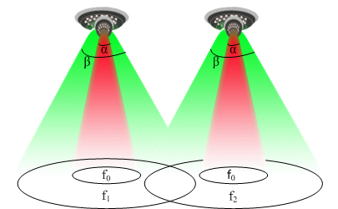
Interference Management
doc.: IEEE 15-12-0279-00-wng0
Difference frequency using for difference FOV.
Interference avoidance and increasing the utilizing bandwidth

Slide 6
MAC Approach
doc.: IEEE 15-12-0279-00-wng0
Processing state
Process of Tag

Slide 7
MAC Approach
doc.: IEEE 15-12-0279-00-wng0
Process of Reader

Slide 8
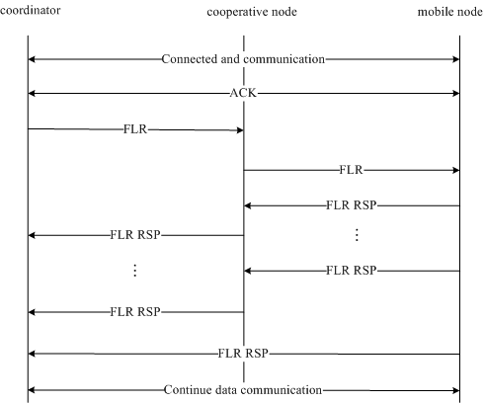
Link Recovery
doc.: IEEE 15-12-0279-00-wng0
Unreliable LED-ID link for obstacles.
Recover the link ASAP
Link Recovery Scheme using Cooperative Communication
Sender
Receiver
Relay node

Slide 9
Location-Aware Fast Link Switching Scheme
doc.: IEEE 15-12-0279-00-wng0
Multi-tags scenario of LED-ID system
Tag#1
Tag#4
Tag#7
Direction
Tag#2
Tag#5
Tag#8
Serving Tag
Tag#3
Tag#6
Tag#9

Slide 10
Location-Aware Fast Link Switching Scheme
doc.: IEEE 15-12-0279-00-wng0
Tag #1 | (X1, Y1)
Tag #4 | (X4, Y4)
Tag #5 | (X5, Y5)
Tag #1 (X1,Y1)
Tag #4 (X4,Y4)
Neighbor Position Table of Serving Tag
(X3,Y3)
Current Position
Past Position
(X2,Y2)
Past Position | (X1, Y1)
Current Position | (X2, Y2)
Predicted Position | (X3, Y3)
L3
(X1,Y1)
L2
L1
Serving Tag
α2
α3
Tag 2 (X2,Y2)
α1
Tag #5 (X5,Y5)
Reader Position Table of Serving Tag
α

Slide 11
Cooperative and Relay Network
doc.: IEEE 15-12-0279-00-wng0
Direct communication
Multi-hop communication
Cooperative communication
Increase the coverage
Reduce blocking probability
Applicable to a Link recovery scheme

Slide 12
Cooperative MAC Protocol for LED-ID
doc.: IEEE 15-12-0279-00-wng0
Why using Cooperative and Relay Network for LED-ID
Interference from another light source
Link disconnection from movement obstacle
Limited of FOV
Applications
Real-time service: QoS application
Advantages
Reliable network
Increasing the coverage
Disadvantages
Working on dense mobile node ( discovery relay node)
Large FOV
Complexity

Slide 13
Conclusion
doc.: IEEE 15-12-0279-00-wng0
LED-ID is one of the ID techniques and it has many advantages of using visible light.
The issues which are presented will be the important topics in future standardization about LED-ID.
FOV limitation is one of the most important issues in LED-ID techniques.
Contribute to IG-LED about the LED-ID issues starting July meeting.

