Slide 1
doc.: IEEE 15-12-0278-00-wng0
Project: IEEE P802.15 Working Group for Wireless Personal Area Networks (WPANs)
Submission Title: [Standardization Issues for LBS using LED]
Date Submitted: [14 May, 2012]
Source: [Yeong Min Jang, Tuan Nguyen, and Nirzhar Saha]
[Kookmin University]
Address [Kookmin University, Seoul, Korea]
Voice:[82-2-910-5068], FAX: [82-2-910-5068], E-Mail:[yjang@kookmin.ac.kr]
Re: []
Abstract: [Standardization Issues for LBS using LED]
Purpose: [Contribution to IEEE 802.15 WNG]
Notice: This document has been prepared to assist the IEEE P802.15. It is offered as a basis for discussion and is not binding on the contributing individual(s) or organization(s). The material in this document is subject to change in form and content after further study. The contributor(s) reserve(s) the right to add, amend or withdraw material contained herein.
Release: The contributor acknowledges and accepts that this contribution becomes the property of IEEE and may be made publicly available by P802.15.
Notes:
doc.: IEEE 802.15-09-0117-00-0007
<month year>

Slide 2
Contents
doc.: IEEE 15-12-0278-00-wng0
Motivation
LED Localization vs. RF Localization
Indoor Positioning Techniques
  TDOA Measurement
  RSSI Measurement
  AOA Measurement
  Comparison of Indoor Positioning Techniques
Conclusions

Slide 3
Motivation
doc.: IEEE 15-12-0278-00-wng0
Applications of LED
  Traffic Notification
  Automotive Vehicle Location
  Self Guided Tours
  Indoor Navigation
  Ubiquitous indoor positioning support.

Slide 4
LED Localization vs. RF Localization
doc.: IEEE 15-12-0278-00-wng0
 | LED Localization | RF Localization
Bandwidth | Unlimited, 400nm~700nm | Regulatory, BW Limited
EMI | No | Yes
Power consumption | Relatively low | Medium
Visibility security | Yes | No
Infrastructure | LED Illumination | Access Point or BS
Coverage, Distance | Narrow, Short | Wide, Medium
Resolution | cm | m
Implementation Complexity | Lower complexity | Higher complexity

Slide 5
Indoor Positioning Techniques
doc.: IEEE 15-12-0278-00-wng0
Time Different of Arrival(TDOA)
Time of Arrival(TOA)
Received Signal Strength Indication(RSSI)
Angle of Arrival(AOA)
Pseudolite
Multipath pattern
Optical tracking
Magnetic tracking

Slide 6

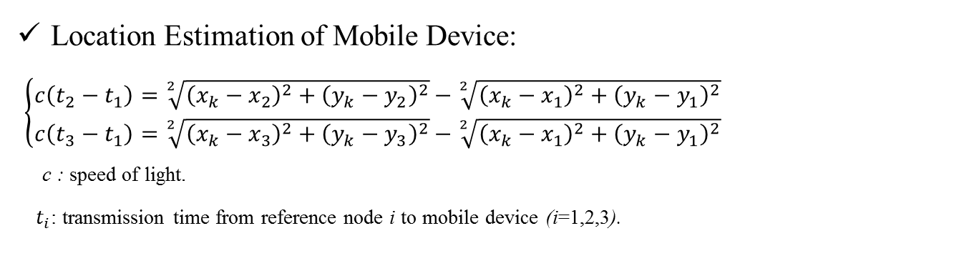



Time Difference of Arrival (TDOA) Measurement [1]
Location Estimation of Mobile Device:
$\left\{\begin{aligned}c\left(t_{2}−t_{1}\right)=\sqrt[2]{{\left(x_{k}−x_{2}\right)}^{2}+{\left(y_{k}−y_{2}\right)}^{2}}−\sqrt[2]{{\left(x_{k}−x_{1}\right)}^{2}+{\left(y_{k}−y_{1}\right)}^{2}} \\ c\left(t_{3}−t_{1}\right)=\sqrt[2]{{\left(x_{k}−x_{3}\right)}^{2}+{\left(y_{k}−y_{3}\right)}^{2}}−\sqrt[2]{{\left(x_{k}−x_{1}\right)}^{2}+{\left(y_{k}−y_{1}\right)}^{2}}\end{aligned}\right.$
  c : speed of light.
  $t_{i}$: transmission time from reference node i to mobile device (i=1,2,3).
$$\left(x_{3},y_{3}\right)$$
$$\left(x_{2},y_{2}\right)$$
$$\left(x_{k},y_{k}\right)$$
TDOA measurements need at least three reference points.
$$\left(x_{1},y_{1}\right)$$

Slide 7

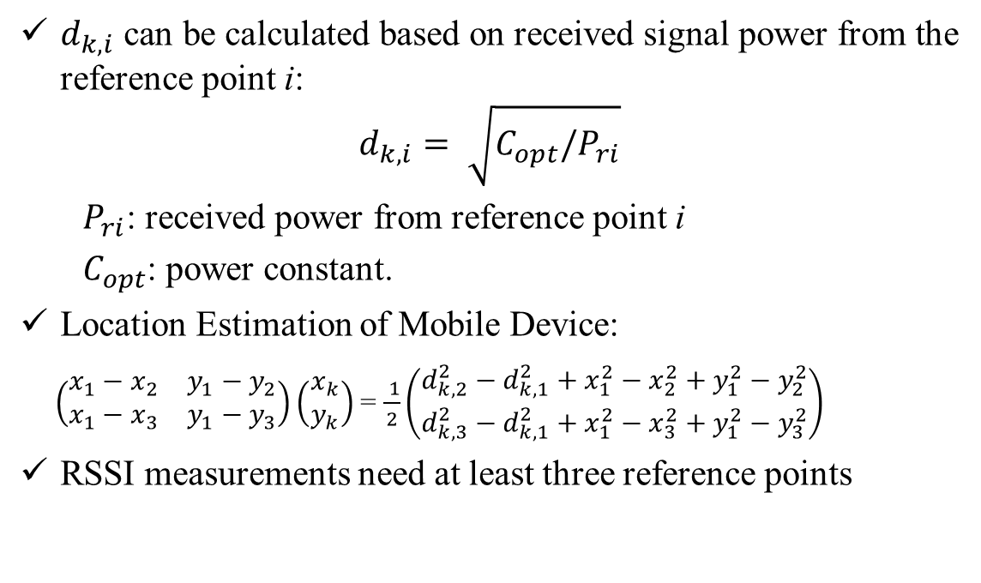



Received Signal Strength Indication (RSSI) Measurement [2]
$d_{k,i}$ can be calculated based on received signal power from the reference point i:
$$d_{k,i}= \sqrt{C_{opt}/P_{ri}}$$
$P_{ri}$: received power from reference point i
$C_{opt}$: power constant.
Location Estimation of Mobile Device:
$\left(\begin{matrix}x_{1}−x_{2} & y_{1}−y_{2} \\ x_{1}−x_{3} & y_{1}−y_{3}\end{matrix}\right)\left(\begin{matrix}x_{k} \\ y_{k}\end{matrix}\right)$= $\frac{ 1}{2}\left(\begin{matrix}d_{k,2}^{2}−d_{k,1}^{2}+x_{1}^{2}−x_{2}^{2}+y_{1}^{2}−y_{2}^{2} \\ d_{k,3}^{2}−d_{k,1}^{2}+x_{1}^{2}−x_{3}^{2}+y_{1}^{2}−y_{3}^{2}\end{matrix}\right)$
RSSI measurements need at least three reference points
$$\left(x_{3},y_{3}\right)$$
$$\left(x_{2},y_{2}\right)$$
$$\left(x_{k},y_{k}\right)$$
$$\left(x_{1},y_{1}\right)$$

Slide 8





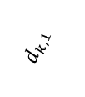

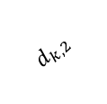
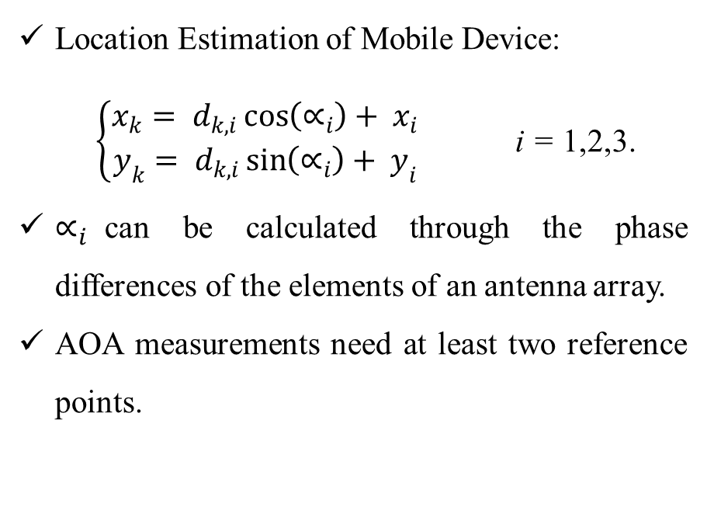
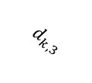

Angle of Arrival (AOA) Measurement [3]
Location Estimation of Mobile Device:
$\left\{\begin{aligned}x_{k}= d_{k,i}\cos\left(∝_{i}\right)+ x_{i} \\ y_{k}= d_{k,i}\sin\left(∝_{i}\right)+ y_{i}\end{aligned}\right.$ i = 1,2,3.
$∝_{i}$can be calculated through the phase differences of the elements of an antenna array.
AOA measurements need at least two reference points.
$$∝_{3}$$
$$\left(x_{3},y_{3}\right)$$
$$d_{k,3}$$
$$\left(x_{2},y_{2}\right)$$
$$∝_{2}$$
$$\left(x_{k},y_{k}\right)$$
$$d_{k,2}$$
$$d_{k,1}$$
$$∝_{1}$$
$$\left(x_{1},y_{1}\right)$$

Slide 9
Comparison of Indoor Positioning Techniques [4]
doc.: IEEE 15-12-0278-00-wng0
 | TDOA | TOA | RSSI | AOA
Primary Observeability | Signal travel time difference between the user and the base stations | Signal travel time between the user and the base stations | Received signal strength | Time (range) to multiple cell-towers (minimum of three measurements is required)
Upgrade of the User Terminal or Network | Network interconnection | Supports legacy terminals Monitoring equipment at every base stations | None | Network interconnection Antenna arrays to measure angles
Location Calculation and Control | Network | Network | Network | Network
Accuracy | Moderate-to-high | Moderate-to-high | Moderate | Low-to-moderate
Implementation Complexity | Most complex | Complex | Simplest | More complex than RSSI

Slide 10
Conclusions
doc.: IEEE 15-12-0278-00-wng0
LED Communication is a promising technology for indoor positioning services.
A call for contribution in July meeting.

Slide 11
References
doc.: IEEE 15-12-0278-00-wng0
[1] S. Jung, S. Hann, and C. Park, “TDOA-Based Optical Wireless Indoor Localization Using LED Ceiling Lamps”, IEEE Transactions on Consumer Electronics, vol. 57, no. 4, pp. 1592-1597, Nov., 2011.
[2] Z. Jia, “A Visible Light Communication Based Hybrid Positioning Method for Wireless Sensor Networks”, In Proc. of Second International Conference on Intelligent System Design and Engineering Application, pp. 1367-1370, Jan., 2012.
[3] K. Yu and Y. J. Guo, “Statistical NLOS Identification based on AOA, TOA, and Signal Strength”, IEEE Transactions on Vehicular Technology, vol. 58, no. 1, pp. 274-286, Jan., 2009.
[4] H. A. Karimi and A. Hammad, Telegeoinformatics Location-Based Computing and Services, CRC Press, 2004.

