Slide 1
doc.: IEEE 15-12-0277-00-wng0
Project: IEEE P802.15 Working Group for Wireless Personal Area Networks (WPANs)
Submission Title: [Future Standardization Plan in IG-LED]
Date Submitted: [, 2012]
Source: [Yeong Min Jang, Vu Van Huynh]
[Kookmin University]
Address [Kookmin University, Seoul, Korea]
Voice:[82-2-910-5068], FAX: [82-2-910-5068], E-Mail:[yjang@kookmin.ac.kr]
Re: []
Abstract: []
Purpose: [Contribution to IEEE 802.15 IG-LED]
Notice: This document has been prepared to assist the IEEE P802.15. It is offered as a basis for discussion and is not binding on the contributing individual(s) or organization(s). The material in this document is subject to change in form and content after further study. The contributor(s) reserve(s) the right to add, amend or withdraw material contained herein.
Release: The contributor acknowledges and accepts that this contribution becomes the property of IEEE and may be made publicly available by P802.15.
Notes:
doc.: IEEE 802.15-09-0117-00-0007
<month year>

Slide 2
Contents
doc.: IEEE 15-12-0277-00-wng0
Overview IEEE 802.15.7 VLC
PHY layer
MAC sub-layer
Key issues in LED Communications
Conclusion

Slide 3
PHY layer
doc.: IEEE 15-12-0277-00-wng0
The PHY is responsible for the following tasks:
Activation and deactivation of the VLC transceiver
WQI (wavelength quality indicator) for received frames
Channel selection
Data transmission and reception
Error correction
Synchronization

Slide 4
MAC Sub-layer
doc.: IEEE 15-12-0277-00-wng0
The MAC layer handles all access to the physical layer and is responsible for the following tasks:
Generating network beacons if the device is a coordinator
Synchronizing to network beacons
Supporting VPAN association and disassociation
Supporting color function
Supporting visibility
Supporting dimming
Flicker removal scheme
Supporting visual indication of device status and channel quality
Supporting device security
Providing a reliable link between two peer MAC entities
Supporting mobility

Slide 5
Super-frame Structure
doc.: IEEE 15-12-0277-00-wng0
Contention access period (CAP)
The CAP shall start immediately following the beacon and complete before the beginning of the CFP on a super-frame slot boundary
Contention-free period (CFP)
The CFP shall start on a slot boundary immediately following the CAP and it shall complete before the end of the active portion of the super-frame.
Beacon
CAP
CFP

Slide 6
Multi-Frame Type
doc.: IEEE 15-12-0277-00-wng0
Proposed LED Communication for indoor LBS applications
Data Frame: Data
Control Frame: Beacon, Synchronization,
Acknowledgement, Command, CVD, location information.

Slide 7
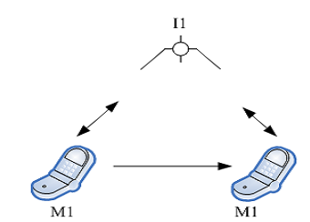
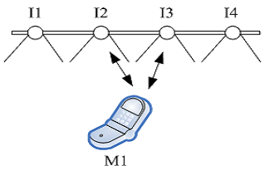
Mobility and Link Switching Issues
doc.: IEEE 15-12-0277-00-wng0
Mobility includes two types: physical and logical
Physical mobility occurs when the VLC
device M1 changes its position due to the
movement within the coverage area of
infrastructure I1
Logical mobility occurs when the device
M1 changes its communication link from
a link with infrastructure I2 to one with
infrastructure I3

Slide 8
Location-Aware Link Switching Scheme
doc.: IEEE 15-12-0277-00-wng0
Minimize the link switching delay.
Reduce the number of scanned neighbor tags

Slide 9
Position Based Mobile Cleaning Robot
doc.: IEEE 15-12-0277-00-wng0
Based on LBS service, provide mobile cleaning robot control in the indoor LED environment.

Slide 10
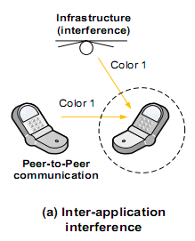
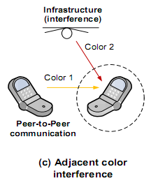
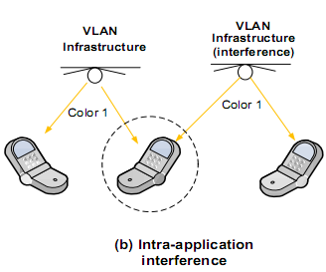
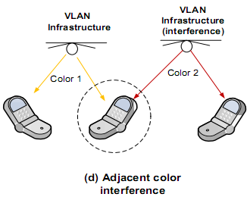
Interference Issues and Scenarios
doc.: IEEE 15-12-0277-00-wng0
Inter-application interference
Intra-application interference
Adjacent color interference

Slide 11
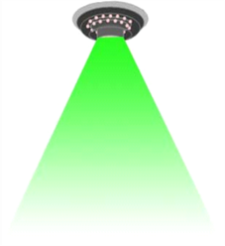
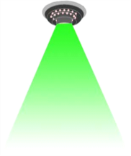
Hidden Terminal Problem in LED Communications
doc.: IEEE 15-12-0277-00-wng0
Current IEEE802.15.7 VLC specification:
Limited Field Of View (FOV)
Inefficient CSMA/CA
C can not sense B’s signal when it tries to
access the channel.
A
FOV
B
C

Slide 12
Dynamic FOV Adjustment
doc.: IEEE 15-12-0277-00-wng0
Dynamic FOV adjustment based on location information
Reduce interference.
Increase reliability.

Slide 13
Cooperative and Relay Networks
doc.: IEEE 15-12-0277-00-wng0
Direct
Direct communication
Less delay
High packet loss
Multi-hop communication
More delay
Low packet loss
LED
Reader
Multi-hop
LED
Reader #2
Reader #3

Slide 14
Cooperative and Relay Network
doc.: IEEE 15-12-0277-00-wng0
Performance improvement of LED-ID network
Delay
Throughput
Loss probability
Increase coverage
LED
Reader #2
Reader #3

Slide 15
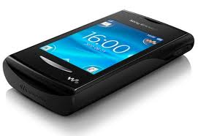
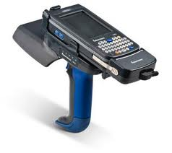
Visible RFID
doc.: IEEE 15-12-0277-00-wng0
RFID system
Visible RFID system
Tags
Tags
RF
Visible light
Reader
Reader

Slide 16
Visible RFID
doc.: IEEE 15-12-0277-00-wng0
Tag
VLC receiver
VLC transmitter
Reader
RF module
RF module
Communication interfaces
Identification process by VLC interface
Data transmission by RF interface
Advantage
Interference reduction
SNR improvement
Ranging selective tag
Efficient bandwidth utilization
Property | RF |  | VLC | Visible RFID
 | Active | Passive
PHY | RF | RF | VLC | VLC & RF
Sensing ability | Yes | No | FOV restriction | Utilizing the FOV characteristics
Collision | High | High | High | Low

Slide 17
Conclusion
doc.: IEEE 15-12-0277-00-wng0
IEEE 802.15.7 defines a PHY and MAC for short-range optical wireless communications using visible light
IEEE 802.15.7 is capable of delivering data rates sufficient to support:
Audio and video multimedia services.
Mobility of the visible link.
MAC layer that accommodates visible links.
Some key issues in current LED Communications and Positioning techniques: commercial services, implementation issues, support multi-frame type, fast link switching, LBS applications, interference management, hidden terminal problems, dynamic FOV, cooperative and relay network, visible RFID(RFID+VLC), spectrum relief issues, automobile applications, applications of smart phone .

