Slide 1
Project: IEEE P802.15 Working Group for Wireless Personal Area Networks (WPANs)
Submission Title: [IEEE 802.15.4p Positive Train Control Task Group Closing Session]
Date Submitted: [17 May 2012]
Source: [Jon Adams] Company [Lilee Systems Ltd.]
Address [2905 Stender Way, Suite 78, Santa Clara, CA 95054 USA]
Voice:[+1 480.628.6686], FAX: [Add FAX number], E-Mail:[jonadams@ieee.org]
Re: [If this is a proposed revision, cite the original document.]
[If this is a response to a Call for Contributions, cite the name and date of the Call for Contributions to which this document responds, as well as the relevant item number in the Call for Contributions.]
[Note: Contributions that are not responsive to this section of the template, and contributions which do
not address the topic under which they are submitted, may be refused or consigned to the “General Contributions” area.]
Abstract: [Closing Session Summary of Progress]
Purpose: [Overview of PTC activities to date and where we need to go next.]
Notice: This document has been prepared to assist the IEEE P802.15. It is offered as a basis for discussion and is not binding on the contributing individual(s) or organization(s). The material in this document is subject to change in form and content after further study. The contributor(s) reserve(s) the right to add, amend or withdraw material contained herein.
Release: The contributor acknowledges and accepts that this contribution becomes the property of IEEE and may be made publicly available by P802.15.

Slide 2
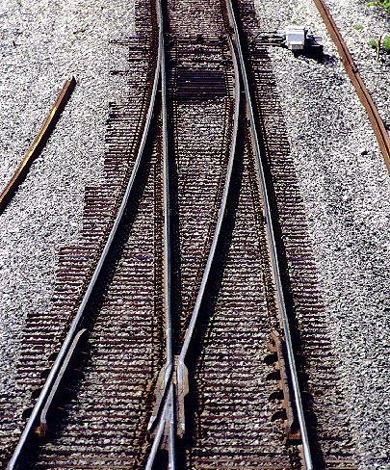
About Positive Train Control
Positive Train Control systems designed to prevent:
Train-to-train collisions
Overspeed derailments
Incursions into work zones
Movement through improperly configured switch
PTC systems are designed to override mistakes by human operators
Comprised of four subsystems
Locomotive segment
Wayside segment
Communications segment
Back office segment
Office
Communications Segment
Locomotive
Wayside

Slide 3
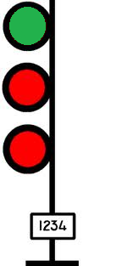
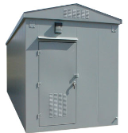
Where IEEE 802.15.4p Work Fits In
Adds vehicular mobility to 802.15.4
Initial application is interoperable communications between
Train and Wayside
Train and Network Infrastructure
Wayside and Network Infrastructure
Network Control Center

Slide 4
90 Participants from over 50 Entities
Siemens
US DOT
Sunrise Micro
US DOT FTA
Samsung Information Systems America
The Ohio State University
Electronics and Telecommunications Research Institute (Korea)
US DOT Volpe
Safetran (Invensys Rail)
Union Pacific RR
LG Electronics
Notor Research
CalAmp
Rail Safety Consulting
Institute for Infocomm Research
National Taiwan University
Qualcomm
Freescale
Kyocera
Interdigital
Tensorcom
Analog Devices
CSX
National Technical Systems
Parsons Brinckerhoff
Stantec
Bombardier Transportation
Rohde and Schwarz
Korea Railroad Research Institute
Lilee Systems
The Boeing Company
Semtech
Vinnotech
Noblis
Tohoku University REIC (Japan)
Beijing Univ of Posts and Telecommunications
NXP
Verizon
Authentec
Sensus
TU Braunschweig
Via Technologies
Halcrow
US DOT FRA
Philips
Astrin Radio
China Academy of Telecomm Research
Gannett Fleming
GE
APTA
Semaphore Group
Anritsu

Slide 5
15.4p Positive Train Control
Approved by NesCom and SA as Task Group 15.4p last month
Atlanta interim session first meeting as Task Group

Slide 6
15.4p Meeting Objectives
5 Time Slots
Technical Guidance Document draft and review, approval
Appoint chair
Hear responses to the CfA (15-11-0876-02)
Discuss technical proposal phase beginning at July session
Updated website

Slide 7
Technical Guidance Document
Draft document 802.15-12-0267-00 posted to Mentor
First revision r01 posted to Mentor on Wednesday
Will continue to fine-tune document over next few weeks

Slide 8
Nomination of Chair
Any nominees for role of Chair?
Adams
Motion to Recommend Chair
Mover: Heile
Second: Moskowitz
Yea/Nay/Abstain: unanimous
Nomination by group presented to 802.15 Chair

Slide 9
Motion to Affirm Chair
Move to affirm Jon Adams as chair of TG4p
Moved:
Seconded:
Y/N/A:

