Slide 1
Project: IEEE P802.15 Working Group for Wireless Personal Area Networks (WPANs)
Submission Title: TG procedure for PAC
Date Submitted: May 2012
Source: Suhwook Kim, Jinsoo Choi, Jinyoung Chun, JinSam Kwak (LG Electronics)
Address: LG R&D Complex 533, Hogye-1dong, Dongan-gu, Anyang-shi, Kyungki-do, Korea
Voice: +82-31-450-1901, FAX: +82-31-450-4049, E-Mail: suhwook.kim@lge.com
Re:
Abstract: TG8 procedure for PAC
Purpose: For a discussion on the TG8 future plan and procedure
Notice: This document has been prepared to assist the IEEE P802.15. It is offered as a basis for discussion and is not binding on the contributing individual(s) or organization(s). The material in this document is subject to change in form and content after further study. The contributor(s) reserve(s) the right to add, amend or withdraw material contained herein.
Release: The contributor acknowledges and accepts that this contribution becomes the property of IEEE and may be made publicly available by P802.15.
Slide 1

Slide 2
Work procedure discussed (Mar. 2012)
In March meeting, PAC procedure was discussed (DCN:15-12-155)
  Call for Application
    To make Application Matrix (AM)
  4 Preliminary Documents
    Application Requirements Document (ARD)
    Channel Model Document (CMD)
    Technical Requirements Document (TRD)
    Evaluation Criteria Document (ECD)
  Call for Proposal
  Proposal Merger
  Draft Documentation
Slide 2

Slide 3

Work procedure for TG8
We are going to walk through a long & challenging way:
  Various use cases
  No baseline specification
  Demanding new PHY & MAC features
Defining a clear procedure helps us to save our time and develop the fine spec in time.
Slide 3

Slide 4
Other TG’s documents
TG4m: Technical Guidance Document (15-11-0684r12)
TGah: Specification Framework Document(11-11-1137r6)
Slide 4

Slide 5
Timeline (Tentative)
TG formation Mar 12
Call for Application April 12
Application presentation May 12
TGD approval/Call for proposal Sep 12
Preliminary proposal presentation Nov 12
Final proposal presentation Jan 13
PAC Framework Document/Call for contribution May 13
Contribution presentation July 13
Draft spec (P802.15.8 D1.0) complete/First Letter Ballot Mar 14
LB Comment resolution/ LB recirculation May 14
Sponsor Ballot Jan 15
RevCom submission July 15
Slide 5

Slide 6
Conclusion
This contribution proposed the procedure and plan for TG8 Peer Aware Communications.
In order to facilitate the specification development, we proposed a step-wise approach:
  Discussion on Applications/Use Cases with Performance/Functional Requirements
  Development of Technical Requirement/Guideline Documents (TRGD)
    A guideline to develop technical proposals satisfying the requirements
    A framework for evaluating proposals with some performance criteria
  Develop a Specification Framework Document (SFD) addressing a high-level PHY/MAC key technologies
  Draft a spec text based on SFD with PHY/MAC ad-hocs
  Complete a specification development
Slide 6

Slide 7
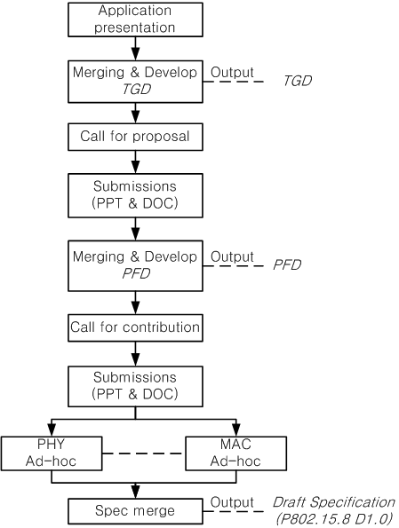
Revised procedure
There are 3 official documents
  Technical Guidance Document (TGD)
  PAC Framework Document (PFD)
  Draft Specification
Call for proposal
  Submission of ppt&doc file for PFD
  Based on TGD
Call for contribution
  Submission of ppt&doc file for draft spec
  Based on PFD

Slide 8
Official documents
Technical Guidance Document (TGD)
  Ex) Data rate: Typically <10Mbps, Up to 20Mbps
  Ex) PAC features include relative positioning
PAC Framework Document (PFD)
  Ex) Supported data rate: 1 Mbps(optional), 5Mbps, 10Mbps, 20Mbps(optional)
  Ex) Resolution of relative positioning: 1m (optional), 10m
Draft Specification
  Ex) Bandwidth, MCS, etc.
  Ex) Frame structure/Signaling for relative positioning,

Slide 9
Motion
Request that TG8 adopt the procedure presented in DCN264r3
  Moved by Marco Hernandez
  Seconded by Suhwook Kim
  Yes: 8 , No: 0 , Abstain: 2
  Motion passed
Slide 9

