Slide 1
Project: IEEE P802.15 Working Group for Wireless Personal Area Networks (WPANs)
Submission Title: TG procedure for PAC
Date Submitted: May 2012
Source: Suhwook Kim, Jinsoo Choi, Jinyoung Chun, JinSam Kwak (LG Electronics)
Address: LG R&D Complex 533, Hogye-1dong, Dongan-gu, Anyang-shi, Kyungki-do, Korea
Voice: +82-31-450-1901, FAX: +82-31-450-4049, E-Mail: suhwook.kim@lge.com
Re:
Abstract: TG8 procedure for PAC
Purpose: For a discussion on the TG8 future plan and procedure
Notice: This document has been prepared to assist the IEEE P802.15. It is offered as a basis for discussion and is not binding on the contributing individual(s) or organization(s). The material in this document is subject to change in form and content after further study. The contributor(s) reserve(s) the right to add, amend or withdraw material contained herein.
Release: The contributor acknowledges and accepts that this contribution becomes the property of IEEE and may be made publicly available by P802.15.
Slide 1

Slide 2
Work procedure discussed (Mar. 2012)
In March meeting, PAC procedure was discussed (DCN:15-12-155)
  Call for Application
    To make Application Matrix (AM)
  4 Preliminary Documents
    Application Requirements Document (ARD)
    Channel Model Document (CMD)
    Technical Requirements Document (TRD)
    Evaluation Criteria Document (ECD)
  Call for Proposal
  Proposal Merger
  Draft Documentation
Slide 6

Slide 3

Work procedure for TG8
We are going to walk through a long & challenging way:
  Various use cases
  No baseline specification
  Demanding new PHY & MAC features
Defining a clear procedure helps us to save our time and develop the fine spec in time.
Slide 6

Slide 4
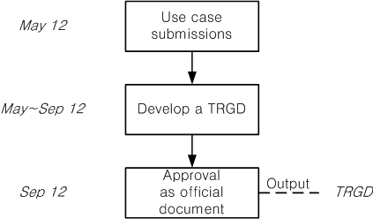
Proposed PAC procedure – Step 1
Procedure for “Technical Requirement/Guideline Document (TRGD)”
  Focusing on applications or use cases for PAC including key performance requirements and functional attributes
  Developing Technical Requirement/Guideline Document for the next step on detailed technical proposals, including
    A guideline to develop technical proposals satisfying the requirements
    A framework for evaluating proposals with some performance criteria
Slide 7

Slide 5
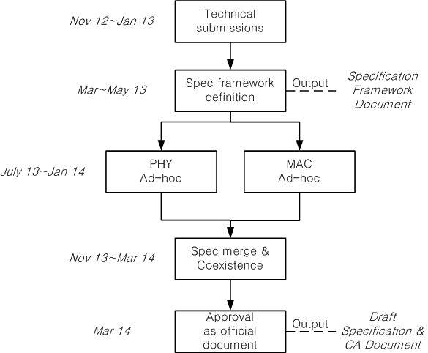
Proposed PAC procedure – Step 2
Procedure for “Specification Framework Documents” & “ Draft Specification”
Based on the TRGD and Technical submissions, we will develop a spec framework document (SFD)
With a stable SFD, drafting a spec. text is done through a parallel PHY/MAC work
We will merge PHY and MAC draft text into a final draft spec documentation
Slide 8

Slide 6
Other TG’s documents
TG4m: Technical Guidance Document (15-11-0684r12)
TGah: Specification Framework Document(11-11-1137r6)
Slide 6

Slide 7
Timeline (Tentative)
TG formation Mar 12
Call for Application April 12
Application presentation May 12
TGRD approval/Call for technical proposal Sep 12
Technical proposal presentation Nov 12~Jan 13
Specification framework definition Mar 13~May 13
PHY, MAC spec development July 13~Jan 14
Draft spec (P802.15.8 D0.1) Mar 14
Letter Ballot (circulation) Mar 14~Jan 15
Sponsor Ballot (circulation) Jan 15~July 15
RevCom submission July 15
Slide 6

Slide 8
Conclusion
This contribution proposed the procedure and plan for TG8 Peer Aware Communications.
In order to facilitate the specification development, we proposed a step-wise approach:
  Discussion on Applications/Use Cases with Performance/Functional Requirements
  Development of Technical Requirement/Guideline Documents (TRGD)
    A guideline to develop technical proposals satisfying the requirements
    A framework for evaluating proposals with some performance criteria
  Develop a Specification Framework Document (SFD) addressing a high-level PHY/MAC key technologies
  Draft a spec text based on SFD with PHY/MAC ad-hocs
  Complete a specification development
Slide 6

Slide 9
Straw polls
TG8 shall develop and adopt a “Technical Requirement /Guideline Document (TRGD)” before issue of Call for Technical proposal
  Yes: , No: , Abstain:
After Call for proposal, TG8 shall develop and adopt a “Specification Framework Document (SFD)” addressing a high-level PHY/MAC key technologies
  Yes: , No: , Abstain:
Slide 6

Slide 10
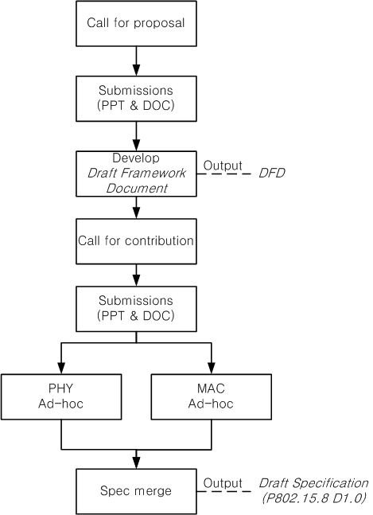
Revised procedure
There are 3 official documents
  Technical Guidance Document (TGD)
  Draft Framework Document (DFD)
  Draft Specification
Call for proposal
  Submission of ppt&doc file for DFD
  Based on TGD
Call for contribution
  Submission of ppt&doc file for draft spec
  Based on DFD

Slide 11
Official documents
Technical Guidance Document (TGD)
  Ex) Data rate: Typically <10Mbps, Up to 20Mbps
  Ex) PAC features include relative positioning
Draft Framework Document (DFD)
  Ex) Supported data rate: 1 Mbps(optional), 5Mbps, 10Mbps, 20Mbps(optional)
  Ex) Resolution of relative positioning: 1m (optional), 10m
Draft Specification
  Ex) Bandwidth, MCS, etc.
  Ex) Frame structure/Signaling for relative positioning,

Slide 12
Motion
Slide 6

