Slide 1
Project: IEEE P802.15 Working Group for Wireless Personal Area Networks (WPANs)
Submission Title: TG procedure for PAC
Date Submitted: May 2012
Source: Suhwook Kim, Jinsoo Choi, Jinyoung Chun, JinSam Kwak (LG Electronics)
Address: LG R&D Complex 533, Hogye-1dong, Dongan-gu, Anyang-shi, Kyungki-do, Korea
Voice: +82-31-450-1901, FAX: +82-31-450-4049, E-Mail: suhwook.kim@lge.com
Re:
Abstract: TG8 procedure for PAC
Purpose: For a discussion on the TG8 future plan and procedure
Notice: This document has been prepared to assist the IEEE P802.15. It is offered as a basis for discussion and is not binding on the contributing individual(s) or organization(s). The material in this document is subject to change in form and content after further study. The contributor(s) reserve(s) the right to add, amend or withdraw material contained herein.
Release: The contributor acknowledges and accepts that this contribution becomes the property of IEEE and may be made publicly available by P802.15.
Slide 1

Slide 2
TG8 PAC
PAR review: Scope
This standard defines PHY and MAC mechanism for Wireless Personal Area Networks (WPAN) Peer Aware Communications (PAC) optimized for peer to peer and infrastructureless communications with fully distributed coordination. PAC features include:
Discovery for peer information without association
Discovery signaling rate, typically 100 kbps
The number of devices in the discovery
Scalable data transmission rates, typically 10 Mbps
Group communications with simultaneous membership in multiple groups, typically up to 10
Relative positioning
Multi-hop relay
Security
Operational in selected globally available unlicensed/licensed bands below 11 GHz capable of supporting these requirements
Slide 2

Slide 3
Work procedure discussed (Mar. 2012)
In March meeting, PAC procedure was discussed (DCN:15-12-155)
Call for Application
To make Application Matrix (AM)
4 Preliminary Documents
Application Requirements Document (ARD)
Channel Model Document (CMD)
Technical Requirements Document (TRD)
Evaluation Criteria Document (ECD)
Call for Proposal
Proposal Merger
Draft Documentation
Slide 6

Slide 4
Work procedure for TG8
We are going to walk through a long & challenging way:
Various use cases
No baseline specification
Demanding new PHY & MAC features
Defining a clear procedure helps us to save our time and develop the fine spec in time.
Slide 6

Slide 5
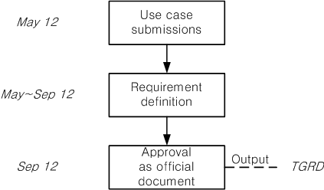
Proposed PAC procedure – Step 1
Procedure for “Technical Requirement/Guideline Document (TRGD)”
Focusing on applications or use cases for PAC including key performance requirements and functional attributes
Developing Technical Requirement/Guideline Document for the next step on detailed technical proposals, including
A guideline to develop technical proposals satisfying the requirements
A framework for evaluating proposals with some performance criteria
Slide 7

Slide 6
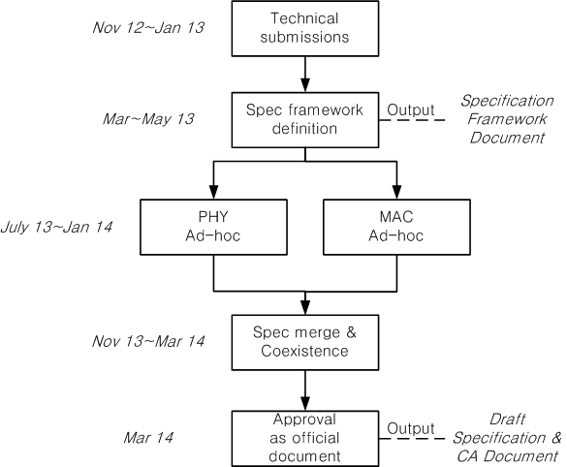
Proposed PAC procedure – Step 2
Procedure for “Specification Framework Documents” & “ Draft Specification”
Based on the TRGD, develop a basic system framework into
spec framework document (SFD)
With a stable SFD, drafting a spec. text is done through a parallel PHY/MAC work
Merging PHY and MAC draft text into a final draft spec documentation
Slide 8

Slide 7
Timeline (Tentative)
TG formation Mar 12
Call for Application April 12
Application presentation May 12
TGRD approval/Call for technical proposal Sep 12
Technical proposal presentation Nov 12~Jan 13
Specification framework definition Mar 13~May 13
PHY, MAC spec development July 13~Jan 14
Draft spec (P802.15.8 D0.1) Mar 14
Letter Ballot (circulation) Mar 14~Jan 15
Sponsor Ballot (circulation) Mar 15~Sep 15
Specification publish Nov 15
Slide 6

Slide 8
Conclusion
This contribution proposed the procedure and plan for TG8 Peer Aware Communications.
In order to facilitate the specification development, we proposed a step-wise approach:
Discussion on Applications/Use Cases with Performance/Functional Requirements
Development of Technical Requirement/Guideline Documents (TRGD)
A guideline to develop technical proposals satisfying the requirements
A framework for evaluating proposals with some performance criteria
Develop a Specification Framework Document (SFD) addressing a high-level PHY/MAC key technologies
Draft a spec text based on SFD with PHY/MAC ad-hocs
Complete a specification development
Slide 6

Slide 9
Appendix
Slide 6

Slide 10
Standard procedure of TG4g
Ref: 15-09-0086-00-004g TG4g Closing Report for Los Angeles
Slide 6

