Slide 1
Summary of
Latest Japanese 920MHz Rules and Conditions
Date: 2012-5-15
Authors:

Slide 2
Purpose
The purpose of this document is to summarize the rules and conditions
with regard to upcoming Japanese 920MHz band, which is scheduled to
be opened up after July 24, 2012, following the consultation of Japanese
Telecommunication Council of MIC, of which summary was already
presented in TG-4g last July plenary (15-11/0510r04), and also to clarify
that the international standardization and VLSI design should be based
on the mandatory rules and conditions mentioned above.
Beside of mandatory rules and conditions, Japanese voluntary standard
defined by ARIB, called Std. T-108 (revised based on Std. T-96 in term
of 950MHz band) is also published, because this standard is expected to
be the factual deployment rules in Japanese 920MHz market, of which
summary is attached as Appendix of this submission.
* MIC : Ministry of internal affair and Communication

Slide 3
Law ordinance and Voluntary ARIB Std. T-108
In the case of upcoming 920MHz band, the rules and conditions of Law
ordinance and ARIB Std. T-108 are not identical.
Every systems and devices operated in 920MHz band have to abide by
Law ordinance, so the device certification process and the test procedure
(TELEC Test procedure T-245/T-248) are based on Law ordinance , not
on ARIB Std. T-108.
Of course ARIB Std. T-108 is articulated to conform sufficiently with
Law ordinance, and is introducing additional rules, which are discussed
and arbitrated within open forum participated by several major industry
alliances and deployment entities. ARIB Std. T-108 recommends several
voluntary deployment rules including a boundary frequency (916.9MHz
and 922.3MHz, so far) in term of coexistence conditions, which is to be
re-examined in future and may be changed by ARIB.

Slide 4
Law ordinance and Voluntary ARIB Std. T-108
Law ordinance
Radio law/Regulations for enforcement of radio law
Ordinance regulating radio equipment
Ordinance concerning technical regulations conformity certification
Parliament(House of representative)
MIC (ministry)
Consultation
Telecommunication
Council
Specific
WGs
Test Procedure (T-245/T-248)
Conformance
of
Product
Mandatory
TELEC
(Telecom Engineering Center )
Voluntary
ARIB Std.
(T-108)
ARIB
(Association of Radio Industries and Businesses)
System
Deploying entities
Industrial
Alliances

Slide 5
Compulsory rules and conditions
Law ordinance

Slide 6
Compulsory rules and conditions
<Frequency band and channelization>

Slide 7
Entire 920MHz channelization
Frequency band usage
  Frequency band : 915.9MHz - 929.7MHz
  200kHz width element channel : 915.9 - 928.1MHz ( 61 channels )
  100kHz width element channel : 928.10 - 929.70 ( 16 channels )
  Shared portion with Passive RFID system : 915.9 - 923.5MHz
  Note: This boundary of 923.5MHz is supposed to be re-examined
  in future by MIC.
Limited channel usages depending on each Tx power level category
Eight categories of channel usage including passive RFID systems

Slide 8
920MHz band and channelization for WSN and passive RFID systems
200kHz Element channel
100kHz Element channel
１W PassiveID
１W・LBT PassiveID
250mW PassiveID
10mW PassiveID
ch |  | 1 | 2 | 3 | 4 | 5 | 6 | 7 | 8 | 9 | 10 | 11 | 12 | 13 | 14 | 15 | 16 | 17 | 18 | 19 | 20 | 21 | 22 | 23 | 24 | 25 | 26 | 27 | 28 | 29 | 30 | 31 | 32 | 33 | 34 | 35 | 36 | 37 | 38 | 39 | 40 | 41 | 42 | 43 | 44 | 45 | 46 | 47 | 48 | 49 | 50 | 51 | 52 | 53 | 54 | 55 | 56 | 57 | 58 | 59 | 60 | 61 | # | # | # | # | # | # | # | # | # | # | # | # | # | # | # | #
Center Frequency | 915.8 | 916.0 | 916.2 | 916.4 | 916.6 | 916.8 | 917.0 | 917.2 | 917.4 | 917.6 | 917.8 | 918.0 | 918.2 | 918.4 | 918.6 | 918.8 | 919.0 | 919.2 | 919.4 | 919.6 | 919.8 | 920.0 | 920.2 | 920.4 | 920.6 | 920.8 | 921.0 | 921.2 | 921.4 | 921.6 | 921.8 | 922.0 | 922.2 | 922.4 | 922.6 | 922.8 | 923.0 | 923.2 | 923.4 | 923.6 | 923.8 | 924.0 | 924.2 | 924.4 | 924.6 | 924.8 | 925.0 | 925.2 | 925.4 | 925.6 | 925.8 | 926.0 | 926.2 | 926.4 | 926.6 | 926.8 | 927.0 | 927.2 | 927.4 | 927.6 | 927.8 | 928.0 | 928.15 | 928.25 | 928.35 | 928.45 | 928.55 | 928.65 | 928.75 | 928.85 | 928.95 | 929.05 | 929.15 | 929.25 | 929.35 | 929.45 | 929.55 | 929.65
1mW ActiveWSN
20mW ActiveWSN
250mW ActiveWSN
 |  |  |  |  |  |  |  |  |  |  |  |  |  |  |  |  |  |  |  |  |  |  |  |  |  |  |  |  |  |  |  |  |  |  |  |  |  |  |  |  |  |  |  |  |  |  |  |  |  |  |  |  | ○ | ○ | ○ | ○ | ○ | ◎ | ◎ | ◎ | ◎ | ◎ | ○ | ○ | ○ | ○ | ○ | ○ | ○ | ○ | ○ | ○ | ○ | ○ | ○ | ○ | ○ | ○
Passive RFID Systems
 |  | Fixed Licensed （1W Licensed） |  |  |  |  |  |  |  |  | Fixed Light License （1W registered） |  |  |  |  |  |  |  |  | Specific Low Power （250ｍW） |  |  |  |  |  |  |  |  | Specific Low Power （10ｍW) |  |  |  |  |  |  |  |  | Data Return Ch. of Miller Sub-carrier Systems
Active Low Power or Convenience Radio Systems including Active RFID & WSN
 |  | Convenience Radio （250ｍW） |  |  |  |  |  |  |  |  | Specific Low Power （20ｍW) |  |  |  |  |  |  |  |  | Specific Low Power （1ｍW）

Slide 9
920MHz band channelization & usage rules in term of Active WSN
Category ( Based on maximum Tx Power )
Specified Low Power 1mW (3dBm eirp) [License exempt] | 1mW or less Tx power: 915.9-928.1MHz, 61x 200kHz element channels
Specified Low Power 20mW (16dBm eirp) [License exempt] | 20mW or less Tx power: 920.5-928.1MHz, 38x 200kHz elementary channels
Convenient Radio 250mW (27dBm eirp) [Registration required] | 250mW or less Tx power: 920.5-923.5MHz, 15x 200kHz elementary channels
Data Transmission
Modulation Scheme | Not specified, i.e. any modulation can be used.
Bundled usage of Element channels ( ~ max. occupied signal width )
Maximum number of Element channels |  | Up to 5 channels, (1MHzBWmax.)

Slide 10
920MHz Band channel usage rule for WSN Systems
(Relating to 11ah)
ch | 1 | 2 | 3 | 4 | 5 | 6 | 7 | 8 | 9 | 10 | 11 | 12 | 13 | 14 | 15 | 16 | 17 | 18 | 19 | 20 | 21 | 22 | 23 | 24 | 25 | 26 | 27 | 28 | 29 | 30 | 31 | 32 | 33 | 34 | 35 | 36 | 37 | 38 | 39 | 40 | 41 | 42 | 43 | 44 | 45 | 46 | 47 | 48 | 49 | 50 | 51 | 52 | 53 | 54 | 55 | 56 | 57 | 58 | 59 | 60 | 61
Center Frequency | 916.0 | 916.2 | 916.4 | 916.6 | 916.8 | 917.0 | 917.2 | 917.4 | 917.6 | 917.8 | 918.0 | 918.2 | 918.4 | 918.6 | 918.8 | 919.0 | 919.2 | 919.4 | 919.6 | 919.8 | 920.0 | 920.2 | 920.4 | 920.6 | 920.8 | 921.0 | 921.2 | 921.4 | 921.6 | 921.8 | 922.0 | 922.2 | 922.4 | 922.6 | 922.8 | 923.0 | 923.2 | 923.4 | 923.6 | 923.8 | 924.0 | 924.2 | 924.4 | 924.6 | 924.8 | 925.0 | 925.2 | 925.4 | 925.6 | 925.8 | 926.0 | 926.2 | 926.4 | 926.6 | 926.8 | 927.0 | 927.2 | 927.4 | 927.6 | 927.8 | 928.0
1mW ActiveWSN
20mW ActiveWSN
250mW ActiveWSN
Active Low Power or Convenience Radio Systems including Active RFID & WSN
 | Convenience Radio （250ｍW） |  | Specific Low Power （20ｍW) |  | Specific Low Power （1ｍW）
[Registration Required]
(Light licensing scheme)
[License exempt]
[License exempt]

Slide 11
Compulsory rules and conditions
<Transmission control requirements>

Slide 12
Transmission control requirements for each system categories
LDC
1mW category | 3.6s per 1 hour | ( or Less than 0.1%)
20mW or 250mW Category | 360s per 1 hour | ( or Less than 10%)
 | not required (LBT>5ms) | within 4s max. Tx followed by 50ms idle at 920.5MHz-923.5MHz.
Max. Transmission Duration
1mW Category | 100ms | for 200KHz element channels, 50ms for 100KHz cases.
20mW or 250mW Category | 400ms (LBT>128us) | (ARIB T-96 recommends 200ms or 100ms in some conditions)
 | 4s (LBT>5ms) | 4s (LBT>5ms) is only permitted for 920.5MHz-923.5MHz.
Idle period after Transmission
1mW Category | 100ms | for 200KHz element channels, 50ms for 100KHz cases.
20mW or 250mW Category | 2ms (LBT>128us) | (not required if Tx duration was no more than 6ms)
 | 50ms (LBT > 5ms) | 50ms (LBT>5ms) is only valid for 920.5MHz-923.5MHz.
LBT requirement
1mW Category | not required
20mW or 250mW Category | listen more than 128us | -80dBm (ED Level) regardless of bundled number of channels.
 | listen more than 5ms | LBT>5ms is only valid for 920.5MHz-923.5MHz.

Slide 13
Exception of LBT
Short Response including Ack frame following Data, Request and
Query needs no LBT, if Tx completes within 50ms on same channel.
Within 50ms
Node A
LBT
Data/Request/Query
time
(Clear)
(Only in case of same frequency channel)
Exemption
of LBT
Node B
Response
time
(Ack)
Short Response don't have to be taken account into LDC.
e.g. 360s per 1hour limit is not affected by Ack response.
( ARIB std. T-108 recommends a few additional conditions over law ordinance above. )

Slide 14
Compulsory rules and conditions
<Adjacent leakage power & spurious emission>

Slide 15
Adjacent leakage & spurious emission
Provision of Channel Mask
Adjacent Channel Leakage
Right Table
Category | Max. Leakage
200kHz adjacent element channel
(output power: P) | (dBm/200kHz)
P =< 250mW | -5dBm
P =< 20mW | -15dBm
P =< 1mW | -26dBm
Adjacent Channel
Leakage
Spur
Emi
dBm
/100kHz
fc
fc+(N+1)*100kHz
Figure below
Maximum Spurious Emission
-29 ( 20mW < P =< 250mW)
(Antenna Gain must be less than 3dBi.)
dBm/100kHz
-36
-36
-36
-45dBm/MHz
-39
-36
-36 ( P =< 20mW )
-55
-55
-55
-61
920.3MHz
924.3MHz
-65(-55dBm/MHz)
-65
電子タグシステム
WSN
(MHz)
710
900
LTE
915
917
919
921
930
MCA
940
Cellular
960
1215

Slide 16
Spurious emission
Frequency ( level at Tx output to Antenna ) | Max. Spurious Emission (Average Power) | Reference Bandwidth
Lower than or equal to 710MHz | -36dBm | 100kHz
Higher than 710MHz and up to 900MHz | -55dBm | 1MHz
Higher than 900MHz and up to 915MHz | -55dBm | 100kHz
Higher than 915MHz and up to 920.3MHz * | -36dBm | 100kHz
Higher than 920.3MHz and up to 924.3MHz * (except for the region within (200+100 n) KHz; n=number of bundled element channels) | -29dBm : (Tx power >20mW) -36dBm : ( otherwise ) | 100kHz
Higher than 924.3MHz and up to 928.1MHz * (except for the region within (200+100 n) KHz; n=number of bundled element channels) | -36dBm | 100kHz
Higher than 928.1MHz and up to 930MHz (except for the region within (100+50 n) KHz; n=number of bundled element channels) | -36dBm | 100kHz
Higher than 930MHz and up to 1GHz | -55dBm | 100kHz
Higher than 1GHz and up to 1.215GHz | -45dBm | 1MHz
Beyond 1.215GHz | -30dBm | 1MHz
Emission from enclosure has to be less than the corresponding EIRP value with above value. Max. Antenna Gain is 3dBi.

Slide 17
Parasitic emission of Rx
Frequency ( level at Tx output to Antenna ) | Max. Spurious Emission (Average Power) | Reference Bandwidth
Lower than or equal to 710MHz | -54dBm | 100kHz
Higher than 710MHz and up to 900MHz | -55dBm | 1MHz
Higher than 900MHz and up to 915MHz | -55dBm | 100kHz
Higher than 915MHz and up to 930MHz | -54dBm | 100kHz
Higher than 930MHz and up to 1GHz | -55dBm | 100kHz
Beyond 1GHz | -47dBm | 1MHz
- Be measured at the condition that Rx operation has to be activated,
while Tx circuitry may be disabled.
- A measurement using temporal antenna terminal is allowed in both case of
measurements in term of Tx spurious emission and Rx parasitic emission,
provided that the loss difference between real antenna and temporal terminal
has to be compensated.

Slide 18
Compulsory rules and conditions
<Spectrum masks>

Slide 19
Spectrum mask
< 1mW Category (915.9 ~ 928.1MHz) >
0dBm/(200 n) KHz
Av. Signal Power
200KHz
(200 n) KHz
200KHz
-36dBm/100KHz
(915 ~ 930MHz)
Spurious Emission
Center Frequency
-26dBm/200KHz (915.9-928.1MHz)
Lower Adjacent Leakage Emission
-26dBm/200KHz(915.9-928.1MHz)
Upper Adjacent Leakage Emission

Slide 20
Spectrum mask
< 20mW Category (920.5 ~ 928.1MHz) >
13dBm/(200 n) KHz
Av. Signal Power
200KHz
(200 n) KHz
200KHz
-36dBm/100KHz
(915 ~ 930MHz)
Spurious Emission
Center Frequency
-15dBm/200KHz
Lower Adjacent Leakage Emission
-15dBm/200KHz
Upper Adjacent Leakage Emission

Slide 21
Spectrum mask
< 250mW Category (920.5 ~ 923.5MHz) >
200KHz
(200 n) KHz
200KHz
24dBm/(200 n) KHz
Av. Signal Power
-29dBm/100KHz
(915 ~ 930MHz)
Spurious Emission
-5dBm/200KHz
Lower Adjacent Leakage Emission
Center Frequency
-5dBm/200KHz
Upper Adjacent Leakage Emission

Slide 22
Compulsory rules and conditions
<Miscellaneous >

Slide 23
Frequency Tolerance
Within ±20 ppm
Tx power Tolerance
Between +20% and -80% of the designed power level
Antenna Gain
+3dBi max. with max. Tx power allowed.
Higher gain antenna is allowed to use, provided that
EIRP level is kept below than that with max. Tx power
using +3dBi antenna.
Permitted Communication
Simplex (with or without Rx), Duplex (FDD, CDD, etc.),
half Duplex (TDD), Broadcast and Multicast.

Slide 24
< Reference >
- IEEE802.11 Doc:
11-11-0974-01-00ah-Consultation-Summary-of-Japanese-920MHzBand-Rules-and-Conditions
- Press Release of MIC ( written in Japanese )
< http://www.soumu.go.jp/menu_news/s-news/0kiban14_01000036.html >
- Summary Table of 920MHz RFID/WSN systems ( written in Japanese )
< http://www.soumu.go.jp/main_content/000119517.pdf >
- Consultation Report for public comments ( written in Japanese )
< http://www.soumu.go.jp/main_content/000113160.pdf >
- TELEC Test procedure document for radio certification (written in Japanese)
< http://www.telec.or.jp/book/files/h2405_kaitei_self07.pdf > (Purchase required)
- ARIB Std. T-108 ( written in Japanese )
< http://www.arib.or.jp/english/html/overview/doc/1-STD-T108v1_0.pdf >
English translation of ARIB Std. T-108
< http://www.arib.or.jp/english/html/overview/doc/5-STD-T108v1_0-E1.pdf >

Slide 25
Appendix

Slide 26
Voluntary deployment rules and conditions
Recommendation of ARIB Std. T-108

Slide 27
Additional rules recommended by ARIB Std. T-108
<Frequency channelization and usage>

Slide 28
Recommended channelization by ARIB Std. T-108
Further channel usage sub-categorization over MIC regulation
  Frequency band : 915.9MHz - 929.7MHz
  200kHz width element channel : 915.9 - 928.1MHz ( 61 channels )
  Introducing two additional frequency boundary at 916.9 & 922.3MHz
  Corresponding spectrum masks including band-edge notation
  Note: This band-edge notation is associated with no consistent
  measurement procedure so far. Both TELEC T-245 and 248
  include no performance requirement on this notation.
Further transmission control sub-categorization are introduced
  Sub-categorization in term of :
    Frequency portion of channel
    Transmission duration and pause duration
    Number of bundled channel, and so on

Slide 29
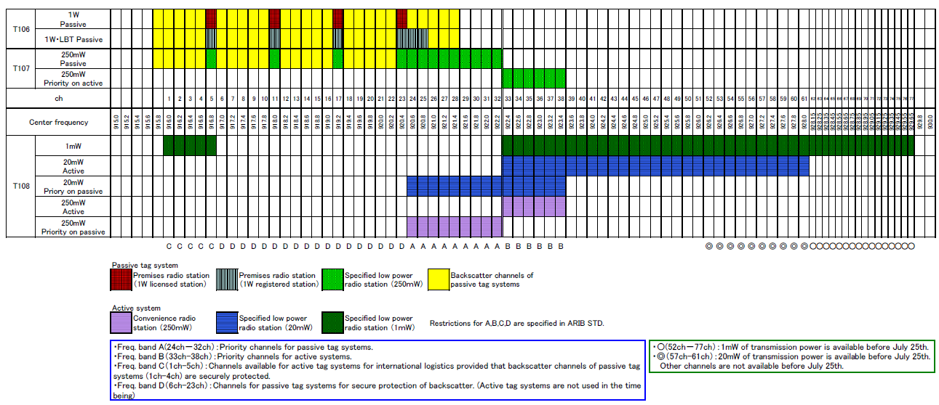
920MHzBand Channel usage Plan of each RFID/WSN Systems
(Recommended by ARIB Std. T-108)
Additional boundary at 916.9MHz
Additional boundary at 922.3MHz

Slide 30
Additional rules recommended by ARIB Std. T-108
<Spectrum masks>

Slide 31
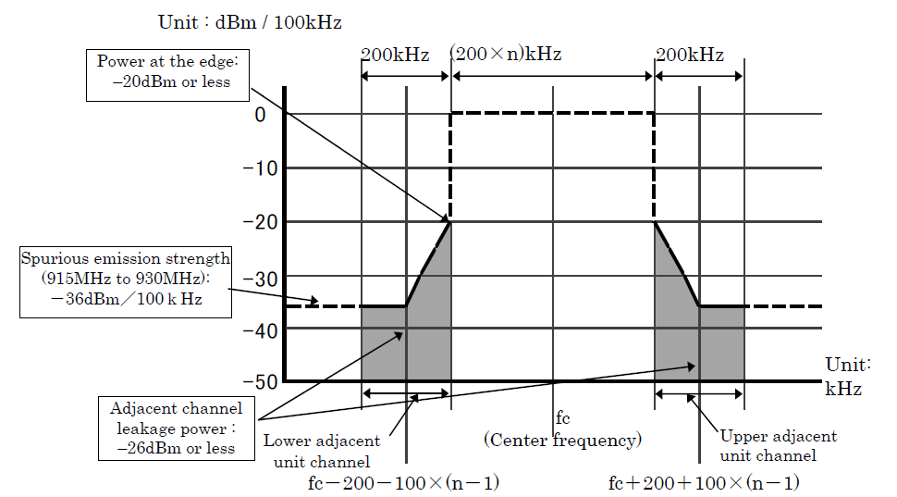
Additional spectrum mask of ARIB Std. T-108
< 915.9~916.9MHz portion of 1mW Category(915.9~928.1MHz) >

Slide 32
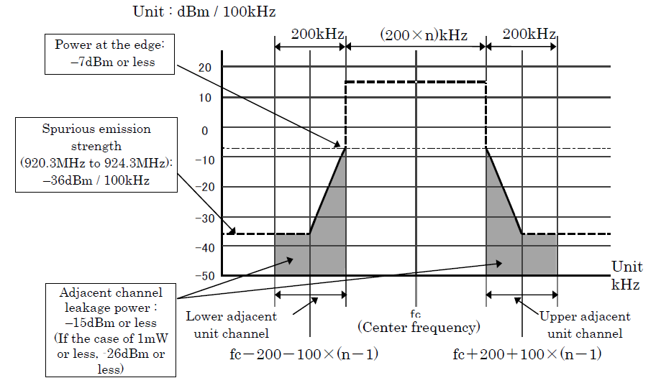
Additional spectrum mask of ARIB Std. T-108
< 920.5~922.3MHz portion of 20mW Category(920.5~928.1MHz) >

Slide 33
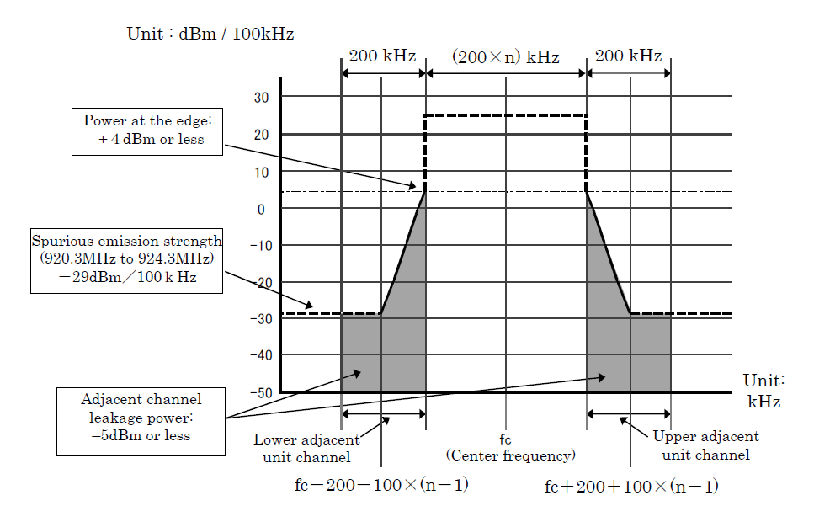
Additional spectrum mask of ARIB Std. T-108
< 920.5~922.5MHz portion of 250mW Category(920.5~923.5MHz) >

Slide 34
<Transmission Control recommendation of ARIB Std. T-108>
Additional rules recommended by ARIB Std. T-108

Slide 35
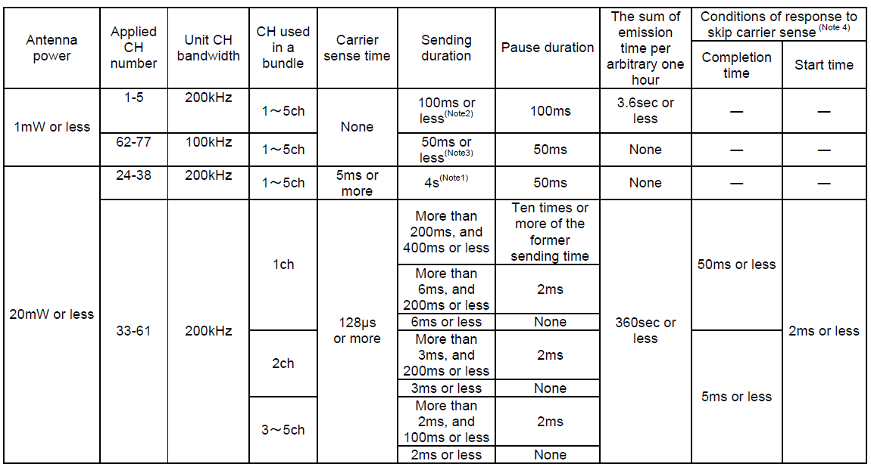
Transmission Control recommendation of ARIB Std. T-108

Slide 36
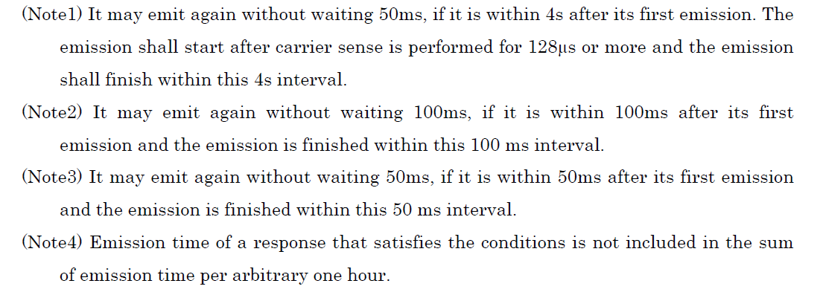
Transmission Control recommendation of ARIB Std. T-108
(Continued)

Slide 37
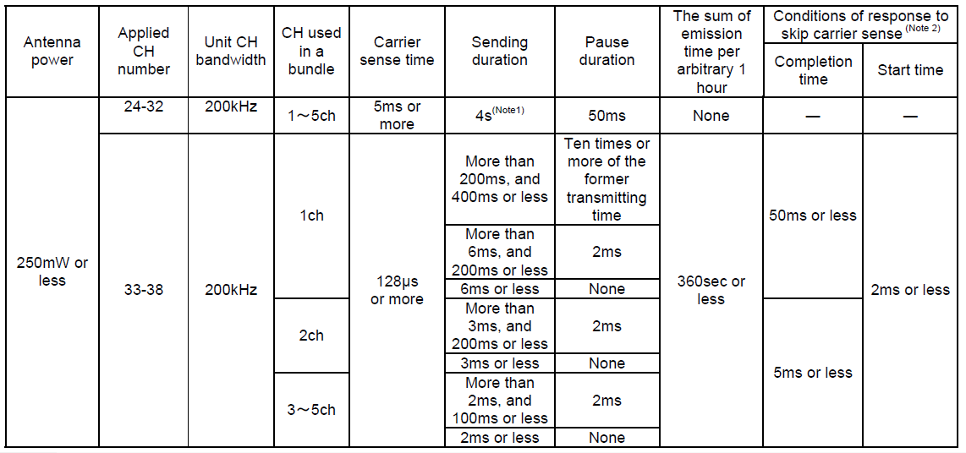
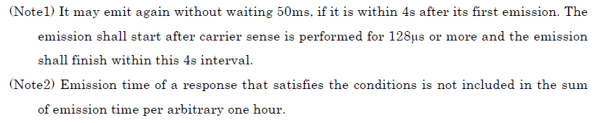
Transmission Control recommendation of ARIB Std. T-108
(Continued)

Slide 38
End

