Slide 1
Project: IEEE P802.15 Working Group for Wireless Personal Area Networks (WPANs)
Submission Title: [Applications of ULP Wireless Sensors]
Date Submitted: [5/15/2012]
Source: [Chunhui (Allan) Zhu, Betty Zhao, Hou-Cheng Tang] Company [Samsung, Huawei]
Address [75 W Plumeria Dr. San Jose, CA, USA]
Voice:[+408-544-2751], FAX: [+], E-Mail:[c.zhu@samsung.com, betty.zhao@huawei.com, tanghoucheng@huawei.com]
Re: []
Abstract: [This presentation examines potential applications of Ultra Low Power wireless sensors]
Purpose: [To initiate the discussion on the applications of Ultra Low Power wireless sensors]
Notice: This document has been prepared to assist the IEEE P802.15. It is offered as a basis for discussion and is not binding on the contributing individual(s) or organization(s). The material in this document is subject to change in form and content after further study. The contributor(s) reserve(s) the right to add, amend or withdraw material contained herein.
Release: The contributor acknowledges and accepts that this contribution becomes the property of IEEE and may be made publicly available by P802.15.

Slide 2
Applications of ULP Wireless Sensors
Chunhui (Allan) Zhu (Samsung)
Betty Zhao, Hou-Cheng Tang (Huawei)

Slide 3

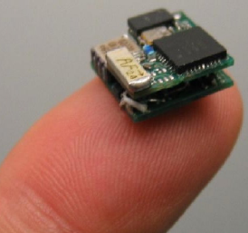
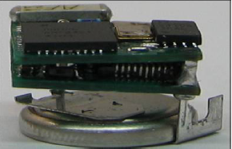
Battery Size Determines the Size of a Sensor Node
Power consumption: 7.56 hours is measured at 50% Tx duty cycle, with 560mAh Li-Coin battery and 0dBm transmission power.
This translates to about 378 hrs or 15.75 days at 1% duty cycle (standby power is not considered due to data availability).
Operated by a CR1225 (48mAh) coin cell battery

Slide 4
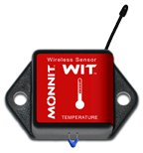
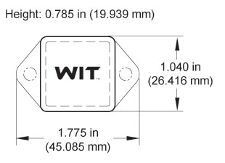
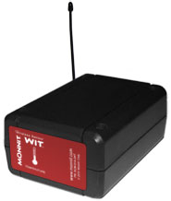
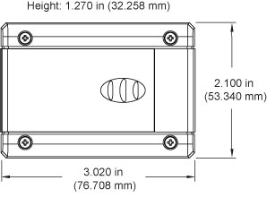
Compact Design vs. Long Battery Life
- You can only get one…not both…
Replaceable 3.0V coin cell battery
At 1 hour heartbeat setting, battery will last ~ 1-2 Years.
Temperature Sensor
using coin cell battery
2 replaceable AA 1.5V batteries.
At 1 hour heartbeat setting, included AA batteries will last more than 4 Years.
The same Temperature Sensor using AA batteries

Slide 5
What Applications Need ULP Sensors? (1/2)
Form Factor
General-purpose Wireless Sensors
Very Long Battery
Life, Size does not Matter
Small,
Long Life
Ultra Small Sensor,
Long Enough Battery Life
Battery Life

Slide 6
What Applications Need ULP Sensors? (2/2)
Large number of sensors in a single or multiple networks under the same management.
  Changing batteries is costly – lots of work
  E.g. WSN of gas meters
A sparse wireless sensor network that covers a long distance or a big area.
  Changing batteries is costly – sensors are not in walking distance
  E.g. oil pipe monitoring sensors
Will not work without ULP technology
  E.g. Energy Harvesting or wireless powered sensor devices.

Slide 7
The Wireless Sensor Market
Market Sector | Big Network? | Sensor Size Matters? | Battery Life Matters?
Smart Energy/Smart Grid | H | L | L
Smart Utility (Gas/Water) | H | L | H
Building Automation | H | M | H
Home Automation | M | M | M
Wireless Control | L | L | M
Medical / Health Care | L | H | H
Retail Service | H | M | H
Telecom Service | L | H | H
Industrial Monitoring (e.g. bridges, pipe lines) | H | L | H
Environment Monitoring | H | L | H
Inventory Tracking | H | H | H
Energy-Harvesting Sensor | L | M | H
H: highly true; M: often true; L: least true

Slide 8
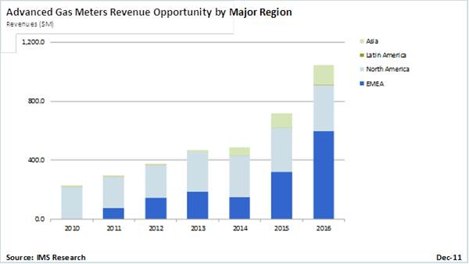
Smart Utility (Gas & Water Meter)
Smart electricity meter market has enjoyed the strong growth for several years. But the smart gas and water meter market has just started.
Unlike smart electricity meters, smart gas and water meters are battery powered.
The network size of the utility network may be very large and are away from the management office, which making changing batteries costly.

Slide 9


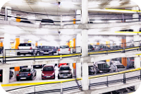
Building Automation
Can be used to
  Manage commercial and industrial buildings intelligently
  Reduce energy use
  Provide intelligent lighting and HAVC control
Potentially large amount of sensor devices;
In some situations batteries are difficult to be changes.
  Sensors on ceilings or other hard-to-reach places.

Slide 10
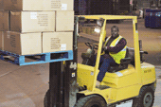
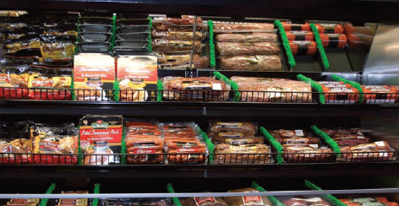

Inventory / Warehouse Management
Potentially large amount of devices;
Devices may be movable or portable so finding a device for changing its battery could be difficult;
Devices need to be made fairly small in order to be attached to some products they are tracking;

Slide 11
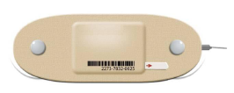

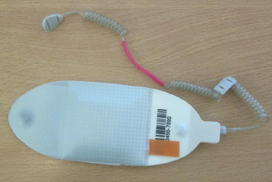
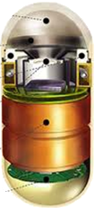
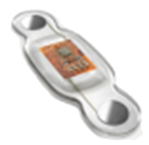
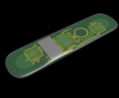
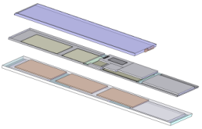
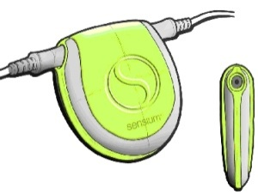
Medical / Health Care
May require ultra small form factor;
Battery life needs to be long enough to accomplish a specific task;
Batteries may need to be flexible in shape and size.
Patch-type Sensors
Security/access Sensor
ECG Sensor with
flexible battery
Life Pebble
Bio/Medical Sensor

Slide 12
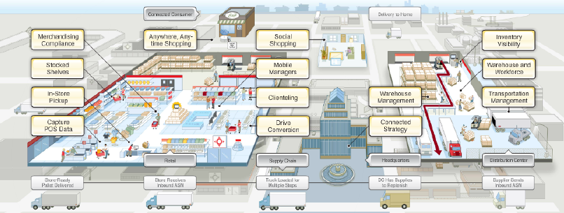
Retail Service
Can be used to
  monitor, control and automate the purchase and delivery of goods.
  help retailers manage their supply chain
  improve the consumer's shopping experience
  reduce time in checkout lines,
  gain insight into shopping behaviors that improve consumers shopping experiences,
The number of hand-held devices can be very large.
The devices could be portable

Slide 13
Telecom Service
Telecom service of wireless sensor covers wide variety of value-added services, including information delivery, mobile gaming, location-based services, secure mobile payments, mobile advertising, zone billing, mobile office access control, payments, and peer-to-peer data-sharing services.
A wireless sensor shares the same battery with other devices (CPU, Cellular, WiFi, GPS, Display and etc.) of the same mobile device, affecting the battery life of the mobile device.
Battery life is now a key differential factor when comparing mobile devices. Manufacturers want to reduce power consumption as much as possible.
Information Delivery (charged)

Slide 14
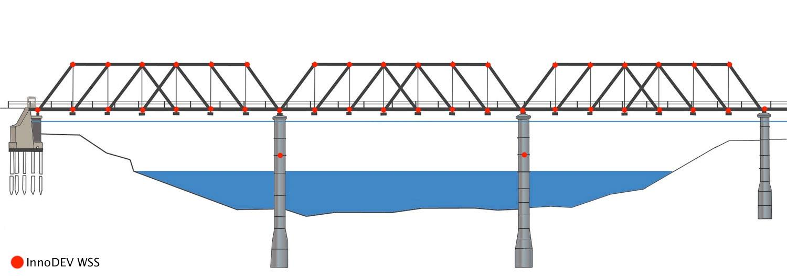
Industrial/Infrastructure Monitoring
Changing batteries could be a very difficult work
  E.g. wireless sensors monitoring a bridge which are not easy to access
Sometimes a monitoring network has a string topology and is very sparse.
  E.g. distance between adjacent wireless sensor nodes deployed to monitor an oil pipeline could be half a mile away.
  Changing batteries becomes a costly work.

Slide 15

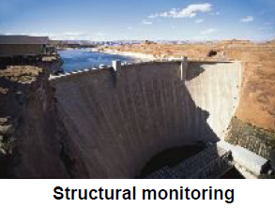
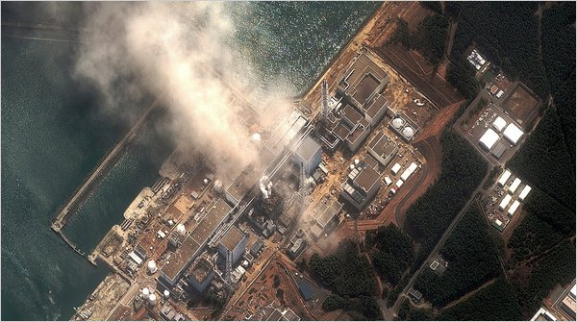
Environment Monitoring
Potentially very large and sparse network;
Sometimes dangerous or hazardous environment making changing batteries impossible
  Require extremely long battery life and make the device disposable.
Fukushima Daiichi nuclear plant

Slide 16
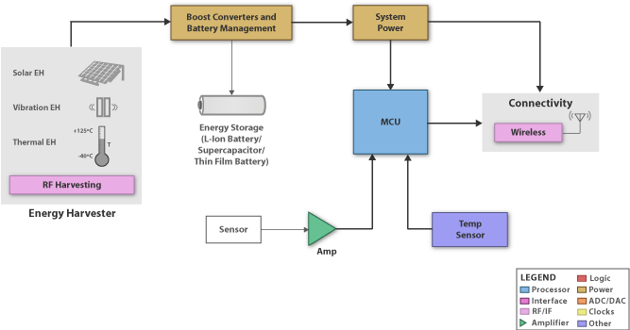
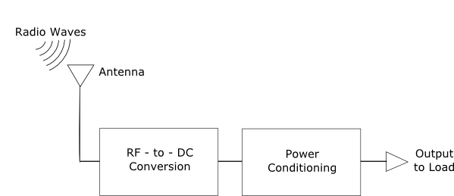
Energy Harvesting/
Wirelessly Charged Sensors
Energy is a very scarce resource for these devices;
Requires a device run as energy-efficient as possible to maintain functional;
In some cases these sensors will not work if the currents drawn are over some thresholds.
  May not be possible without ULP technology.

Slide 17
Conclusions and Future Work
ULP applications have been reviewed and analyzed
  Many applications require either small form factor or long battery life, and some times both.
  In current stage, we are not able to achieve both goals so we usually sacrifice one goal to achieve another.
In the future, we will
  Identify the most applicable use cases as our targets
  Extract technical requirements from the most applicable use cases to help create the PAR and 5C.

