Slide 1
Project: IEEE P802.15 Working Group for Wireless Personal Area Networks (WPANs)
Submission Title: Response to the Call for Applications
Date Submitted:
Source: Sunggeun Jin, Jinkyeong Kim, Byung-Jae Kwak, Young-Hoon Kim, Soochang Kim, Seon-Ae Kim, and Sungcheol Chang
Address: sgjin@etri.re.kr
Re: Call for Applications
Abstract: We provide the usage cases for the PAC applications.
Purpose:
Notice: This document has been prepared to assist the IEEE P802.15. It is offered as a basis for discussion and is not binding on the contributing individual(s) or organization(s). The material in this document is subject to change in form and content after further study. The contributor(s) reserve(s) the right to add, amend or withdraw material contained herein.
Release: The contributor acknowledges and accepts that this contribution becomes the property of IEEE and may be made publicly available by P802.15.
Slide 1

Slide 2
Outline
PAC Applications in Near Future
Technical Features for Coverage
Application Examples
PAC Functions
Summary

Slide 3


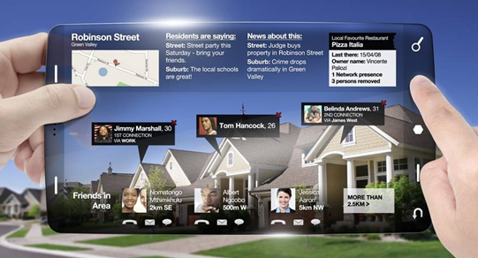






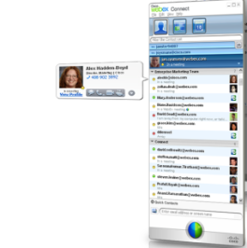








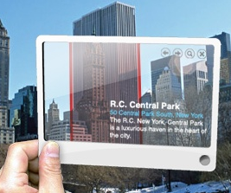

PAC Applications in Near Future
Internet of
networked objects
All connected & interactive world
Convergence of
real & virtual world
  Most devices and mobile terminals are connected via IP protocols
  Information is exchanged through the interconnections of the devices
  Integrated services with virtual and real lives
Smart Driving
Merged into PAC applications
Localized networking services
Speed Limit
Distance : 5m
Caution
  In-Building
Searches for services and users
  In-Campus
Social network services
Local information services with location guide services
Advertisement with augmented reality
PAC Services w/o infrastructure

Slide 4

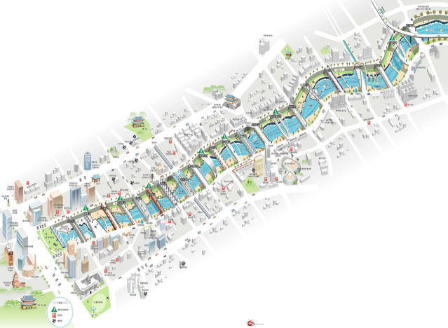
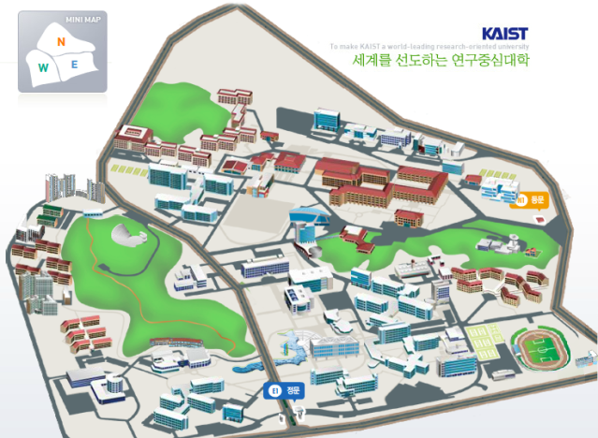
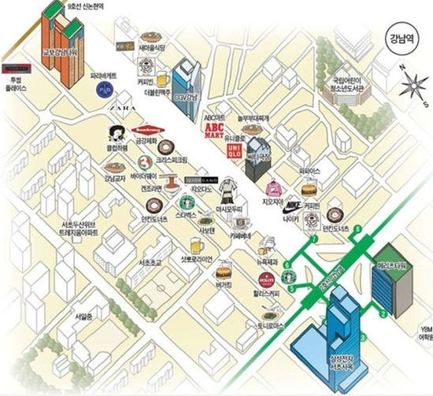








Technical Features for Coverage
Coverage and Distributed Coordination
Cheong Gye River in Korea
Campus (KAIST)
Kangnam District in Korea
2.6 Km~
1 Km
1.6 Km
  Cheong Gye River in Korea
  KAIST (<2 km)
  Commercial District (<1 km)
  MIMO/Beamforming for PAC
User Device
Wi-Fi Direct
PAC
(short range)
PAC
(long range)
Communications for PAC
  One-hop coverage : ~ 1 km
  Multi-hop support: ~3 km
  Coverage extension with MIMO/Beamforming

Slide 5
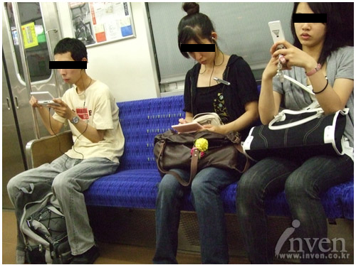
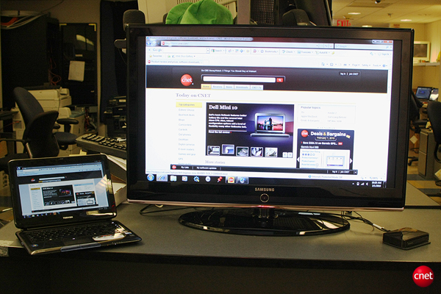
Applications in Close Proximity
Applications
  game, wireless display, chatting, and data (e.g. pictures) sharing,
Technical requirements
  Easy connection setup and fast service initiation
  Direct communications without coordination
  Group communications
  Multimedia streaming
  High speed data transmissions

Slide 6

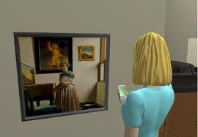
Applications with Location Information
Applications
  Route navigation in a district
  Narration services in a museum
  Experiences of sample video and audio clips in a shop
Technical requirements
  User or service recognition with profile matching
  Information broadcastings
  Advertisements with personalized information – coupon, mileage
  Location tracking with high precision

Slide 7
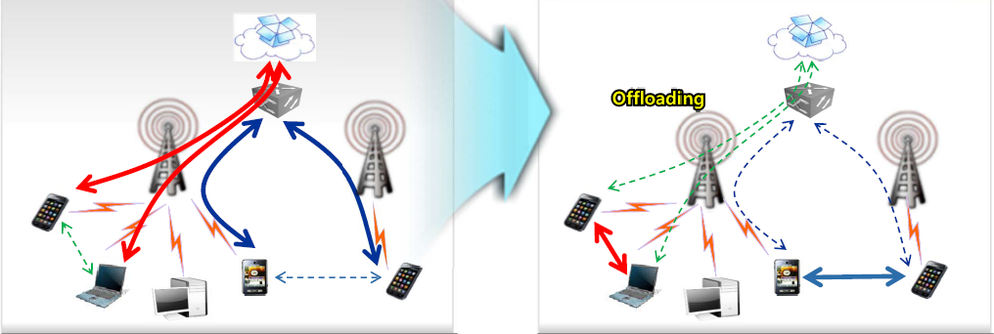
Applications with Traffic Offloading
Applications
  Large volume of data transfers, and social network services
Technical requirements
  Direct traffic transfer without infrastructure network
  Distributed wireless resource management

Slide 8
PAC Functions
Key Features
  Coverage extension
    multi-hop, MIMO, beamforming, routing protocol and addressing
  High precision location services
    Time of Arrival
  High speed ( ~ 50 Mbps ) throughput
    MIMO, minimized MAC operation overhead
    distributed wireless resource scheduling policy for throughput improvement
  Power management support to save energy consumption
    Sleep mode operation, Idle mode operation
  Group Communications
    Group management for group creation, joining and deletion

Slide 9
Summary
We need to define functional requirements for the PAC applications
We will provide our considerations for practical parameters of the PAC applications

