Slide 1
Project: IEEE P802.15 Working Group for Wireless Personal Area Networks (WPANs)
Submission Title: 2.4 GHz IEEE 802.15.4 Chipsets: Existing & Next Generation
Date Submitted: May 2012
Source: : Shahriar Emami, Samsung
E-Mail: [Shahriar.e@samsung.com]
Re:
Abstract: To request to compare/contrast 2.4 GHz silicon and establish a target for next generation
Purpose: ULP related information
Notice: This document has been prepared to assist the IEEE P802.15. It is offered as a basis for discussion and is not binding on the contributing individual(s) or organization(s). The material in this document is subject to change in form and content after further study. The contributor(s) reserve(s) the right to add, amend or withdraw material contained herein.
Release: The contributor acknowledges and accepts that this contribution becomes the property of IEEE and may be made publicly available by P802.15.

Slide 2
2.4 GHz IEEE 802.15.4 Chipsets: Existing & Next Generation
May 2012

Slide 3
Goals
Evaluate existing 2.4 GHz 802.15.4 Chipsets
Establish battery life targets
Determine current targets for next generation chipsets

Slide 4
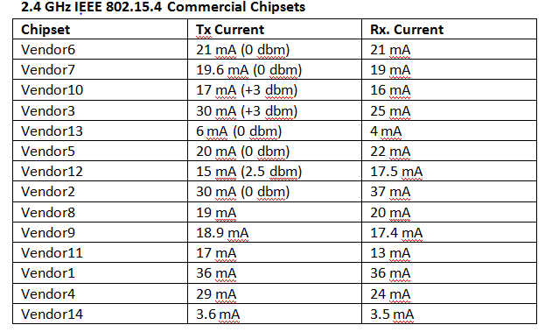
Commercial Chipsets

Slide 5
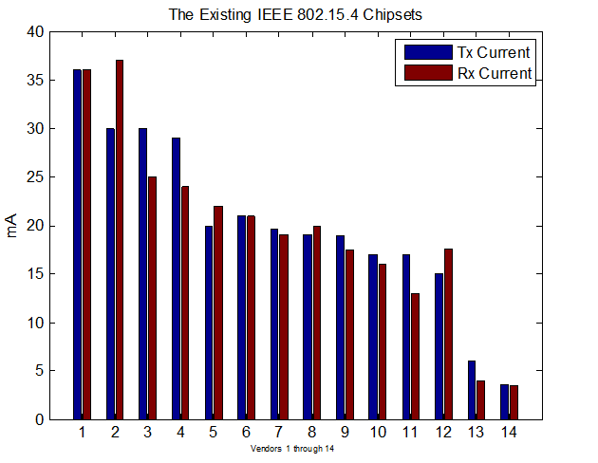
Chipset- Graphical Representation

Slide 6

Chipset Groups

Slide 7
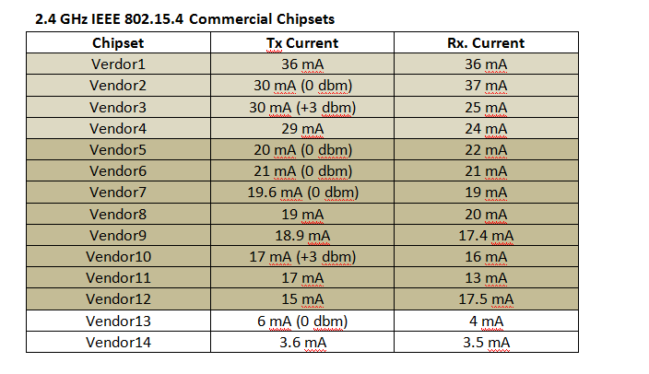
Chipset Groups

Slide 8
Battery Life
Duty cycle in the [0.1% 4%] range
Tx/Rx currents roughly identical
Tx/Rx durations roughly identical
Focus on AA and coin shaped batteries
Battery life vs. duty cycle

Slide 9
AA Battery

Slide 10

Estimated Battery Life for AA Battery

Slide 11
Coin Shaped Battery

Slide 12

Estimated Battery Life for Coin Shaped Battery

Slide 13
Target
The existing silicon falls short of expectations
Minimum of one year for coin shaped batteries
Multi year target for AA battery

Slide 14
Coin Shaped Battery

Slide 15

Estimate for Next Generation- Coin Shaped Battery
Transmit/receive currents of 250 μA is required to achieve 1 year goal (coin shaped battery) for the entire duty cycle range

Slide 16
AA Battery

Slide 17
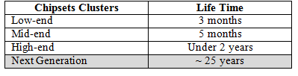
Estimate for Next Generation- AA
Transmit/receive currents of 250 mA achieves a life time of 25 years for the entire duty cycle range

Slide 18
Summary
The existing commercially available 2.4 GHz IEEE 802.15.4 silicon can be classified into low, mid and high tiers
The battery life for even the high tier class falls short of expectation
Target life time is reiterated (1 year for coin shaped and multiple years for AA)
Next generation transmit/receive currents roughly 250 mA

Slide 19
References
[1] Available from WWW: <http://www.accent-soc.com/products/asm201.php>..
[2] Available from WWW: <http://www.analog.com/en/press release/2232011_ADI_Intros_Hi_Integr_Lo_power_RF_Trans/press.html>.
[3] Available from WWW: <http://www.atmel.com/products/microcontrollers/wireless/
transceivers.aspx>.
[4] Available from WWW: <http://www.ember.com/products_zigbee_chips_e300series.html>.
[5] Available from WWW: <http://www.energymicro.com/draco>.
[6] Available from WWW: <http://www.greenpeak.com/product/Products.html>..
[7] Available from WWW:
<http://www.globaltec.com.hk/oki-zigbee.php> .
[8]Available from
WWW:<http://www.radiopulse.co.kr/eng/main.html?mode=02_05>.
[9] Available from
WWW:<http://documentation.renesas.com/doc/DocumentServer/U20196EU1V0PB00.pdf>.
[10] Available from
WWW:<http://investor.silabs.com/releasedetail.cfm?ReleaseID=649004> .
[11] Available from WWW: < http://www.ti.com/product/cc2530>.
[12] Available from
WWW: <http://www.ti.com/product/cc2530>.
[13] Available from
WWW:<http://cache.freescale.com/files/rf_if/doc/data_sheet/MC13202.pdf>.

