Slide 1
May 2012
Project: IEEE P802.15 Working Group for Wireless Personal Area Networks (WPANs)
Submission Title: OFDM Filtering for TG4m
Date Submitted: May 14, 2012
Source: Soo-Young Chang (California State University Sacramento) and Cristina Seibert (Silver Spring Networks)
Voice: +1 530 574 2741, E-maill: sychang@ecs.csus.edu
Re: [802.15.4m]
Abstract: Raised cosine and root raised cosine filters are examined for OFDM signals to meet the regulatory spectral requirements of white space bands.
Purpose: To provide information on filtering OFDM signals to the 802.15 TG4m group
Notice: This document has been prepared to assist the IEEE P802.15. It is offered as a basis for discussion and is not binding on the contributing individual(s) or organization(s). The material in this document is subject to change in form and content after further study. The contributor(s) reserve(s) the right to add, amend or withdraw material contained herein.
Release: The contributor acknowledges and accepts that this contribution becomes the property of IEEE and may be made publicly available by P802.15.

Slide 2
REGULATORY LIMITS IN TVWS FCC 12-36, PARAGRAPH 31
Effectively, the power in a 6 MHz TV channel is distributed across the center 5.5 MHz of that channel, with 250 kHz guard-bands on each side.
The adjacent channel emission limit becomes -55.4 dBr.
Outside the FCC, regulatory work still on-going. The proposal will be updated to reflect such rules once identified.
From document 15-12-0223-00-004m

Slide 3
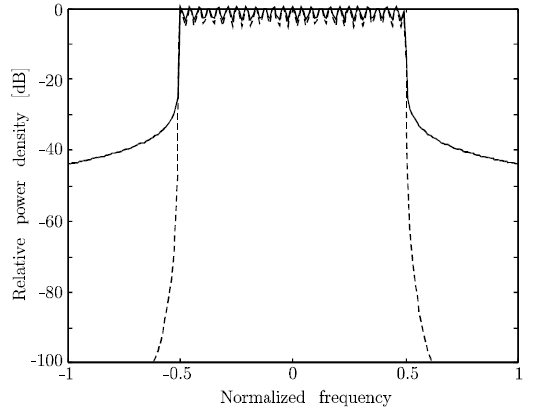
SPECTRAL SHAPING USING RAISED COSINE FILTERING (1)
OFDM signal spectrum with raised cosine filtering
Spectrum with rectangular pulse (solid) and raised cosine pulse (dashed)
http://www.sm.luth.se/csee/sp/research/report/esb96rc.pdf

Slide 4
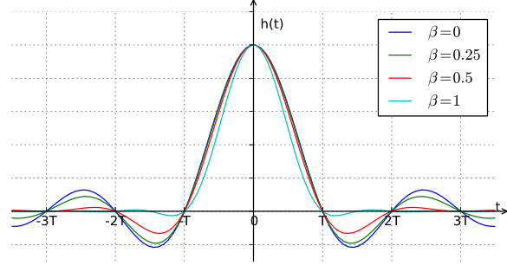
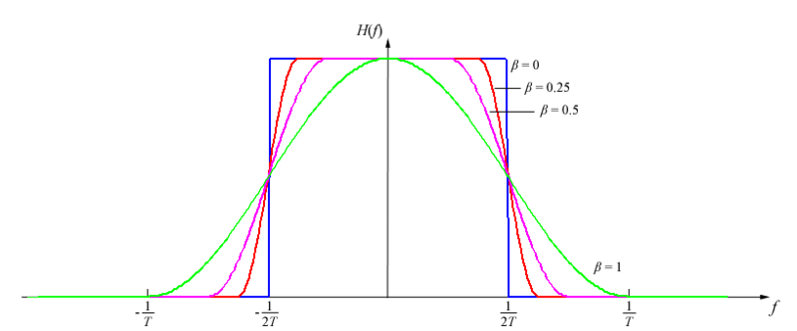
SPECTRAL SHAPING USING RAISED COSINE FILTERING (2)
A rectangular pulse occupies large b/w
Alternative is the sync pulse which reduces b/w and inter-symbol interference
Impulse response of raised-cosine filter with various roll-off factors, β
Frequency response of raised-cosine filter with various roll-off factors, β
http://en.wikipedia.org/wiki/Raised-cosine_filter

Slide 5
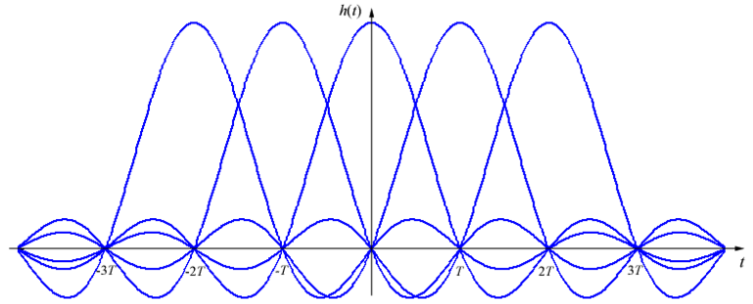
SPECTRAL SHAPING USING RAISED COSINE FILTERING (3)
Raised cosine filter (RCF) to eliminate ISI
Impulse response is zero at all nT (where n is an integer), except n=0.
→ if the transmitted waveform is correctly sampled at the receiver, the original symbol values can be recovered completely.
Root raised cosine filter (RRCF) to eliminate ISI
For zero ISI, it is the net response of the transmit and receive filters that must equal to H(f):
H_{R}(f) x H_{T}(f) = H(f)
For RRCF
In this document, two types of filters
Raised cosine filter (RCF)
Root Raised Cosine Filter (RRCF)
http://en.wikipedia.org/wiki/Raised-cosine_filter

Slide 6
Simulation results for Root Cosine Filter (rcf)

Slide 7
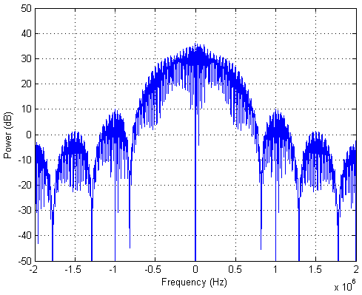
OFDM WITH RAISED COSINE FILTERING (1)
The effect of roll off factor (bandwidth overspill) for RCF
Roll off factor: 0
OFDM bandwidth: 1MHz
using BPSK
no. of subcarriers: 128
Filter order: 32
3dB bandwidth: 0.5MHz
20dB bandwidth: 1.4MHz
-55dBr Bandwidth below the highest average power: >10MHz

Slide 8
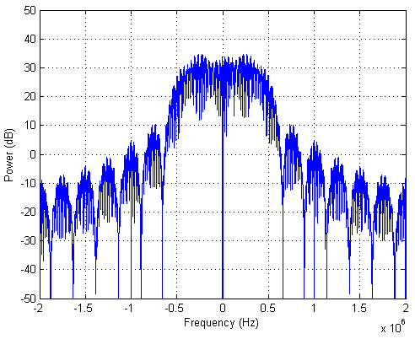
OFDM WITH RAISED COSINE FILTERING (2)
The effect of roll off factor (bandwidth overspill) for RCF
Roll off factor: 0
OFDM bandwidth: 1MHz
using BPSK
no. of subcarriers: 128
Filter order: 64
3dB bandwidth: 0.9MHz
20dB bandwidth: 1.3MHz
-55dBr Bandwidth below the highest average power: ~8.2MHz

Slide 9
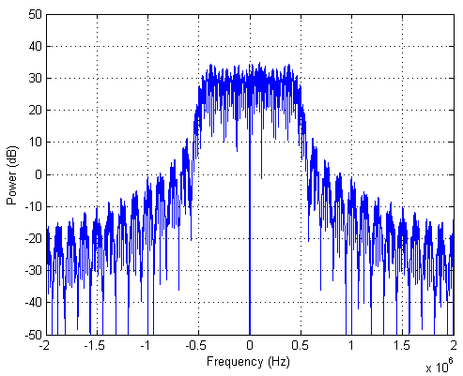
OFDM WITH RAISED COSINE FILTERING (3)
The effect of roll off factor (bandwidth overspill) for RCF
Roll off factor: 0
OFDM bandwidth: 1MHz
using BPSK
no. of subcarriers: 128
Filter order: 128
3dB bandwidth: 0.95MHz
20dB bandwidth: 1.15MHz
-55dBr Bandwidth below the highest average power: ~6.1MHz

Slide 10
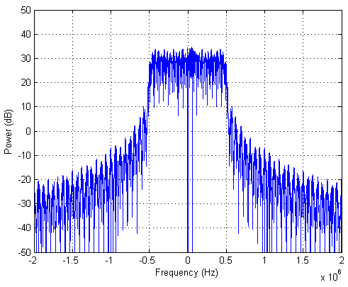
OFDM WITH RAISED COSINE FILTERING (4)
The effect of roll off factor (bandwidth overspill) for RCF
Roll off factor: 0
OFDM bandwidth: 1MHz
using BPSK
no. of subcarriers: 128
Filter order: 256
3dB bandwidth: 1.0MHz
20dB bandwidth: 1.05MHz
-55dBr Bandwidth below the highest average power: ~4.3MHz

Slide 11
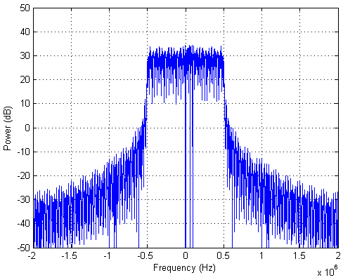
OFDM WITH RAISED COSINE FILTERING (5)
The effect of roll off factor (bandwidth overspill) for RCF
Roll off factor: 0
OFDM bandwidth: 1MHz
using BPSK
no. of subcarriers: 128
Filter order: 512
3dB bandwidth: 1.05MHz
20dB bandwidth: 1.05MHz
-55dBr Bandwidth below the highest average power: ~3.1MHz

Slide 12
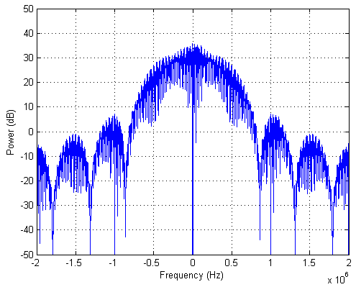
OFDM WITH RAISED COSINE FILTERING (6)
The effect of roll off factor (bandwidth overspill) for RCF
Roll off factor: 0.5
OFDM bandwidth: 1MHz
using BPSK
no. of subcarriers: 128
Filter order: 32
3dB bandwidth: 0.8MHz
20dB bandwidth: 1.4MHz
-55dBr Bandwidth below the highest average power: >10MHz

Slide 13
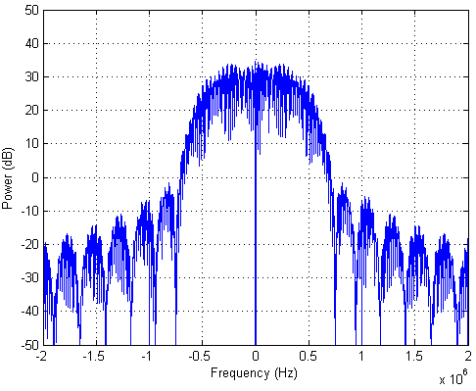
OFDM WITH RAISED COSINE FILTERING (7)
The effect of roll off factor (bandwidth overspill) for RCF
Roll off factor: 0.5
OFDM bandwidth: 1MHz
using BPSK
no. of subcarriers: 128
Filter order: 64
3dB bandwidth: 0.9MHz
20dB bandwidth: 1.4MHz
-55dBr Bandwidth below the highest average power: ~5.3MHz

Slide 14
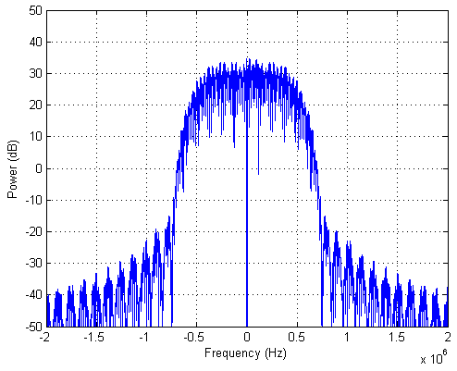
OFDM WITH RAISED COSINE FILTERING (8)
The effect of roll off factor (bandwidth overspill) for RCF
Roll off factor: 0.5
OFDM bandwidth: 1MHz
using BPSK
no. of subcarriers: 128
Filter order: 128
3dB bandwidth: 0.9MHz
20dB bandwidth: 1.4MHz
-55dBr Bandwidth below the highest average power: ~2.0MHz

Slide 15
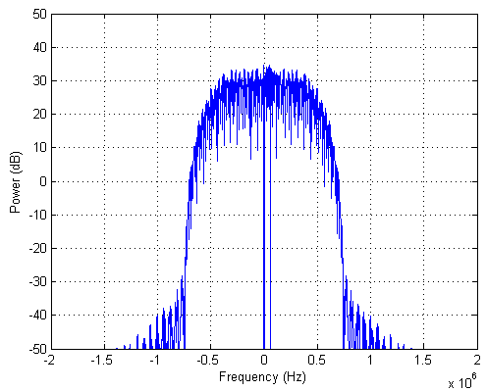
OFDM WITH RAISED COSINE FILTERING (9)
The effect of roll off factor (bandwidth overspill) for RCF
Roll off factor: 0.5
OFDM bandwidth: 1MHz
using BPSK
no. of subcarriers: 128
Filter order: 256
3dB bandwidth: 0.9MHz
20dB bandwidth: 1.35MHz
-55dBr Bandwidth below the highest average power: ~1.5MHz

Slide 16
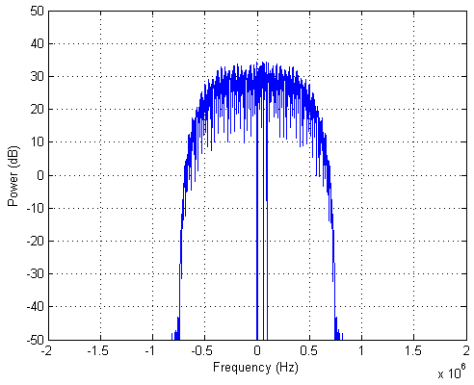
OFDM WITH RAISED COSINE FILTERING (10)
The effect of roll off factor (bandwidth overspill) for RCF
Roll off factor: 0.5
OFDM bandwidth: 1MHz
using BPSK
no. of subcarriers: 128
Filter order: 512
3dB bandwidth: 0.9MHz
20dB bandwidth: 1.4MHz
-55dBr Bandwidth below the highest average power: ~1.45MHz

Slide 17
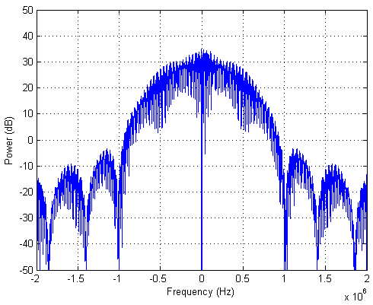
OFDM WITH RAISED COSINE FILTERING (11)
The effect of roll off factor (bandwidth overspill) for RCF
Roll off factor: 1
OFDM bandwidth: 1MHz
using BPSK
no. of subcarriers: 128
Filter order: 32
3dB bandwidth: 0.8MHz
20dB bandwidth: 1.6MHz
-55dBr Bandwidth below the highest average power: ~3.7MHz

Slide 18
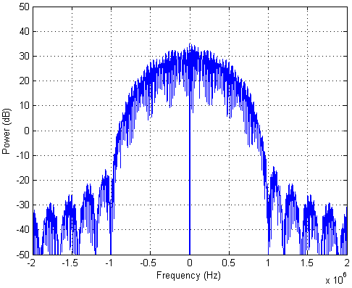
OFDM WITH RAISED COSINE FILTERING (12)
The effect of roll off factor (bandwidth overspill) for RCF
Roll off factor: 1
OFDM bandwidth: 1MHz
using BPSK
no. of subcarriers: 128
Filter order: 64
3dB bandwidth: 0.7MHz
20dB bandwidth: 1.6MHz
-55dBr Bandwidth below the highest average power: ~2.5MHz

Slide 19
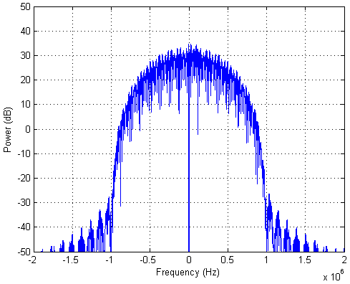
OFDM WITH RAISED COSINE FILTERING (13)
The effect of roll off factor (bandwidth overspill) for RCF
Roll off factor: 1
OFDM bandwidth: 1MHz
using BPSK
no. of subcarriers: 128
Filter order: 128
3dB bandwidth: 0.8MHz
20dB bandwidth: 1.6MHz
-55dBr Bandwidth below the highest average power: ~1.95MHz

Slide 20
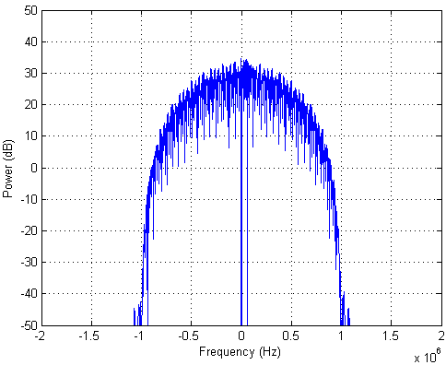
OFDM WITH RAISED COSINE FILTERING (14)
The effect of roll off factor (bandwidth overspill) for RCF
Roll off factor: 1
OFDM bandwidth: 1MHz
using BPSK
no. of subcarriers: 128
Filter order: 256
3dB bandwidth: 0.8MHz
20dB bandwidth: 1.6MHz
-55dBr Bandwidth below the highest average power: ~1.9MHz

Slide 21
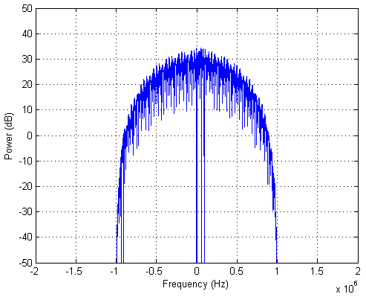
OFDM WITH RAISED COSINE FILTERING (15)
The effect of roll off factor (bandwidth overspill) for RCF
Roll off factor: 1
OFDM bandwidth: 1MHz
using BPSK
no. of subcarriers: 128
Filter order: 512
3dB bandwidth: 0.75MHz
20dB bandwidth: 1.6MHz
-55dBr Bandwidth below the highest average power: ~1.9MHz

Slide 22
Simulation results for root raised cosine filter (RRCF)

Slide 23
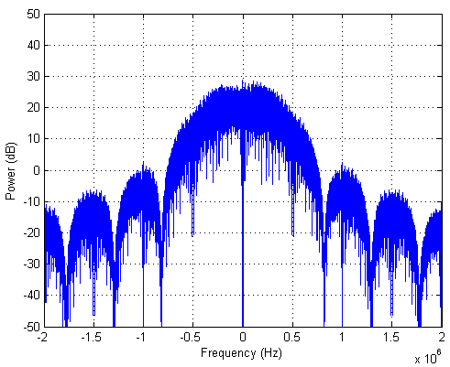
OFDM WITH ROOT RAISED COSINE FILTERING (1)
The effect of roll off factor (bandwidth overspill) for RRCF
Roll off factor: 0
OFDM bandwidth: 1MHz
using BPSK
no. of subcarriers: 128
Filter order: 32
3dB bandwidth: 0.6MHz
20dB bandwidth: 1.5MHz
-55dBr Bandwidth below the highest average power: >10MHz

Slide 24
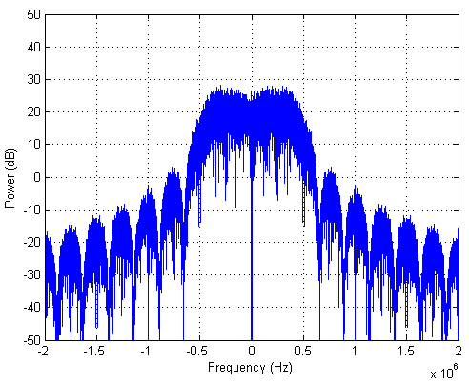
OFDM WITH ROOT RAISED COSINE FILTERING (2)
The effect of roll off factor (bandwidth overspill) for RRCF
Roll off factor: 0
OFDM bandwidth: 1MHz
using BPSK
no. of subcarriers: 128
Filter order: 64
3dB bandwidth: 0.7MHz
20dB bandwidth: 1.4MHz
-55dBr Bandwidth below the highest average power: >10MHz

Slide 25
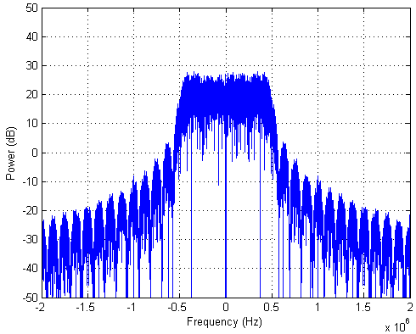
OFDM WITH ROOT RAISED COSINE FILTERING (3)
The effect of roll off factor (bandwidth overspill) for RRCF
Roll off factor: 0
OFDM bandwidth: 1MHz
using BPSK
no. of subcarriers: 128
Filter order: 128
3dB bandwidth: 0.95MHz
20dB bandwidth: 1.2MHz
-55dBr Bandwidth below the highest average power: ~4.5MHz

Slide 26
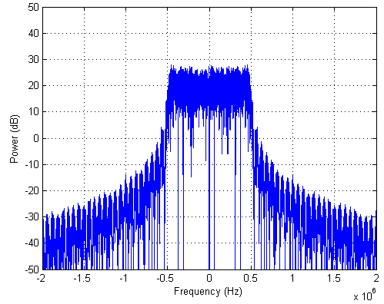
OFDM WITH ROOT RAISED COSINE FILTERING (4)
The effect of roll off factor (bandwidth overspill) for RRCF
Roll off factor: 0
OFDM bandwidth: 1MHz
using BPSK
no. of subcarriers: 128
Filter order: 256
3dB bandwidth: 0.95MHz
20dB bandwidth: 1.1MHz
-55dBr Bandwidth below the highest average power: ~3.5MHz

Slide 27
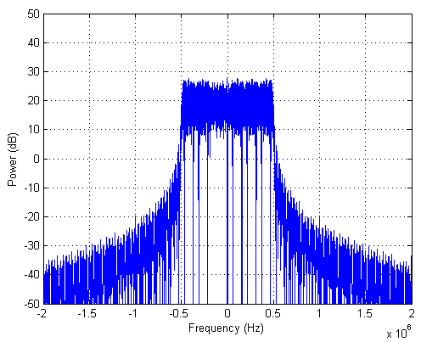
OFDM WITH ROOT RAISED COSINE FILTERING (5)
The effect of roll off factor (bandwidth overspill) for RRCF
Roll off factor: 0
OFDM bandwidth: 1MHz
using BPSK
no. of subcarriers: 128
Filter order: 512
3dB bandwidth: 0.95MHz
20dB bandwidth: 1.05MHz
-55dBr Bandwidth below the highest average power: ~2.6MHz

Slide 28
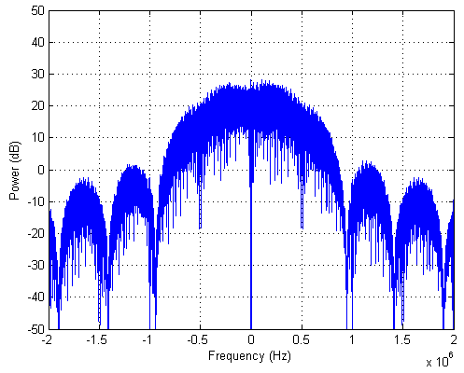
OFDM WITH ROOT RAISED COSINE FILTERING (6)
The effect of roll off factor (bandwidth overspill) for RRCF
Roll off factor: 0.5
OFDM bandwidth: 1MHz
using BPSK
no. of subcarriers: 128
Filter order: 32
3dB bandwidth: 0.65MHz
20dB bandwidth: 1.6MHz
-55dBr Bandwidth below the highest average power: >10MHz

Slide 29
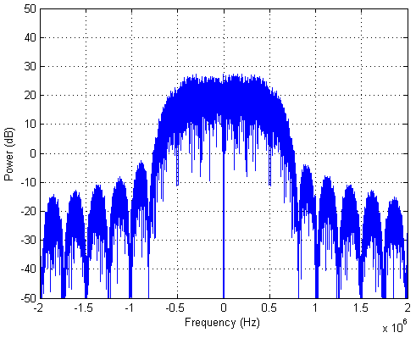
OFDM WITH ROOT RAISED COSINE FILTERING (7)
The effect of roll off factor (bandwidth overspill) for RRCF
Roll off factor: 0.5
OFDM bandwidth: 1MHz
using BPSK
no. of subcarriers: 128
Filter order: 64
3dB bandwidth: 0.9MHz
20dB bandwidth: 1.45MHz
-55dBr Bandwidth below the highest average power: >10MHz

Slide 30
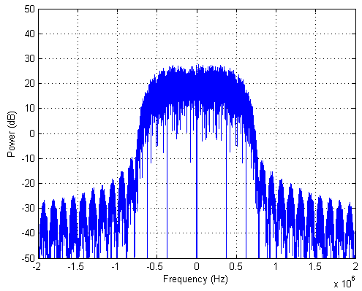
OFDM WITH ROOT RAISED COSINE FILTERING (8)
The effect of roll off factor (bandwidth overspill) for RRCF
Roll off factor: 0.5
OFDM bandwidth: 1MHz
using BPSK
no. of subcarriers: 128
Filter order: 128
3dB bandwidth: 1.05MHz
20dB bandwidth: 1.4MHz
-55dBr Bandwidth below the highest average power: ~3.8MHz

Slide 31
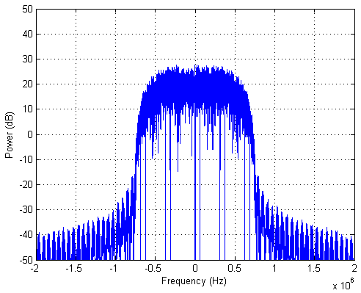
OFDM WITH ROOT RAISED COSINE FILTERING (9)
The effect of roll off factor (bandwidth overspill) for RRCF
Roll off factor: 0.5
OFDM bandwidth: 1MHz
using BPSK
no. of subcarriers: 128
Filter order: 256
3dB bandwidth: 1.1MHz
20dB bandwidth: 1.4MHz
-55dBr Bandwidth below the highest average power: ~1.85MHz

Slide 32
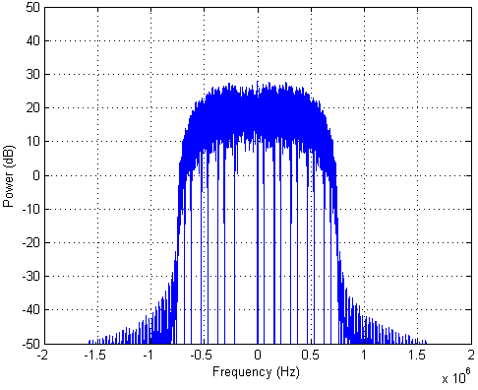
OFDM WITH ROOT RAISED COSINE FILTERING (10)
The effect of roll off factor (bandwidth overspill) for RRCF
Roll off factor: 0.5
OFDM bandwidth: 1MHz
using BPSK
no. of subcarriers: 128
Filter order: 512
3dB bandwidth: 1.15MHz
20dB bandwidth: 1.4MHz
-55dBr Bandwidth below the highest average power: ~1.5MHz

Slide 33
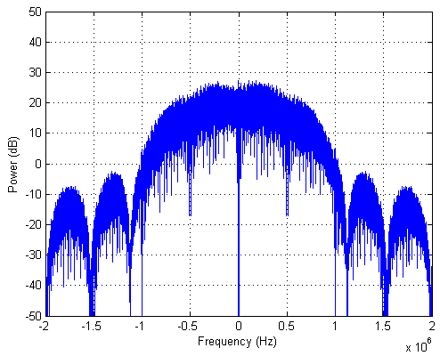
OFDM WITH ROOT RAISED COSINE FILTERING (11)
The effect of roll off factor (bandwidth overspill) for RRCF
Roll off factor: 1
OFDM bandwidth: 1MHz
using BPSK
no. of subcarriers: 128
Filter order: 32
3dB bandwidth: 1.05MHz
20dB bandwidth: 1.9MHz
-55dBr Bandwidth below the highest average power: >10MHz

Slide 34
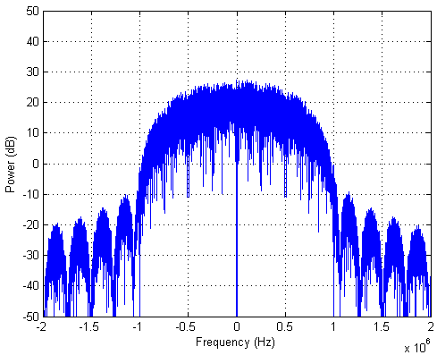
OFDM WITH ROOT RAISED COSINE FILTERING (12)
The effect of roll off factor (bandwidth overspill) for RRCF
Roll off factor: 1
OFDM bandwidth: 1MHz
using BPSK
no. of subcarriers: 128
Filter order: 64
3dB bandwidth: 1.2MHz
20dB bandwidth: 1.8MHz
-55dBr Bandwidth below the highest average power: ~8.2MHz

Slide 35
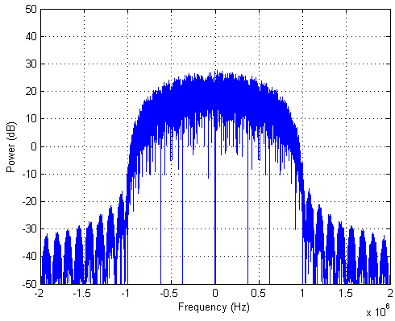
OFDM WITH ROOT RAISED COSINE FILTERING (13)
The effect of roll off factor (bandwidth overspill) for RRCF
Roll off factor: 1
OFDM bandwidth: 1MHz
using BPSK
no. of subcarriers: 128
Filter order: 128
3dB bandwidth: 1.2MHz
20dB bandwidth: 1..85MHz
-55dBr Bandwidth below the highest average power: ~2.9MHz

Slide 36
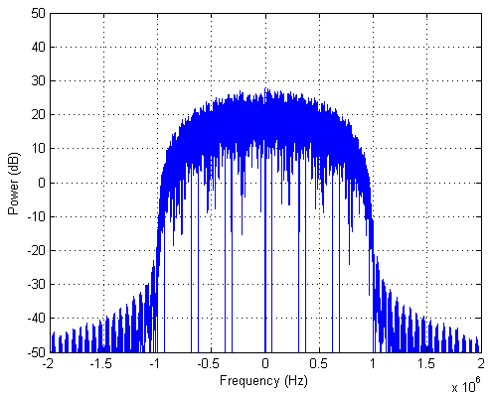
OFDM WITH ROOT RAISED COSINE FILTERING (14)
The effect of roll off factor (bandwidth overspill) for RRCF
Roll off factor: 1
OFDM bandwidth: 1MHz
using BPSK
no. of subcarriers: 128
Filter order: 256
3dB bandwidth: 1.25MHz
20dB bandwidth: 1.85MHz
-55dBr Bandwidth below the highest average power: ~2.15MHz

Slide 37
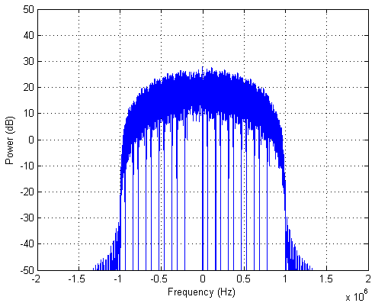
OFDM WITH ROOT RAISED COSINE FILTERING (15)
The effect of roll off factor (bandwidth overspill) for RRCF
Roll off factor: 1
OFDM bandwidth: 1MHz
using BPSK
no. of subcarriers: 128
Filter order: 512
3dB bandwidth: 1.3MHz
20dB bandwidth: 1.85MHz
-55dBr Bandwidth below the highest average power: ~2.0MHz

Slide 38
OBSERVATION AND CONCLUSIONS ON OFDM WITH RCF AND RRCF

Slide 39
SUMMARY, EFFECT OF FILTER ORDERS AND ROLL OFF FACTORS OF RCF AND RRCF
 |  | Raised cosine filter (RCF) |  |  |  | Root raised cosine filter (RRCF)
 |  | 3dB BW (MHz) | 20dB BW (MHz) | -55dBr BW (MHz) | -55dBr from 1MHz inband edge (MHz) | 3dB BW (MHz) | 20dB BW (MHz) | -55dBr BW (MHz) | -55dBr from 1MHz inband edge (MHz)
roll off factor of 0 | 32 | 0.5 | 1.4 | >10 | >4.5 | 0.6 | 1.5 | >10 | >4.5
 | 128 | 0.95 | 1.15 | 6.1 | 2.55 | 0.95 | 1.2 | 4.5 | 1.75
 | 512 | 1.05 | 1.05 | 3.1 | 1.05 | 0.95 | 1.05 | 2.6 | 0.8
roll off factor of 0.5 | 32 | 0.8 | 1.4 | >10 | >4.5 | 0.65 | 1.6 | >10 | >4.5
 | 128 | 0.9 | 1.4 | 2.0 | 0.5 | 1.05 | 1.4 | 3.8 | 1.4
 | 512 | 0.9 | 1.35 | 1.45 | 0.23 | 1.15 | 1.4 | 1.5 | 0.25
roll off factor of 1 | 32 | 0.8 | 1.6 | 3.7 | 0.85 | 1.05 | 1.8 | >10 | >4.5
 | 128 | 0.8 | 1.6 | 1.95 | 0.48 | 1.2 | 1.8 | 2.9 | 0.95
 | 512 | 0.75 | 1.6 | 1.9 | 0.45 | 1.3 | 1.85 | 2.0 | 0.5

Slide 40
OBSERVATION AND CONCLUSIONS
Observations
As roll of factor increases,
20dB bandwidth increases.
As filter order increases,
-55dBr bandwidth decrease.
Raised cosine filter has less 20dB bandwidth than root raised cosine filter.
However, it cannot be said which filter type has less 55dB bandwidth.
Factors to be considered in optimizing filter parameters:
Implementation complexity (that is, filter order or number of taps of a filter)
In-band channel spacing, e.g., 1200 kHz for OFDM Mode 1 from 802.4g
Spectral requirement of 55dB attenuation from the highest average power
Given said factors, roll off factor of 0.5 and filter order of 128 are optimal.

