Slide 1
Project: IEEE 802.15 Working Group for Wireless Personal Area Networks (WPANs)
Submission Title: Support for Ranging in 802.15.4 TVWS (4TV)
Date Submitted: 13 May 2012
Source: [Benjamin Rolfe] Company [BCA]
Address [PO Box 798 Los Gatos CA 95031]
Voice:[+1 408 395 7207], FAX: [], E-Mail:[ben @ blindcreek.com]
Re: [TG4mCall for Proposals https://mentor.ieee.org/802.15/dcn/12/15-12-0170-02-004m-call-for-proposals.doc ]
Abstract: [Summary of RF-ranging as it exists in 802.15.4-2011, and discussion of MAC extensions tosupport localization requirements for TVWS]
Purpose: Support 4TV PHY proposals
Notice: This document has been prepared to assist the IEEE 802.15. It is offered as a basis for discussion and is not binding on the contributing individual(s) or organization(s). The material in this document is subject to change in form and content after further study. The contributor(s) reserve(s) the right to add, amend or withdraw material contained herein.
Release: The contributor acknowledges and accepts that this contribution becomes the property of IEEE and may be made publicly available by 802.15.
Ben Rolfe (BCA)
Notes:
doc.: IEEE 802.15-11/0204r0
March 2011
John Barr, JRBarr, Ltd.

Slide 2
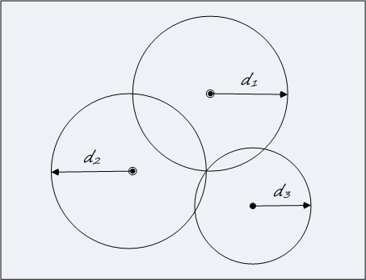
Support for Ranging in 802.15.4 TVWS (4TV)
802.15.4 Features

Slide 3
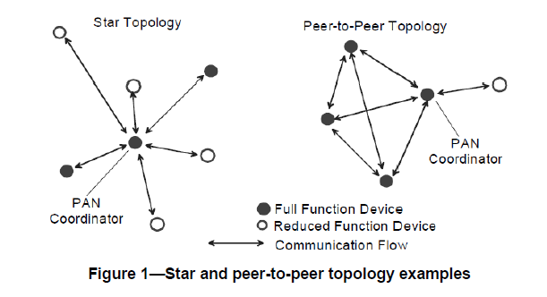
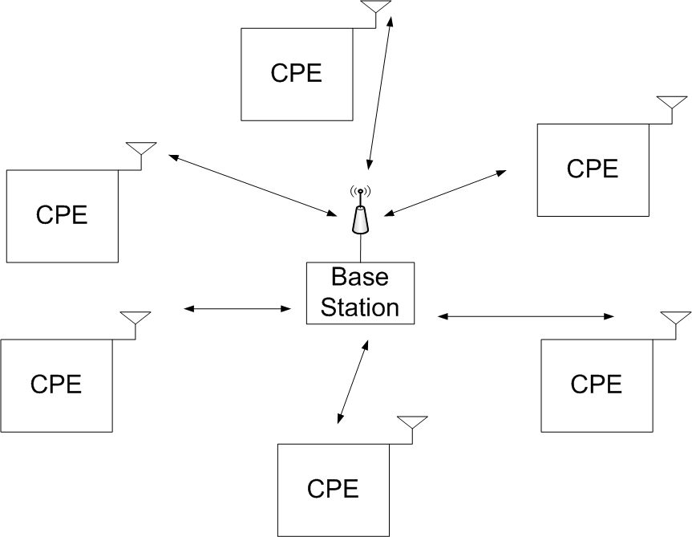
Network Topology
802.15.4 supports almost any network topology
  Star, peer-to-peer, cluster tree, …
  asynchronous or synchronous Access
802.22: Centrally controlled Synchronous Access (TDM)

Slide 4
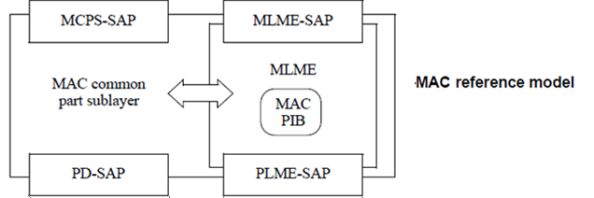
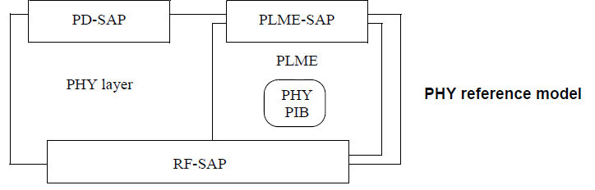
802.15.4 Reference Model
MAC Service Access Point (SAP)
  MCPS : MAC Common Part Sublayer Data service
  MLME : MAC Layer Management Entity service
PHY Service Access Point (SAP)
  PD: PHY Data service
  PLME : PHY Layer Management Entity service

Slide 5
Network Management
MAC provides “tools” to build networks
Few constraints on network topology
  Star, Tree, Peer-to-peer, Mesh, Cluster tree, …
Multiple access and transfer models
  Asynchronous (non-beacon enabled)
    pure contention based
  Semi-synchronous, superframe-based
    Supports contention and contention free access
    Multiple superframe structures (by now)
  Time-synchronized (TSCH)

Slide 6
Network Management
802.15.4 Architectural Philosophy
Network management is done at the network layer
MAC provides “tool kit” of MAC mechanisms available to the higher layer Network Management Entity.
External standards specify how the “tools” are used to build specific kinds of networks
  ZigBee, ISA-100.11A, 6loWPAN, IEC 62591, IEC62734, …
Many features available but not necessarily used

Slide 7
802.15.4 Superframe Structures
No superframe
  Contention access only
  No synchronous access structure
Multiple superframe formats
  Basic superframe
  Extended superframes (802.15.4e-2012)
  TSCH slot-frame structure (802.15.4e-2012)
  LLDN Superframe (802.15.4e-2012)

Slide 8
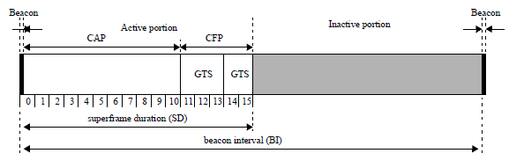
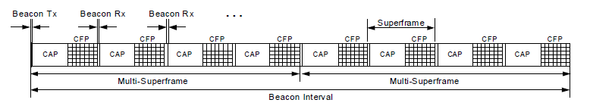
Superframe Structure
Basic Superframe: Contention and Contention Free access, supports sleepy devices with inactive periods
802.15.4-2006
DSME Multi-superframe: Expands superframe, more CFPs
802.15.4e-2012
Notes:
Not shown in the figure but DSME also can include inactive periods in the repeated superframe.

Slide 9
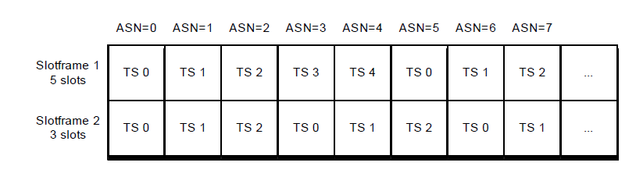
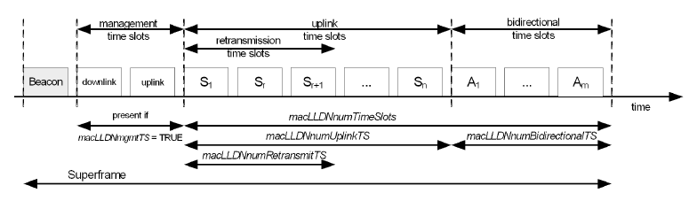
Superframe Structure
TSCH Slotframe: Synchronous access (and hopping),
802.15.4e-2012
LLDN Superframe: Synchronous access, STAR network

Slide 10
Ranging in 15.4 Overview
PHY support
  UWB provides precision ranging
    Signal structure, bandwidth optimized for ToA measurement
    Defines timers for TX and RX time capture sub nansecond resolution.
  Supports ranging on any data frame (initiated with MCPS-DATA request)
  Can be used for round-trip time of flight, or single direction synchronous
MAC support
  Defines attributes for PHY configuration and control (MLME)
  Provides for controlling ranging (enable/disable) on data exchange (MCPS)
  Management services for channel sounding and preamble selection (MLM)
  Supports single direction or two-way ranging
  Provides local timestamps to higher layer
  Exchange between peers higher layer function

Slide 11
MAC services MLME
MLME-RX-ENABLE
  Added Parameter to enable Ranging measurement
MLME-DPS.request
  Controls preambles used for UWNB PHY ranging
MLME-SOUNDING.request
  Request PHY to return channel multi-path profile measurement
  Algorithm not defined (implementation specific)
MLME-CALIBRATE.request
  Supports reporting internal delay offsets
  Calibration method not defined (implementation specific)

Slide 12
MAC Services MCPS
MCPS-Data.Request parameters to control ranging
MCPS-Data.Confirm parameters to pass ranging measurement information to the higher layer
MCPS-Data.Indication includes parameters to pass ranging measurement information with received data frame

Slide 13
MAC Frames
Few frame types
More flexible formats introduced in 802.15.4e-2012
  Enhances existing frames to allows addition of IEs
  Multpi-purpose frame defined to provide extensibility

Slide 14
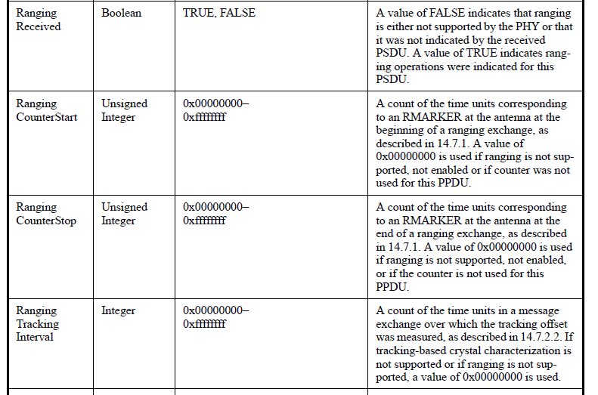
MCPS Ranging Parameters

Slide 15
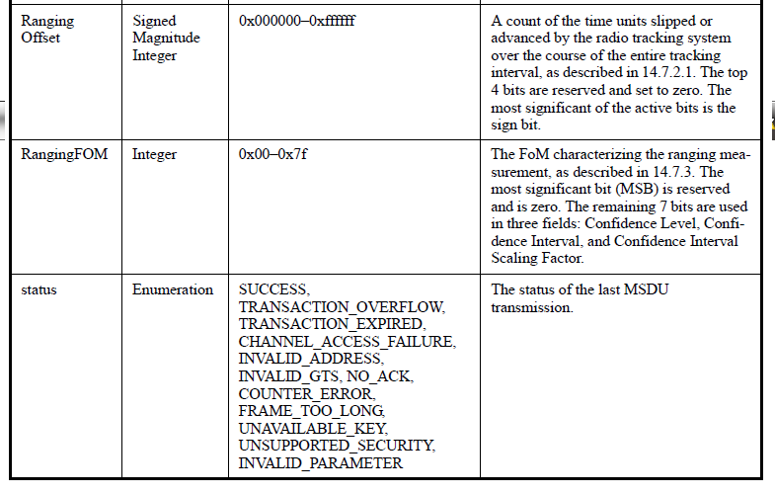
MCPS Ranging Parameters

Slide 16
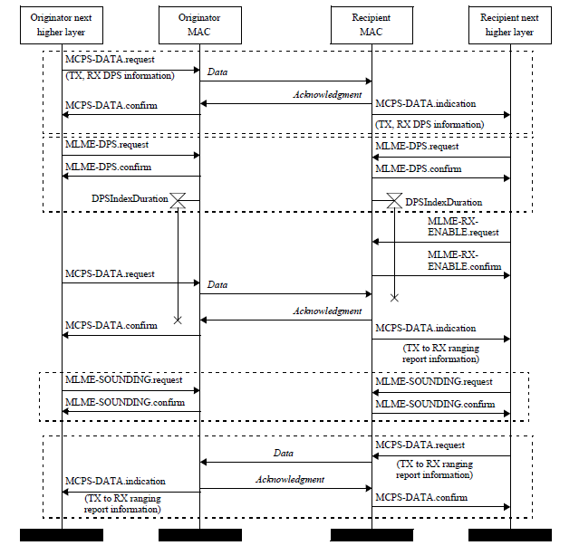
Example MSC for Ranging Process

Slide 17
Description
Higher layer process controls process:
  Determines peers that are ranging capable (RDEVs)
  Initiates ranging
  Collects local range measurements and exchanges range measurements with peers
  Performs “solver” (local ranges to relative position to geo-position)
Geo-calculations not defined in the standard, left to higher layer
  May be centralized or distributed
Exchange of data needed for calculations left to higher layer
  No message formats defined in the MAC

Slide 18
Description
MAC provides
  Primitives for performing ranging steps
  Interface to PHY(s) ranging counters (ToF timers)
  Supplies information to higher layer
  Means to exchange data
  *new in 4e* are mechanisms that support capabilities exchange, other advertisements in beacons
  Hooks for initiating/managing internal calibration
PHY provides
  Ranging counters: Time-stamp to high precision TX and RX times
  Support for channel sounding
Supports ranging w/o global synchronization

Slide 19
TG4m Considerations
Channel access requires position knowledge
  Exchange of position and position dependent data required for channel access
802.15.4 has evolved since 2007
  MAC enhanced to include more superframe flexibility, more synchronous options, support for information exchange between MAC peers via IEs in beacons and other frames
Transformation of range to position (solver)
  Algorithms not interoperability concern
  Defining data exchange can enhance interoperability

Slide 20
Suggestions
Build on MAC features
  Some ranging hooks PHY agnostic (mostly)
Define Information Elements to exchange range measurements
  Use timer definitions in 802.15.4-2011?
    Much higher resolution than required
  Provide several resolutions
    Precision in support of 15.4-2011
    Less precises in support of TVWS at lower overhead
  Leave position solver as higher layer function
  Define rules for when localization is required
    Part of network forming?

Slide 21
Information Exchange
Raw range measurements
  TX time of request (initiator)
  RX time of request packet (responder)
  TX time of response packet
  Signal quality indication (Range FOM)
Report exchanged between peers and ability for peers to relay neighbor reports
  You need a collection of ranges in on place to solve for location

Slide 22
Information Exchange
Use IEs
  Can be added to beacon (sync or async)
  Can be added to other frames (data, MP, commands)
New IEs for
  Synchronization exchanges
  measurement exchanges
  Capabilities and setup
  Define Location Reports
    Relative Position
    Geo-position

Slide 23
Background Reference
Annex E 802.15.4-2011
  Provides a good overview of RF ranging and localization

