Slide 1
Project: IEEE P802.15 Working Group for Wireless Personal Area Networks (WPANs)
Submission Title: [Response to the Call for Applications: Look-and-Link Communication]
Date Submitted: []
Source: [Byung-Jae Kwak, Seon-Ae Kim, Min-Hong Yun, Cheol Ryu, Young-Hoon Kim, Jae-Ho Lee, Soochang Kim, Sunggeun Jin, Jinkyeong Kim]
Company: [ETRI, Korea]
Address: bjkwak@etri.re.kr
Re: [IEEE P802.15 TG8 Call for Applications, IEEE P802.15-12-0202]
Abstract: [This document presents applications of PAC in response to CFA]
Purpose: [To discuss applications of PAC and their implications]
Notice: This document has been prepared to assist the IEEE P802.15. It is offered as a basis for discussion and is not binding on the contributing individual(s) or organization(s). The material in this document is subject to change in form and content after further study. The contributor(s) reserve(s) the right to add, amend or withdraw material contained herein.
Release: The contributor acknowledges and accepts that this contribution becomes the property of IEEE and may be made publicly available by P802.15.
Slide 1

Slide 2
Outline
A PAC Usage Scenario
  Scenario from user experience point of view
  Scenario from technical point of view
  Challenges
Look-and-Link Communication
  Limitation of the conventional approach
  Look-and-Link communication
  Use cases
Requirements for PAC

Slide 3

A PAC Usage Scenario
Kelly went shopping
with Sally
Slide 2

Slide 4

Kelly went shopping with Sally
Let’s split!
Kelly wants to buy some shoes and cloths
Sally wants to buy some cosmetics
Not enough time!
They decided to split & meet up later.

Slide 5



Kelly calls Sally… on her PAC phone
Sally!
I am done with shopping.
Where are you?
I will meet you at OOO.

Slide 6

Kelly & Sally meet again.
Let’s eat!
I am starving.
Me too!

Slide 7
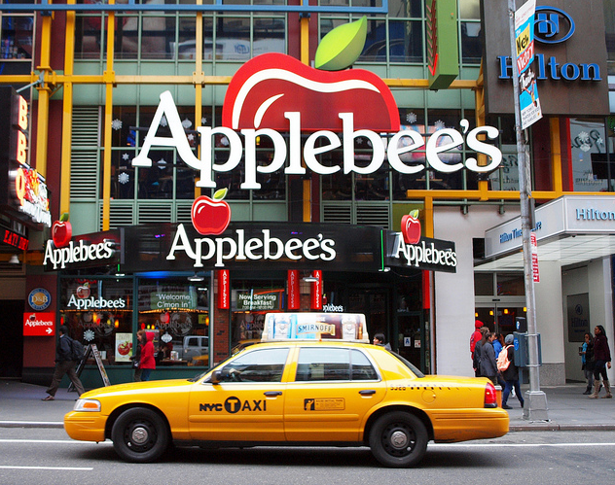

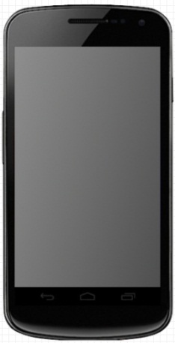

That’s one fine looking restaurant
Look!
PAC Phone

Slide 8
The scenario from technical point of view
PAC within 1 Km range
  Non-visible peer
  Probably the ID/name of the peer is known
PAC within visible range
  The peer mostly in close proximity
  The ID/name of the peer may not known
  The (relative) location of the peer is the ID

Slide 9
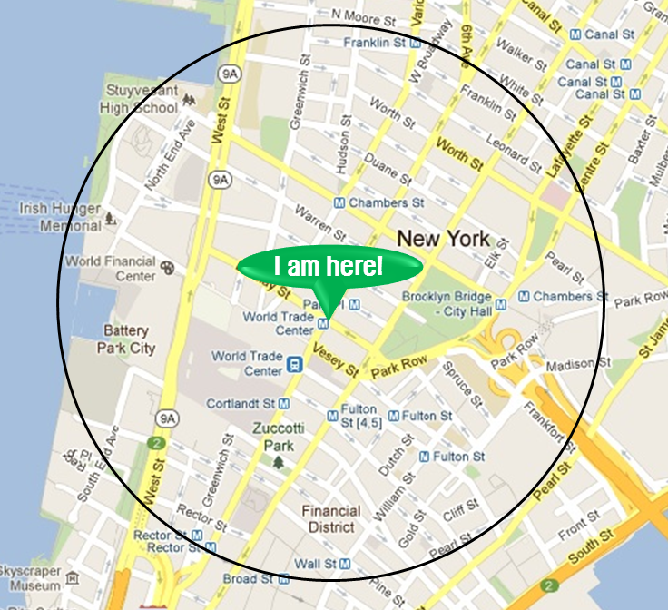
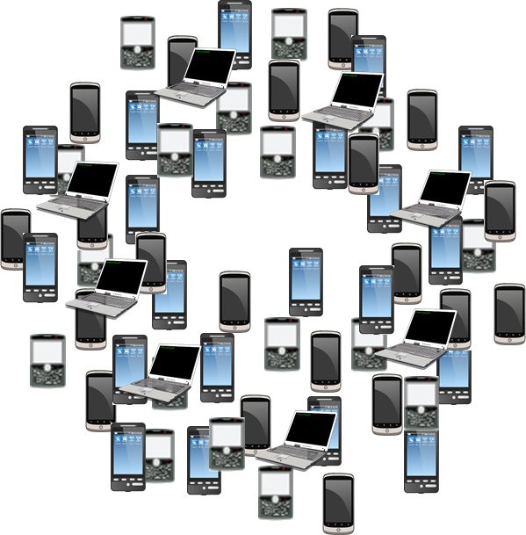
Challenges
Huge number of devices
  Assuming 9m² (3m x 3m square) per person → 1700 devices within 70m range [2]
PHY & MAC overhead
  A case in point: 35% of the resource is used for discovery (Probe Request/Response) in WLAN hotspot area [3]
How to minimize user intervention

Slide 10
Look-and-Link Communication
Slide 3

Slide 11



Conventional D2D Communication
User needs to know the ID of the peer device (IP address, hardware address, device nickname, etc)
ID ?

Slide 12
Conventional D2D Communication
Device selection requires the user to shift through non-intuitive addresses/names [4].
Discovery time can be critical from user experience point of view.

Slide 13

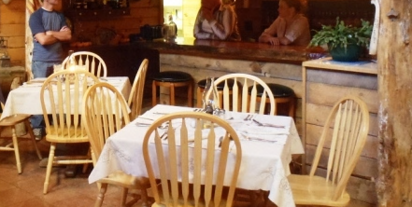

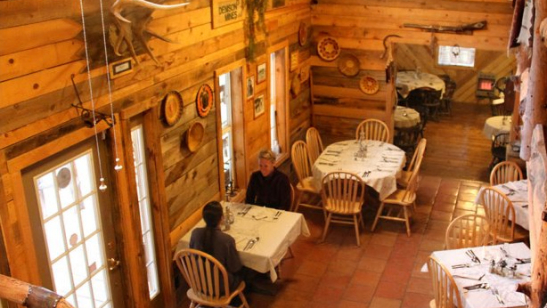











Look-and-Link Communication

Slide 14
Use Cases
Advertising
Productivity: meeting, printing, etc.
E-Commerce: ticketing, etc.
Social Life: blind date, social gathering, etc.
Public service, emergency, etc.

Slide 15
Requirements for PAC
Slide 4

Slide 16
Requirements for PAC
Device filtering
  Service filtering
  Spatial filtering (angular/distance)
  Device type filtering
Minimize user intervention
PnL Requirements
Discovery Time | Data Rate | Latency | Range | Mobility | Angular Resolution | Ranging Accuracy
< 3 s | 1~10 Mbps | 100 ~ 200 ms | < 100 m | < 4 km/h | < 15 deg | < 5 m

Slide 17
References
[1] IEEE 802.15.8 PAR (draft), IEEE 802.15-12/0157r0, Mar. 2012.
[2] “Scalability of Device Discovery,” IEEE 802.11-11/1517r0, October 2011.
[3] “Real Air-Time Occupation by Beacon and Probe,” IEEE 802.11-11/1413r4, Jan. 2012.
[4] Ryan W. Woodings, Derek D. Joos, Trevor Clifton, Charles D. Knutson, “Rapid Heterogeneous Ad Hoc Connection Establishment: Accelerating Bluetooth Inquiry Using IrDA,” WCNC 2002, vol. 1, pp.342-349, Mar. 17-21, 2002.

Slide 18


Thank You!
ID….

