Slide 1
Project: IEEE P802.15 Working Group for Wireless Personal Area Networks (WPANs)
Submission Title: [Proposed 900 MHz and 430 MHz Channelization in Japan for IEEE802.15.4k ]
Date Submitted: [25, March, 2012]
Source: [Shu Kato, Hirokazu Sawada, Hiroyuki Nakase] Company [ Tohoku University]
Address [2-1-1, Katahira, Aoba-ku, Sendai, Miyagi, Japan]
Voice:[+81-22-217-5506], FAX: [+81-22-217-5476], E-Mail:[shukato@riec.tohoku.ac.jp]
Re: [Channelization in Japan for 8082.15.4k]
Abstract: [900 MHz and 430 MHz Channelization for IEEE is proposed]
Purpose: [Presented to the IEEE802.15.4k LECIM task group for consideration]
Notice: This document has been prepared to assist the IEEE P802.15. It is offered as a basis for discussion and is not binding on the contributing individual(s) or organization(s). The material in this document is subject to change in form and content after further study. The contributor(s) reserve(s) the right to add, amend or withdraw material contained herein.
Release: The contributor acknowledges and accepts that this contribution becomes the property of IEEE and may be made publicly available by P802.15.

Slide 2
Proposed 900 MHz and 430 MHz Channelization in Japan for IEEE802.15.4k
Marc 25, 2012
Shu Kato
RIEC Tohoku University

Slide 3
900 MHz and 430 MHz Japanese Regulations and Channelization Summary
900 MHz
The band, 915.9~929.7MHz is usable but need carefully to pay attention on complicated regulations
Need to coordinate USA 900 MHz channelization: starting with “0” frequency such as 902, 903, ..MHz (If it changes, need to follow)
Worked on 1024 kc/s, 512 kc/s, and 256 kc/s signal transmission
Some cases need relatively stringent filtering and high resolution D/A converters to meet out of band signal transmission power regulation
Worked on 250 mW, 1-20 mW, 1mW (or less) output power transmission
Came out with the workable numbers of channels for each bonded bandwidth, 400, 600, 1000 kHz
II. 430 MHz
Ten channels with 12.5 kHz spacing (8.5 kHz signal bandwidth) have been identified

Slide 4
A New 900 MHz Spectrum Allocation in Japan
: 13.8 MHz
26 MHz
902
US (max erp <=1 W)
928 MHz
6.5 MHz
Korea
917
923.5
13.8 MHz
Japan
929.7
915.9
928 MHz
(Max BW = 1MHz)
Country | Tx power regulations
USA | Max e.r.p. <= 1 W
Korea | 3 mW or 10 mW (920.6~923.5MHz and six 200 KHz channels below 920.6 MHz)
Japan | 1mW , 20 mW or 250 mW (915.9~929.7MHz) Max BW = 1 MHz

Slide 5
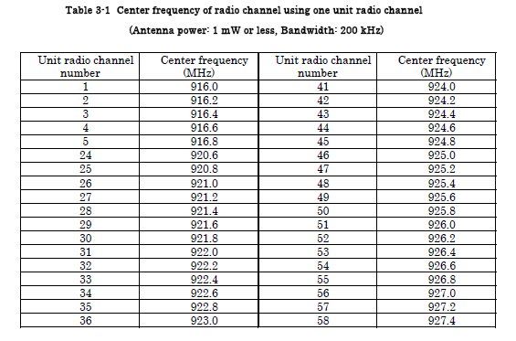

900 MHz Available Channels in Japan (915.9~928.1MHz)(200 KHz BW/unit channel)
Tx Power= 1 mW or less

Slide 6
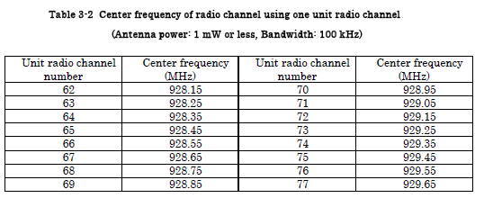
900 MHz Available Channels in Japan (928.1~929.7MHz)(100 KHz BW/unit channel)
Tx Power: 1 mW or less

Slide 7
Classification by Transmission Power
Case 1: Output power= 250 mW (ch. 24 - 38)
Case 2: Output power= 1 - 20 mW (Ch. 1-5, 54 – 61, 62 - 77 )
Case 3: Output power = less than 1 mW (Ch. 1-61, 62-77)
Power level at the occupied band edge: may decide usable
/ non-usable (may need signal bandwidth reduction,
“higher number of bits” in DAC) may be required)
2. Adjacent channel leakage power limitation

Slide 8
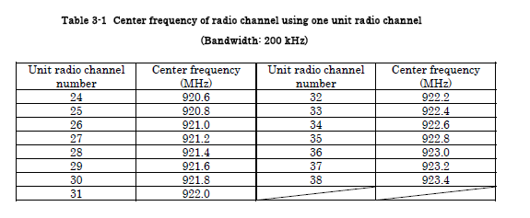
Case 1 : Pout=250 mW
Radio Channel
Unit channel (Center/carrier frequency: from 920.6MHz to 923.4MHz, 200kHz step, ch 24 - 38）（Max boded unit channels: 5)

Slide 9
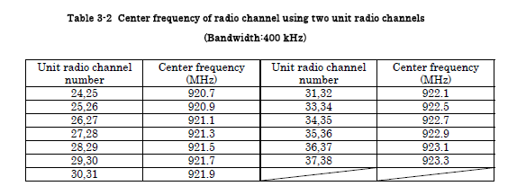
400 kHz channels by bonding two unit channels (for 250 mW Transmission)

Slide 10
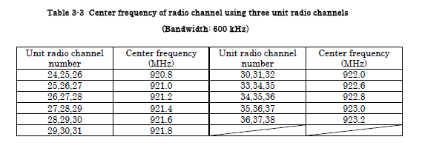
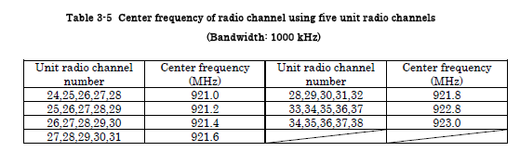
600 kHz channels by bonding three unit channels (for 250 mW Transmission)
1 MHz channels by bonding five unit channels (for 250 mW Transmission)

Slide 11
Pout=24dBm
Out of band power regulation (920MHz band)
STD-108 Pout=250mW (24dBm)
Channel edge regulation
(In the case of using 920.0~922.3MHz)
+4dBm
Adjacent channel
-5dBm/200kHz
Adjacent channel
-5dBm/200kHz
-29dBm/100kHz
-29dBm/100kHz
-30dBm/1MHｚ
-36dBm/100kHz
-36dBm/100kHz
-36dBm/100kHz
-55dBm/1MHz
-55dBm/100kHz
-55dBm/100kHz
-45dBm/1MHz
710
900
915
920.3
Occupied
bandwidth
200kHz x N
924.3
930
1000
1215
Frequency
[MHz]
-200kHz
+200kHz

Slide 12
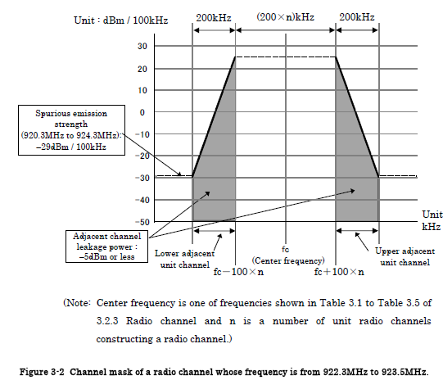
Case 1-1(Pout=250 mW) 922.5MHz~923.4MHz (Ch33~Ch38)
A. Power level limitation at the edge of occupied band: Not specified –
– possible to transmit 1 Mc/s signals
B. Adjacent channel leakage power : less than -5dBm/200 kHz
C. Further outer bands (shown in the following picture)
: -29 dBm/100 kHz (-53dBc from the peak power)

Slide 13
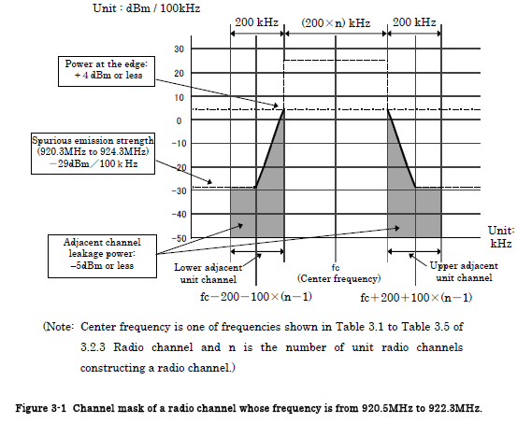
Case 1-2 (Pout=250 mW), 920.6MHz~922.3MHz (Ch24~Ch32)
A. Power level limitation at the edge of occupied band
: less than +4 dBm (- 20 dBc from the peak power) - Not feasible to transmit 1Mc/s signals
B. Adjacent channel leakage power : less than -29dBm/200 kHz
C. Further outer bands (shown in the following picture)
: -29 dBm/100 kHz (-53dBc from the peak power)

Slide 14
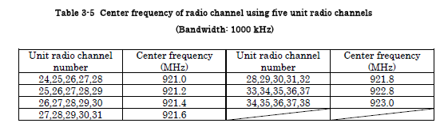
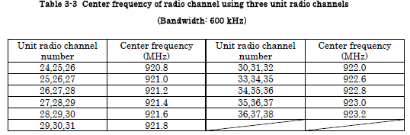
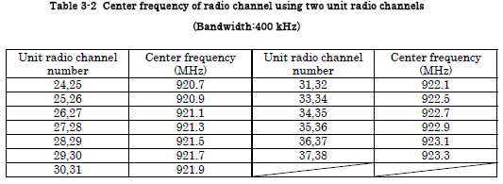
Channelization for Case 1-1 (Available channels: ch 33-38, guard band : one ch)
1MHz BW(5ch combined)
Available channels：1
(ch 33,34,35,36)
Channel starts from 922 MHz: good for USA coordination
600kHz BW(3ch combined)
Available channels：1
(ch 33,34,35)
400kHz BW(2ch combined)
Available channels：2
(ch 33,34 and Ch 36,37)

Slide 15
Case 2: Output power = 1 – 20 mW
Radio channel
916 – 916.8 MHz, 920.6MHz - 928.0MHz
916.0MHz and 916.0MHz + N x 200kHz
920.6MHz and 920.6MHz + N x 200kHz
Unit channel bandwidth: 200 kHz, can be combined up to 5
2. 928.15MHz - 929.65MHz
928.15MHz and 928.15MHz + N x 100kHz
Unit channel bandwidth: 100 kHz, can be combined up to 5
Condition: Passive Systems have priority in these bands
Can not use the channels with center frequency of 920.6MHz to 922.2MHz (ch#24 – 32) and channels with center frequency of 922.4MHz or higher (ch#33~) simultaneously

Slide 16
Out of band power regulation (920MHz band)
Pout=1mW～20mW
Pout=0 ~ 13dBm
Channel edge regulation
(In the case of using 915.9~922.3MHz)
-20dBm/100kHz @ Pout=0dBm
-7dBm/100kHz @ Pout=13dBm
Adjacent channel power leakage:
Pout=1～20mW: -15dBm/200kHz以下
Pout=1mW以下: -26dBm/200kHz以下
-30dBm/1MHz
-36dBm/100kHz
-36dBm/100kHz
-36dBm/100kHz
-55dBm/1MHz
-55dBm/100kHz
-55dBm/100kHz
-45dBm/1MHz
710
900
915
Occupied
bandwidth
200kHz x N
930
1000
1215
Frequency
[MHz]
-200kHz
+200kHz

Slide 17
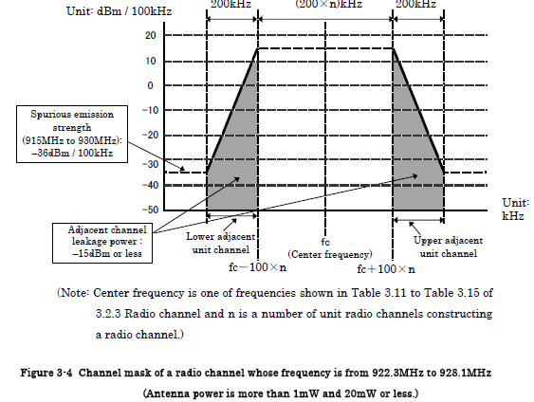
CASE 2-1(Pout=1-20 mW),
922.3MHz~928.1MHz (Ch 33~Ch 61)
Power level limitation at the edge of occupied band: Not specified
(Roll off filter (Alpha=0.6 ) may work)
B. Adjacent channel leakage power : less than -15dBm/200 kHz
C. Further outer bands (shown in the following picture)
: -36 dBm/100 kHz (-49dBc from the peak power)

Slide 18
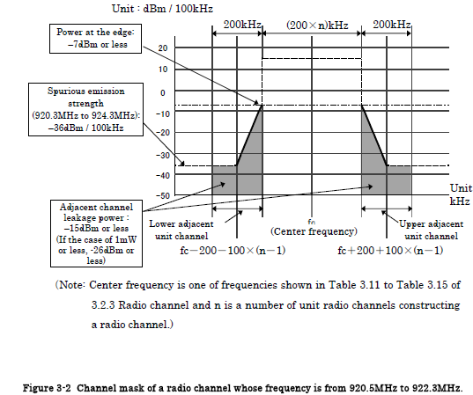
CASE 2-2 (Pout=1-20 mW),
920.5 MHz~922.3MHz (Ch 24~Ch 32)
A. Power level limitation at the edge of occupied band: -7dBm or less (20 dBc max), or -26 dBm or less (for 0 dBm Tx power output)
B. Adjacent channel leakage power : less than -15dBm/200 kHz, or -26 dBm or less (for 0 dBm Tx power output)
C. Further outer bands (shown in the following picture)
: -36 dBm/100 kHz (-49dBc from the peak power)

Slide 19
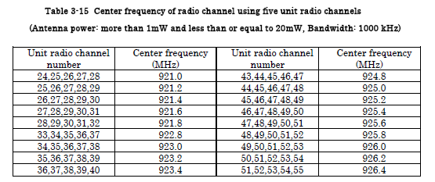
Case 2-1
1MHz BW(5ch combined) (Ch 33~Ch 61)
Each channel to start at “0” MHz – 1.2 MHz for signal transmission bandwidth
(to coordinate USA frequency allocation)
(Roll off filter (Alpha= 0.17 ) may work)
Available channels：3 (ch. 33,34,5,36,37,ch. , ….)
1M
1M
1M

Slide 20
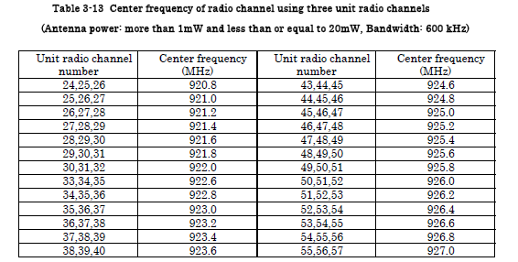

Case 2-1 600 kHz BW(3ch combined) to transmit 512 kc/s signals (Ch 33~Ch 61)
Each channel needs: 0.8 MHz channel spacing for signal transmission (Roll off filter (Alpha= 0.6) may work)
Available channels：7 (ch. 33,34,35,ch , ….)
6K
6K
6K
6K
6K
6K
6K

Slide 21
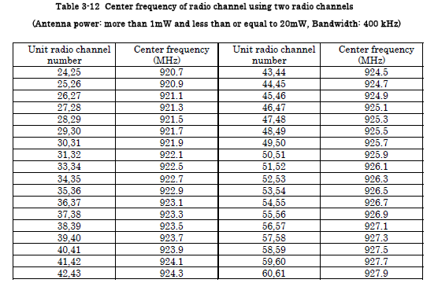
Case 2-1 400 kHz BW(2ch combined) to transmit 256 kc/s signals (Ch 33~Ch 61)
Each channel needs: 0.6 MHz channel spacing for signal transmission
Channels：10 (ch 33, 34 ….)
4K
4K
4K
4K
4K
4K
4K
4K
4K
4K

Slide 22
Case 3: Output power= 1 mW or less
922.3MHz ~ 928.1MHz(Ch. 33～61)
Power level limitation at the edge of occupied band: Not specified
2. 915.9MHz ~ 916.9MHz (Ch. 1～5）
A. Power level limitation at the edge of occupied band:
- 20 dBm or less (20 dBc max)

Slide 23
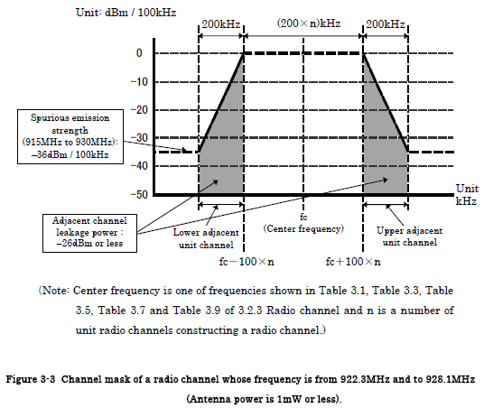
CASE 3-1 922.3MHz - 928.1MHz (Ch. 33～61)
A. Power level limitation at the edge of occupied band: Not specified – possible to transmit up to 1Mcps
B. Adjacent channel leakage power : less than -26 dBm/200 kHz
C. Further outer bands (shown in the following picture)
: -36 dBm/100 kHz (-36 dBc from the peak power)

Slide 24
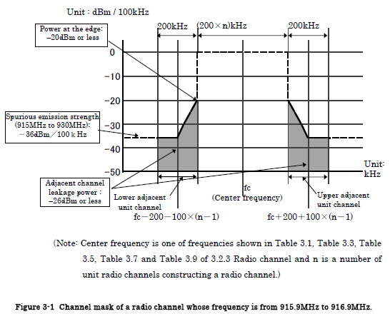
Case 3-2
A. Power level limitation at the edge of occupied band: -20 dBm or less –
not feasible to transmit 1Mc/s signals
B. Adjacent channel leakage power : less than -26 dBm/200 kHz
C. Further outer bands (shown in the following picture)
: -36 dBm/100 kHz (-36 dBc from the peak power)

Slide 25
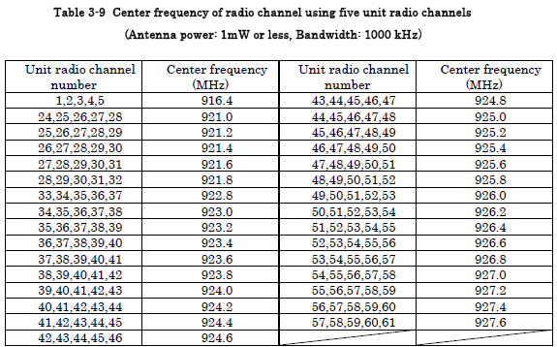
Channelization for Case 3-1 (Available channels: ch 33-61, guard band : one ch): 1 mW or less
1MHz BW x 3 channels ( by combining 5 unit channels )
Each channel starts with “0” (922, 924,..) to coordinate USA Spectrum

Slide 26
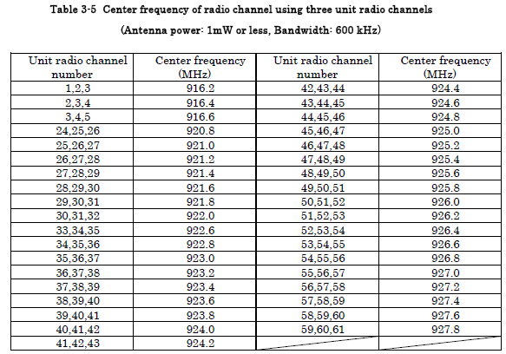
Channelization for Case 3-1 (Available channels: ch 33-61, guard band : one ch)
600 kHz BW x 7 channels ( by combining 3 unit channels)
Each channel has 800 kHz channel spacing (Roll off filter (Alpha =0.5) may work

Slide 27
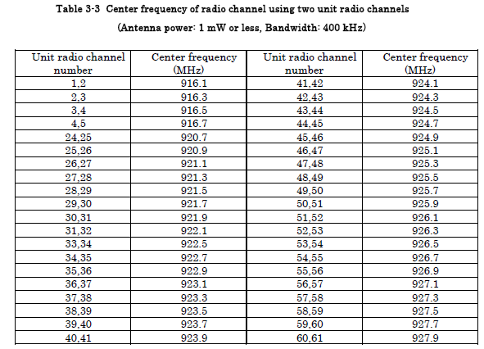
Channelization for Case 3-1 (Available channels: ch. 33-61, guard band : one ch.)
400 kHz BW x 11channels ( by combining 2 unit channels)
Each channel has 600 kHz channel spacing (Roll off filter (Alpha =1.5) may work

Slide 28
400 MHz Frequency Availability in Japan
FDD channels for duplex communications only
Channel spacing: 12.5 kHz (8.5 kHz signal bandwidth) – spreading factor of 10
Frequency bands
: 429.8125 ~ 429.9250 MHz (ch. 1 ~ 10)
: 449.7125 ~ 449.8250 MHz (ch.1 ~ 10)

Slide 29
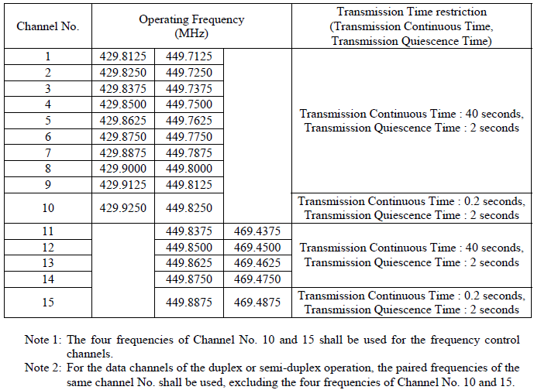
400 MHz Available channels in Japan
: 12.5 kHz channel spacing (Occupied Bandwidth of 8.5 kHz or less)
Channel No., Operating Frequency and Transmission Time restriction

Slide 30
Conclusion
900 MHz Channelization
1. With Tx power of 250 mW
Channel starts from 922.1 MHz, Center: 922.8 MHz, 923.5 MHz ending,
Could be usable for USA
Available channels：1 ( ch. 33,34,35,36)
2. With Tx power of 1 -20 mW
1MHz BW(5ch combined) (Ch 33~Ch 61)
Each channel to start at “0” MHz – 1.2 MHz for signal transmission bandwidth (to coordinate USA frequency allocation)
(Roll off filter (Alpha= 0.17 ) may work)
Available channels：3 (ch. 33,34,5,36,37,ch. , ….)
3. With Tx power of 1 mW or less
1MHz BW (5ch combined) (Ch 33~Ch 61)
Each channel starts with “0” (922, 924,..) to coordinate USA Spectrum
Available channels：3 (ch. 33,34,5,36,37,ch. , ….)

