Slide 1
Project: IEEE P802.15 Working Group for Wireless Personal Area Networks (WPANs)
Submission Title: [IG SRU Technical Document]
Date Submitted: [18 July, 2012]
Source: [Shoichi Kitazawa] Company [ATR ]
Address [2-2-2 Hikaridai Seika, Kyoto 619-0288 Japan]
Voice:[+81-774-95-1511], FAX: [+81-774-95-1508], E-Mail:[kitazawa@atr.jp]
Re: []
Abstract: [This document summarizes of technical issues discussed in IG SRU meeting.]
Purpose: [To summarizes of contribution regarding spectrum resource utilization in WPAN’s.]
Notice: This document has been prepared to assist the IEEE P802.15. It is offered as a basis for discussion and is not binding on the contributing individual(s) or organization(s). The material in this document is subject to change in form and content after further study. The contributor(s) reserve(s) the right to add, amend or withdraw material contained herein.
Release: The contributor acknowledges and accepts that this contribution becomes the property of IEEE and may be made publicly available by P802.15.

Slide 2
IG SRU Technical Document
Shoichi Kitazawa

Slide 3
Authors / Contributors
Authors / Contributors
Name | Company | email
Shoichi Kitazawa | ATR | kitazawa@atr.jp
Satoshi Tsukamoto |  | tsukamoto@atr.jp
Tomohiro Miyasaka |  | miyasaka@atr.jp
Kohji Ohshima |  | k_ohshima@atr.jp
Kazuto Yano |  | kzyano@atr.jp
Narihiro Nakamoto |  | nakamoto_n@atr.jp
Masashiro Uno |  | uno@atr.jp
Kiyoshi Kobayashi |  | kobayashi@atr.jp
Yasuo Suzuki
Miki Sato
Masazui Ueba
Mineo Takai | UCLA Computer Science Department | mineo@cs.ucla.edu
Jitin Bajaj
Wooseong Kim
Brian Choi
Mario Gerla
Bob Conley | Eigen Wireless | bconley@eigenwireless.com
Steven Schennum | Gonzaga University | schennum@gonzaga.edu
Yukimasa Nagai | Mitsubishi Electric

Slide 4
Table of Contents
Introduction
  I-1. Activity of IG SRU
Problems in Unlicensed band
Possible solutions
  III-1. DSA system
  III-2. Any other solution
Topics to be discussed in the next step
  IV-1. Applications and System requirement
  IV-2. Technical issues
  IV-3. 5C & PAR
References

Slide 5
I. Introduction
This technical document provides summary of contribution of IG SRU regarding efficient use spectrum resources.
  The IG SRU chartered to explore mechanism of efficient spectrum use in ISM and unlicensed band.
  The draft plan of IG SRU, the IG SRU will release a report at March 2012 plenary meeting.

Slide 6
I-2. Activity of IG SRU
The IG SRU meeting held every plenary meeting.
Year | Month | Venue | Agenda | Closing Report | Minutes | Number of participant
2010 | November | Dallas | 15-10-0839-01 | 15-10-0924-01 | 15-10-0934-00 | 10
2011 | March | Singapore | 15-11-0159-01 | 15-11-0298-00 | 15-11-0440-00 | 8
 | July | San Francisco | 15-11-0456-00 | 15-11-0552-00 | 15-11-755-00 | 11
 | November | Atlanta | 15-11-0757-01 | 15-11-0830-00 | 15-12-0106-00 | 13
2012 | March | Waikoloa | 15-12-0107-00 | 15-12-0191-00 | 15-12-0197-00 | 4

Slide 7
II. Problems in Unlicensed band
II-1 Current situation
  Measured results of 2.4GHz band.
II-2 Future problem
  900MHz
  2.4GHz
  5GHz
II-3 Measurement system

Slide 8
II-1. Current situation
There are various radio system autonomously operated in unlicensed band. It is expected that degradation of system performance will be occur in a high traffic load situation due to inter-system interference.
To confirm current situation of 2.4GHz ISM band, following locations were measured.
  Airport
  Conference room
  Residential area
  Hospital

Slide 9
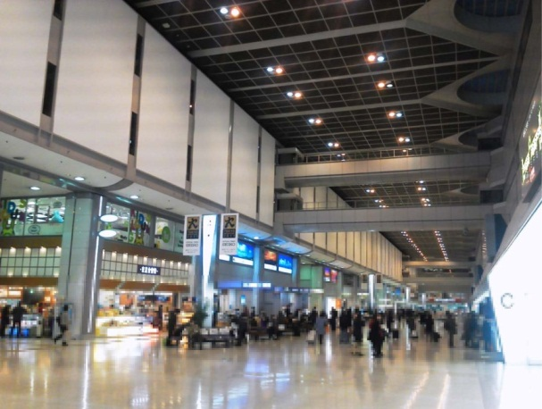
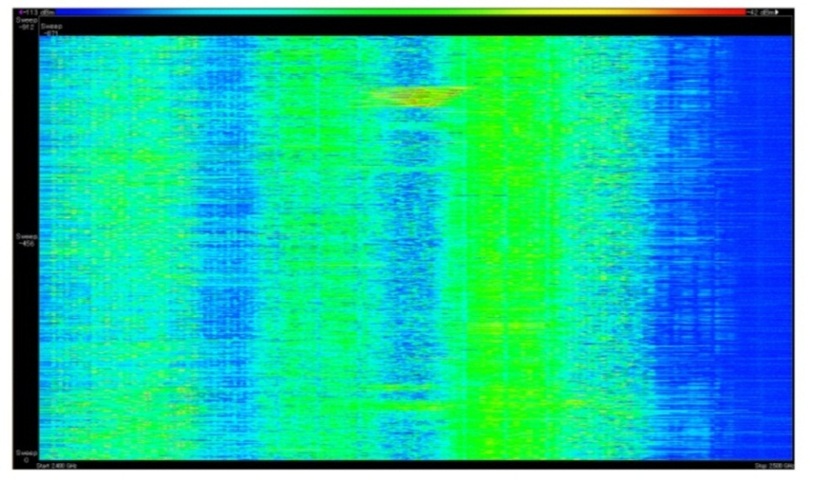
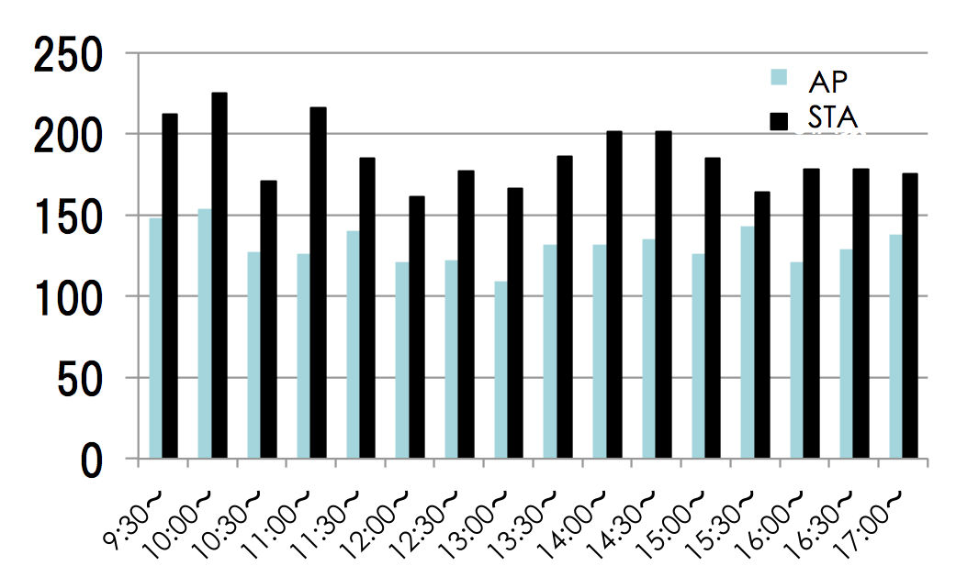
Airport
II-1. Current situation
Haneda (Tokyo International Airport)
  61million passengers/Year
Large number of AP and STA were observed.
-114dBm
Signal strength
-34dBm
10:00
Time
10:15
2.4GHz
Frequency
2.5GHz
Number of AP and STA
Spectrogram

Slide 10
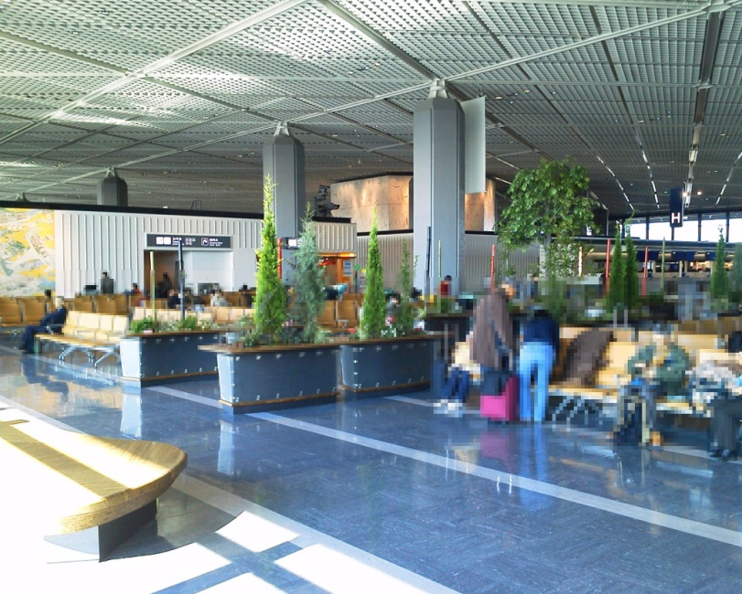
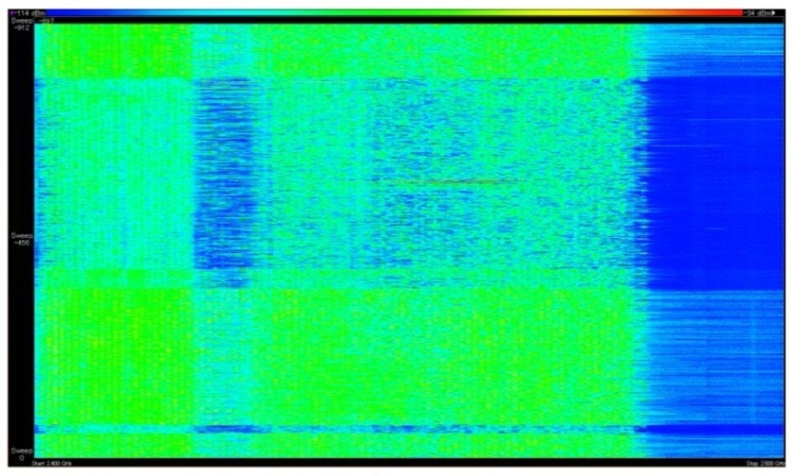
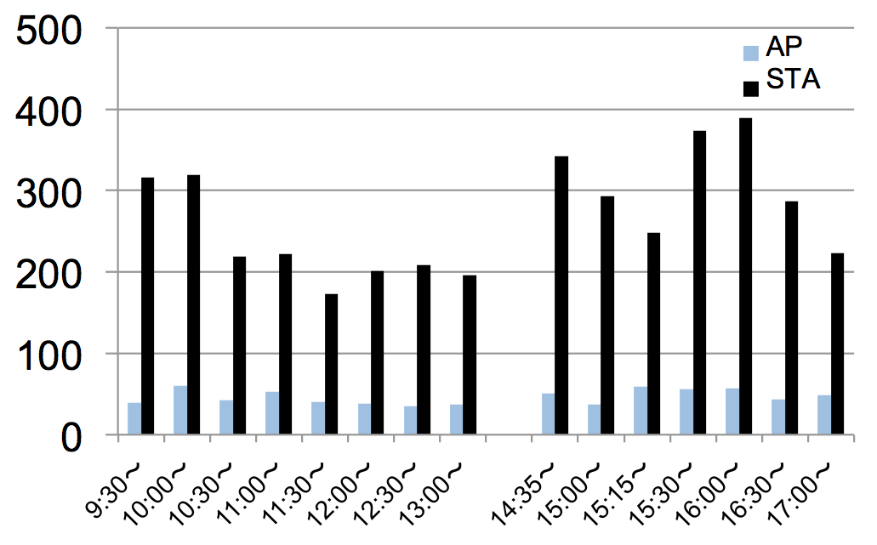
Airport
II-1. Current situation
Narita International Airport
  30million passengers/Year
Large number STA were observed.
-114dBm
Signal strength
-34dBm
16:00
Time
16:15
2.4GHz
Frequency
2.5GHz
Spectrogram
Number of AP and STA

Slide 11
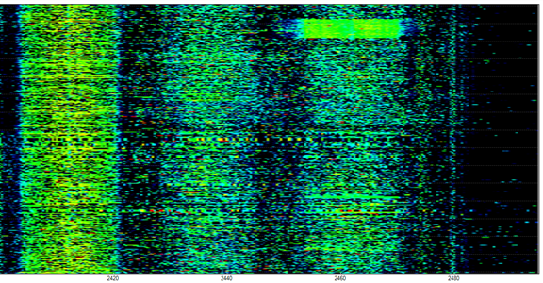
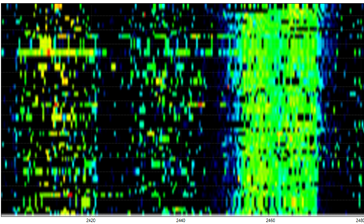
Conference room
II-1. Current situation
Opening plenary meeting of WG15 (July 2011.)
  19AP’s were observed at CH 1, 6, 7,11
11:47
30 sec
11:32
2.4GHz
Frequency
2.48GHz
2.4GHz
Frequency
2.48GHz
Spectrogram

Slide 12
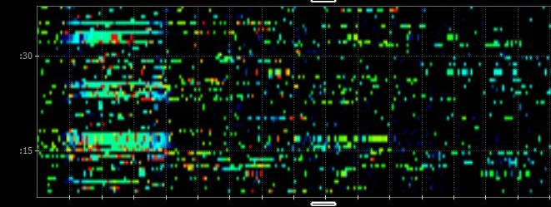
Residential area
II-1. Current situation
There are more than 20 houses and apartment houses within a 50-meters radius.
  WLAN 15 AP’s were observed at CH1, 2, 5, 6, 7, 11.
  FH system (cordless telephone)
30 sec
2.4GHz
Frequency
2.48GHz
Spectrogram
Slide 12

Slide 13
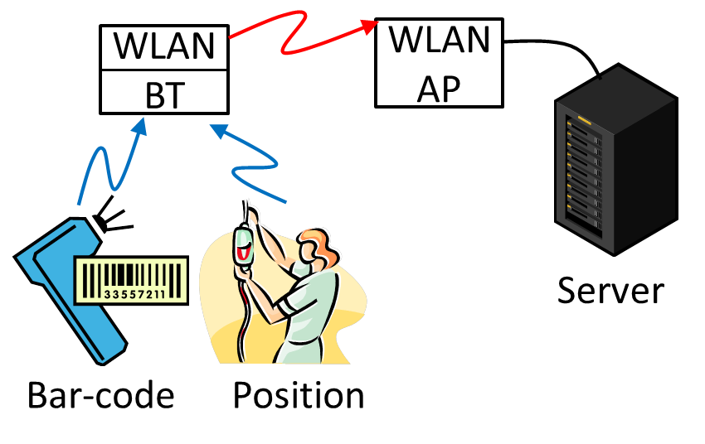
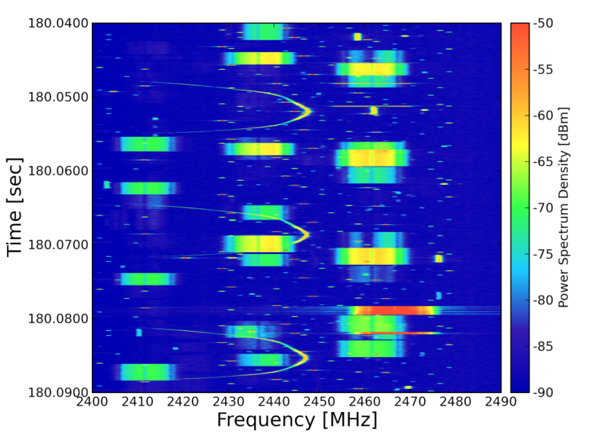
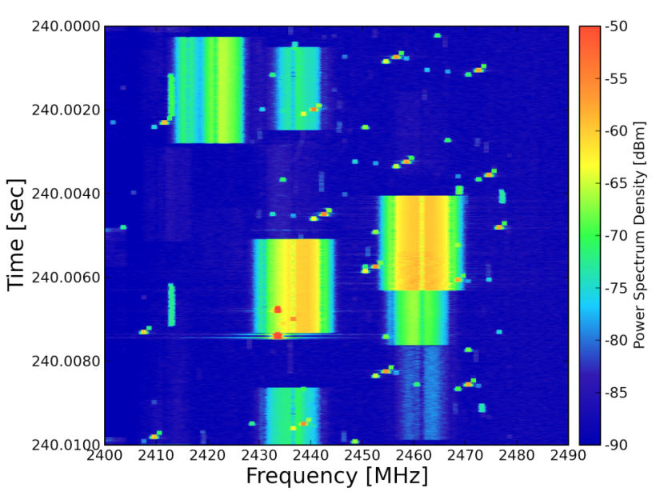
Hospital
Kyoto University Hospital
  Number of Beds:1121
  Bluetooth and WLAN are equipped in the hospital.
The ISM band is congested with WLAN, Bluetooth and Microwave oven.
Spectrogram

Slide 14
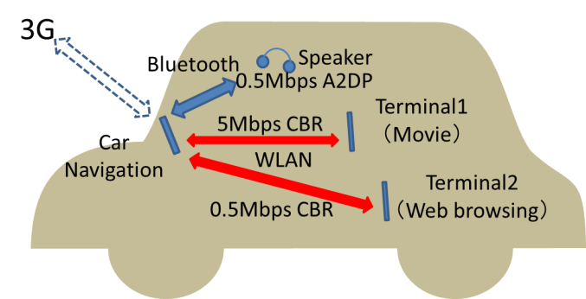
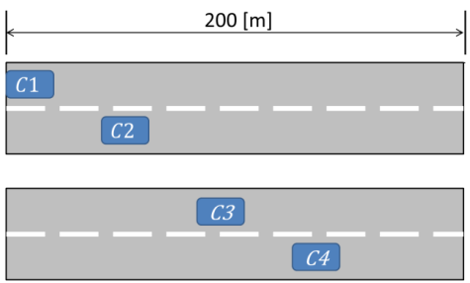
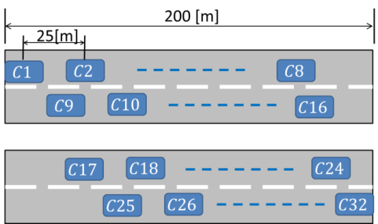
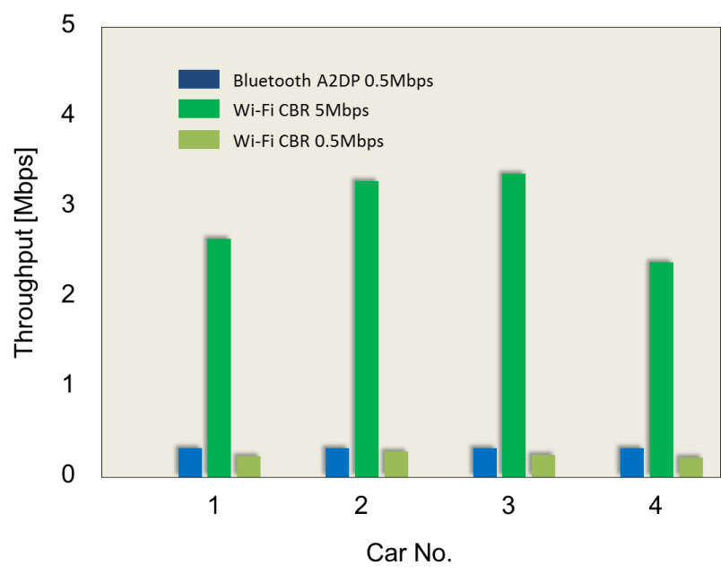
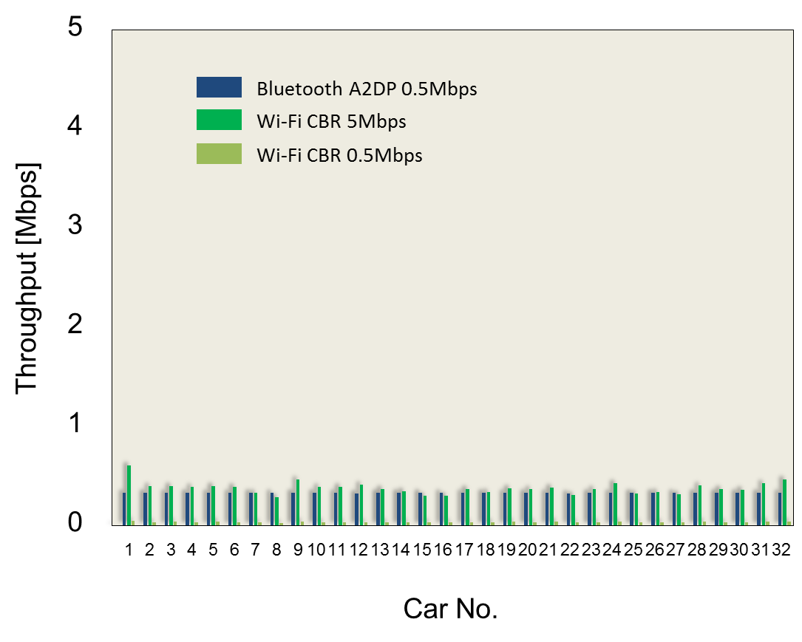
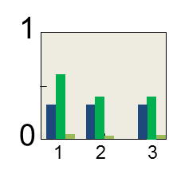
In Car communication
Wireless communication inside the car will be common near future.
Throughput of WLAN and Bluetooth were simulated.
  Each car using WLAN and Bluetooth.
  2 Scenarios
Case1
Case2

Slide 15
II-2. Future problem
In 2.4GHz ISM band, many kinds of SRD’s becomes more common.
  In this band, more congestion is expected.
Recently, unlicensed band at sub 1GHz are attracting attention for M2M communication.
  It is likely that congestion situation similar to 2.4GHz ISM band will be occur in the near future.

Slide 16
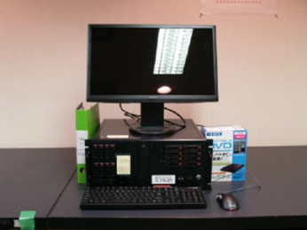
II-3. Measurement system
Following measurement system were used for assessment of 2.4GHz situation.
  AirMagnetWiFi by Fluke Networks
  Wi-Spy 2.4x by Metageek
  Developed RF signal recorder system
Block diagram of measurement system

Slide 17
III. Possible solutions
In this section, promising technologies for efficient use of spectrum resources are summarized.
III-1 DSA system
  Concept
  System detail
  Simulation results
III-2 Other solutions
  Intelligent Spectrum Sensing for vehicular Communications in the ISM Bands
  Smart Antenna Opportunities for Spectrum Resource Usage Improvements
  Cooperative Channel Segmentation for Interference Mitigation in the 2.4GHz Band

Slide 18
III-1. DSA System
In this subsection following topics are described.
  Concept of proposed DSA
  Feature of DSA
  Frequency Channel Plan in 2.4 GHz Band
  Frame Configuration for CCH
  Simulation

Slide 19
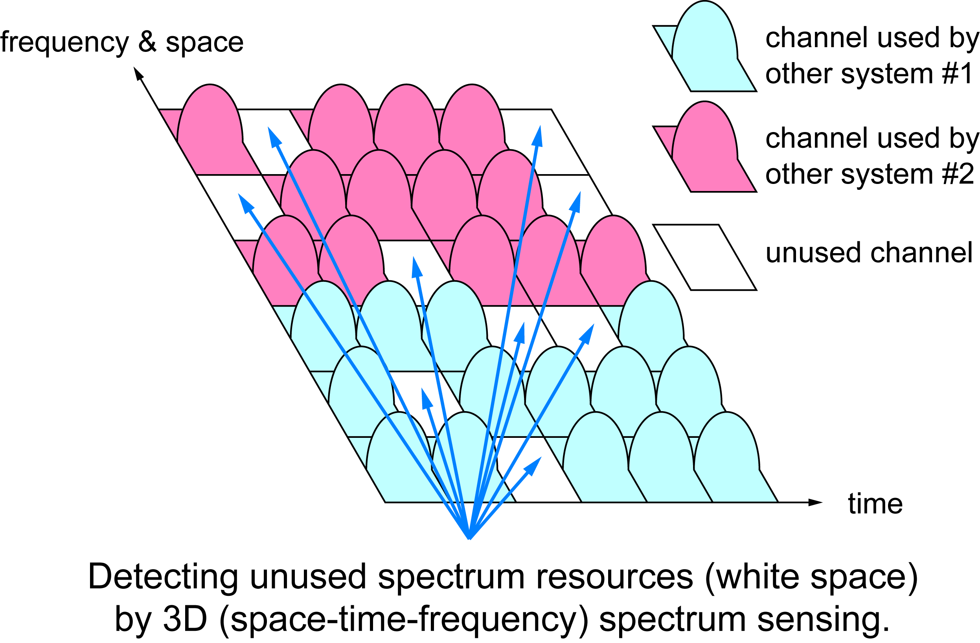
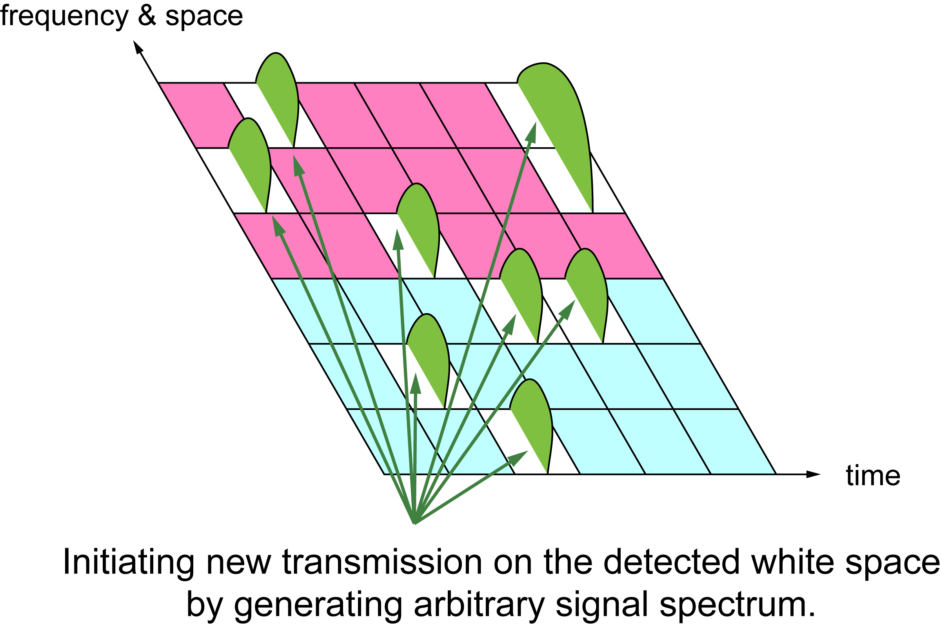
Concept of proposed DSA
III-1. DSA system
DSA system transmits its own traffic over fragmented unused radio resources detected by spectrum sensing.
It shares radio resources, managing the influence on other wireless system.

Slide 20
Features of DSA system
III-1. DSA system
The system consisting of an access point (AP) and mobile stations (MS).
For efficient spectrum use and low overhead,
  Carrier sense to avoid interference to/from the other radio systems, but without random back-off (fixed-length quiet time)
  TDMA (polling) with DSA forming time frame and slots
  Using a Control Channel (CCH) with frequency hopping (FH) for link establishment
  Spectrum divided and single carrier modulation

Slide 21
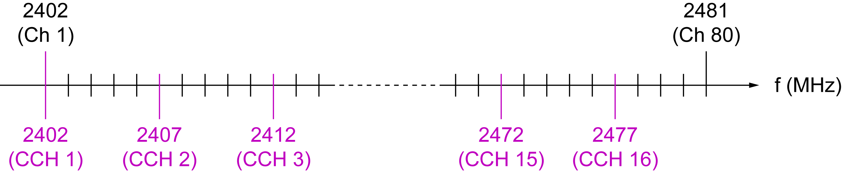
Frequency Channel Plan in 2.4 GHz Band
III-1. DSA system
80 Frequency channel unit(FCU) in 80MHz.
Control channel (CCH) hops on predetermined subset of frequency channels.
Data link channel (DCH) signal can be divided into multiple subspectra.
Example of DCH signal spectrum
1FCU
3FCU
4FCU

Slide 22
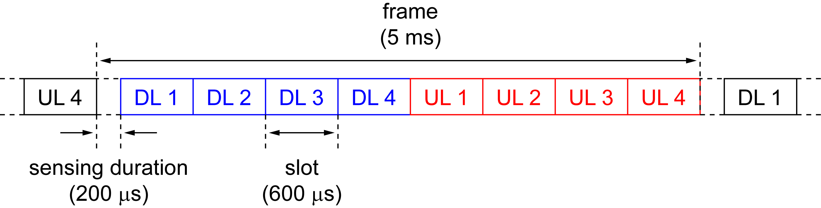
Frame Configuration
III-1. DSA system
Frame and CCH hopping period of 5ms
Sensing and guard duration (quiet time) of 200 μs
4+4 slots TDMA-TDD

Slide 23
Simulation
III-1. DSA system
The performance of the DSA when the system coexists with WLAN and/or BT were evaluated by network simulator based on QualNet.
  QualNet with newly developed library for inter-system interference evaluation.
Performance index
  MAC throughput
  Amount of unused resources

Slide 24
Simulation settings
III-1. DSA system
30 m x 30 m area with AWGN propagation channel
WLAN (IEEE 802.11g ERP-OFDM DCF)
Bluetooth (Bluetooth2.0+EDR)
DSA system
WLAN
Physical Data rate | 54 Mbps
TX Power | +16 dBm
Application | CBR (AP ➔ STA)
Offered load | 17, 20 Mbps
Bluetooth (BT)
Physical Data rate | 1, 2, 3 Mbps
TX Power | 0 dBm
Application | CBR (Full buffer)
AFH | ON
DSA
Physical Data rate | 2.8 Mbps/MHz
TX Power | +4 dBm
Application | CBR (AP ➔ MS)
Offered load | 20 Mbps

Slide 25
Simulation Scenarios
III-1. DSA system
Condition |  | Condition
Case1 | WLAN 3BSS’s (ch 1, 6, 11) | Case4-1 | + DSA 1pair
Case2-1 | + WLAN 1BSS (ch 3) | Case4-2 | + DSA 2pairs
Case2-2 | + WLAN 2BSS’s (ch 3, 9) | Case4-3 | + DSA 3pairs
Case2-3 | + WLAN 3BSS’s (ch 3, 5, 9) | Case4-4 | + DSA 4pairs
Case2-4 | + WLAN 4BSS’s (ch 3, 5, 9, 13) | Case5 | + WLAN 1BSS + BT 2pairs
Case3-1 | + BT 1pair | Case6 | + WLAN 1BSS + DSA 2pairs
Case3-2 | + BT 2pairs | Case7 | + WLAN 1BSS + BT 1pair+DSA 2pairs
Case3-3 | + BT 3pairs
Case3-4 | + BT 4pairs

Slide 26
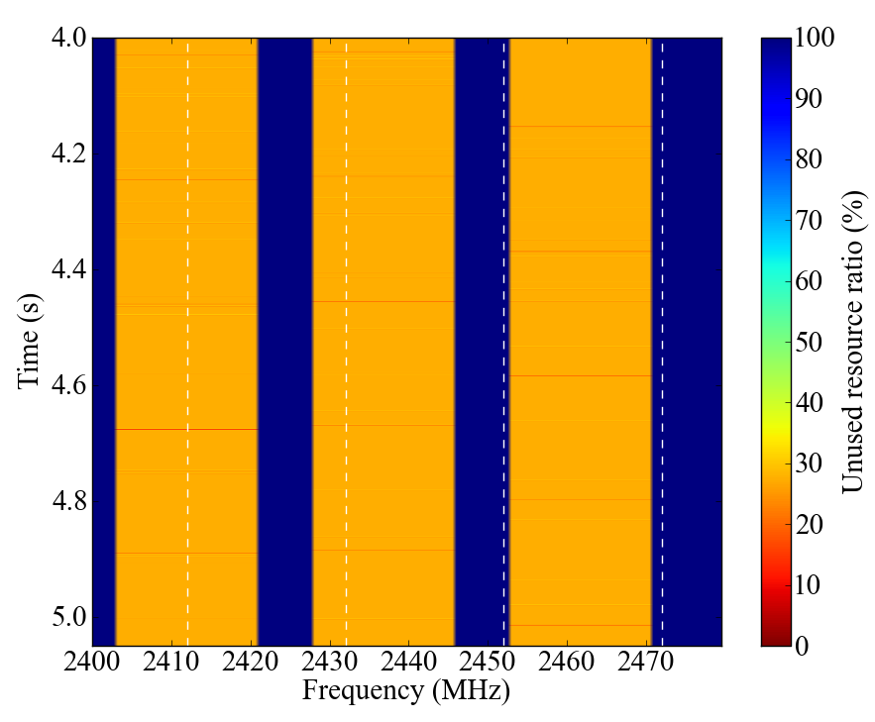
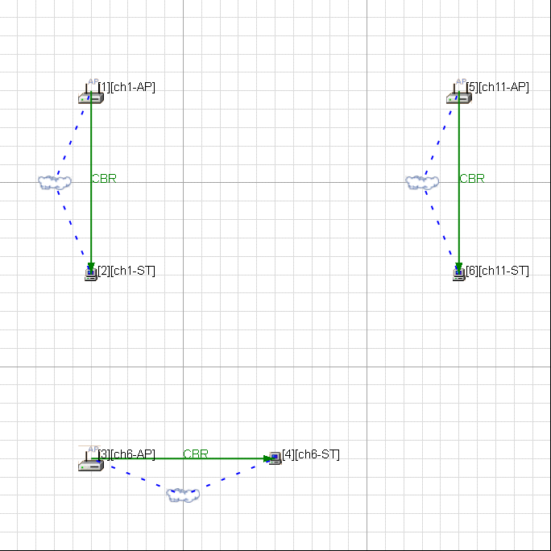
Case1: Baseline condition
III-1. DSA system
WLAN 3 BSS’s operate at Ch 1, 6, 11 in 30 m × 30 m area
  Total throughput: 57.6Mbps
  Node throughput:19.2Mbps
Node location
Unused resources

Slide 27
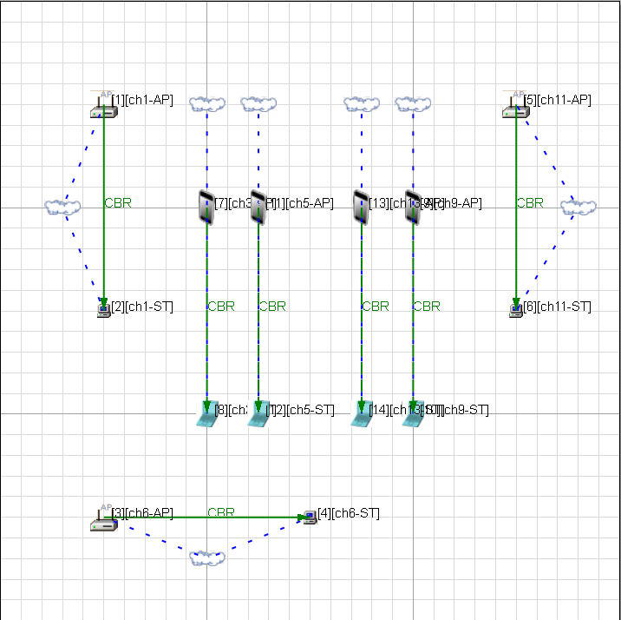
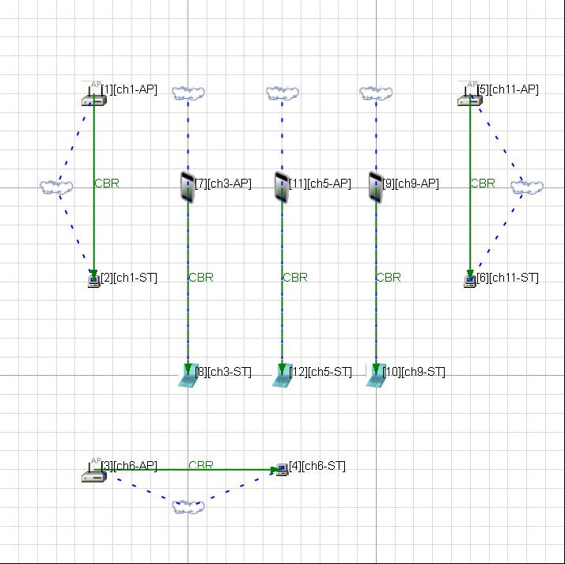
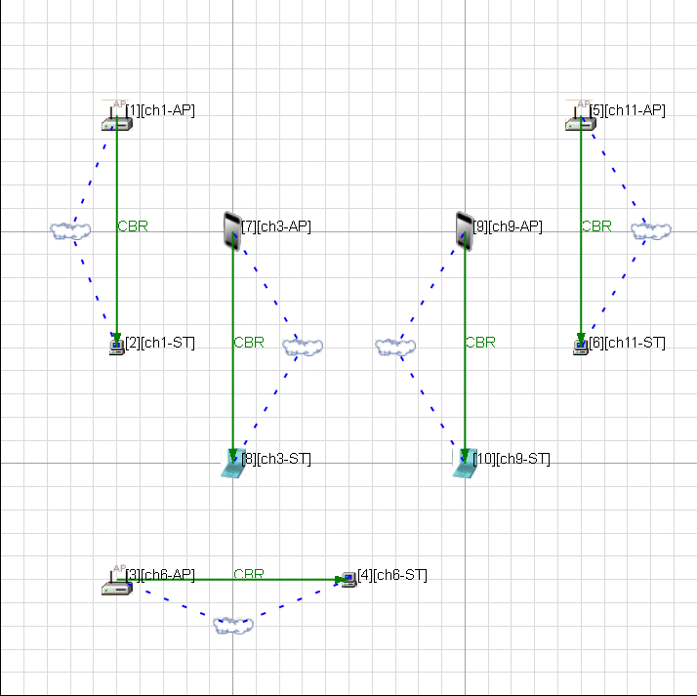
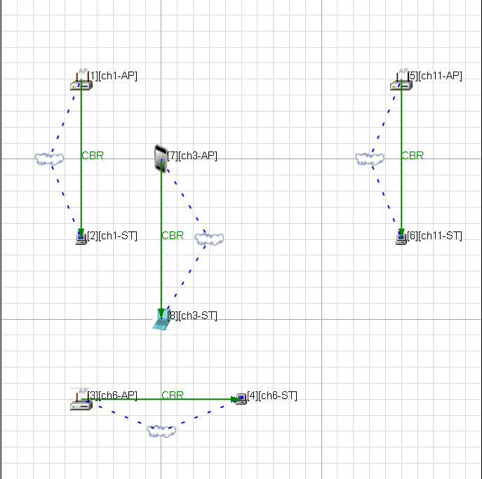
Case2: Setting & Location
III-1. DSA system
Adding more WLAN BSS to Case1.
Case2-4
Case2-1
Case2-3
Case2-2
Node location

Slide 28

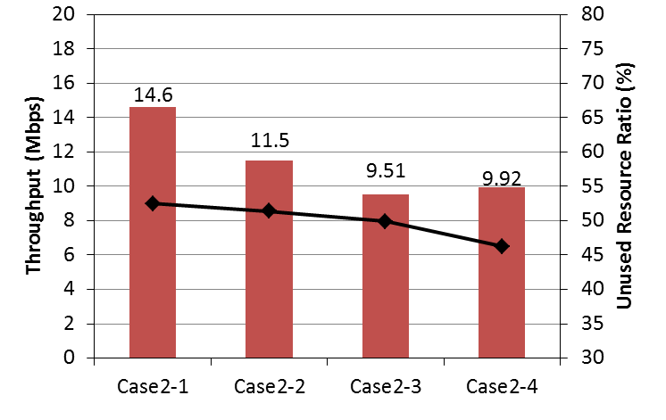
Case2: Simulation results
III-1. DSA system
Average node throughput becomes deteriorate with the increase of number of BSS.
Average node throughput

Slide 29
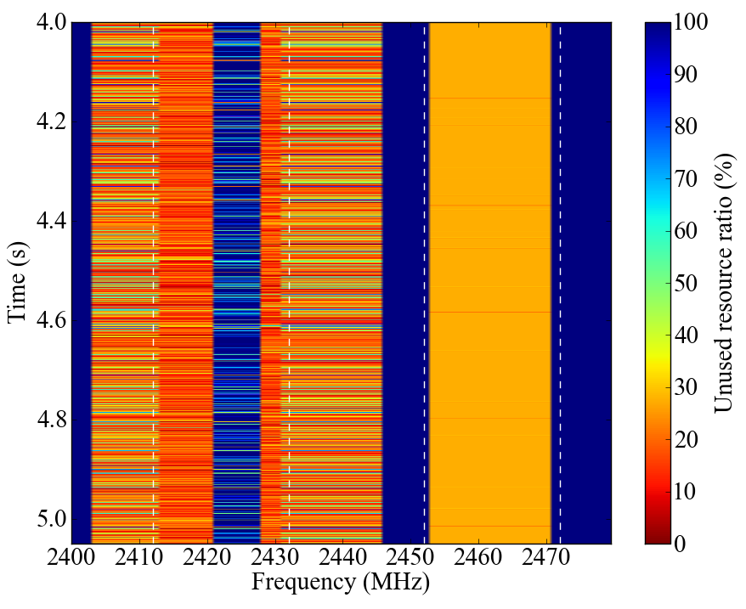
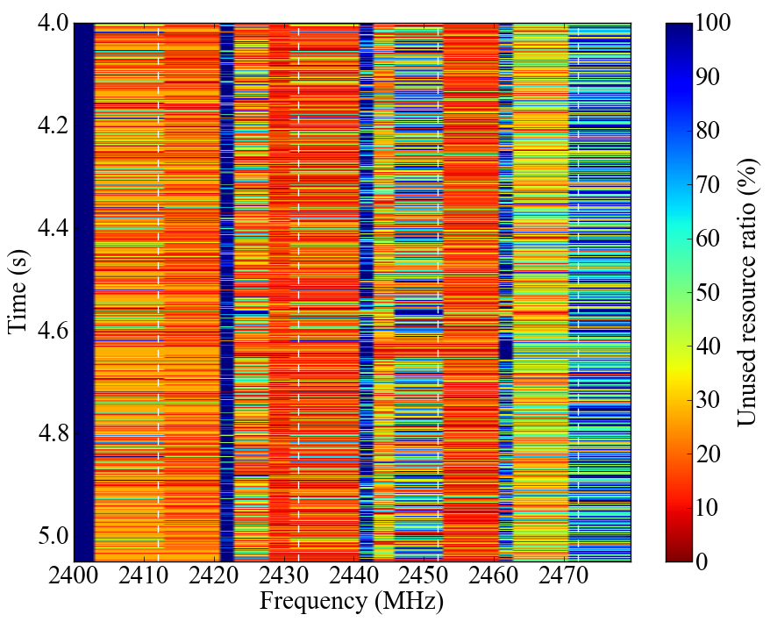
Resource usage
III-1. DSA system
Case2-1
Case2-4

Slide 30
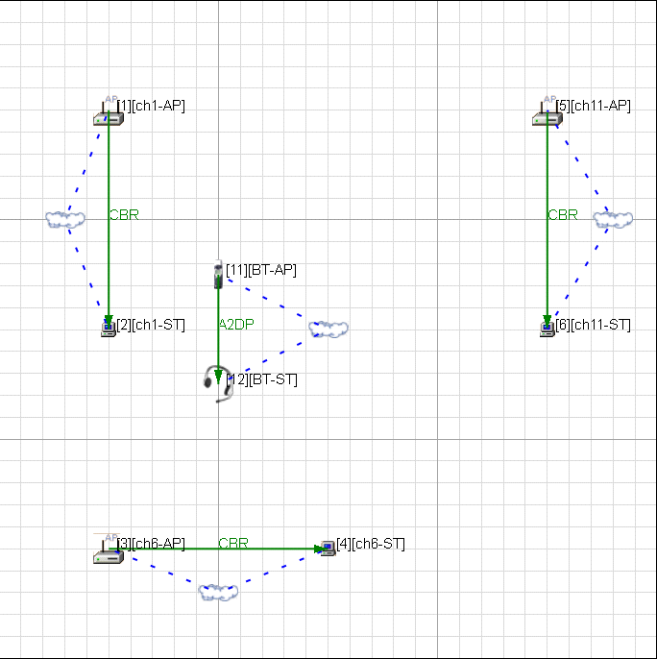
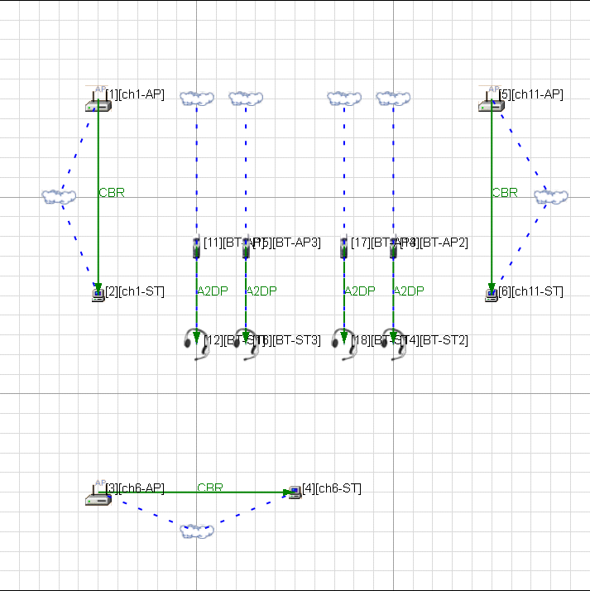
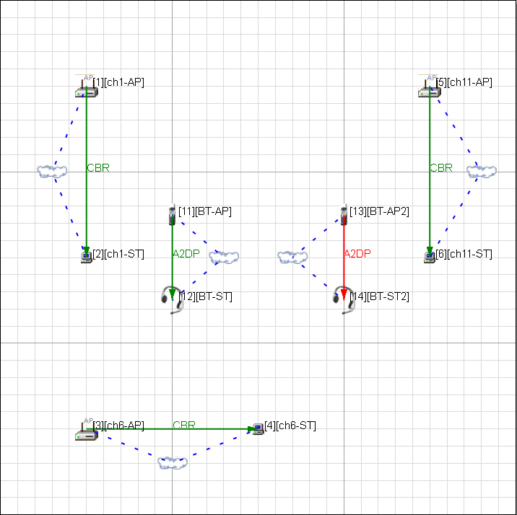
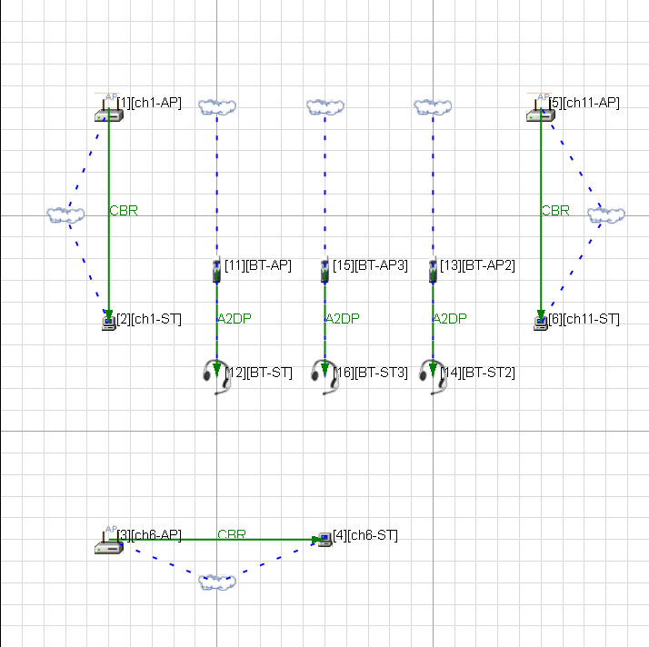
Case3: Setting & Location
III-1. DSA system
Adding Bluetooth piconet to Case1.
Case3-1
Case3-2
Case3-4
Case3-3
Node location

Slide 31

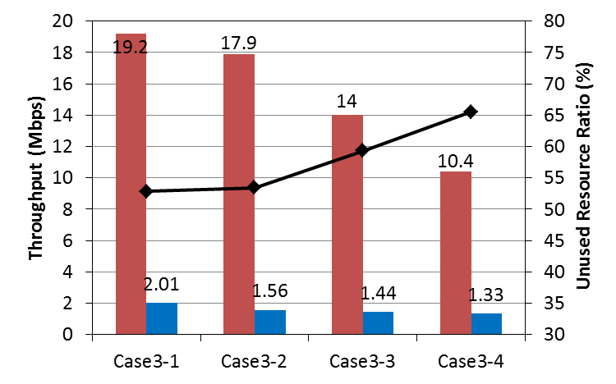
Case3: Simulation results
III-1. DSA system
The unused resource ratio increase according to increase of BT node.
Average node throughput

Slide 32
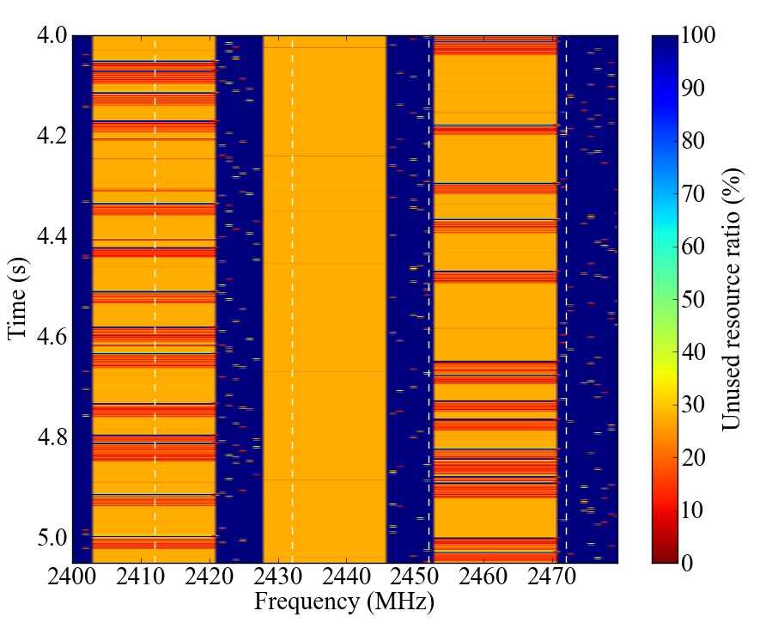
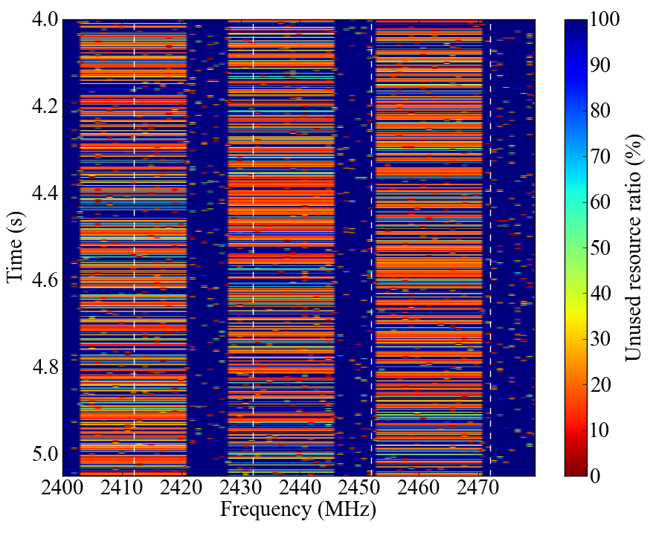
Resource usage
III-1. DSA system
Case3-1
Case3-4

Slide 33
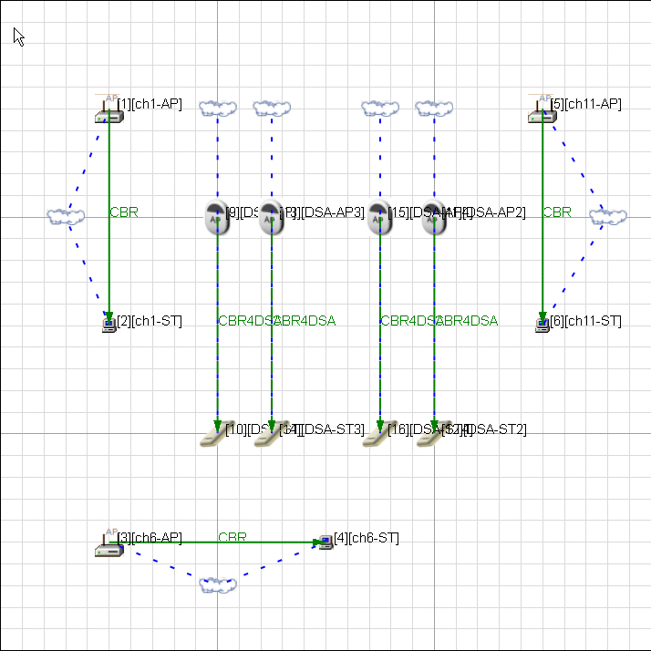
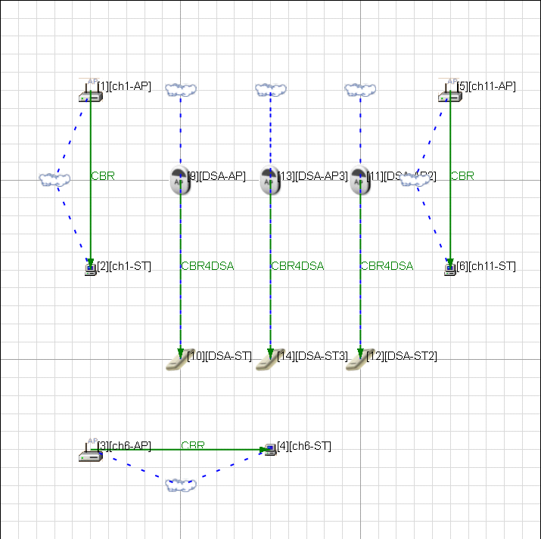
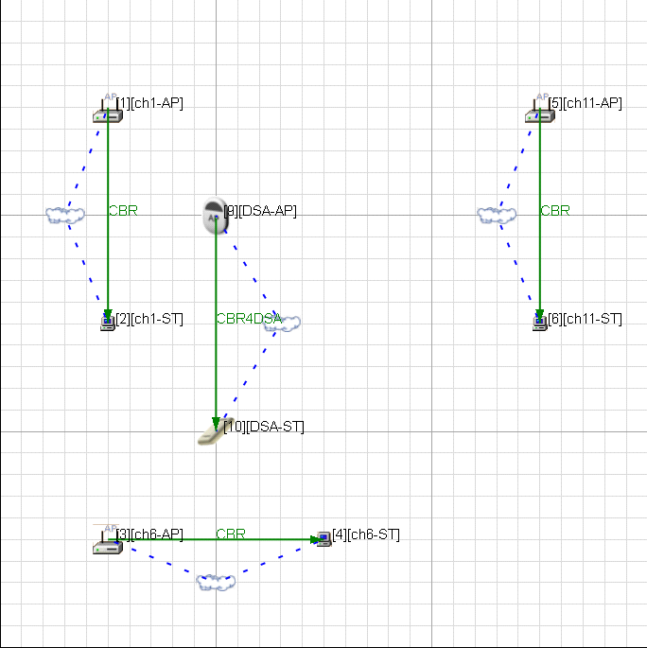
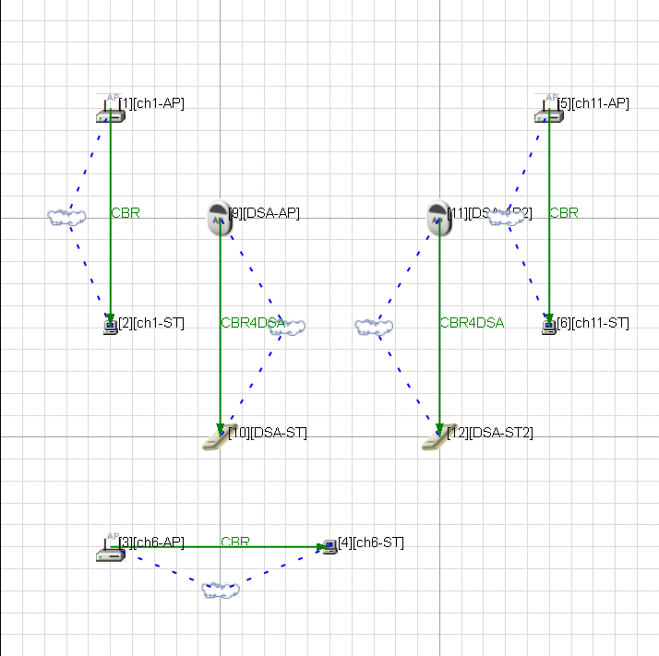
Case4: Setting & Location
III-1. DSA system
Adding DSA group to Case1.
Case4-4
Case4-2
Case4-3
Case4-1
Node location

Slide 34

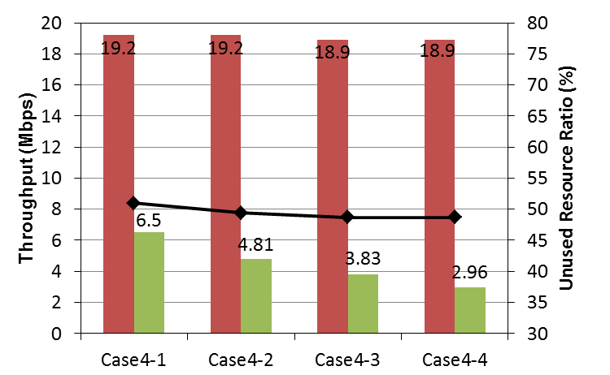
Case4: Simulation results
III-1. DSA system
Even if the number of DSA nodes increase,
throughput of the WLAN does not deteriorate.
Average node throughput

Slide 35
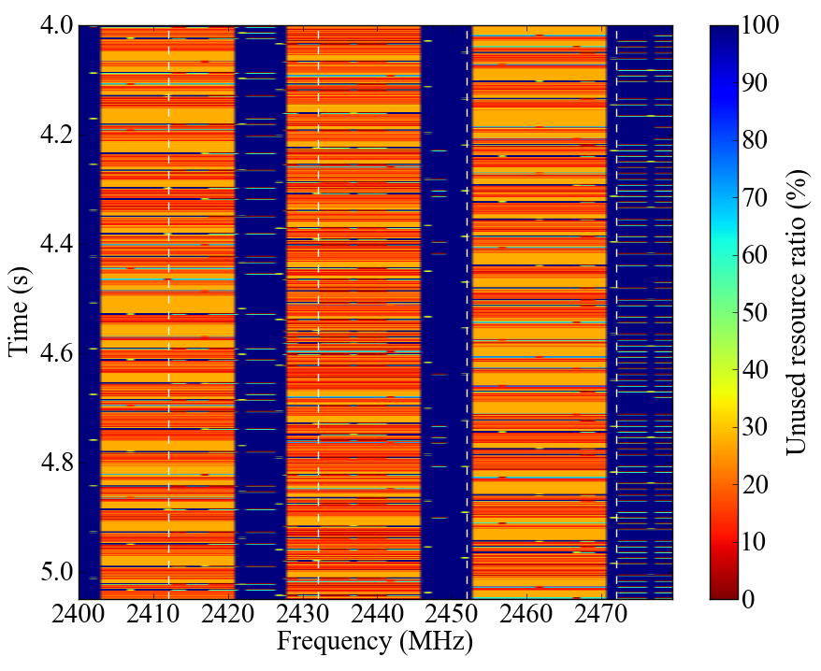
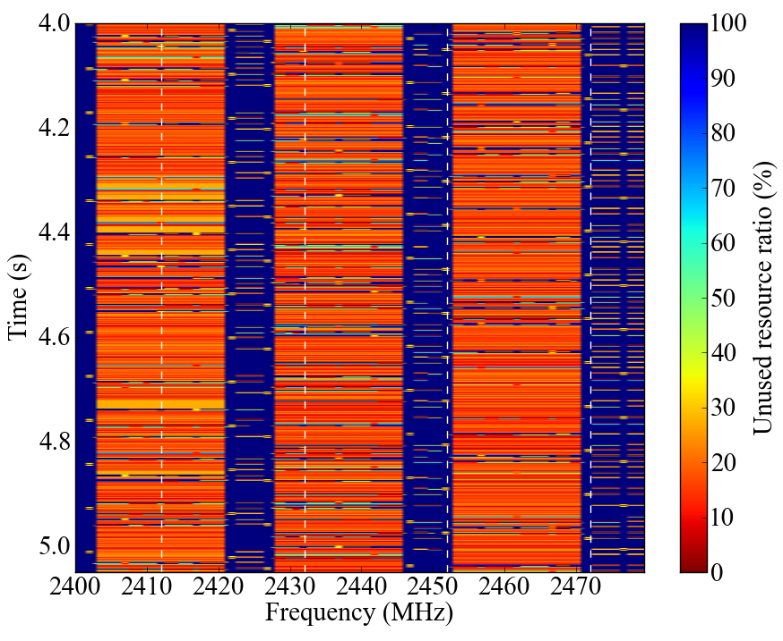
Resource usage
III-1. DSA system
Case4-1
Case4-4

Slide 36
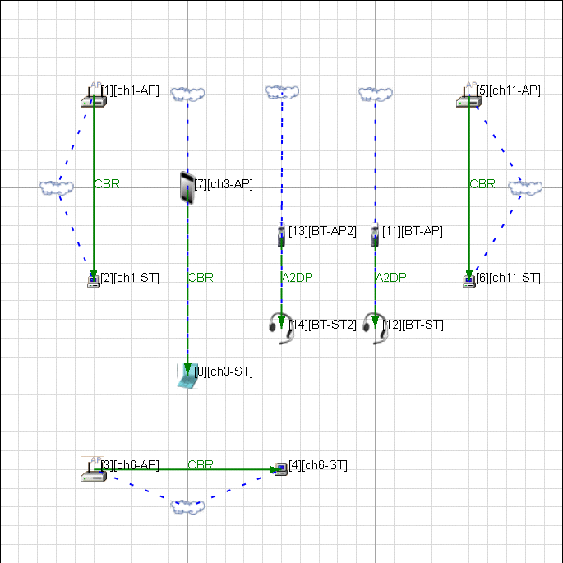
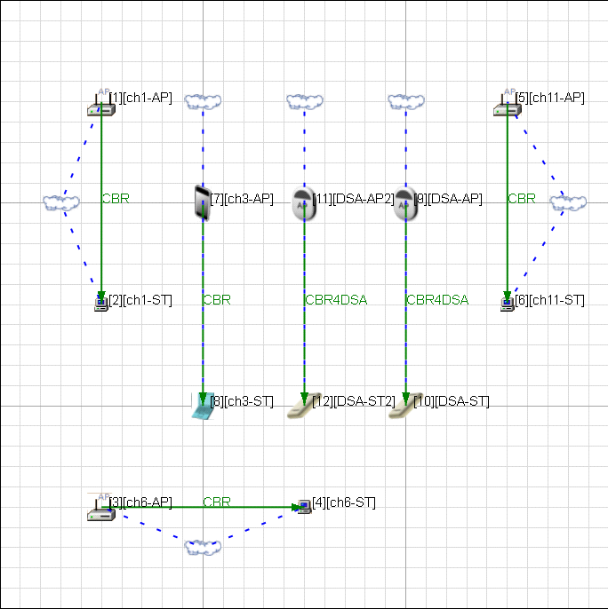
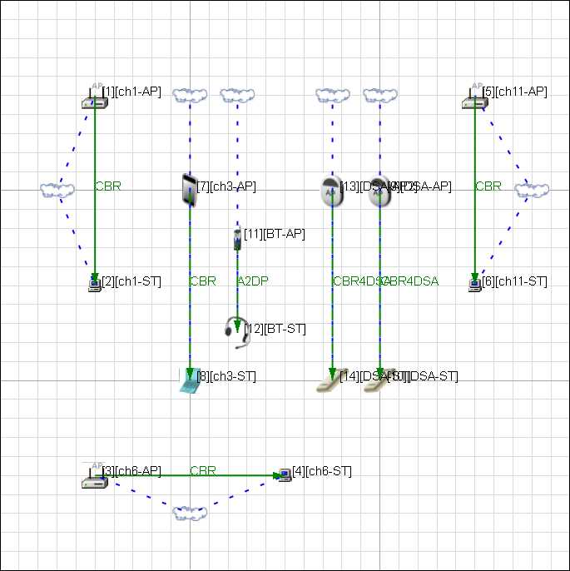
Case5 to 7 : Setting & Location
III-1. DSA system
Coexistence with WLAN, BT, DSA
Case5
Case6
Case7
Node location

Slide 37

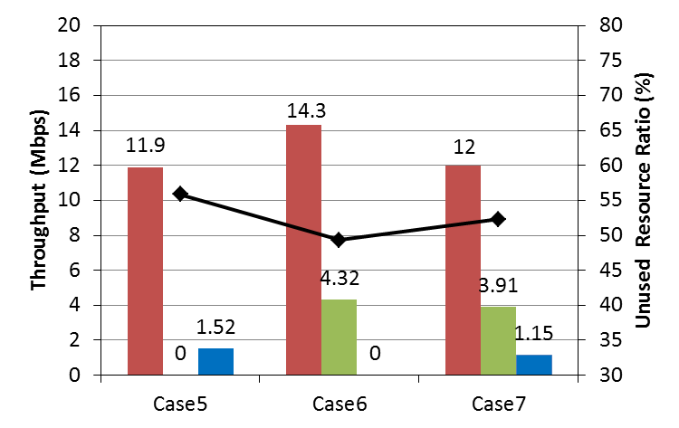
Case5 to 7: Simulation results
III-1. DSA system
Average node throughput

Slide 38


Resource usage
III-1. DSA system
Case5
Case6

Slide 39

Resource usage
III-1. DSA system
Case7

Slide 40
Short Summary
III-1. DSA system
The concept of the DSA system has been presented.
  Spectrum sensing for detecting unused radio resources
  Dynamic assignment of DCH spectrum
  TDMA
The network simulation results show that effectiveness of proposed DSA system under congestion condition.
  Higher area throughput
  Coexistence with other system
Acknowledgment
This work is supported by the Ministry of Internal Affairs and Communications under a grant “Research and development on radio resource control technologies among multiple radio systems on same frequency band.”

Slide 41
III-2. Other solutions
In this section, outline of two presentation at the IG SRU meeting are introduced.

Slide 42
Intelligent Spectrum Sensing for vehicular Communications in the ISM Bands(15-11-0528)
III-2. Other solution
Vehicle-to-Vehicle (V2V), Vehicle-to-Infrastructure (V2I) communications via ISM band were considered.
Adopt a cognitive radio approach to avoid interfering and / or being interfered with other communications.
Channel workload estimation module on an SDR for V2V / V2I communications in the ISM bands were implemented.
  Estimated workload have a strong correlation with actual workload
  A shorter scanning cycle gives better estimation

Slide 43

Intelligent Spectrum Sensing for vehicular Communications in the ISM Bands(15-11-0528)
III-2. Other solution

Slide 44



Smart Antenna Opportunities for Spectrum Resource Usage Improvements (15-11-0817)
III-2. Other solution
Measurement results of 2.4GHz ISM band were shown.
  Vertical and Horizontal antenna were used.
To avoid interference, “Smart Antenna” using array configurations has been proposed.

Slide 45
Cooperative Channel Segmentation for Interference Mitigation in the 2.4GHz Band (15-12-0183)
III-2. Other solution
Bluetooth and IEEE802.11 are sometimes used simultaneously in mutually.
Shares the mutual interference channel information and divides operation.
Propose the Cooperative Channel Segmentation (CCS) which mitigate mutual interference and improve throughput.
Results show over 10 % improvement for WLAN throughput against Legacy AFH, and achieve error free for Bluetooth cased by interference.

Slide 46



III-2. Other solution
Cooperative Channel Segmentation for Interference Mitigation in the 2.4GHz Band (15-12-0183)

Slide 47
IV. Topics to be discussed in the next step
IV-1 Applications and System requirement
IV-2 Technical issues
IV-3 5C & PAR

Slide 48
IV-1. Applications and System requirement
The following applications were extracted from document 15-11-0162-01-0sru and 15-11-0528-00-0sru.
Home monitoring
  Intercommunication system
  Security
  Health care
Vehicular communications
  Vehicle-to-Vehicle (V2V)
  Vehicle-to-Infrastructure (V2I)

Slide 49
IV-2. Technical issues
More detail about PHY and MAC requirement for efficient use of spectrum resources will be added this section.

Slide 50
IV-3. 5C & PAR
It is necessary to think about 5C&PAR for transition to the next step.
PAR (Project Authorization Request)
  Scope of Proposed Standard
  Purpose of Proposed Standard
  Need for the Project
  Stakeholders for the Standard
5C (Five Criteria)
  Broad Market Potential
  Compatibility
  Distinct Identity
  Technical Feasibility
  Economic Feasibility

Slide 51
List of Technical Contribution for IG SRU
Doc No. | Auther | Affiriation | Tittle | Meeting
15-10-886-00-0SRU | Shoichi Kitazawa | ATR | Experimental results of High traffic-load situation | Dallas
15-11-0161-00-0SRU | Shoichi Kitazawa | ATR | System concept of DSA | Singapore
15-11-0162-01-0SRU | Shoichi Kitazawa | ATR | Home monitoring applications | Singapore
15-11-0508-00-0SRU | Shoichi Kitazawa | ATR | Current situation in 2.4GHz ISM band | San Francisco
15-11-0528-00-0SRU | Mineo Takai | UCLA | Intelligent Spectrum Sensing for vehicular Communications in the ISM Bands | San Francisco
15-11-0764-00-0SRU | Shoichi Kitazawa | ATR | Performance simulation of DSA system | Atlanta
15-11-0817-01-0SRU | Bob Conley | Gonzaga University Eigen Wireless | Smart Antenna Opportunities for Spectrum Resource Usage Improvements | Atlanta
15-12—0121-02-0SRU | Shoichi Kitazawa | ATR | Overview of IG SRU Activities | Waikoloa
15-12-0183-00-0SRU | Yukimasa Nagai | Mitsubishi Electric | Cooperative Channel Segmentation for interference mitigation in the 2.4GHz ISM Band | Waikoloa

