Slide 1
Project: IEEE P802.15 Working Group for Wireless Personal Area Networks (WPANs)
Submission Title: [Considerations for Position Location in TG4m]
Date Submitted: [11 March 2012]
Source: [Ben Rolfe, Blind Creek Associates]
[Cristina Seibert, Silver Spring Networks]
[George Flammer, Silver Spring Networks]
Address [Los Gatos, CA]
Voice:[+1.408.395.7207], E-Mail:[ben @ blindcreek.com ]
Re: [Technical contribution: position location in TG4m]
Abstract: [Potential application of position location to TG4m devices]
Purpose: [Technical Contribution]
Notice: This document has been prepared to assist the IEEE P802.15. It is offered as a basis for discussion and is not binding on the contributing individual(s) or organization(s). The material in this document is subject to change in form and content after further study. The contributor(s) reserve(s) the right to add, amend or withdraw material contained herein.
Release: The contributor acknowledges and accepts that this contribution becomes the property of IEEE and may be made publicly available by P802.15.

Slide 2
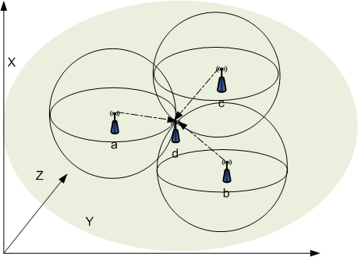
RF Localization in TVWS
Considerations for 15.4TV

Slide 3
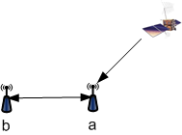
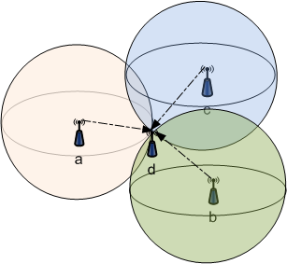
Background
TVBD Regulations require geo-location capability
US rules published [Part 15, Subpart H]
Other regions expected to have similar requirements
GPS commonly used as low-cost geo-position source
Some deployment scenarios challenge GPS:
Indoors, urban canyons, other places where satellites are not visible.
Assisted GPS can augment GPS yield, performance and time to fix
AGPS can leverage terrestrial based approaches such as TVWS signals to augment GPS
Time of arrival or signal strength measurements based on TVWS signals from multiple sources can be used to locate TVWS devices

Slide 4
Location requirements for FCC TVBD
Fixed and Mode II must have geo-location capability
+/- 50 meters
Fixed may be “professionally installed” (provisioned when installed)
Mode II devices expected to be mobile, so must have autonomous location capability
[FCC 15.711]
For Mode I devices may need location
Can’t relay availability info without means to “ensure that each device is operating within the parameters for its particular location” [FCC 10-174 page 22]
Other regional regulations expected to be similar to FCC

Slide 5
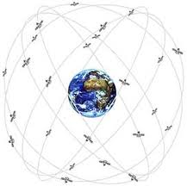
GPS + Localization
GPS does the job where it works
GPS not 100% available such as indoors, urban canyons
Localization based on TVWS signals can provide location where GPS not available
Allows simple low cost devices
Potential power saving in low power devices

Slide 6
RF Ranging Applications
For fixed devices, can simplify install and provisioning (less skill required)
Mode II devices expected to be mobile
Mode I devices in a mesh
Notes:
Notes from FCC review (FCC-10-174A1):
"The rules do not permit personal/portable devices operating in Mode I to relay channel availability information from one Mode I device to another Mode I device unless some means is used to ensure that each device is operating within the parameters for its particular location."

Slide 7
RF Ranging Applications
Locating and tracking
TVWS frequencies good for in-building performance (RF penetration)
Typical Wireless Sensor Network applications can achieve +/- 50m with < 5MHz bandwidth
[add references]

Slide 8
Position from Range
Determine Relative location:
Devices relative to each other in local reference
Geo-position: known point on earth (earth reference)
Needed for database access ±50m
Can be resolved when one or more participating devices at known location

Slide 9
RF ranging methods suitable to TVWS
Time of flight ranging methods
One-way TOF measurement
All devices tightly synchronized
Round-trip (2-way)
Absolute synchronization of devices not needed
Signal strength methods
Inaccuracies do to fading, interference
Good for proximity detection and where propagation characteristics well known

Slide 10
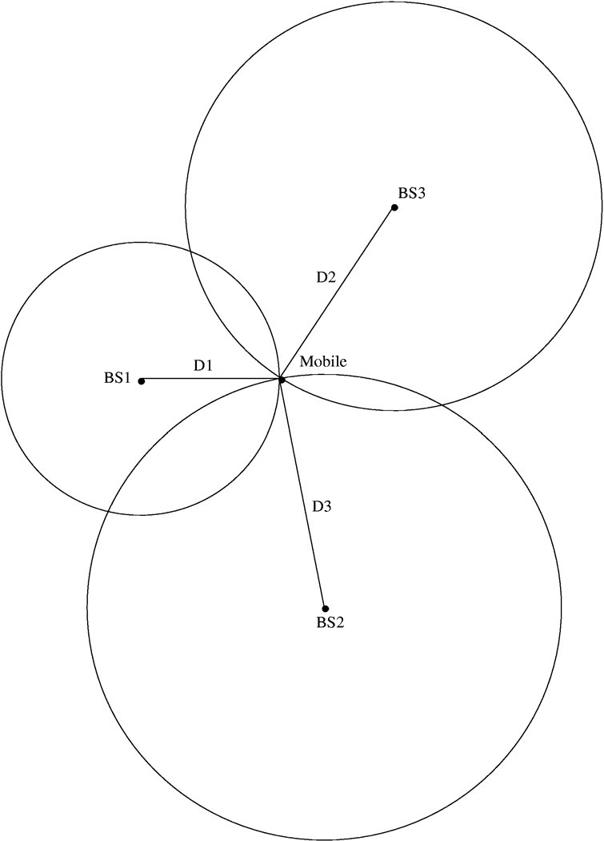
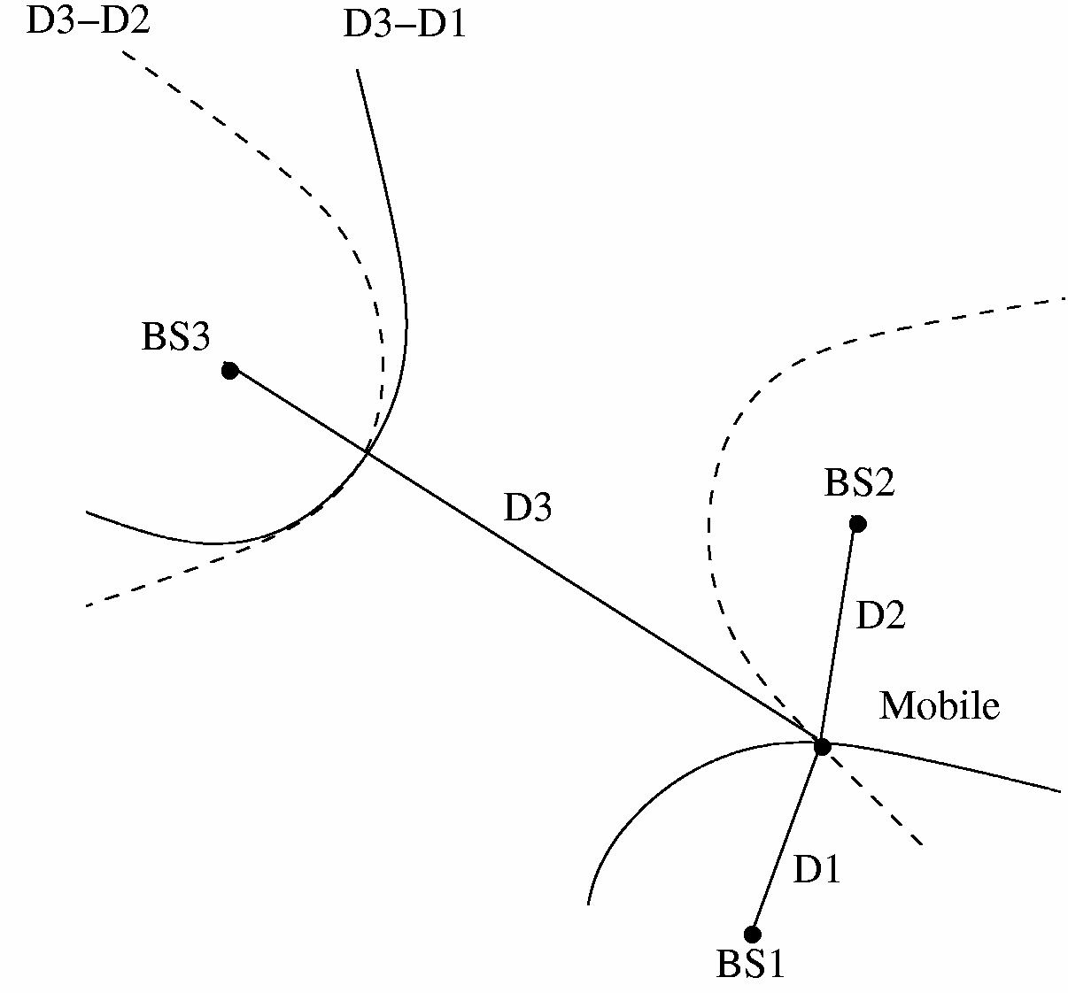
Time of Flight Considerations
Simple to implement
2-way simplifies timing requirements
Minimal additional hardware required for range measurement
Position calculations can be done in mains powered fixed device and distributed

Slide 11
Performance Factors
Clock resolution and drift over measurement duration (ToF + loopback)
Signaling rate and bandwidth of ranging
Effective SNR
Non-LOS signal contribution (MP)
cab be dominant error indoors and in outdoor urban environments
As distance increases, MP exacerbated
Wider bandwidth mitigates MP
Statistical methods can mitigate MP (Trade-off between accuracy and dynamic response)

Slide 12
Conclusions
Fixed and Mode II devices must have geo-location capability. Mode I devices may also need geo-location capability.
The geo-location requirements are challenging:
+- 50 meters
And 100% yield
While some devices may be deployed with GPS capability, GPS does not work under all scenarios, e.g. indoor and urban canyons.
This proposal recommends that consideration be given to the use of TG4m terrestrial signals for position location, for example as augmentation to Assisted GPS.

Slide 13
References and links
US CFR Title 47 Part 15 Subpart H Television Band Devices [http://ecfr.gpoaccess.gov/cgi/t/text/text-idx?c=ecfr&sid=c150759fe8321d79d2978375f850c808&rgn=div6&view=text&node=47:1.0.1.1.16.8&idno=47]
“RF Time of Flight Ranging for Wireless Sensor Network Localization”, Slanzise,Dtlin,Pister [http://www.eecs.berkeley.edu/~slanzise/research/rf_tof_ranging_dist.pdf]
IEEE Standard for Local and metropolitan area networks—Part 15.4: Low-Rate Wireless Personal Area Networks (LR-WPANs), Annex E Location topics (good overview of ToF ranging)
15-05-0390-00-004a “An overview of sub-GHz UWB technology for 802.15.4a” Jamtgaard, et al (includes data on RF penetration respective to frequency) [https://mentor.ieee.org/802.15/dcn/05/15-05-0390-01-004a-sub-ghz-overview-sf.ppt ]
Ultra-Wideband Positioning Systems: heoretical Limits, Ranging Algorithms, and Protocols. Şahinoğlu et al, Cambridge University Press, 2008.
Cramér, Harald (1946). Mathematical Methods of Statistics. Princeton, NJ: Princeton Univ. Press. ISBN 0-691-08004-6. OCLC 185436716.

