Slide 1
Project: IEEE P802.15 Working Group for Wireless Personal Area Networks (WPANs)
Submission Title: [Overview and Applications of LED-ID System and Visible RFID System]
Date Submitted: [14 March, 2012]
Source: [Yeong Min Jang, Le Nam Tuan, Jaesang Cha, and Yanggi Kang]
[Kookmin University, SNUT, IDRO Co., Ltd ]
Address [Kookmin University, Seoul, Korea]
Voice:[82-2-910-5068], FAX: [82-2-910-5068], E-Mail:[yjang@kookmin.ac.kr, ygkang@idro.co.kr]
Re: []
Abstract: [Overview and Applications of LED-ID System and Visible RFID System]
Purpose: [Contribution to IEEE 802.15 WNG]
Notice: This document has been prepared to assist the IEEE P802.15. It is offered as a basis for discussion and is not binding on the contributing individual(s) or organization(s). The material in this document is subject to change in form and content after further study. The contributor(s) reserve(s) the right to add, amend or withdraw material contained herein.
Release: The contributor acknowledges and accepts that this contribution becomes the property of IEEE and may be made publicly available by P802.15.
Slide 1
Notes:
doc.: IEEE 802.15-09-0117-00-0007
<month year>

Slide 2
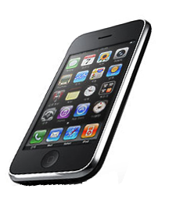


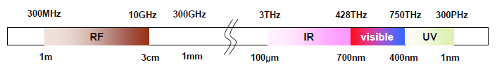
Mar 2012
LED-ID Technology
LED Source
LED-ID Information
Reader
IR
Tag
R
G
B
θ
θ
UV
Photodiode
Image sensor
Tag
Reader

Slide 3
Mar 2012
LED-ID Technology
Characteristics of LED-ID
Low power consumption
Support QoS
No interference with RF
High speed read and write capability
High security
Harmless to human
Green environment
Service scenario of LED-ID
Museum
Product expo/Exhibition
Intelligent menu system
( airplane, restaurant )
Advertisement
Sign board
Kiosk
Indoor localization
(LBS applications)
Inventory management system
Car parking
Cleaning robot
Guiding system for blind person
Supermarket/Department store
Entertainment/movie/amusement park

Slide 4
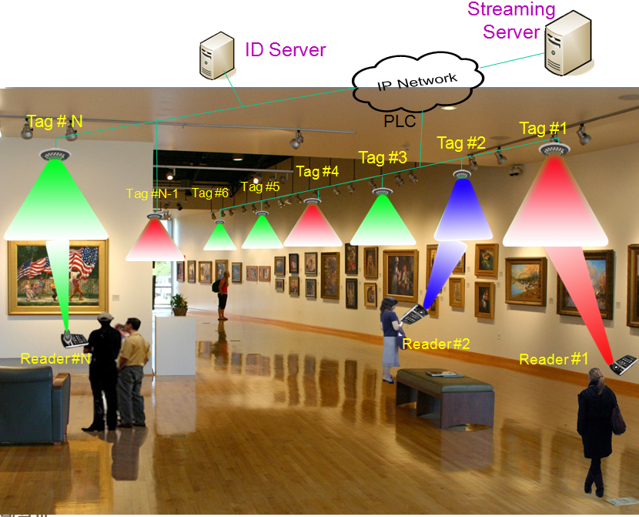
Mar 2012
LED-ID Application Scenario example
Museum Scenario

Slide 5
RFID Technology
RFID
Active : <10m, no power source
Passive: >10m, battery powered
Property | Frequency Classification
 | LF | HF | UHF | Microwave
Freq. Range | 125 – 134 KHz | 13.56 MHz | 866 - 915MHz | 2.45 - 5.8 GHz
Read Range | 10cm | 1 m | 2 – 7 m | 1 m
Standards | 11784/85, 14223 | 18000-3.1, 15693, 14443 | EPC C0, C1, C1G2, 18000-6 | 18000-4
Property | Standard
 | ISO/IEC 18000-6 | ISO/IEC 18000-7 | EPC Class 1 Gen 2
Data rate | 10, 20, 40Kbps | 27 Mbps | 40, 80, 160kbps
Collision arbitration | ALOHA, Binary Tree | Slot ALOHA | Query Tree
Problem in RFID technology
  Anti-collision (Tag Collision, Reader Collision)
  Interference

Slide 6
VLC vs. RF Communication
Property |  | RF | VLC
EMI |  | High | No
Line of Sight |  | No | Yes
Hazard |  | Yes | No
Mobile To Mobile | Visibility | No | Yes
 | Power Consumption | Medium | Relative Low
 | Distance | Medium | Short
 | Power Budget | Medium | Tight
 | Security | No | Yes
Infra to Mobile | Infra | Access Point | LED Illumination
 | Mobility | Yes | Limited
 | Coverage (Distance) | Wide (Short-Long Range) | Short (Around 10m)

Slide 7

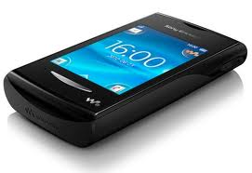


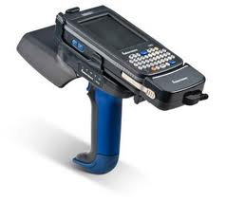
Visible RFID
RFID system
Visible RFID system
Tags
Tags
Visible light
Reader
Reader

Slide 8
Visible RFID
Tag
VLC receiver
VLC transmitter
Reader
RF module
RF module
Communication interfaces
  Identification process by VLC interface
  Data transmission by RF interface
Advantage
  Interference reduction
    SNR improvement
    Ranging selective tag
  Efficient bandwidth utilization
Property | RF |  | VLC | Visible RFID
 | Active | Passive
PHY | RF | RF | VLC | VLC & RF
Sensing ability | Yes | No | FOV restriction | Utilize the FOV characteristics
Collision | High | High | High | Low

Slide 9
Visible RFID
Application
  Facilities Management
  Asset Tracking
  Real-Time Location System (RTLS)
  Secure Access Control

Slide 10
Visible RFID
Hybrid LED-ID and RFID MAC protocol
  VLC signal sensing, RF signal sensing
  High speed data transmission
  Link switching function
  LBS support
Many institutes are interested
Need to form VLC Enhancement IG(vlceIG)

