Slide 1
Project: IEEE P802.15 Working Group for Wireless Personal Area Networks (WPANs)
Submission Title: [Enhancement of IEEE 802.15.7 Specification for LBS Applications]
Date Submitted: [14 March, 2012]
Source: [Yeong Min Jang, Vu Van Huynh, Jaesang Cha, and Sang-Kook Han]
[Kookmin University, Seoul National University of Science and Technology, Yonsei University]
Address [Kookmin University, Seoul, Korea]
Voice:[82-2-910-5068], FAX: [82-2-910-5068], E-Mail:[yjang@kookmin.ac.kr]
Re: []
Abstract: [Enhancement of IEEE 802.15.7 Specification for LBS Applications]
Purpose: [Contribution to IEEE 802.15 WNG]
Notice: This document has been prepared to assist the IEEE P802.15. It is offered as a basis for discussion and is not binding on the contributing individual(s) or organization(s). The material in this document is subject to change in form and content after further study. The contributor(s) reserve(s) the right to add, amend or withdraw material contained herein.
Release: The contributor acknowledges and accepts that this contribution becomes the property of IEEE and may be made publicly available by P802.15.
Notes:
doc.: IEEE 802.15-09-0117-00-0007
<month year>

Slide 2
Contents
Characteristics of IEEE 802.15.7 VLC
PHY layer
FOV consideration
Estimation of Rx position
MAC layer
Frame type
Channel access mechanism
MAC frame
Link switching call
Conclusion

Slide 3
Characteristics of IEEE 802.15.7 VLC
Advantages:
Short range distance communication.
High security and high data rate.
Green LED communications in addition to LED lighting and entertainments.
Harmless for human body and electronic devices.
Drawbacks:
Does not support LBS services.
Does not have ID (Identification) functionality.

Slide 4
FOV Consideration
Current VLC specification: fixed FOV
VLC for indoor LBS applications: dynamic FOV
Reduce interference.
Increase reliability.
<Fixed FOV>
<Dynamic FOV>

Slide 5
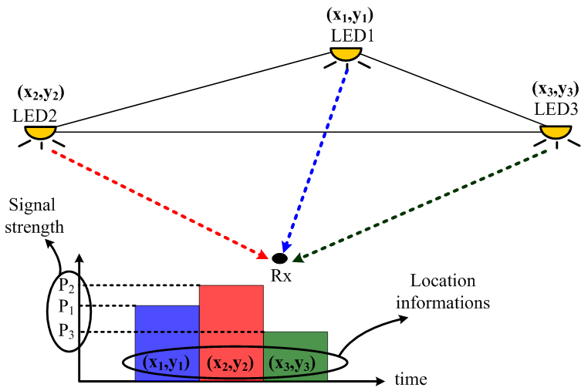
Estimation of Rx position
LEDs send each own coordinate information.
Rx measures the signal strength and estimates distance between Rx and LEDs.
Estimated distances are adjusted by compensation algorithm.
Rx position is calculated by trilateration with compensated distances and LED coordinate information.

Slide 6
Frame Type
Current IEEE802.15.7 VLC specification:
Data Frame : Data.
Control Frame : Beacon, Synchronization,
Acknowledgement, Command, CVD.
Proposed VLC for indoor LBS applications
Data Frame: Data.
Control Frame: Beacon, Synchronization,
Acknowledgement, Command, CVD, location information.

Slide 7
Channel Access Mechanism
Current IEEE802.15.7 VLC specification:
Use CSMA/CA mechanism in CAP (contention access period).
Use GST (guarantee time slot) in CFP (contention free period).
Beacon
CAP
CFP

Slide 8
Channel Access Mechanism
VLC for indoor LBS applications
Use TDMA.
Reduce collision.
Increase throughput.
Decrease delay.
Beacon
Time slots
1
3
6
16
User#2
User#1
User#3

Slide 9
MAC frame
Current VLC specification:
General MAC frame format.
Frame control field.
Frame type.
Frame type value b2 b1 b0 | Description
000 | Beacon
001 | Data
010 | ACK
011 | Command
100 | CVD
101–111 | Reserved
Octets:2 | 1 | 0/2 | 0/2/8 | 0/2 | 0/2/8 | 0/5/6/10/ 14 | variable | 2
Frame Control | Sequence Number | Destination VPAN Identifier | Destination Address | Source VPAN Identifier | Source Address | Auxiliary Security Header | Frame Payload | FCS
 |  | Addressing fields
MHR |  |  |  |  |  |  | MSDU | MFR
MHR: MAC header
MSDU: MAC SDU
MFR: MAC footer

Slide 10
MAC frame
VLC for indoor LBS applications:
Frame type.
Add location type value.
Frame type value b2 b1 b0 | Description
000 | Beacon
001 | Data
010 | Acknowledgment
011 | Command
100 | CVD
101 | Location
110–111 | Reserved
Octets: 2 | 1 | Address | 0/5/6/10/14 | variable | 2
frame control | Sequence Number | Addressing fields | Auxiliary Security Header | Location Payload | FCS
MHR |  |  |  | MSDU | MFR

Slide 11
Link switching call
Current VLC specification: does not support priority for link switching call.
VLC for indoor LBS applications:
Device: Lower RSSI in boundary area.
Target Coordinator: Support a priority
for link switching call to support seamless
communication between two coordinators.
Coordinator#1
Coordinator#2
Boundary information
Data
Data
Priority support
device
Boundary area
device

Slide 12
Conclusion
Support location information traffic.
Support dynamic FOV based on location information.
Need to have a novel channel access mechanism based on location information.
Add new location frame in MAC frame.
Support priority for link switching call based on location information.
Need to form VLC Enhancement IG (vlceIG).

