Slide 1
Project: IEEE P802.15 Working Group for Wireless Personal Area Networks (WPANs)
Submission Title: Implicit Certificate scheme in Host Identity Protocol (HIP) Diet Exchange (DEX) for the Fast Initial Authentication (FIA) use
Date Submitted: 15 March 2012
Source: Jani Pellikka, Andrei Gurtov (University of Oulu)
Address: Erkki Koiso-Kanttilan katu 3, 90570 Oulu, Finland
Voice: +358 8 553 1011, FAX: +358 8 553 2845, E-Mail: [jpellikk, gurtov]@ee.oulu.fi
Abstract: Describes implementing an implicit certificate scheme in HIP DEX for FIA
Purpose: To be used for discussion within IEEE whether to include the proposed mechanism (described herein) in the 802.15 standard/best current practice.
Notice: This document has been prepared to assist the IEEE P802.15. It is offered as a basis for discussion and is not binding on the contributing individual(s) or organization(s). The material in this document is subject to change in form and content after further study. The contributor(s) reserve(s) the right to add, amend or withdraw material contained herein.
Release: The contributor acknowledges and accepts that this contribution becomes the property of IEEE and may be made publicly available by P802.15.

Slide 2
Implicit Certificates in Host Identity Protocol (HIP) Diet Exchange (DEX) for the Fast Initial Authentication use
Efficient certificate verification and ephemeral ECDH in DEX
Jani Pellikka, Andrei Gurtov
University of Oulu

Slide 3
Implicit Certificates in HIP DEX
Verification of implicit certificates is extremely fast compared with standard certificates with signatures and even ECDSA
Certificate verification is a CMAC run and a few elliptic curve polynomial operations (multiplication and addition)
No signatures at all
If only HI is certificated no need for transmitting X.509, SPKI, or any ASCII-structured documents in HIP signaling (not to mention processing them!) → smaller packet size and processing overhead
Attribute certs require a more sophisticated format though
Pseudonym HIs (public keys) certified by a 3rd party and bound to the static HIs and/or other relevant information
Yes, every host still maintains its own static host identity
Provides host privacy if certified CERTs encrypted (in I2 and R2)
Both Initiator and Responder can be protected
Better forward secrecy due to use of ephemeral keys

Slide 4
Implicit Certificates in HIP DEX
Implemented ECQV to HIP-DEX protocol
DEX carried out with disposable certified public keys (certified and bound cryptographically to the static HI and/or other relevant information by a 3rd party)
Conforms to “SEC 4: Elliptic Curve Qu-Vanstone Implicit Certificate Scheme (ECQV)”, working draft Oct-2008, version 0.97
Exception: hash function Hash is CMAC function
Hash(BEU || I_{U}) → CMAC(BEU, I_{U})
BEU = negotiated (CA and host) random point in binary format, also know as the public-key reconstruction data
I_{U} = certified information about the host (e.g. HI, APN, NAI, …)

Slide 5
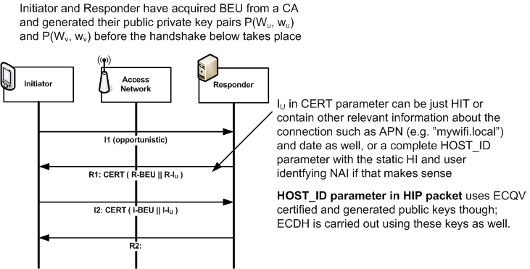
Implicit Certificates in HIP DEX

Slide 6
References
http://www.secg.org/download/aid-785/sec4-0.97.pdf
http://tools.ietf.org/id/draft-moskowitz-hip-rg-dex-05.txt
Related patents
http://www.freepatentsonline.com/20110087883.pdf

