Slide 1
Project: IEEE P802.15 Working Group for Wireless Personal Area Networks (WPANs)
Submission Title: Extended DSME MAC for LECIM
Date Submitted: 13 March, 2012
Source: Wun-Cheol Jeong, Chang-Sub Shin, Tae-Joon Park, Ho-Yong Kang
Company: ETRI
Address: 161 Gajeong-dong, Yuseong-gu, Daejeon, KOREA
Voice: +82-42-860-5104, FAX: +82-42-860-4197, E-Mail: wjeong@etri.re.kr
Re:
Abstract: Extension of DSME Multi-Superframe to meet the requirements of LECIM, TG4k.
Purpose: To propose MAC specification to support the requirements of LECIM by enhancing existing DSME MAC
Notice: This document has been prepared to assist the IEEE P802.15. It is offered as a basis for discussion and is not binding on the contributing individual(s) or organization(s). The material in this document is subject to change in form and content after further study. The contributor(s) reserve(s) the right to add, amend or withdraw material contained herein.
Release: The contributor acknowledges and accepts that this contribution becomes the property of IEEE and may be made publicly available by P802.15.

Slide 2
Issues (DCN 15-11-359-04-004k)
  Low power consumption ( low duty cycle)
  - The proposed provides very low duty cycle (< 0.004 %)
  - Surprisingly, endpoint device can survive > 20 years!
  Support to scheduled and event data
  - DSME delivers periodic data using DSME-GTS slot
  - Event data or urgent data can be delivered during CAP (Low system delay)
  Support to large number of endpoints (> 1,000 devices)
  - Enhanced GTS management can support > 1,000 devices.
    Example) BO(14), MO(22), SO(3) => supports more than 3.6 million devices
  Reliability during very long time ( > 20yrs)
  - Channel diversity (channel hopping/adaptation) enhances RF reliability.

Slide 3
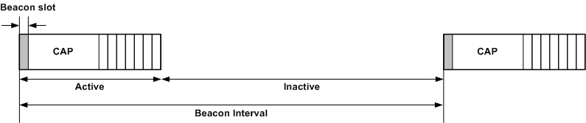

IEEE802.15.4-2006 Beacon-enabled PAN: Recap
Number of supported devices : 7 devices (GTS) + small number of devices (CAP)
Superframe structure is characterized by macSuperframeOrder (SO) and macBeaconOrder (BO).
16 superframe slots
D
CAP
C
B
7 GTS slots
A
Superframe

Slide 4
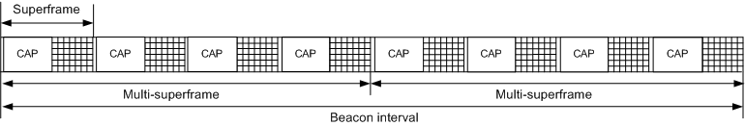
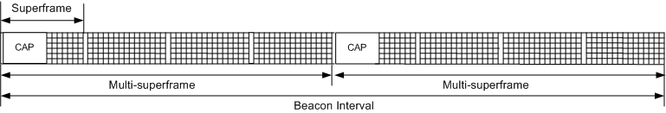
DSME: Recap
macMultisuperframeOrder
, MO=5
BO = 6, SO = 3
CAP reduction = FALSE
CAP reduction = TRUE

Slide 5
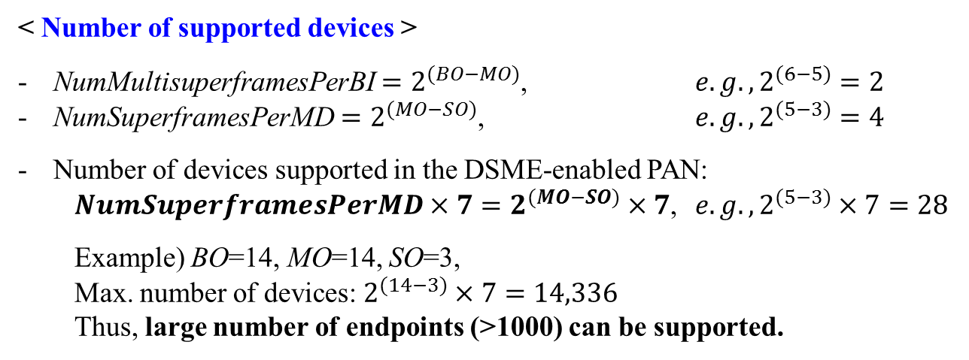
DSME: Recap
BO = 6, SO = 3, MO = 5
< Number of supported devices >
NumMultisuperframesPerBI $=2^{(BO−MO)}$, $e.g., 2^{(6−5)}=2$
NumSuperframesPerMD $=2^{(MO−SO)}$, $e.g., 2^{(5−3)}=4$
Number of devices supported in the DSME-enabled PAN:
  $NumSuperframesPerMD×7=2^{(MO−SO)}×7$, ${e.g.,2}^{(5−3)}×7=28$
  Example) BO=14, MO=14, SO=3,
  Max. number of devices: $2^{(14−3)}×7=14,336$
  Thus, large number of endpoints (>1000) can be supported.

Slide 6
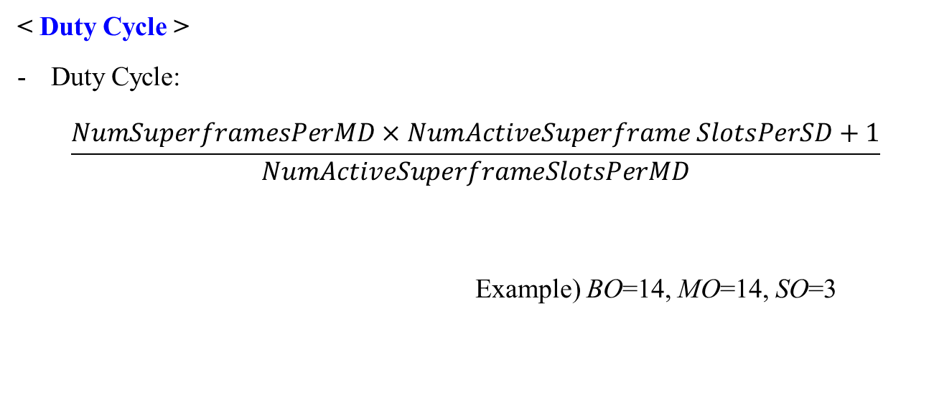
DSME: Recap
< Duty Cycle >
Duty Cycle:
  $$\frac{NumSuperframesPerMD×NumActiveSuperframe SlotsPerSD+1}{NumActiveSuperframeSlotsPerMD}$$
  Example) BO=14, MO=14, SO=3
NumDSME-GTSSlots
 | Coord (BLE)
Duty Cycle (%) | 6.26

Slide 7
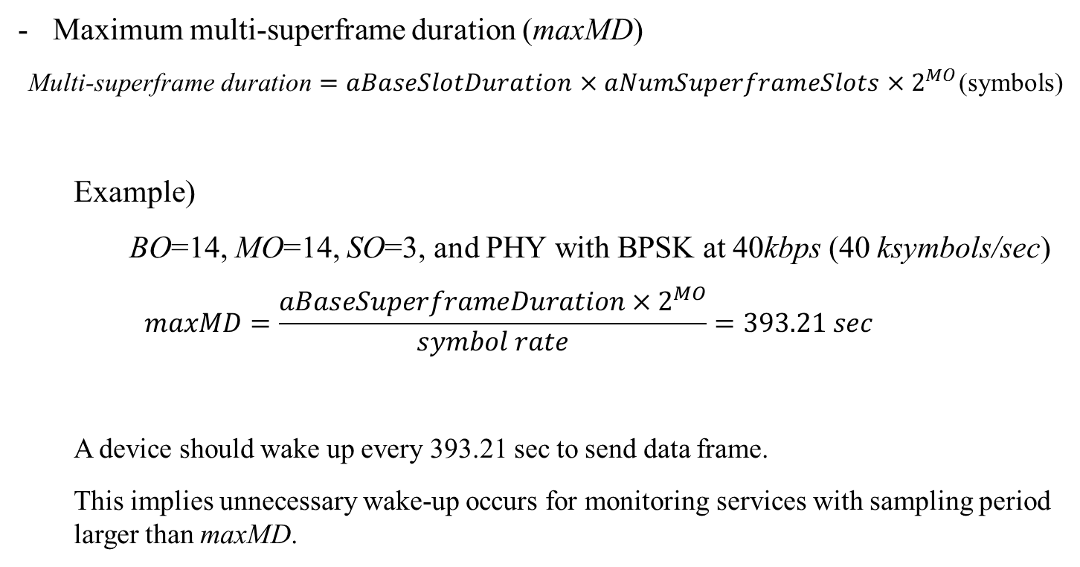
DSME: Recap
Maximum multi-superframe duration (maxMD)
  Multi-superframe duration $=aBaseSlotDuration×aNumSuperframeSlots×2^{MO}$(symbols)
  Example)
  BO=14, MO=14, SO=3, and PHY with BPSK at 40kbps (40 ksymbols/sec)
  $$maxMD=\frac{aBaseSuperframeDuration×2^{MO}}{symbol rate}=393.21 sec$$
  A device should wake up every 393.21 sec to send data frame.
  This implies unnecessary wake-up occurs for monitoring services with sampling period larger than maxMD.
aBaseSuperframeDuration

Slide 8
Issues on current DSME specification
(from LECIM’s perspective)
Frequent Wake-up: MO, which specifies multi-frame length (MD) and number of MD in BI, is bounded by BO. This may result in frequent wake-up for monitoring services with very long sampling period like LECIM.
Large Overhead: A node device, who wishes to join the PAN, should get through association procedure and DSME-GTS allocation procedure to allocate a single DSME-GTS slot.
High Duty Cycle: Turning-on an endpoint device for every CAP may be unnecessary in LECIM services.

Slide 9
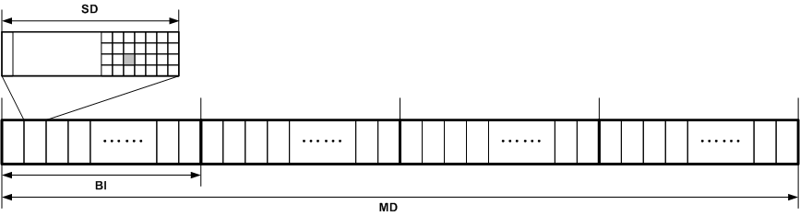
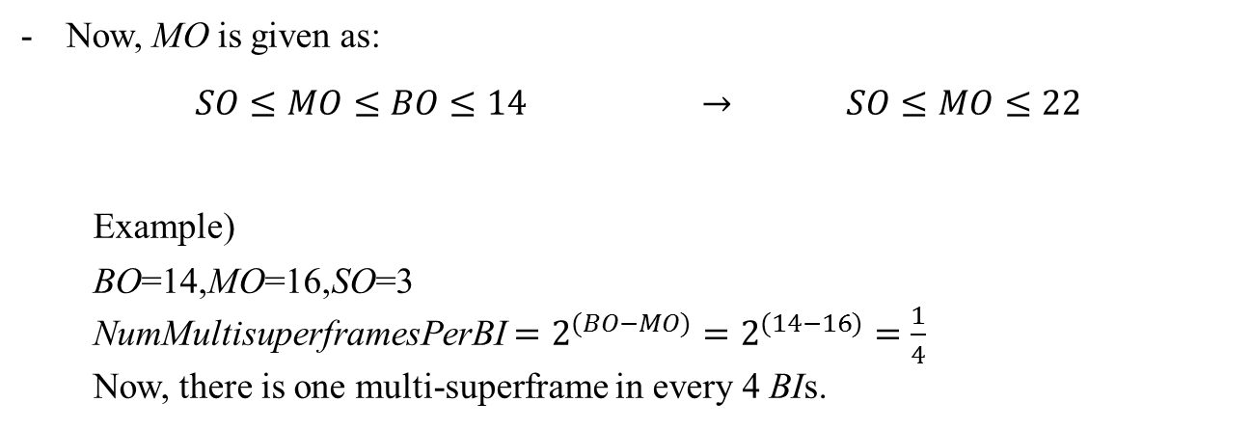
Extended DSME for TG4k
Item I: Extending macMultisuperframeOrder (MO)
BO = 14, SO = 3, MO = 16
Now, MO is given as:
  $SO≤MO≤BO≤14$ $→$ $SO≤MO≤22$
  Example)
  BO=14,MO=16,SO=3
  NumMultisuperframesPerBI $=2^{(BO−MO)}=2^{(14−16)}=\frac{1}{4}$
  Now, there is one multi-superframe in every 4 BIs.

Slide 10
Extended DSME for TG4k
Item II: Turning off transceivers during CAPs
BO = 14, SO = 3, MO = 16
Endpoint devices turn off transceivers during CAP, unless MAC frame is pending.
1. FramePending flag in an enhanced beacon shall notify if a MAC frame is pending
2. PendingAddressList notifies individual endpoint devices for frame pending.
    -> Endpoint devices wake up at the following CAP.
- (PAN) Coordinator is assumed to be turned on during CAP.

Slide 11
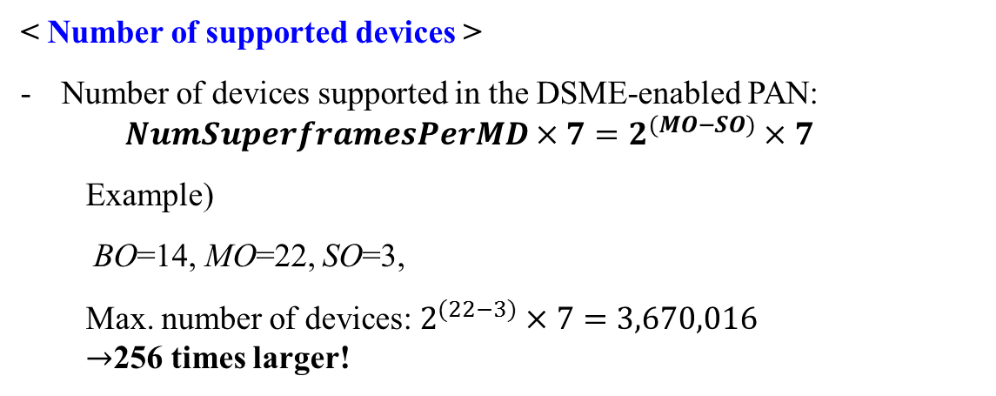
Extended DSME for TG4k
BO = 14, SO = 3, MO = 16
< Number of supported devices >
Number of devices supported in the DSME-enabled PAN:
  $$NumSuperframesPerMD×7=2^{(MO−SO)}×7$$
  Example)
  BO=14, MO=22, SO=3,
  Max. number of devices: $2^{(22−3)}×7=3,670,016$
  $→$256 times larger!

Slide 12
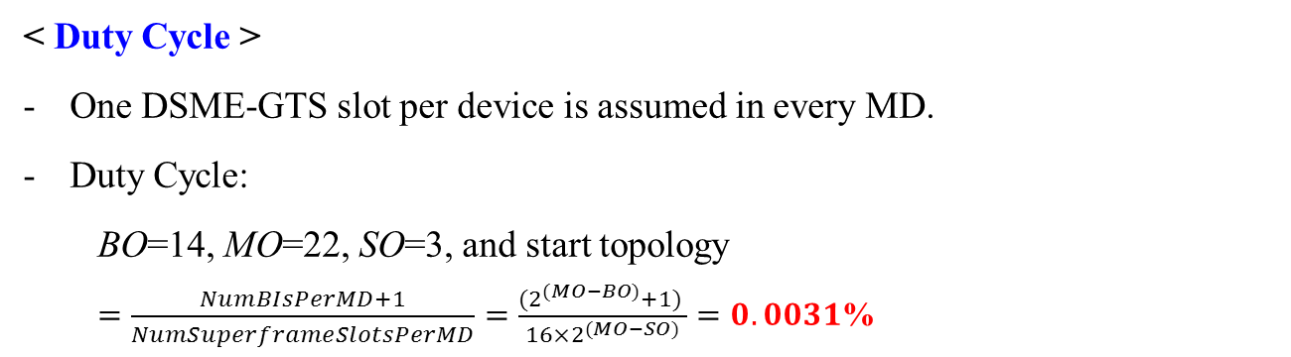
Extended DSME for TG4k
BO = 14, SO = 3, MO = 16
< Duty Cycle >
One DSME-GTS slot per device is assumed in every MD.
Duty Cycle:
  BO=14, MO=22, SO=3, and start topology
  $=\frac{NumBIsPerMD+1}{NumSuperframeSlotsPerMD}=\frac{{(2}^{(MO−BO)}+1) }{16×2^{(MO−SO)}}=0.0031$%

Slide 13
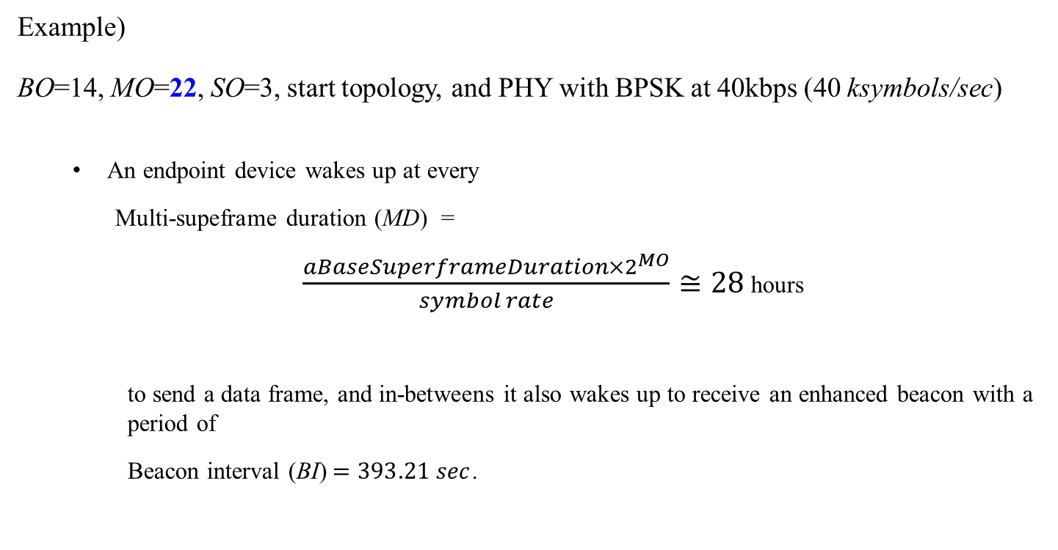
Extended DSME for TG4k
  Example)
BO=14, MO=22, SO=3, start topology, and PHY with BPSK at 40kbps (40 ksymbols/sec)
  An endpoint device wakes up at every
    Multi-supeframe duration (MD) =
  $\frac{aBaseSuperframeDuration×2^{MO}}{symbol rate}≅28$hours
    to send a data frame, and in-betweens it also wakes up to receive an enhanced beacon with a period of
    Beacon interval (BI)$=393.21 sec$.

Slide 14
Extended DSME for TG4k
Item III: Merging association and DSME-GTS allocation
Six MAC commands need for a device to associate and get a DSME-GTS slot:
Now, association and DSME-GTS allocation procedures are merged.
Procedures | Commands
Association | DSME-Association request DSME-Association response DSME-Beacon allocation notification
DSME-GTS allocation | DSME-GTS request DSME-GTS reply DSME-GTS notify
Procedures | Commands
Association | Multipurpose DSME-Association request Multipurpose DSME-Association response

Slide 15
Extended DSME for TG4k
DSME-Association request command
  Association Type,
  Extended DSME-GTS allocation (Direction, Allocation Order, HoppingSequence Request)
DSME-Association response command
  Association status
  BI index, SuperframeID, SlotID
0
1
3
2
0
Coordinator
End Device

Slide 16
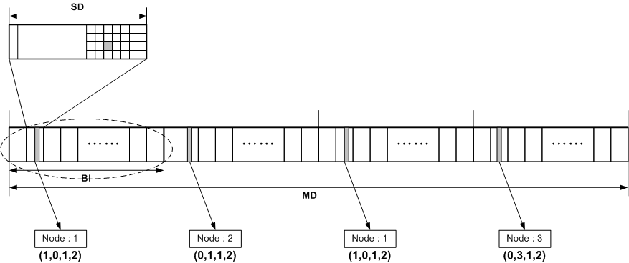
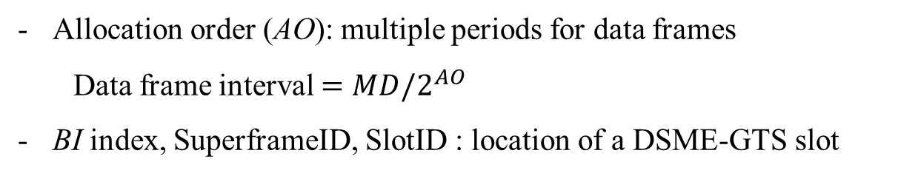
Extended DSME for TG4k
Allocation order (AO): multiple periods for data frames
  Data frame interval $=MD/2^{AO}$
BI index, SuperframeID, SlotID : location of a DSME-GTS slot
DSME-GTS slot description : (AO, BI index, SuperframeID, SlotID)
BO = 14, SO = 3, MO = 16

Slide 17
Extended DSME for TG4k
Item IV: Hopping sequence management
In a DSME enabled PAN, hopping sequence list is determined by Hopping Sequence ID.
When Hopping Sequence ID is one, DSME-Association response contains channel hopping sequence list. This may decrease association success probability.
Hopping Sequence ID | Description
0x00 | a default hopping sequence
0x01 | a hopping sequence generated by PANCoord
0x02-0x0f | a hopping sequence set by higher layer

Slide 18
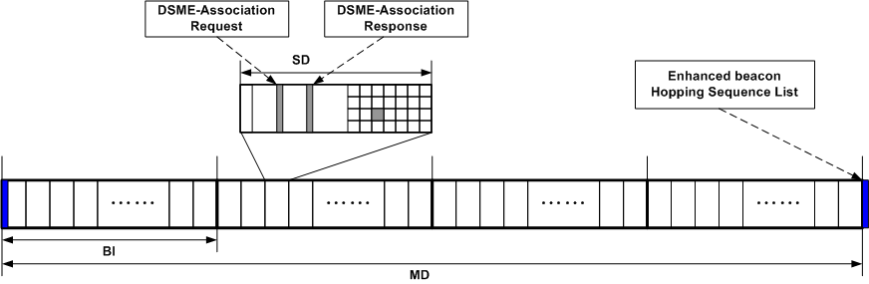
Extended DSME for TG4k
Item IV: Hopping sequence management
Channel hopping sequence list is included in the next enhanced beacon when association request command is received.

Slide 19
Summary of extended DSME
To support large number of endpoint devices and enhance device life-time, the followings are proposed:
  Extending the concept of MO:
    support of longer periodic monitoring services
  Merging association procedure and slot allocation procedure into single association procedure:
    decrease complexity and over-the-air signaling
    share channel offset value among endpoints explicitly
  Hopping Sequence List management (for channel hopping)
By extending DSME, the followings are expected:
  Large number of supported endpoint devices (>3.6 million)
  Significant increase in node device’s lifespan (>20 years)

